Slide 1
Adaptive Repetition Scheme for NGV
Date: 2019-05-10
Authors:

Slide 2
Abstract
This submission provides additional technical details and measurements results from existing commercial device, for the adaptive message retransmission technique for interoperable NGV PHY improvements initially described in NGV Study Group submissions 11-18/1577 and 11-18/1186.

Slide 3
Background
Thousands of cars equipped with IEEE 802.11p V2X are already on the road, and several major auto manufacturers have announced massive 802.11p roll-outs [including VW and GM]
Improvements to IEEE 802.11p by IEEE 802.11bd need to take into account the potentially large number of legacy IEEE 802.11p stations that will be in service by the time IEEE 802.11bd is adopted and deployed
As already agreed, NGV needs to be fully interoperable with “legacy 802.11p”
We cannot segment the safety critical V2X applications between “legacy” and “NGV users” – Millions of lives are at stake
Therefore, it is highly desirable to identify and adopt techniques which improve PHY performance while retaining full interoperability with the IEEE 802.11p PHY

Slide 4
Introduction
In 2018, NXP presented documents 11-18/1186 and 11-18/1577, which proposed a series of fully-interoperable PHY improvements, addressing topics such as spectrum emission mask, receiver sensitivity, channel model, Doppler, and, most importantly, better link reliability and/or range through reduction of packet error rate.

Slide 5
Waveform Design Improvements
One new technique we are proposing is adaptive repetition of messages
Depending on channel load, the same PPDU is retransmitted zero, one, two, or three times
To avoid creating congestion, as channel load, measured by the Channel Busy Ratio (or Channel Busy Percentage), increases, the number of retransmissions is reduced
This technique is fully interoperable – the individual PPDUs are standard 802.11p transmissions
This technique reduces packet error rate for communication from NGV stations to 802.11p stations, not just for communication between NGV stations

Slide 6
Benefits from Adaptive Repetition of Messages
802.11p stations see each retransmission as a standalone message
Performance is improved (1 to 2 dB) due to temporal diversity
Duplicated messages will be naturally filtered by application
Filtering of duplicate messages is already performed by higher protocol layers – no software update needed
For example, for ITS-G5, see EN 302 636-4-1 Annex A.2 and A.3
The initial PPDU and retransmissions can be combined by NGV stations
Combining at LLR levels is the recommended technique, but other are possible
+4 dB performance boost for 1 retransmission
+7 dB performance boost for 3 retransmissions

Slide 7
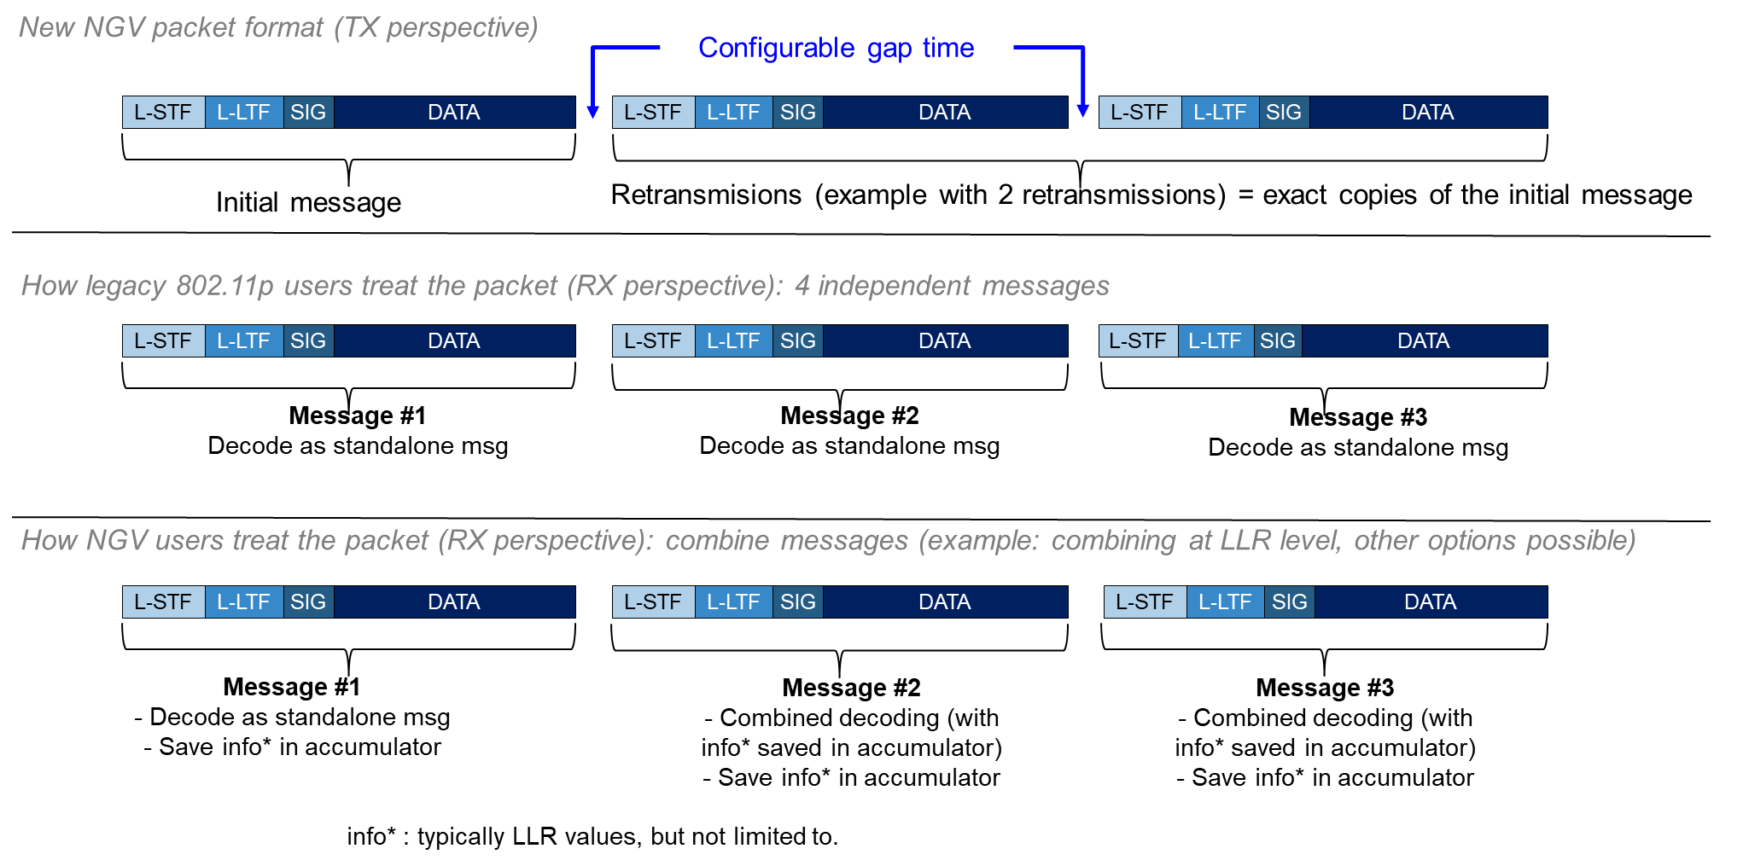
Example with Two Repetitions

Slide 8
Simulation Results Summary
Simulations results indicate:
with 1 repetition: 0.5-0.8 dB improvement for 802.11p stations and 3-4 dB improvement for NGV stations
with 3 repetitions: 1.0-1.7 dB improvement for 802.11p stations and 6-8 dB improvement for NGV stations
 |  | improvement for 802.11p stations | improvement for NGV stations
AWGN | 1 retransmission | 0.5 dB | 3.0 dB
 | 2 retransmissions | 0.7 dB | 4.7 dB
 | 3 retransmissions | 0.8 dB | 6.0 dB
G5-HighwayNLOS 886 Hz Doppler | 1 retransmission | 0.8 dB | 4.3 dB
 | 2 retransmissions | 1.4 dB | 6.7 dB
 | 3 retransmissions | 1.7 dB | 8.1 dB

Slide 9
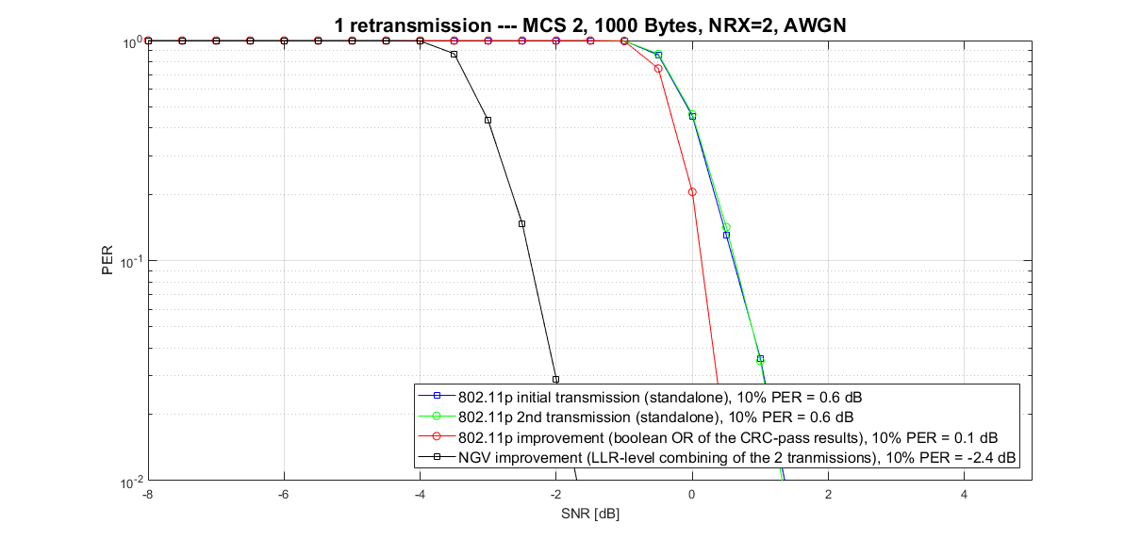
Simulation Results, Example (a)

Slide 10
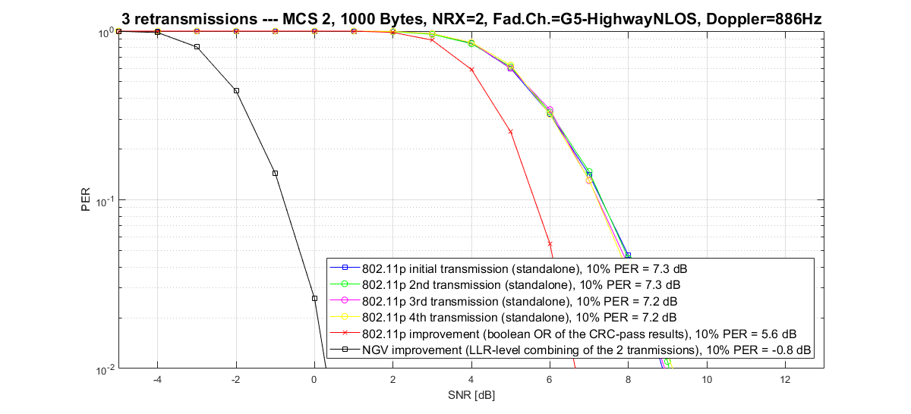
Simulation Results, Example (b)

Slide 11
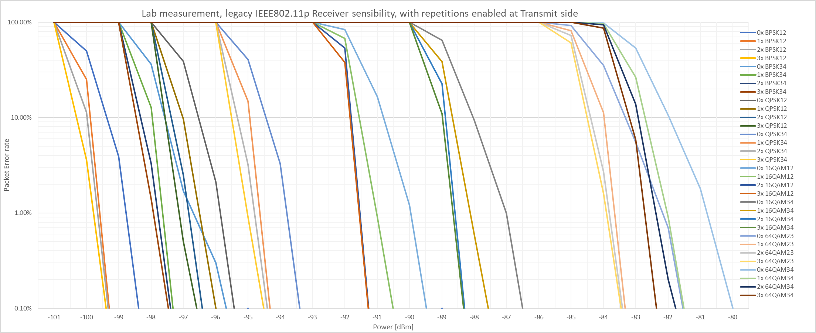
“Legacy” 802.11p device: HW measurements (AWGN)
Concept validated on commercial IEEE 802.11p device, for all transmit rates
HW measurements aligned with simulation results: in AWGN channel, from 0.5 (1x repetition) to 0.8 dB gain (3x repetitions)

Slide 12
Time Gap Between Repeated PPDUs
There are several alternatives for the time gap between repeated PPDUs:
The recommended approach sends the repetitions as a burst, separated by a small time gap, typically set as SIFS (32 usec)
SIFS is the minimum gap that maintains interoperability with 802.11p stations, although measurements on commercial IEEE 802.11p device indicate smaller values possible
Time gap should be lower than the min AIFS (58 usec), to avoid other messages sent in between
Each PPDU burst looks like a single transmission to CCA at other stations within range
Another approach is to schedule each repetition as a separate transmission
Normal channel access under EDCA is used between each retransmission
To bound receiver memory requirements, a time limit needs to be defined, after which the receiver is not required to retain information from older PPDUs

Slide 13
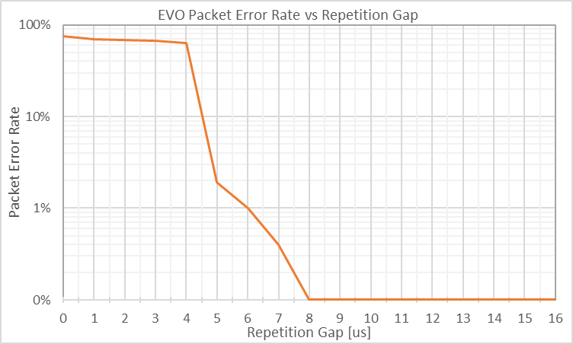
Time Gap Between Repeated PPDUs “Legacy” 802.11p device: HW measurements
Measurements of Packet Error Rate as a function of the repetition time gap:

Slide 14
Combining of Repeated PPDUs
For NGV stations, the substantial performance improvement comes from the combining of the multiple transmissions of a message into a combined decoding
This allows the receiving station to fully leverage white-noise reduction and fading channel temporal diversity
The combining of different transmissions can be performed at different stages of the NGV receiver PHY
This includes, but not limited to, joint equalization or LLR generation
LLR-level combining is what is typically used in HARQ implementation for 3GPP LTE

Slide 15
Adaptive Retransmission Control
We propose that the IEEE 802.11bd provides capability of up to 3 number retransmissions, based on the measured congestion of the channel (for instance using the Channel Busy Ratio metrics)
ITS standardization bodies such as ITS-G5 or SAE can define the exact transition steps
Two example schemes are given on the next slide.

Slide 16
Adaptive Retransmission Control: example schemes
The number of retransmissions can be gradually increased as the occupancy of the channel goes down. In congested environment (high CBR), retransmissions are disabled. Exemplary schemes for controlling the number of repetitions:
Average number of transmissions
Measured CBR | Number of Rep. | Traffic increase for this transmitter
≥ 0.3 | 0 | No increase in traffic
[0.2 – 0.3[ | 1 | x2
[0.15 – 0.2[ | 2 | x3
< 0.15 | 3 | x4
« Hard steps »
4
« Hard steps »
3
« Soft steps »
2
1
Measured CBR | Number of Rep. | Traffic increase for this transmitter
≥ 0.6 | 0 | No increase in traffic
[0.3 – 0.6[ | 0 or 1 (*) | x1 to x2 (depending on CBR)
[0.2 – 0.3[ | 1 or 2 (**) | x2 to x3 (depending on CBR)
[0.15 – 0.2[ | 2 or 3 (***) | x3 to x4 (depending on CBR)
< 0.15 | 3 | x4
CBR
0.15
1.0
0.2
« Soft steps »
0.3
0.6
(*) random value with probability of retransmission = p = (0.6-CBR)/0.3
For example, CBR=0.45 ➔ p = (0.60-0.45)/0.3 = 0.15/0.3 = 0.5
(**) random value with probability of retransmission = p = (0.3-CBR)/0.1
For example, CBR=0.25 ➔ p = (0.30-0.25)/0.1 = 0.05/0.1 = 0.5
(***) random value with probability of retransmission = p = (0.2-CBR)/0.05
For example, CBR=0.175 ➔ p = (0.20-0.175)/0.1 = 0.025/0.05 = 0.5

Slide 17
Compatibility with NGV new modulation symbols: possibility to send repetition of mixed packets
Configurable gap time
New NGV PPDU format (TX perspective)
L-STF
L-LTF
SIG
DATA (IEEE 802.11p)
New modulation symbols
L-STF
L-LTF
SIG
DATA (IEEE 802.11p)
New modulation symbols
Initial message
Retransmission (example with 1 retransmission) = exact copies of the initial message
How legacy IEEE 802.11p stations treat the PPDU (RX perspective): 2 independent messages
L-STF
L-LTF
SIG
DATA (IEEE 802.11p)
(high-power) energy
L-STF
L-LTF
SIG
DATA (IEEE 802.11p)
(high-power) energy
Message #1
Decode as standalone message
Treated as energy that occupies the channel
Message #2
Decode as standalone message
Treated as energy that occupies the channel
How NGV stations treat the PPDU (RX perspective): combine messages (example: combining at LLR level)
L-STF
L-LTF
SIG
DATA (IEEE 802.11p)
New modulation symbols
L-STF
L-LTF
SIG
DATA (IEEE 802.11p)
New modulation symbols
Message #1 “legacy”
- Decode as standalone message
- Save “legacy” info* in accumulator
Message #1 “new”
- Decode as standalone msg
- Save “new” info* in accumulator
Message #2 “legacy”
- Combined decoding (with “legacy” info* saved in accumulator)
- Save “legacy” info* in accumulator
Message #2 “new”
- Combined decoding (with “new” info* saved in accumulator)
- Save “new” info* in accumulator
info* : typically, but not limited to, LLR values

Slide 18
Benefits
These techniques improve performance while maintaining interoperability, coexistence, and proven backward compatibility with 802.11p equipment
These techniques provide substantial improvements for communication between NGV stations, while also providing some improvement for communication to and from 802.11p stations that do not implement NGV
These techniques do not increase channel load in congested environments
These techniques do not require changing higher layers of the ITS protocol stack

Slide 19
Straw Poll
Do you agree to add the following text into Section 3.1 of SFD?
“Repetition of NGV messages, primarily targeting performance improvement under low or medium channel congestion, is a feature benefitting to both legacy and NGV stations population. The number of repetitions ranges from 1 to 3, and is adapted based on metrics such as CBR, with thresholds defined at upper layers.”
Y:
N:
A:

