Slide 1
Consideration on 320MHz Bandwidth and 16 Spatial Streams
Date: 2019-05-13
Authors:
Name | Affiliation | Address | Phone | Email
Eunsung Park | LG Electronics | 19, Yangjae-daero 11gil, Seocho-gu, Seoul 137-130, Korea |  | esung.park@lge.com
Dongguk Lim |  |  |  | dongguk.lim@lge.com
Jinmin Kim |  |  |  | jinmin1230.kim@lge.com
Sunwoong Yun |  |  |  | sunwoong.yun@lge.com
Jinsoo Choi |  |  |  | js.choi@lge.com

Slide 2
Introduction
In our previous contribution [1], we discussed PHY features to be considered for enabling potential EHT candidates
  We focused on several PHY candidates such as 320MHz bandwidth, 16 spatial streams (SS), etc.
A bunch of contributions also proposed 6GHz / multi-band aggregation [2-12]
In this case, we need to clarify how to support 320MHz bandwidth and 16 SS for developing PHY features
We discuss and compare two approaches
We also study three options for a 320MHz tone plan design

Slide 3
How to Support 320MHz Bandwidth and 16 SS
We consider the following two approaches
  Approach 1: EHT allows only up to 160MHz and 8 SS in each band as in 11ax, and EHT can support 320MHz or 16 SS by utilizing multiple bands at the same time
  Approach 2: EHT can support up to 320MHz or 16 SS in one band (e.g., 6GHz) and EHT can support much larger bandwidth or more SS by additionally utilizing multi-band aggregation
Several PHY designs shown in [1] may depend on the approach

Slide 4
BW and SS Related PHY Features
In [1], the following features are discussed for 320MHz or 16 SS candidates
  Tone plan
  EHT-STF / EHT-LTF sequence
  Preamble puncturing
  Phase rotation for legacy part
  EHT-SIGB
  Feedback overhead reduction
  LTF overhead reduction
  P-matrix
  CSD
We should design the above features when supporting 320MHz or 16 SS in each band is considered (approach 2) whereas 11ax features may be reused in case that each band supports the same bandwidth and SS as in 11ax (approach 1)

Slide 5
How to Support 320MHz Bandwidth and 16 SS – Approach 1
The maximum allowable bandwidth and the maximum number of spatial streams supported in each band are the same as those of 11ax
  This means that we can use up to (contiguous/non-contiguous) 160MHz in 5/6 GHz and up to 8 SS in 2.4/5/6GHz
  11ax PHY features related to bandwidth and spatial streams can be reused
  By utilizing multi-band aggregation, we can transmit signals through multiple bands at the same time and can obtain higher throughput than 11ax
    For example, we can consider 8 + 8 SS transmission in 160 + 160MHz using 5GHz and 6GHz simultaneously*, and in this case, a peak throughput increase by 2x can be achieved
    Even in the multi-band aggregation, it seems that we don’t have to design new PHY features listed in the previous slide, i.e., we can just apply the 11ax features to each band
  Note that the target maximum throughput of EHT is 30 Gbps at the MAC data service access point [13] and the peak PHY rate of 11ax is about 10 Gbps, and thus, to achieve the target, we need additional methods to further increase the peak throughput in Approach 1
* This is equivalent to 16 SS transmission in 160MHz or 8 SS transmission in 320MHz

Slide 6
How to Support 320MHz Bandwidth and 16 SS – Approach 2 (1/3)
In each band, the maximum allowable bandwidth is contiguous / non- contiguous 320MHz or the maximum number of spatial streams is 16 SS
  This means that we can use up to 320MHz in 6GHz or up to 16 SS in 2.4/5/6GHz
    There are many contiguous 160MHz channels and even contiguous 320MHz channels in 6GHz as shown in Appendix A, and thus we don’t have to waste the capacity of this band
  We can achieve a peak throughput increase by 2x (using 160MHz and 16 SS in 5GHz) or 4x (using 320MHz and 16 SS in 6GHz) without multi-band aggregation
    With multi-band aggregation, much higher throughput can be expected
  To this end, PHY features in slide 3 need to be developed
    For example, a tone plan for 320MHz needs to be designed for the 6GHz band
Issues for supporting up to 16 SS in each band
  16 antennas are needed per band and it causes cost and size increase
  To reduce the cost and size, we can consider antenna sharing between 5GHz and 6GHz bands, and by doing so, we can even flexibly use them to support these two bands
  To enable the antenna sharing, several hardware factors such as optimal antenna length, frequency tunable filter, oscillator and so on should be considered

Slide 7
How to Support 320MHz Bandwidth and 16 SS – Approach 2 (2/3)
Issues for supporting up to 320MHz in 6GHz
  We need to decide what new bandwidths EHT supports
    Note that new bandwidths mentioned below are not the ones constructed across multiple bands (i.e., not the ones constructed from the multi-band aggregation) but the ones used within 6GHz
  The candidates of new bandwidths can be as follows
    Contiguous 320MHz / non-contiguous 320MHz (160+160 / 160+80+80 / 80+80+80+80 MHz)
  Additionally, we can also consider the bandwidths as below
    Contiguous 240MHz / non-contiguous 240MHz (80+160 / 80+80+80 MHz)
  In terms of the frequency utilization, it would be better that various bandwidths are adopted
    Utilizing both 240MHz and 320MHz provides better throughput compared to using only 320MHz as shown in Appendix B
    Also, having a variety of non-contiguous bandwidths can further increase efficiency

Slide 8
How to Support 320MHz Bandwidth and 16 SS – Approach 2 (3/3)
Issues for supporting up to 320MHz in 6GHz (cont.)
  When 320MHz with preamble puncturing is supported, adopting 240MHz may not offer an additional throughput gain
    Bandwidths constructed from 320MHz with preamble puncturing can include all the cases of 240MHz with preamble puncturing
  However, note that it is not always possible to support/implement 320MHz because of hardware limit or insufficient available channels, hence it seems that adopting 240MHz as a new bandwidth in EHT definitely has an advantage
  The following aspects need to be also considered carefully
    Signaling overhead may become larger especially with preamble puncturing based on 20MHz CCA
    Various BW capable RF and DSP designs may increase hardware complexity

Slide 9
Summary for Approach 1 & 2
Approach 1: EHT allows only up to 160MHz and 8 SS in each band as in 11ax
Approach 2: EHT can support up to 320MHz or 16 SS in one band
For achieving the PAR requirement, we prefer Approach 2 which can attain a substantial peak rate increase
 | Approach 1 | Approach 2
Pros | Reuse existing PHY features | Substantial increase in peak throughput
Cons | Relatively small increase in peak throughput | Need new PHY designs Need enhanced RF and DSP designs

Slide 10
320MHz Tone Plan
Assuming approach 2, we introduce the following three options to design a 320MHz tone plan
  Option 1 : Reuse the 11ax 80MHz tone plan four times
  Option 2 : Design a new 160MHz tone plan and repeat it twice
  Option 3 : Design a new 320MHz tone plan

Slide 11
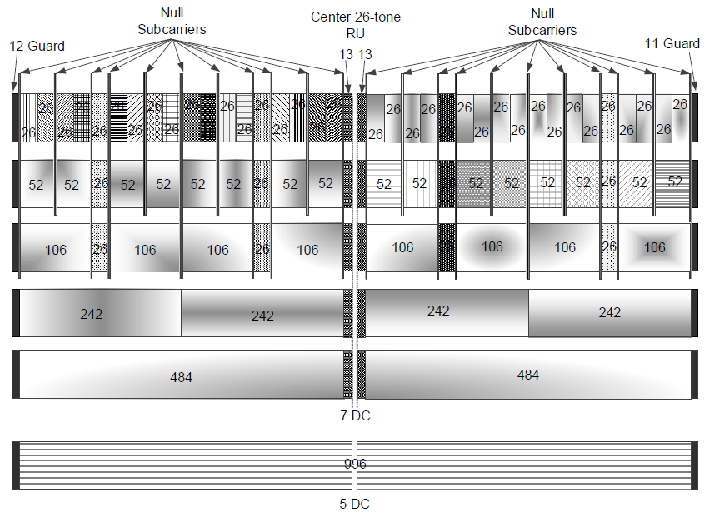
320MHz Tone Plan – Option 1
Reuse the 11ax 80MHz tone plan four times
  It is similar to reusing the 11ax 160MHz tone plan twice
  4x996-tone RU can be defined
It is straightforward and available to various types of contiguous / non-contiguous 320MHz bandwidths
  All 80MHz segments have the same tone plan
However, this option has too many null tones and it can result in throughput degradation
  It has the lowest throughput among three options
← 11ax 80MHz tone plan

Slide 12

320MHz Tone Plan – Option 2
Design a new contiguous 160MHz tone plan and repeat it twice
  The current 160MHz tone plan in 11ax has 23 DC tones and 10 null tones in 2x996-tone RU
  One center 26-tone RU can be added by reducing DC tones and null tones
  A new RU size can be defined for the entire 160MHz bandwidth
  By repeating it twice, tone plan for 320MHz can be developed
By doing so, we can expect a better throughput than 11ax
It can be applied to both contiguous 320MHz and non-contiguous 160+160MHz bandwidth
  It may be undesirable for other non-contiguous cases such as 80+80+80+80MHz due to non-consistent tone plans among 80MHz segments
  However, if 160+160MHz is decided as the only option for the non-contiguous 320MHz bandwidth for simplicity, this tone plan may be promising
996
13
13
996
2020 or 2018 or …
→ Note that there are so many contiguous 160MHz channels available in 6GHz as shown in Appendix A, so we can consider more efficient contiguous 160MHz tone plan

Slide 13
320MHz Tone Plan – Option 3
Design a new 320MHz tone plan
  The proposed 320MHz tone plan in option 2 has 23 DC tones and some null tones
  One center 26-tone RU can be added by reducing DC tones and null tones
  A new RU size can be defined for the entire 320MHz bandwidth
By doing so, it can achieve the highest throughput among three options
  About 4% gain can be obtained compared to option 1
It can be applied only to the contiguous 320MHz bandwidth
  It may be undesirable for non-contiguous bandwidths due to different tone plans in all 80MHz segments
2020 or 2018 or …
2020 or 2018 or …
2020 or 2018 or …
13
13
2020 or 2018 or …
4068 or 4066 or …
→ Note that there are some contiguous 320MHz channels available in 6GHz as shown in Appendix A, so we can consider more efficient contiguous 320MHz tone plan

Slide 14
Summary for 320MHz Tone Plan
Option 1 : Reuse the 11ax 80MHz tone plan four times
Option 2 : Design a new 160MHz tone plan and repeat it twice
Option 3 : Design a new 320MHz tone plan
We prefer to design new contiguous 160MHz and 320MHz tone plans as depicted in option 2 and 3, respectively
For the non-contiguous 320MHz cases, we slightly prefer option 1 but option 2 can be considered if TGbe adopts 160+160MHz as the only option for the non-contiguous 320MHz bandwidth
 | Option 1 | Option 2 | Option 3
Pros | Simple and straightforward Available to various contiguous & non-contiguous cases | Better throughput | Better throughput
Cons | Low throughput | Need a new tone plan design Undesirable for some of the non-contiguous cases | Need a new tone plan design Only available to the contiguous 320MHz

Slide 15
Conclusion
We have discussed two approaches on how to support 320MHz bandwidth and 16 SS
  For easily achieving the PAR requirement, we prefer Approach 2 which can attain a substantial peak rate increase
We have also introduced three options for the tone plan
  We prefer to design new tone plans for the contiguous cases to enhance the throughput
  For the non-contiguous cases, our preference depends on which non-contiguous bandwidths are selected to use in TGbe

Slide 16
SP #1
Do you agree to support the spatial stream up to 16 in TGbe?

Slide 17
SP #2
Do you agree to support the bandwidth up to 320MHz in TGbe?
Y/N/A

Slide 18
SP #3
Do you agree to define a tone plan for the 320MHz bandwidth in TGbe?
Y/N/A

Slide 19
SP #4
Do you agree to define a tone plan for the 240MHz bandwidth in TGbe?
Y/N/A

Slide 20
SP #5
Do you agree to design a new tone plan for the contiguous 160MHz bandwidth in TGbe?

Slide 21
SP #6
Do you agree to design a tone plan for the contiguous 320MHz bandwidth which is not consistent with tone plans for the non-contiguous 320MHz bandwidths in TGbe?

Slide 22
SP #7
Do you agree to reuse the 11ax 80MHz tone plan for the non-contiguous 320MHz bandwidth in TGbe?

Slide 23
SP #8
Do you agree to reuse the 11ax 80MHz tone plan for the contiguous and non-contiguous 320MHz bandwidth in TGbe?

Slide 24
Appendix A
Unlicensed 6GHz band
5.925GHz ~ 6.425GHz (500MHz) | U-NII-5
6.425GHz ~ 6.525GHz (100MHz) | U-NII-6
6.525GHz ~ 6.875GHz (350MHz) | U-NII-7
6.875GHz ~ 7.125GHz (250MHz) | U-NII-8

Slide 25
Appendix B (1/2)
Average throughput gain with 240MHz capability
  Case 1: w/o 240MHz capa. (80/160/320MHz capa.)
  Case 2: w/ 240MHz capa. (80/160/240/320MHz capa.)
  Assume four 80MHz channels, i.e., primary, secondary 80MHz channels and secondary 160MHz channel which has two 80MHz channels
  Consider the probability that each 80MHz channel is idle is p
  When primary and secondary 80MHz channels are idle, assume the following
    If one of the two 80MHz channels in secondary 160MHz channel is busy, only 160MHz transmission is possible in case 1
    If one of the two 80MHz channels in secondary 160MHz channel is idle, 240MHz transmission is possible in case 2

Slide 26
Appendix B (2/2)
Average throughput gain with 240MHz capability (cont.)
  Thus, we simply consider the following BW transmission in each case depending on each 80MHz channel status
  According to p, case 2 provides the average throughput gain compared to case 1 as follows
In each p, we simulated 50,000 times and obtained the average bandwidth size used in each case
throughput gain = (BW2-BW1)/BW1 x 100 [%]
BW1 = avg. BW size for case 1
BW2 = avg. BW size for case 2
P | 0.1 | 0.2 | 0.3 | 0.4 | 0.5 | 0.6 | 0.7 | 0.8 | 0.9
Gain [%] | 1.62 | 5.04 | 8.65 | 10.94 | 12.42 | 12.34 | 10.83 | 8.41 | 4.61

Slide 27
References
[1] 802.11-18/1967r1 Overview of PHY Features for EHT
[2] 802.11-18/0789r6 Extreme Throughput (XT) 802.11
[3] 802.11-18/1461r1 Discussions on the PHY features for EHT
[4] 802.11-18/1547r0 Technology Features for 802.11 EHT
[5] 802.11-18/1549r0 Recommended Direction for EHT
[6] 802.11-18/1184r1 Follow up Discussions on Throughput Enhancement
[7] 802.11-18/1155r1 Multi-AP Enhancement and Multi-Band Operations
[8] 802.11-18/1161r0 EHT Technology Candidate Discussions
[9] 802.11-18/1533r0 View on EHT Candidate Features
[10] 802.11-18/1171r0 View on EHT Objectives and Technologies
[11] 802.11-18/857r0 Beyond 802.11ax – Throughput Enhancement Utilizing Multi-bands across 2.4/5/6 GHz Bands
[12] 802.11-18/1525r1 EHT features for Multi-Band Operation
[13] 802.11-18/1231r4 802.11 EHT Proposed PAR

