Slide 1
PHY designs for NGV
Date: 2019-05-12
Authors:
Name | Affiliation | Address | Phone | Email
Yujin Noh | Newracom | 25361 Commercentre Dr Lake Forest, CA 92630 |  | yujin.noh at newracom.com

Slide 2
Background
For 11bd, advanced PHY candidates have been considered to achieve higher throughput and better reliability [1][2].
So far some documents provided simulation results to show how much gain 11bd can get from
DCM (Dual Carrier Modulation) under discussion to achieve at least 3 dB lower sensitivity (longer range) [3]
LDPC adopted as a motion passed [4]
In this contribution, with additional simulation results, DCM is intensely taken into account to help the group yield concrete results.

Slide 3
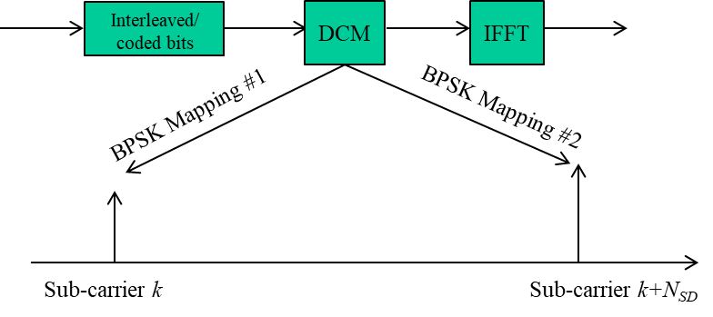
DCM 1/2
MCS0 DCM is a feature of 802.11ax to be possibly introduced for range extension in 11bd.
and are BPSK modulated symbols for data subcarrier at k and k+N_{SD}.
N_{SD} in DCM is defined with a half of (N_{SD} when DCM is not enabled)
To reduce the PAPR, additional modulation scheme is applied.

Slide 4
DCM 2/2
(If BCC)
Transmission diagram for DCM
Once accepted, depending on OFDM numerology in 11bd, N_{SD} of 10 MHz and 20 MHz NGV PPDU for DCM will be specified.
With operation on BCC, the modulated symbols are mapped to a pair of DCM tones.
BCC interleaver configuration for DCM needs to be defined if needed.
With operation on LDPC, the LDPC tone mapper for the lower frequency segment and the LDPC tone mapper for the upper frequency segment are exactly the same.
LDPC tone mapper (i.e., D_{TM,DCM}) for DCM needs to be defined if needed.

Slide 5
Simulation Parameters 1/2
General configuration:
1 TX, 1 RX, 1 SS, 300 and 800 bytes
# of channel realizations: 10,000
C2C Channel Model (including Enhanced C2C channel Model)
12.5ns sampling rate, tapped delay line with Doppler shift
channel power distribution with the total power normalized to 1.
Impairments
PA Non-linearity : RAPP PA model with p = 3.
Carrier Frequency Offset : fixed 20 ppm
Phase noise with a pole-zero model
PSD(0) = -100 dBc/Hz
Pole frequency fp = 250 kHz
Zero frequency fz = 7905.7 kHz
Rx processing:
Ideal timing and Ideal PPDU detection,
CFO estimation and compensation in preamble portion

Slide 6
Simulation Parameters 2/2
11p with DACE (Data-Aid Channel Estimation)
Channel estimation based on Genie-aided transmitted symbols with no errors
Tracking latency of 2 OFDM symbols
Tracking period of 1 OFDM symbol.
11p with M4
Half of L-LTF as Midamble inserted on every 4 data symbols
11ac 20MHz DC2 with BCC
VHT-LTF as Midamble inserted on every 4 data symbols
MCS0 DCM enabled
BCC interleaver configuration for DCM not optimized
11ac 20MHz DC2 with LDPC
VHT-LTF as Midamble inserted on every 4 data symbols
MCS0 DCM enabled
LDPC tone mapper (i.e., D_{TM,DCM}) for DCM not optimized

Slide 7
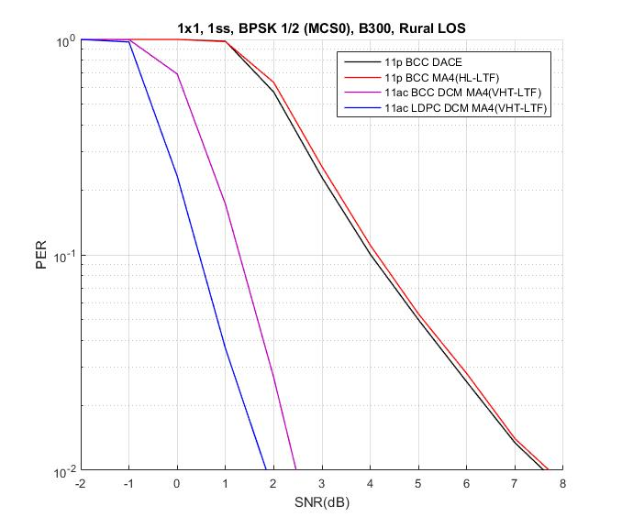
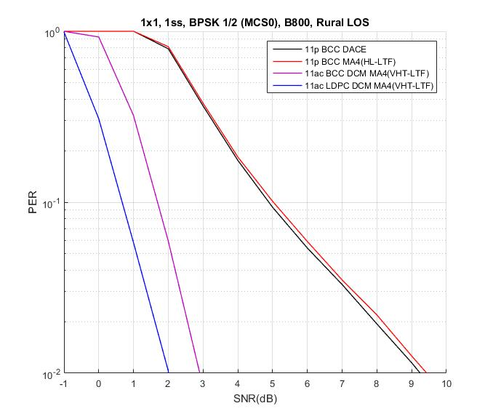
Rural LOS
3.5 dB
4.2 dB
2.5 dB
3.2 dB
For 300 bytes, MCS0 DCM shows around 2.5 dB and 3.5 dB gain with BCC and LDPC, respectively comparing to 11p
For 800 bytes with increased packet length, MCS0 DCM shows more benefit
To achieve at least 3 dB lower sensitivity to meet PAR, MCS0 DCM may need to operate with LDPC together.

Slide 8
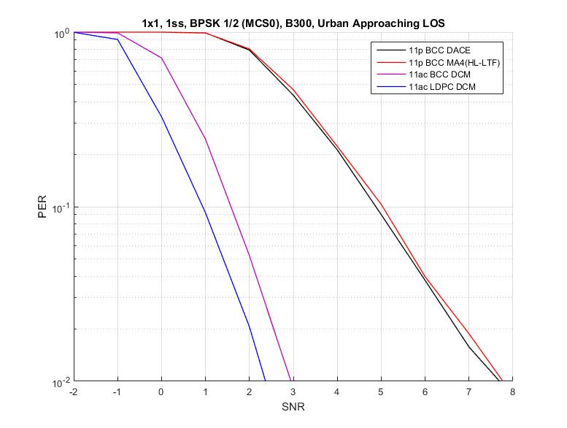
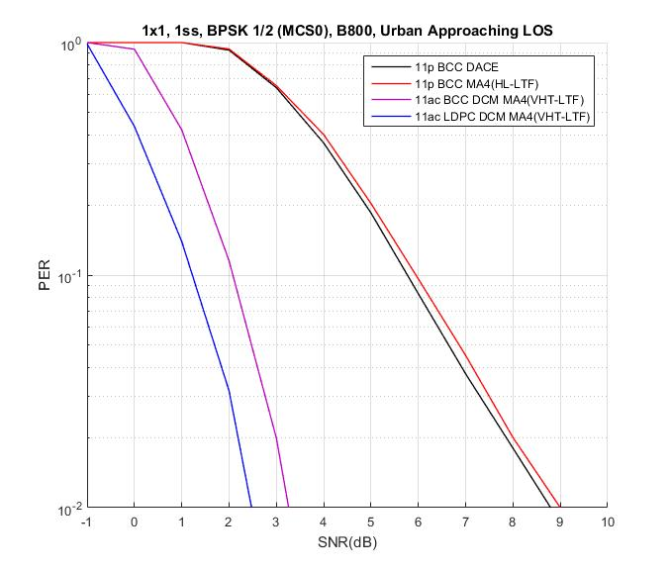
Urban Approaching LOS
4.0 dB
5.0 dB
3.3 dB
4.0 dB
For 300 bytes, MCS0 DCM shows around 3.3 dB and 4.0 dB gain with BCC and LDPC, respectively comparing to 11p
For 800 bytes with increased packet length, MCS0 DCM shows more benefit

Slide 9
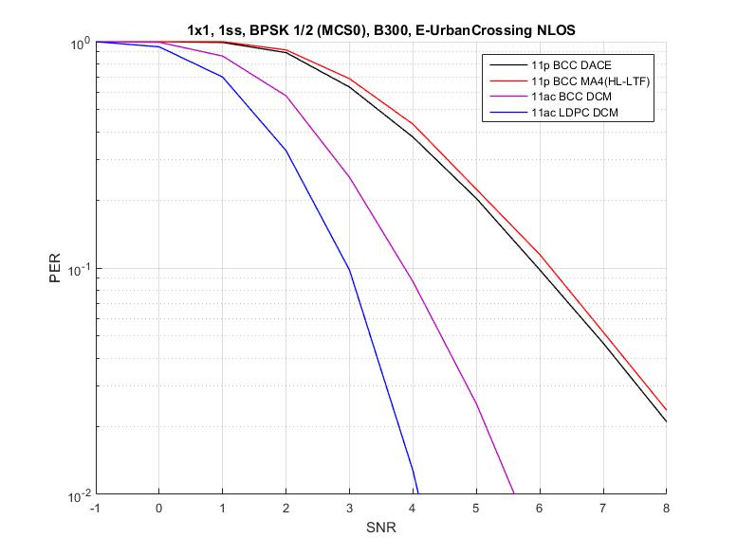
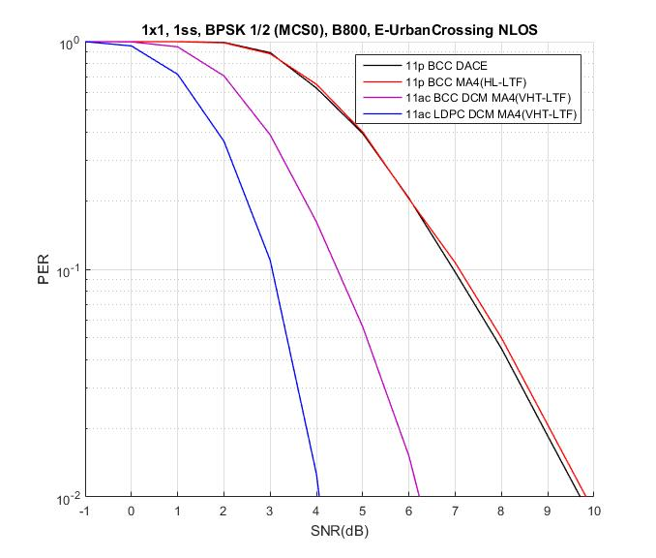
Enhanced Urban Crossing NLOS
3.2 dB
4.0 dB
2.2 dB
2.5 dB
For 300 bytes, MCS0 DCM shows around 2.2 dB and 3.2 dB gain with BCC and LDPC, respectively comparing to 11p
For 800 bytes with increased packet length, MCS0 DCM shows more benefit
To achieve at least 3 dB lower sensitivity to meet PAR, MCS0 DCM may need to operate with LDPC together.

Slide 10
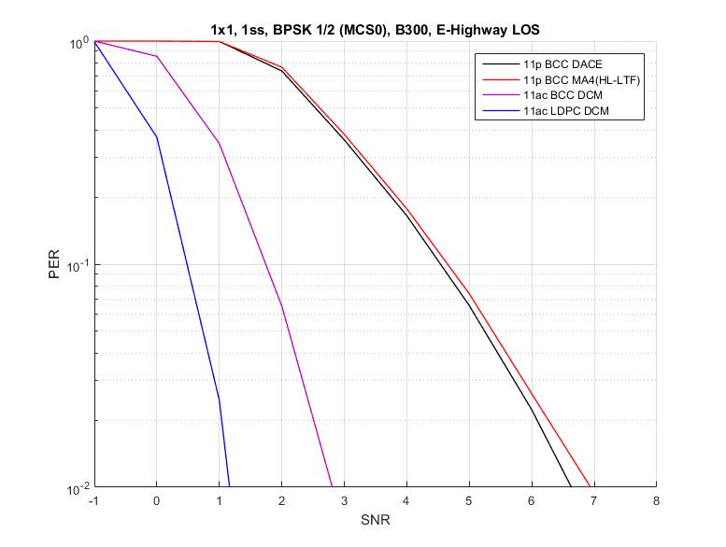
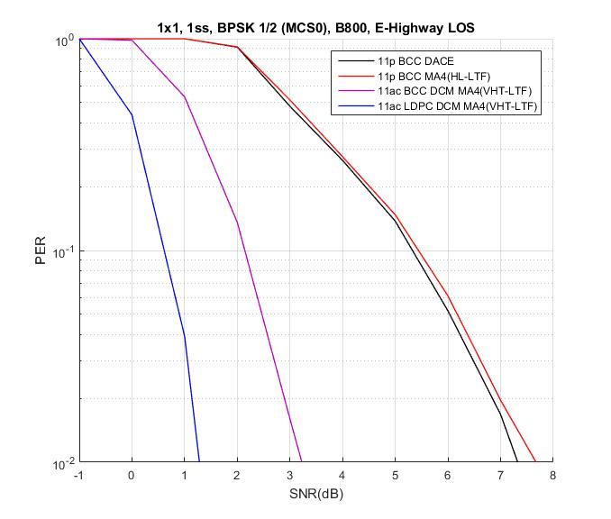
Enhanced Highway LOS
4.2 dB
5.0 dB
3.0 dB
3.2 dB
For 300 bytes, MCS0 DCM shows around 3.0 dB and 4.2 dB gain with BCC and LDPC, respectively comparing to 11p
For 800 bytes with increased packet length, MCS0 DCM shows more benefit

Slide 11
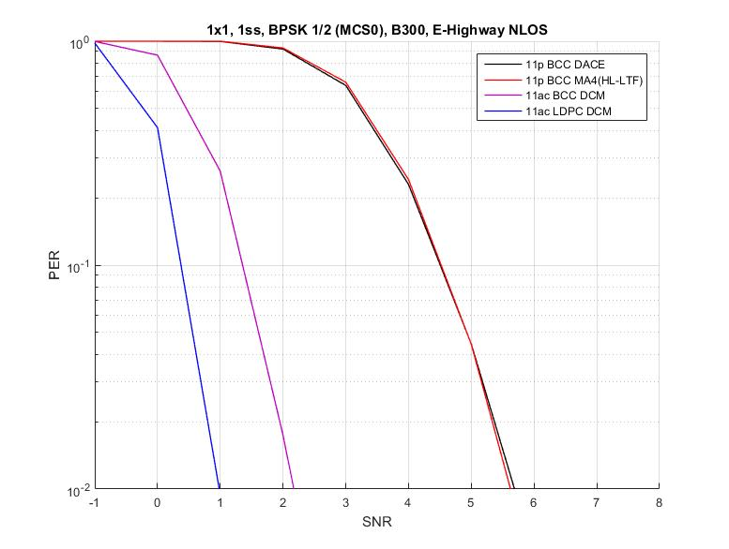
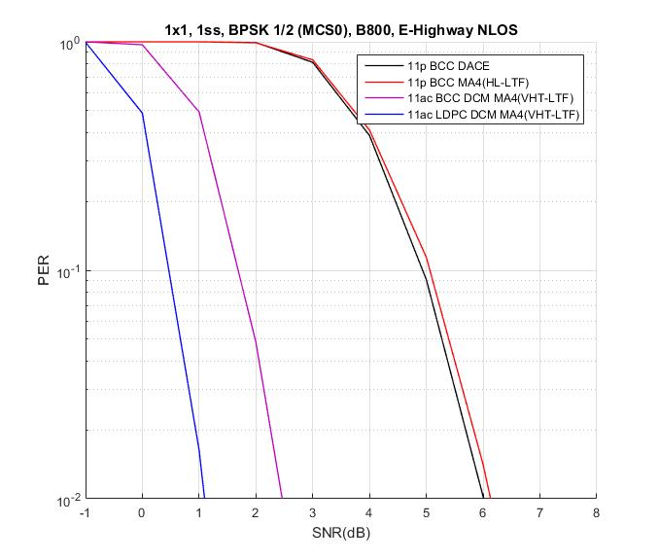
Enhanced Highway NLOS
4.0 dB
4.5 dB
3.0 dB
3.2 dB
For 300 bytes, MCS0 DCM shows around 3.0 dB and 4.0 dB gain with BCC and LDPC, respectively comparing to 11p
For 800 bytes with increased packet length, MCS0 DCM shows more benefit

Slide 12
Summary
DCM is an implementation-friendly technology accepted in 11ax.
Once accepted, extra work may be needed depending on N_{SD} in DCM
For most C2C channel circumstance with different packet length, MCS0 DCM seems to provide reasonable gain to meet at least 3 dB lower sensitivity requirement.
However, for some cases (e.g. low and medium Doppler channels, low packet length), MCS0 DCM with BCC may not provide enough gain to cover sensitivity requirement for 11bd.
Considering CAM size starting with around 190 bytes [5], what it can achieve might be lower than the gain of 300 bytes simulated here.
Given initial simulation results, once accepted in 11bd, how to operate MCS0 DCM needs to be taken into account.

Slide 13
Reference
[1] 11-19/0016r0 Potential PHY Designs for NGV
[2] 11-19/0009r0 Consideration on Features for 11bd
[3] 11-19/0343r0 Modulation Scheme for 11bd Range Extension
[4] 11-19/0514r2 Motion Booklet for IEEE 802.11 TGbd
[5] 11-19/0319r0 Car-2Car- A survey on CAM statics

