Slide 1
20 MHz transmission in NGV
Date: 2019-05-13
Authors:
Name | Affiliation | Address | Phone | Email
Yujin Noh | Newracom | 25361 Commercentre Dr Lake Forest, CA 92630 |  | yujin.noh at newracom.com

Slide 2
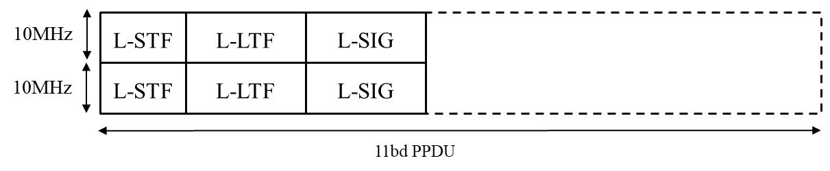
Background
For 11bd, advanced PHY candidates have been considered to achieve higher throughput.
FRD&SFD Motion #4 passed [1]
  “In 20MHz bandwidth, L-STF, L-LTF, and L-SIG for 10MHz PPDU are duplicated as shown in the figure below.”
In this contribution, with some methods proposed, show simulation results of PAPR of L-STF, L-LTF, L-SIG and data portion in NGV 20MHz PPDU (e.g. 11ac 40MHz DC2 based).

Slide 3
PAPR
(Peak-to-Average Power Ratio)
PAPR is well-known to be high when sequence is duplicated in frequency domain.
  Given L-STF, L-LTF, and L-SIG for 10MHz PPDU repeated at legacy portion in 20 MHz PPDU, it is obvious that being simply repeated causes high PAPR for legacy portion of the preamble
Low PAPR value is important in reducing implementation cost of Tx Power Amplifier (PA) and Rx dynamic range related function blocks.
  PAPR could be a nice guideline on actual backoff and dynamic ranges that the implementations need to consider

Slide 4
Simulation Configuration
99.9% PAPR
  The max power is set to a value of top 99.9%
8x oversampled rate
GI considered as part of the OFDM symbol
L-SIG PAPR
  All combination of values in R1-R4 (RATE field) and R5-R16 (LENGTH field)
Data PAPR
  40 MHz 11ac DC2 (downclocked by 2) based
  Random values applied to more than 100,000 data OFDM symbols with MCS0, MCS2, MCS4, MCS6 and MCS8 (256QAM ¾)

Slide 5
Options
Considering no legacy devices (e.g. 11n, 11ac and 11ax) in the specially assigned channels, different options can be taken into account.
  Legacy gamma vector with {1, +j}
  Phase rotation in MCS0 DCM (Dual Carrier Modulation)
  CSD (Cyclic Shift Delay)
  Gamma vector on top of CSD
  etc

Slide 6
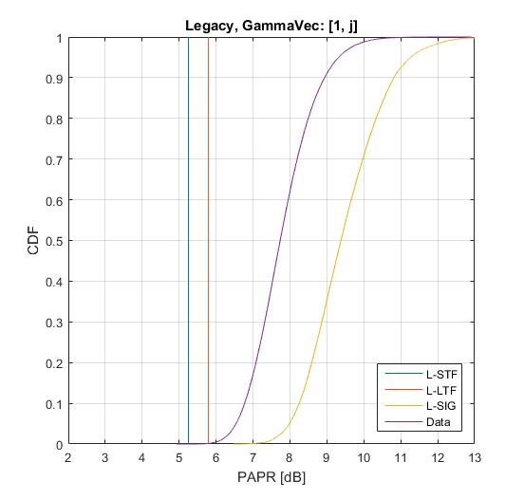
Legacy gamma vector with {1, +j}
PAPR [dB] (99.9%, 8x oversampled) in 20 MHz
L-STF | L-LTF | L-SIG (Median)
5.2497 | 5.7927 | 9.3806
Simple way to reuse what we have used (11n-like approach)
  + 1 is multiplied to lower 10 MHz subchannel
  +j is multiplied to upper 10 MHz subchannel
PAPR simulation shows L-SIG is identified as bottleneck of 20 MHz PPDU transmission.
  PAPR of data portion is even better than PAPR of L-SIG field.
PAPR values here could be used as reference for further analysis.
1.7dB

Slide 7
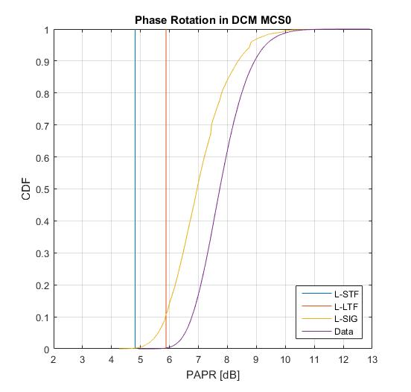
Phase rotation in MCS0 DCM
gamma vector
{1, +j}
PAPR [dB] (99.9%, 8x oversampled) in 20 MHz
L-STF | L-LTF | L-SIG (Median)
4.8133 (5.2497) | 5.8799 (5.7927) | 6.9529 (9.3806)
It is accepted to mitigate the PAPR issues for DCM MCS 0 in 11ax
  + 1 is multiplied to lower 10 MHz subchannel
  (-1)^{k} is multiplied to upper 10 MHz subchannel
    k: subcarrier indices
Generally providing improved PAPR over L-STF, L-LTF and L-SIG comparing to reference PAPR values
Legacy portion (especially L-SIG) is not a bottleneck anymore comparing to data portion.

Slide 8

  CSD (Cyclic Shift Delay) 1/2
Cyclic delayed sequence applied to 10 MHz subchannel.
  + 1 is multiplied to lower 10 MHz subchannel
  is multiplied to upper 10 MHz subchannel
    k: subcarrier indices
Depending on T_{CS}, some CSD values provide improved PAPR over L-STF, L-LTF and L-SIG comparing to reference PAPR values
 | PAPR [dB] in 20 MHz (99.9%, 8x oversampled)
CSD (ns) (T_{CS}) | L-STF | L-LTF | L-SIG (Median)
-25 | 5.0489 | 5.7085 | 9.228
-50 | 4.3818 | 5.5877 | 8.5107
-75 | 3.8746 | 4.6096 | 8.0954
-100 | 3.5696 (5.2497) | 5.1641 (5.7927) | 7.3959 (9.3806)
-125 | 4.6851 | 5.3532 | 7.3918
-150 | 5.0674 | 5.8687 | 7.5948
-175 | 5.1405 | 5.6444 | 7.6878
$$e^{−j2πk∆_{F}T_{CS}^{}}$$

Slide 9
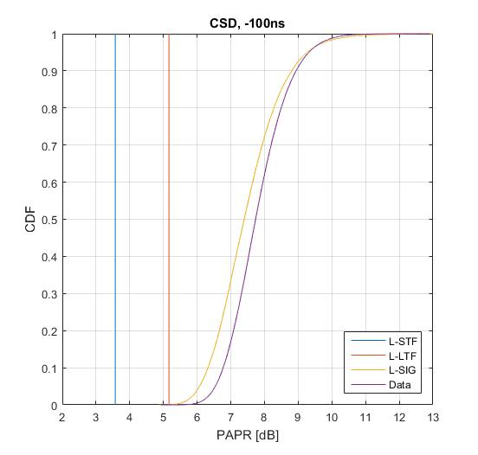
CSD (Cyclic Shift Delay) 2/2

Slide 10

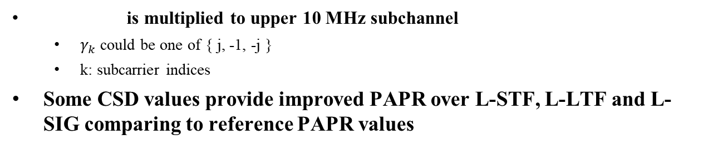
  Gamma Vector on top of CSD 1/2
 | PAPR [dB] in 20 MHz (99.9%, 8x oversampled)
CSD (ns) (T_{CS}) Gamma [1, j] | L-STF | L-LTF | L-SIG (Median)
-25 | 4.79 | 6.0069 | 8.8938
-50 | 4.5376 | 5.1647 | 8.7774
-75 | 3.9535 | 4.4964 | 7.97
-100 | 3.9235 (5.2497) | 4.8237 (5.7927) | 7.4244 (9.3806)
-125 | 4.6851 | 5.6354 | 7.3848
-150 | 5.0208 | 5.7121 | 7.611
-175 | 4.904 | 5.8758 | 7.5834
 | PAPR [dB] in 20 MHz (99.9%, 8x oversampled)
CSD (ns) (T_{CS}) Gamma [1, -1] | L-STF | L-LTF | L-SIG (Median)
-25 | 5.0489 | 5.5939 | 9.2226
-50 | 4.5502 | 5.2744 | 8.5665
-75 | 3.8746 | 4.5822 | 8.098
-100 | 3.9235 (5.2497) | 5.1661 (5.7927) | 7.3775 (9.3806)
-125 | 4.6851 | 5.5537 | 7.3673
-150 | 4.4881 | 5.8535 | 7.5281
-175 | 5.1405 | 5.4795 | 7.7092
 | PAPR [dB] in 20 MHz (99.9%, 8x oversampled)
CSD (ns) (T_{CS}) Gamma [1, -j] | L-STF | L-LTF | L-SIG (Median)
-25 | 4.9626 | 5.9549 | 8.9272
-50 | 4.5376 | 5.2717 | 8.7766
-75 | 3.6072 | 4.9051 | 7.907
-100 | 3.9235 (5.2497) | 5.0862 (5.7927) | 7.4111 (9.3806)
-125 | 4.1353 | 5.6177 | 7.3596
-150 | 5.0208 | 5.4568 | 7.6325
-175 | 5.1229 | 5.871 | 7.6496
is multiplied to upper 10 MHz subchannel
  $γ_{k}$ could be one of { j, -1, -j }
  k: subcarrier indices
Some CSD values provide improved PAPR over L-STF, L-LTF and L-SIG comparing to reference PAPR values
$${γ_{k}e}^{−j2πk∆_{F}T_{CS}^{}}$$

Slide 11
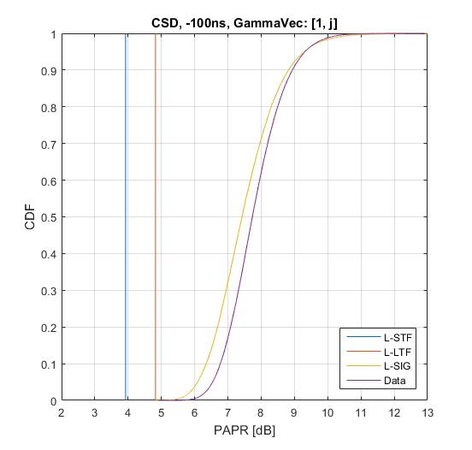
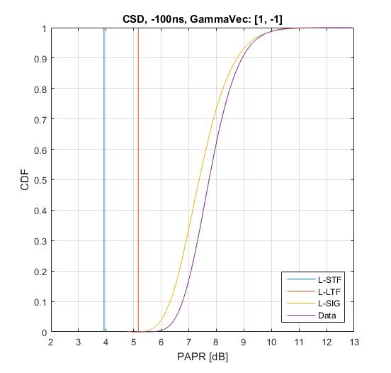
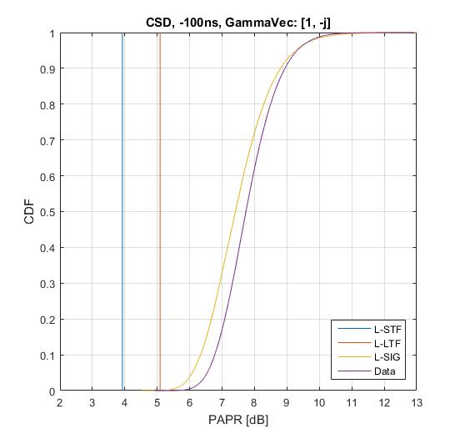
Gamma Vector on top of CSD 2/2

Slide 12
PAPR bottleneck of 20 MHz NGV PPDU
PAPR [dB] (99.9%, 8x oversampled) | L-STF | L-LTF | L-SIG (Median) | 20 MHz NGV-DATA
[ 1, +j ] Phase rotation | 5.2497 | 5.7927 | 9.3806 | 7.7349
Phase rotation in DCM+MCS0 | 4.8133 | 5.8799 | 6.9529
CSD -100ns | 3.5696 | 5.1641 | 7.3959
CSD -100ns [ 1, +j ] | 3.9235 | 4.8237 | 7.4244
CSD -100ns [ 1, -1 ] | 3.9235 | 5.1661 | 7.3775
CSD -100ns [ 1, -j ] | 3.9235 | 5.0862 | 7.4111
Gamma vector [+1, +j] does not seem to give any PAPR benefits
Phase rotation in DCM+MCS0 improves PAPR of legacy portion meaningfully.
  Prominently reduced PAPR of L-SIG
CSD related options generally provide reasonable PAPR values
  -100ns picked as an example

Slide 13
Summary
20 MHz phase rotation {+1, +j} seems not to provide any benefits in terms of PAPR reduction
  PAPR simulation shows L-SIG is identified as bottleneck of 20 MHz PPDU transmission.
  PAPR of data portion is even better than PAPR of SIG field
11bd gives the great opportunity not to have PAPR bottleneck in L-SIG of legacy portion for 20 MHz operation.
  Phase rotation in DCM+MCS0 seems good.
    Simple implementation
    Already accepted in 11ax to reduce PAPR in DCM+MCS0 and HE-SIG-B
Currently, given OFDM numerology and format of 20 MHz PPDU (NGV-SIG field, NGV STF and NGV LTF) not decided yet, further investigations are required.

Slide 14
SP
Based on so-far simulation results of PAPR, which option(s) are you prefer?
  Opt.1: legacy gamma vector with {1, +j}
    Y/N/A
  Opt.2: phase rotation in DCM (Dual Carrier Modulation) + MCS0
    Y/N/A
  Opt.3 : CSD (Cyclic Shift Delay) related
    Y/N/A

Slide 15
Reference
[1] 11-19/0514r2 Motion Booklet for IEEE 802.11 TGbd

