Slide 1
Modulation Scheme for 11bd Range Extension Update
Date: 2019-05-05
Authors:
Name | Affiliation | Address | Phone | Email
Jianhan Liu | Mediatek | 2840 Junction Ave, San Jose, CA 95134, USA | +1-408-526-1899 | jianhan.Liu@mediatek.com
Gary Anwyl
Thomas Pare

Slide 2
Schemes for Range Extension
In the PAR of 11bd [1], it says “this amendment also defines at least one mode that achieves at least 3dB lower sensitivity level (longer range)”.
Different schemes can be applied to achieve 3dB lower sensitivity. We should select the scheme with following considerations:
  1. Implementation friendly: low cost, low complexity and easy to implement;
  2. Proven technology: avoid unexpected corner cases that the technology may fail.
  3. Better be the technology already adopted in IEEE 802.11.

Slide 3
Introduce 11ax DCM scheme for MCS0
DCM scheme has been adopted in 11ax for range extension.
  It is implementation friendly: no extra antenna needed, no latency added, no extra coding efforts, just the addition of two LLRs.
  It is a proven technology in UWB and 11ax.
We will show the performance gain of MCS0 DCM is more than 3dB in the following slides.
We had presented the simulation results in [3] in the March 2019 IEEE TGbd meeting.
  The straw poll showed that there is no objection to adopt BPSK-DCM modulation scheme.
  There was a question about the spectrum of BPSK-DCM scheme. We evaluate the spectrum of our proposed BPSK-DCM scheme and show there is no difference with BPSK modulation used in 11p.

Slide 4
MCS0 DCM modulation scheme in 11ax
and are modulated symbol for data subcarrier k and k+N_{SD} for DCM. are both BPSK modulated.
To reduce the PAPR of MCS0 DCM modulation, we propose the following modulation scheme
Interleaved/coded bits
DCM
IFFT
BPSK Mapping #1
BPSK Mapping #2
Sub-carrier k
Sub-carrier k+N_{SD}
Note: N_{SD} is defined for DCM which is half of .

Slide 5
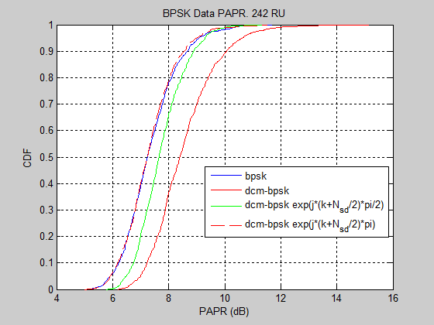
Why Rotate by (k+N_sd)*Pi?
We can see that the proposed MCS0 DCM modulation scheme reaches the similar PAPR as BSPK modulation.
Other MCS0 DCM modulation schemes have larger PAPR.

Slide 6
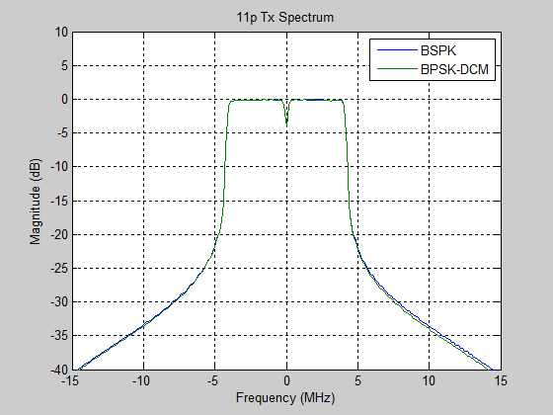
Spectrum of 11bd with DCM Modulation
In the March meeting, the question on the spectrum of BPSK-DCM modulation has been asked.
  We compared the spectrum of ½ rate BPSK and ½ rate BPSK-DCM with Sample Rate = 40MHz.
We can see that the proposed BPSK-DCM modulation scheme in fact has similar spectrum to BPSK.
  In fact, the proposed BPSK-DCM modulation scheme has slightly better spectrum than BPSK in the out bands.

Slide 7
Straw Poll #1
Do you agree to include the following BPSK DCM modulation scheme in the section 3 of 11bd SFD for achieving lower sensitivity?
Where N_{SD} is defined for DCM which is half of .

Slide 8
Back Up Slides

Slide 9
Simulation Results
Settings
  Configuration = 1x1, 10MHz Channel, 8usec symbols
  MCS = 0, 1, 0-DCM, 1-DCM
  Coding = LDPC
  Midamble = Inserted every 10 symbols
  Packet = 300 bytes/packet, 400 packets
  Rx processing = DFE Channel Tracking using slicer outputs
  Channel = C2C channel models [2]

Slide 10
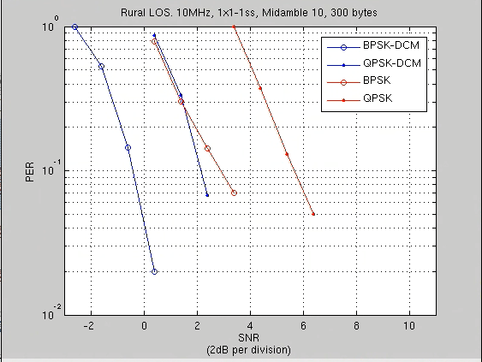
Results: Rural LOS
We can see MCS0 DCM has 3.3dB gain over MCS 0 in Rural LOS.

Slide 11
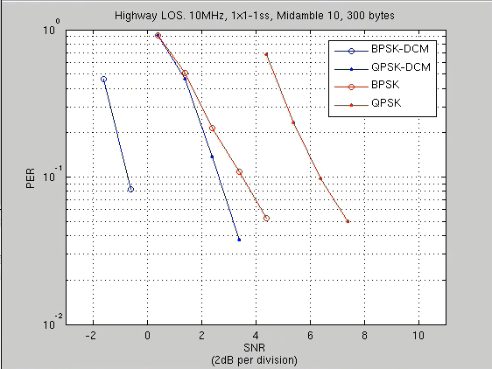
Results: Highway LOS
We can see MCS0 DCM has 4.1dB gain over MCS 0 in Highway LOS.

Slide 12
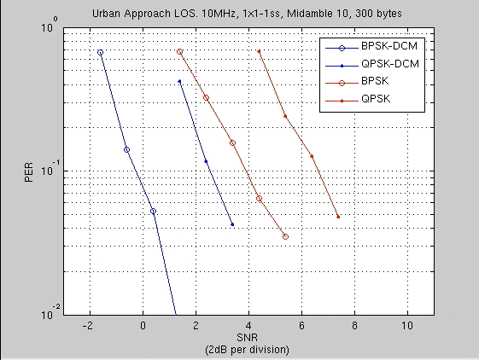
Results: Urban Approaching LOS
We can see MCS0 DCM has 4.2dB gain over MCS 0 in Urban Approaching LOS.

Slide 13
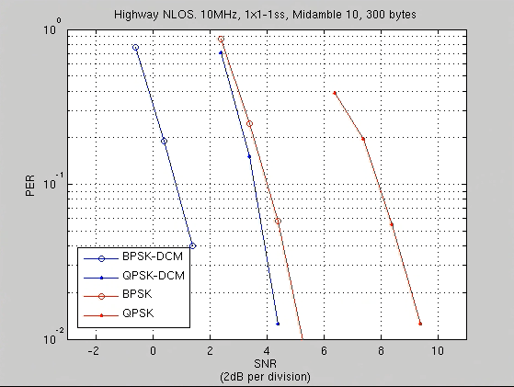
Results: Highway NLOS
We can see MCS0 DCM has 3.2dB gain over MCS 0 in Highway NLOS.

Slide 14
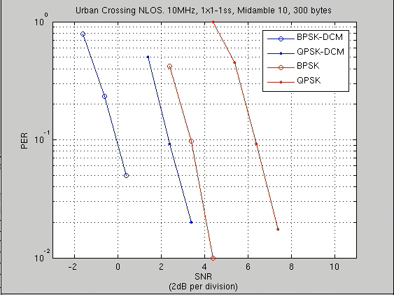
Results: Urban Crossing NLOS
We can see MCS0 DCM has 3.4dB gain over MCS 0 in Urban Crossing NLOS.

Slide 15
Reference
[1]. “802.11 NGV Proposed PAR”, IEEE 802.11-18/0861r9, Bo Sun, Hongyuan Zhang.
[2]. "Simulation of NGV Channel Models", IEEE 802.11-19/0017r4, Prashat Sharma, Rui Cao, Hongyuan Zhang
[3] “Modulation Scheme for 11bd Range Extension”, IEEE 802.11-19/0343r1, Jianhan Liu.

