Slide 1
Multi-AP Collaborative BF in IEEE 802.11
Date: 2019-5-8
Authors:

Slide 2
Introduction
Collaborative BF (CBF):
  Multiple APs transmit in the same time/frequency (each to their own STAs)
    Data of Each STA is sent from a Single AP
    No joint Data Processing across APs
  Multi-AP Coordination
    Timing/Synchronization across APs
    Interference awareness/ Interference Cancellation
  Spatial Reuse Enhancement through Multi-AP Coordination and interference cancellation
  Enabling simultaneous connectivity for several devices where interference is a concern
  Increasing Area Throughput
  The concept was also introduced in [1] and [2].

Slide 3



Collaborative BF
Key: Coordination and Interference Cancellation
Transmitter: Transmit Nulling/ ZF and Scheduling at each AP
  Multi-AP Channel Sounding to provide some information on interference channel
  Number of transmit antennas at each AP>=number of interfering STAs
  Ideal interference nulling may not be enforced.
    Non-ideal Channel Information
    Multiuser/Multi-Cell
  Residual interference at STA
Receiver: MMSE
  Resolvable LTFs across coordinated multi-AP to enable interference suppression at the receiver
  Spatial multiplexing (Matrix-P) may be applied across multiple APs to orthogonalize LTFs (improve channel estimation in presence of interference)
  Training signals for channel estimation at STA are beam-formed
$${AP}_{i}$$
$${AP}_{j}$$
Interference channel
$${STA}_{i1}$$
$${STA}_{i2}$$
$${STA}_{j1}$$
$${STA}_{j2}$$

Slide 4
Collaborative BF
Multi-AP Channel Sounding: Each AP may require channel information for the STAs in OBSS for the sake of interference cancellation.
  Explicit Feedback
    Extending 802.11ax sounding sequence
    NDP transmission from APs in downlink
    The STAs may be directed to send feedback reports on channel of each individual AP
  Implicit Feedback
    A proposal for single AP/802.11be is presented in [3].
    Training fields are transmitted in the uplink from the required STAs
    All APs in coordinated set will be able to measure the channel for all STAs in OBSS
    Reduce network overhead significantly
Multi-AP Trigger frame is transmitted by initiating AP to enable synchronization/time alignment and initiate Multi-AP data transmission to the scheduled STAs.

Slide 5
Simulation Results

Slide 6
CBF versus Single AP and Coordinated SR
Three examples are considered for evaluation of Collaborative BF
Simulation Set up:
  MATLAB Simulator/IEEE Channel model D (BW=80 MHz)
  AP with 4/8 Tx antennas transmitting at 24 dBm/ STA with 2 Receive antennas
  Noise floor of -89.9 dBm
  Ideal Channel Estimation/ Uncompressed BF feedback
  Receiver: MMSE
  Path Loss Model: Channel D (NLOS)
  Coordinated Spatial Reuse (SR): Multi-AP transmission is allowed, MU ZF/Eigen BF is performed in each AP (for in-cell STAs), No interference Cancellation across APs
  CBF: Nulling /ZF is performed in each AP, considering BF reports from OBSS STAs, to combat interference across APs
    Perfect Channel estimation at each STA /residual interference estimation at each STA
  Single-AP: The same dimensionality as each AP in CBF and Coordinated SR

Slide 7
Example I:Two Single-user Cells
AP: 4 antennas
STA: 2 antennas
2 Overlapping Cells, distance between APs=45 m
One STA in each cell.
STA’s distance from in-cell AP changes (1: 30 m)
AP-1
45 m
AP-2
30 m
Int.
STA-1
STA-2

Slide 8
CBF versus Single AP and SR
Example I: Two AP/ Two STAs, One and Two spatial stream (SS) per STA
CBF (2-AP) provides about 2x Throughput gain compared with Single AP and major improvement over Coordinated SR .
$$×1.9$$

Slide 9
Example II: 3 APs
3 overlapping APs: Single user/ AP1 and AP3, Two STAs/ MU MIMO/AP2
One SS to each STA
AP-1
AP-2
50 m
AP-3
30 m
STA-2
STA-3
STA-1
STA-4

Slide 10
CBF versus Single AP and SR
Example II: 3 AP, 4 STAs
$$×1.7$$

Slide 11
Example III: Two STAs per AP
Distance between APs=45 m, Two STA (MU-BF) in each cell (dropped randomly in (1:30 m) from in-cell AP).
One SS to each STA
AP-1
AP-2
45 m
30 m
Int.
STA-4
STA-2
STA-1
STA-3

Slide 12
CBF versus Single AP and SR
Example III: 2 AP (4 and 8 antennas), 4 STAs
$$×1.4$$
$$×1.8$$

Slide 13
Conclusion
Multi-AP Collaborative BF provides major Sum Throughput gain over single AP and Coordinated SR
Enabling CBF, each individual AP may require channel sounding for OBSS STAs
In CBF, Resolvable LTFs across APs in collaborative set, improves channel estimation and interference suppression at MMSE Receiver.

Slide 14
References
[1]: Terminology for AP Coordination, doc.: IEEE 802.11-18/1926r2
[2]: Considerations on AP Coordination, doc.: IEEE 802.11-18/1576
[3]: Implicit Channel Sounding in IEEE 802.11, doc.: IEEE802.11-19/0768r0

Slide 15
Back Up

Slide 16
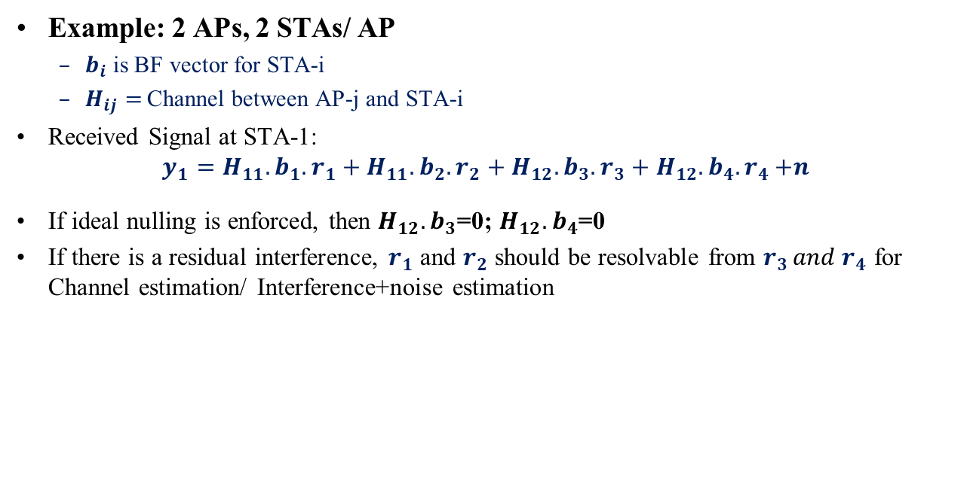
CBF/ Resolvable LTFs for MMSE Rx
Example: 2 APs, 2 STAs/ AP
  $b_{i}$ is BF vector for STA-i
  $H_{ij}=$Channel between AP-j and STA-i
Received Signal at STA-1:
$$y_{1}=H_{11}.b_{1}. r_{1}+H_{11}.b_{2}. r_{2}+H_{12}.b_{3}. r_{3}+H_{12}.b_{4}{.r}_{4}+n$$
If ideal nulling is enforced, then $H_{12}.b_{3}$=0; $H_{12}.b_{4}$=0
If there is a residual interference, $r_{1}$ and $r_{2}$ should be resolvable from $r_{3 }{and r}_{4}$ for Channel estimation/ Interference+noise estimation
AP-1
AP-2
40 m
Int.
STA-4
STA-2
STA-1
STA-3

