Slide 1
Implicit Channel Sounding in IEEE 802.11
Date: 2019-5-8
Authors:

Slide 2
Introduction
Explicit BF Feedback/ IEEE 802.11ax Challenges:
  BF Feedback Overhead esp in case of higher number of antennas/higher number of STAs, and Multi-AP
  Quantization/Compression impact
  Channel aging/Feedback delay
Implicit channel sounding may result:
  Lower network overhead/ Less Latency as there is no BF feedback transmission.
  No quantization/compression impact as BF weights are calculated directly from channel.
  Efficient DL Multiuser (MU) BF, MU scheduling, power control

Slide 3
Introduction
RF Reciprocity Calibration is required to facilitate implicit feedback.
In previous contribution we analyzed the feasibility of Local AP Calibration where the device is not required to be involved in calibration process.
  Calibration algorithms were discussed.
  Simulation results were provided to show residual calibration errors.
  The impact of residual calibration error on performance gain of Multiuser (MU) BF was evaluated.
In this contribution, a Trigger-based scheme is presented for enabling Implicit Channel
Sounding in 802.11be.

Slide 4
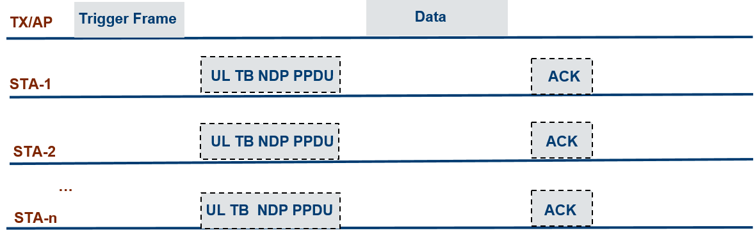
Implicit BF Feedback Using Trigger Frame
AP transmits a trigger frame, to trigger one or multiple STAs, to send NDP in uplink.
The STAs can be directed to be multiplexed in spatial domain on different spatial streams, and/or in frequency. Alternatively STAs may be directed to transmit NDP sequentially in time.
Upon receiving NDP from the STA(s), AP will directly calculate BF weights and transmit data.
Trigger-Based Uplink Sounding Sequence to enable Implicit BF Feedback in Multiuser MIMO

Slide 5
Implicit BF Feedback Using Trigger Frame
Spatial Multiplexing/ Matrix P
  Trigger frame will define the ordering in Matrix P for each STA
  Multiplexing devices with a large power imbalance (received power) may be problematic.
    Near-Far problem
  Multiplexing devices in different classes (A and B) may be problematic.
TDMA
  STAs are directed to transmit NDP sequentially
  STAs may be grouped to send spatially multiplexed NDP.
  Different groups may be triggered separately to send NDP sequentially in UL.
    Devices in different classes (A and B) can be separated in time.

Slide 6
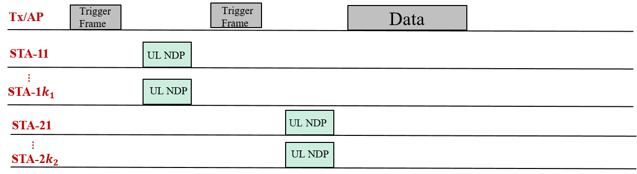

Spatial/Time Multiplexing
Time and spatial multiplexing of NDP in UL. STA-11 … STA${1k}_{1}$ belong to the same group are multiplexed by Matrix-P (dimension of $k_{1}$). STA-21 … STA${2k}_{2}$ belong to the second group, are scheduled in a different time slot and multiplexed by Matrix-P (dimension of${ k}_{2}$).

Slide 7

NDP Spatial Multiplexing in Uplink
The impact of CFO error when there is a power imbalance across multiplexed STAs
Transmit power accuracy/ RSSI Measurement accuracy:
  Class A: ±3/ ±3
  Class B: ±9/ ±5
2x LTF is used and STAs may have maximum of 350 Hz residual CFO
%5 $↓$

Slide 8
Frequency Multiplexing
Frequency Multiplexing of Training Fields from multiple STAs in Uplink:
  Following the idea of grouping in explicit feedback, each STA will send training in one tone out of g tones (g=4, 16).
  Channel is estimated in UL in every 1/g of subcarriers
  Interpolation is required at the receiver.
STA1 | Set 1 | 0 | 0 | 0 | Set 1 | 0 | 0 | 0 | Set 1 | …
STA2 | 0 | Set 2 | 0 | 0 | 0 | Set 2 | 0 | 0 | 0 | …
STA3 | 0 | 0 | Set 3 | 0 | 0 | 0 | Set 3 | 0 | 0 | …
STA4 | 0 | 0 | 0 | Set 4 | 0 | 0 | 0 | Set 4 | 0 | …
….. Subcarriers …..

Slide 9
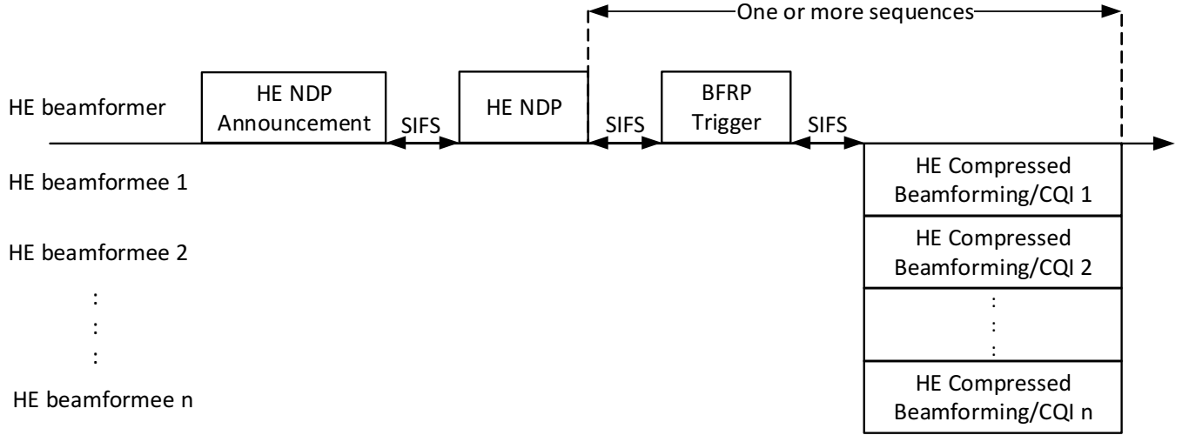
Network Overhead Evaluation: Implicit vs Explicit
Overhead Reduction of Implicit Feedback
  The key overhead component in explicit feedback is on compressed BF reports.
Sounding Protocol
  Explicit Feedback: NDPA+NDP+BFRP Trigger+ BF Feedback Reports
  Implicit Feedback: Trigger +NDP
An example of Explicit Sounding Protocol [802.11ax_D4.0]

Slide 10
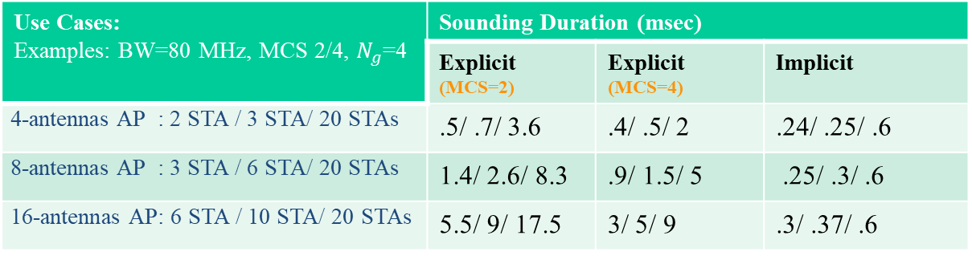
Network Overhead Evaluation: Implicit vs Explicit
Explicit Feedback: Network overhead is increased with number of antennas at AP and number of STAs.
Note: If UL MU MIMO is enabled for feedback reports, the network overhead of explicit feedback will be reduced.
Use Cases: Examples: BW=80 MHz, MCS 2/4, $N_{g}$=4 | Sounding Duration (msec)
 | Explicit (MCS=2) | Explicit (MCS=4) | Implicit
4-antennas AP : 2 STA / 3 STA/ 20 STAs | .5/ .7/ 3.6 | .4/ .5/ 2 | .24/ .25/ .6
8-antennas AP : 3 STA / 6 STA/ 20 STAs | 1.4/ 2.6/ 8.3 | .9/ 1.5/ 5 | .25/ .3/ .6
16-antennas AP: 6 STA / 10 STA/ 20 STAs | 5.5/ 9/ 17.5 | 3/ 5/ 9 | .3/ .37/ .6

Slide 11
Conclusion
A Trigger-based (TB) scheme is presented to enable implicit channel sounding in 802.11be.
Different schemes for multiplexing the training signals of multiuser in UL are discussed which include: Spatial, Time and Frequency
Trigger frame will define the detailed allocation of time/code/tone for each user.
Network Overhead evaluation shows significant improvement of implicit vs explicit sounding especially for higher number of antennas and/or higher number of STAs.

Slide 12
References
[1]: Implicit Channel Sounding in IEEE 802.11 (Feasibility Study), doc.: IEEE 802.11-19/
0767r0

Slide 13
Back up

Slide 14
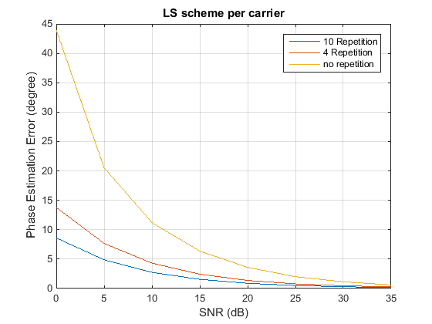
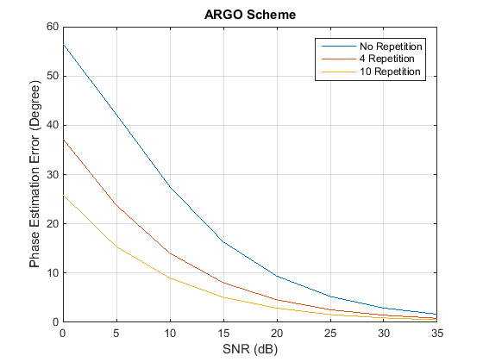

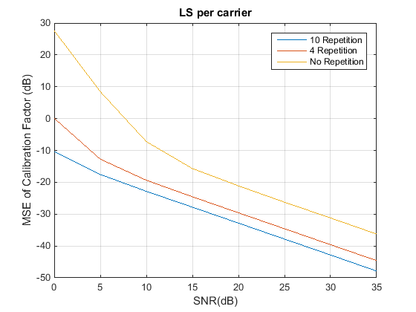
Simulation Results: Calibration Accuracy at AP
LS vs ARGOS [1]
The residual phase/amplitude calibration error at AP is less than 4 degrees/ -22 dB.
(F is Calibration Factor)

