Slide 1
Implicit Channel Sounding in IEEE 802.11
(Feasibility Study)
Date: 2019-5-8
Authors:

Slide 2
Introduction
Explicit BF Feedback/ IEEE 802.11ax Challenges:
  Network overhead as a result of BF feedback reports esp in case of AP with larger number of antennas, dense network with large number of STAs, and Multi-AP
  Quantization/Compression impact
  Channel aging/large delays between the channel estimation and the MU-MIMO data transmission time
Implicit Channel Sounding may result:
  Lower network overhead/ Less Latency as there is no BF feedback transmission.
  No quantization/compression impact as BF weights are calculated directly from channel.
  Efficient DL Multiuser (MU) BF, MU scheduling, power control

Slide 3
Introduction
Implicit BF Feedback: Relying on TDD transmission and channel reciprocity
  Uplink pilot/NDP transmission from users to enable uplink channel sounding
  TDD: UL and DL channels have identical impulse response in the same coherence interval
  The baseband-to-RF and RF-to-baseband conversion chains need not be reciprocal. As a result, the effective downlink baseband channel is not equal to the effective uplink baseband channel unless this mismatch is explicitly compensated through Calibration.
    RF Reciprocity Calibration is required.
      Newer developed Local AP Calibration may be applied where the device is not required to be involved in calibration process[1, 2].
In this contribution, we analyze the feasibility of Local AP Calibration and also provide some results on required calibration accuracy for MU MIMO BF

Slide 4

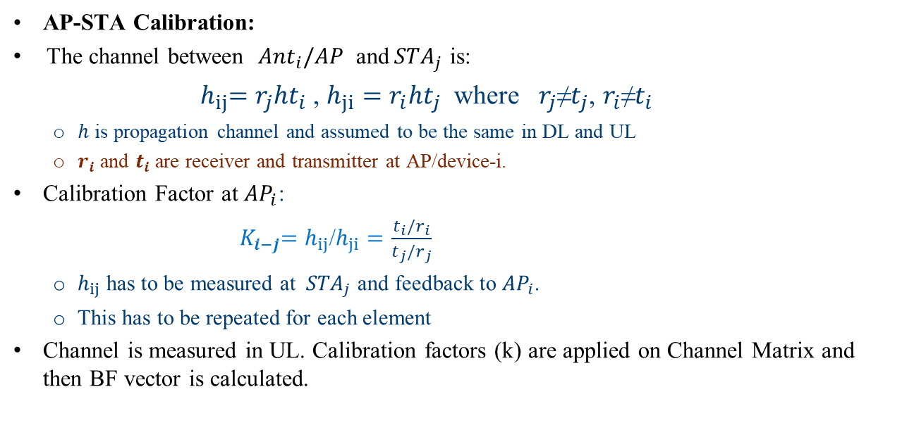



RF Calibration Concept
AP-STA Calibration:
The channel between ${Ant}_{i}/AP$ and${ STA}_{j}$ is:
    ${ h}_{ij}=r_{j}ht_{i}$ , $h_{ji}=r_{i}ht_{j}$ where $r_{j}$≠$t_{j}$, $r_{i}$≠$t_{i}$
  $h$ is propagation channel and assumed to be the same in DL and UL
  $r_{i}$ and $t_{i}$ are receiver and transmitter at AP/device-i.
Calibration Factor at ${AP}_{i}$:
  ${ K}_{i−j}=h_{ij}$/$h_{ji}=\frac{t_{i}/r_{i}}{t_{j}/r_{j}}$
  $h_{ij}$ has to be measured at ${ STA}_{j}$ and feedback to ${AP}_{i}$.
  This has to be repeated for each element
Channel is measured in UL. Calibration factors (k) are applied on Channel Matrix and then BF vector is calculated.
$${ Ant}_{i}$$
$${ h}_{ji}$$
$${ h}_{ij}$$
$${ STA}_{j}$$

Slide 5


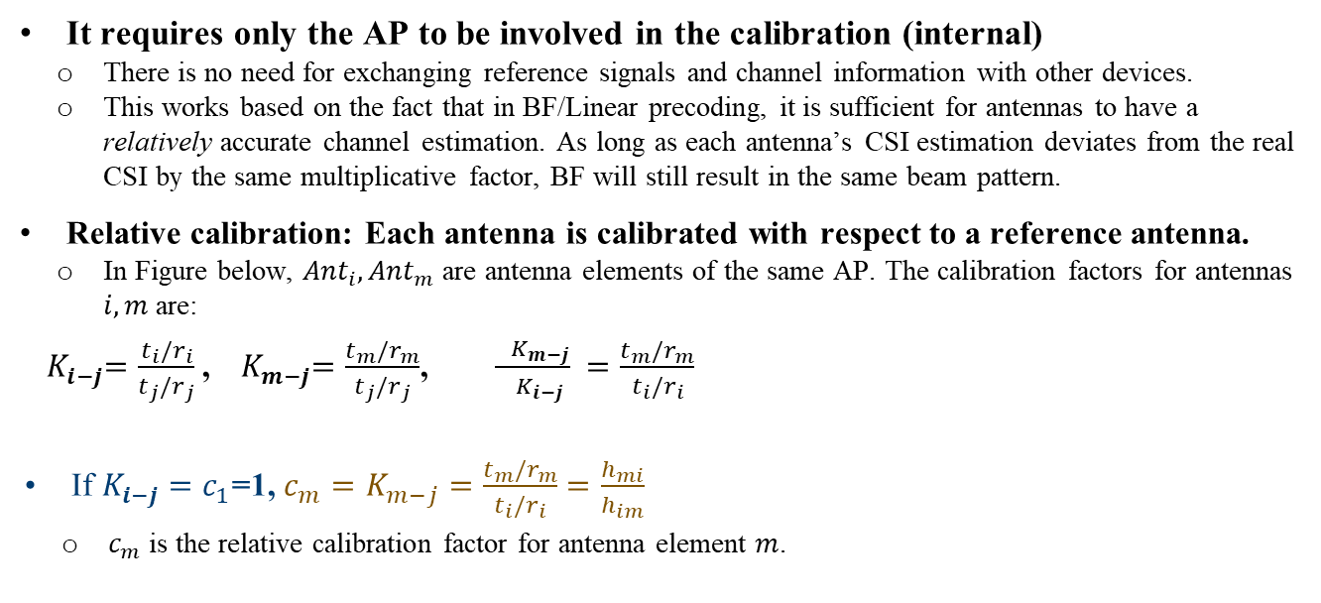



Local AP Calibration
It requires only the AP to be involved in the calibration (internal)
  There is no need for exchanging reference signals and channel information with other devices.
  This works based on the fact that in BF/Linear precoding, it is sufficient for antennas to have a relatively accurate channel estimation. As long as each antenna’s CSI estimation deviates from the real CSI by the same multiplicative factor, BF will still result in the same beam pattern.
Relative calibration: Each antenna is calibrated with respect to a reference antenna.
  In Figure below, ${Ant}_{i}, {Ant}_{m}$ are antenna elements of the same AP. The calibration factors for antennas $i, m$ are:
${ K}_{i−j}=\frac{t_{i}/r_{i}}{t_{j}/r_{j}}$ , ${ K}_{m−j}=\frac{t_{m}/r_{m}}{t_{j}/r_{j}}$, $\frac{{ K}_{m−j}}{{ K}_{i−j}} =\frac{t_{m}/r_{m}}{t_{i}/r_{i}}$
If $K_{i−j}=c_{1}$=1, ${c_{m}=K}_{m−j}=\frac{t_{m}/r_{m}}{t_{i}/r_{i}}=\frac{h_{mi}}{h_{im}}$
    $c_{m}$ is the relative calibration factor for antenna element $m$.
$${ Ant}_{i}$$
$${ Ant}_{m}$$
$${ h}_{ji}$$
$${ h}_{jm}$$
$${ h}_{ij}$$
$${ h}_{mj}$$
$${ STA}_{j}$$

Slide 6
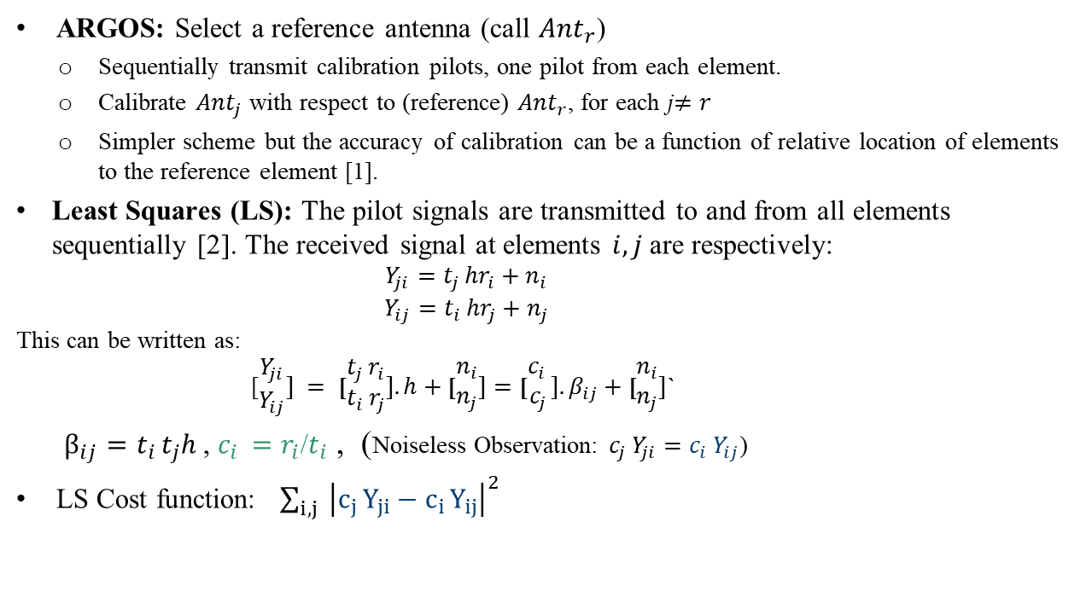
Local AP Calibration
ARGOS: Select a reference antenna (call ${Ant}_{r}$)
  Sequentially transmit calibration pilots, one pilot from each element.
  Calibrate ${Ant}_{j}$ with respect to (reference) ${Ant}_{r}$, for each j$≠r$
  Simpler scheme but the accuracy of calibration can be a function of relative location of elements to the reference element [1].
Least Squares (LS): The pilot signals are transmitted to and from all elements sequentially [2]. The received signal at elements $i, j$are respectively:
        $$Y_{ji}=t_{j }hr_{i}+n_{i}$$
        $$Y_{ij}=t_{i }hr_{j}+n_{j}$$
This can be written as:
[$\begin{matrix}Y_{ji} \\ Y_{ij}\end{matrix}] = \text{[}\begin{matrix}t_{j }r_{i} \\ t_{i }r_{j}\end{matrix}].h+\text{[}\begin{matrix}n_{i} \\ n_{j}\end{matrix}]=\text{[}\begin{matrix}c_{i } \\ c_{j}\end{matrix}].β_{ij}+\text{[}\begin{matrix}n_{i} \\ n_{j}\end{matrix}]$`
    $β_{ij}=t_{i }t_{j}h$, $c_{i }=r_{i}$/$t_{i}$ , (Noiseless Observation: $c_{j }Y_{ji}=c_{i }Y_{ij}$)
LS Cost function: $\sum_{i,j}{{ \left|c_{j }Y_{ji}−c_{i }Y_{ij}\right|}^{2}}$

Slide 7
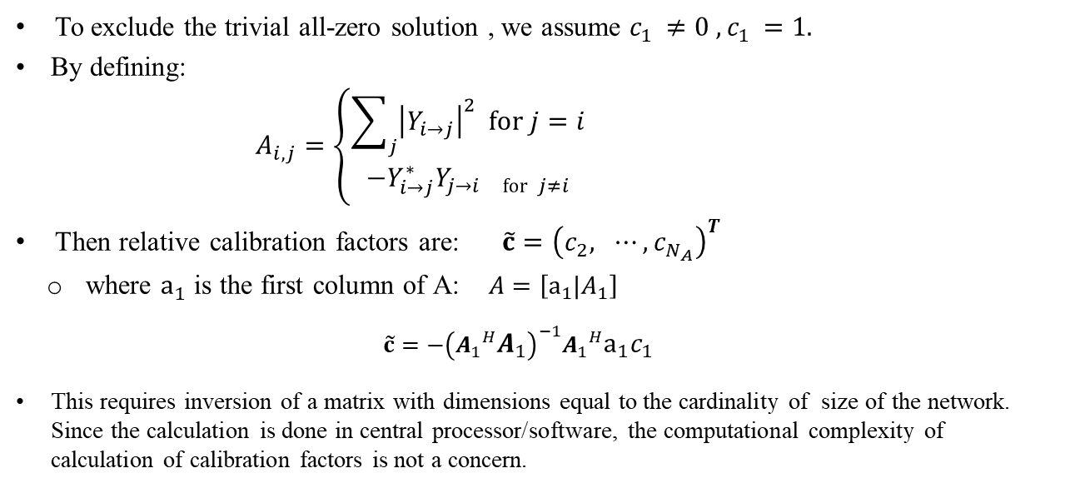
Local AP Calibration
To exclude the trivial all-zero solution , we assume $c_{1 }≠0 ,c_{1 }=1.$
By defining:
            $$A_{i,j}=\left\{\begin{aligned}\sum_{j}{{\left|Y_{i→j}\right|}^{2} for j=i} \\ −Y_{i→j}^{∗}Y_{j→i for j≠i}\end{aligned}\right.$$
Then relative calibration factors are: $\tilde{c}={\left(c_{2}, ⋯,c_{N_{A}}\right)}^{T}$
  where $a_{1}$ is the first column of A: $A=\left[a_{1}|A_{1}\right]$
  $$\tilde{c}=−{\left({A_{1}}^{H}A_{1}\right)}^{−1}{A_{1}}^{H}a_{1}c_{1}$$
This requires inversion of a matrix with dimensions equal to the cardinality of size of the network. Since the calculation is done in central processor/software, the computational complexity of calculation of calibration factors is not a concern.

Slide 8
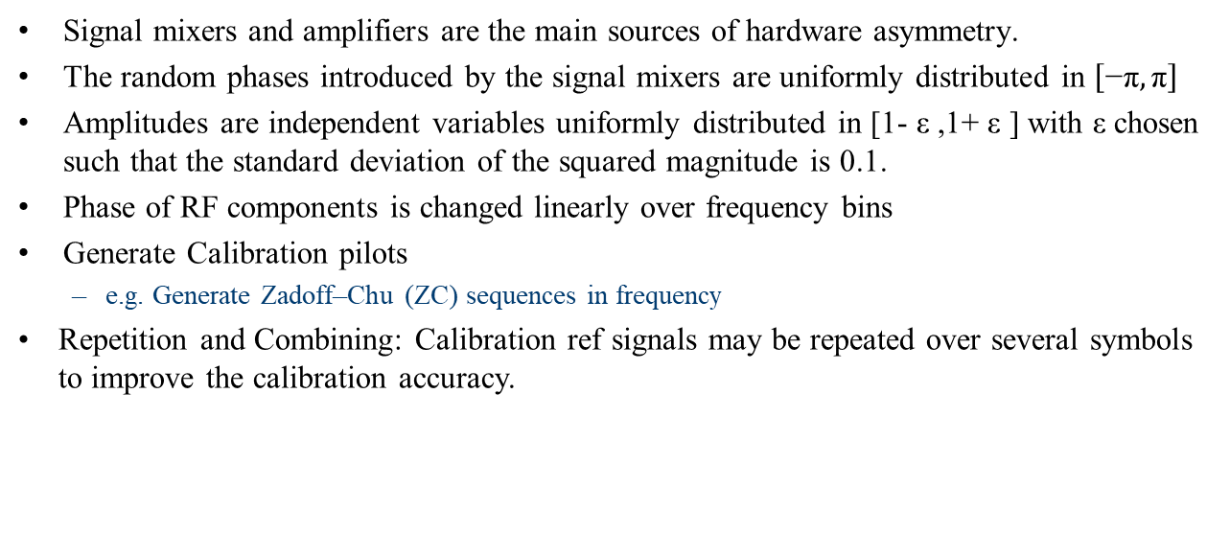
Simulations
Signal mixers and amplifiers are the main sources of hardware asymmetry.
The random phases introduced by the signal mixers are uniformly distributed in $\left[\text{−}\text{π}, \text{π}\right]$
Amplitudes are independent variables uniformly distributed in [1- ε ,1+ ε ] with ε chosen such that the standard deviation of the squared magnitude is 0.1.
Phase of RF components is changed linearly over frequency bins
Generate Calibration pilots
  e.g. Generate Zadoff–Chu (ZC) sequences in frequency
Repetition and Combining: Calibration ref signals may be repeated over several symbols to improve the calibration accuracy.

Slide 9

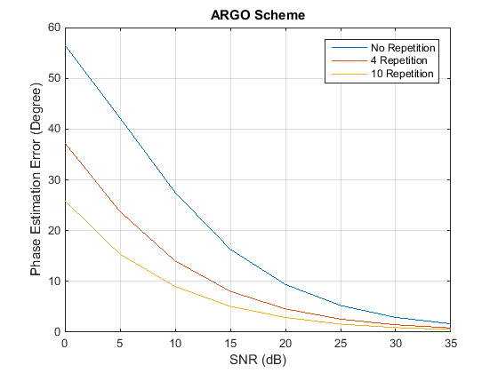

Simulation Results: LS vs ARGO
LS improves Calibration accuracy compared to ARGO scheme.
The residual phase/amplitude calibration error at AP is less than 3 degrees/ -25 dB.
  For SNR$>20 dB,$LS calibration error falls less than 3 deg/1 deg (one repetition/4 repetition)
(F is Calibration Factor)

Slide 10
Simulation Results/Impact of Calibration Error on MU BF

Slide 11
Simulations
IEEE Channel model D (BW=80 MHz)
AP with 4/8 Tx antennas transmitting at 24 dBm
Number of STAs: 4 and 6
Single data steam to each STA
Noise floor of -89.9 dBm
STA with 2 Receive antennas
Transmitter:
  Multiuser ZF BF
Receiver: MMSE
Path Loss Model: Free Space: Ploss= 46.77+20log10(d)
  D=10:10:80 m

Slide 12
Impact of Reciprocity Error at the Device in MU MIMO BF
Reciprocity Phase Error at the device has no impact on MU MIMO Transmit BF [2]
Reciprocity Amplitude error at the device has a minor impact.
Conclusion: RF Calibration is only applied at AP. No need for Calibration at the device.
Example: AP (8-antennas) and 4 STAs (two antennas)
AP: No Reciprocity error
STAs: Phase Errors of (-70, 70) deg
  No Impact
STAs: Amplitude Error (Uniform distribution (0.5,1.5) )
  Less than 0.5 dB impact
Amp/Phase Error is the difference in Amp/Phase between
transmitter and receiver in each Antenna (Reciprocity error)

Slide 13
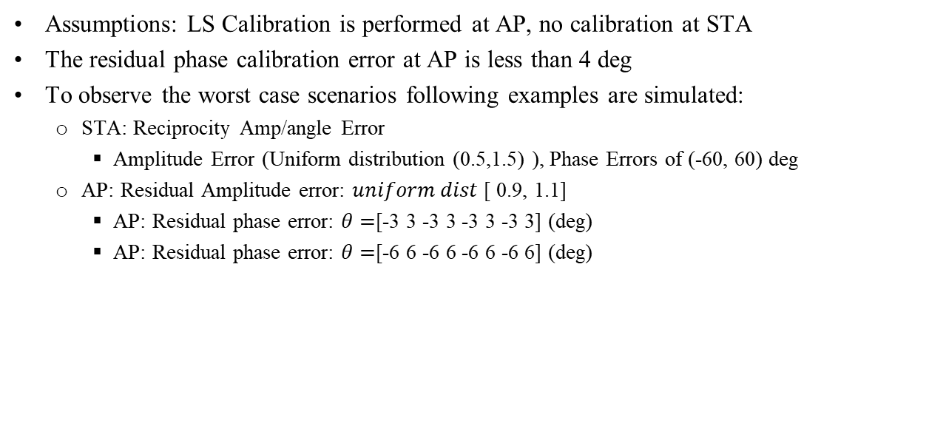
Impact of Residual Calibration Error at AP
Assumptions: LS Calibration is performed at AP, no calibration at STA
The residual phase calibration error at AP is less than 4 deg
To observe the worst case scenarios following examples are simulated:
  STA: Reciprocity Amp/angle Error
    Amplitude Error (Uniform distribution (0.5,1.5) ), Phase Errors of (-60, 60) deg
  AP: Residual Amplitude error: $uniform dist$[ 0.9, 1.1]
    AP: Residual phase error: $θ=$[-3 3 -3 3 -3 3 -3 3] (deg)
    AP: Residual phase error: $θ=$[-6 6 -6 6 -6 6 -6 6] (deg)

Slide 14
Simulation Results
Impact of residual calibration error at AP on MU BF performance
  Residual phase calibration error is for each antenna (the difference between receive and transmit RF chains).

Slide 15
PER Results
IEEE Channel model D (BW=20 MHz)
AP with 4/8 Tx antennas transmitting
Number of STAs (2 receive antennas) : 2 / Single data steam to each STA
Noise floor of -89.9 dBm
Receiver: MMSE

Slide 16
Conclusion
Local AP Calibration is discussed
LS and ARGO schemes are evaluated, LS provides improvement in calibration accuracy.
  LS calibration at AP may result less than 3 deg residual error at each element.
RF calibration is not required at the device.
The impact of calibration error on MU MIMO BF is evaluated.
For higher number of users in DL MU MIMO BF, AP calibration error has to be maintained in lower range (less than 3 deg).
Multi-AP:
  In Coordinated Multi-AP schemes when data is transmitted by single-AP, calibration is performed in each single AP.
  In joint Processing/ BF schemes, calibration has to be performed across multi-AP.
RF calibration can be performed locally at the AP to facilitate implicit sounding.

Slide 17
References
[1]: Shepard et all, Argos: practical many-antenna base stations,” in Proceedings of the 18th Annual International Conference on Mobile Computing and Networking, Mobicom ’12
[2]: Rogalin et all, Hardware-Impairment Compensation for Enabling Distributed Large-Scale MIMO, ITA Workshop, Feb 2013.

