Slide 1
Latency analysis for EHT
Date: 2019-07-15
Authors:
Name | Affiliation | Address | Phone | Email
Suhwook Kim | LG Electronics | 19, Yangjae-daero 11gil, Seocho-gu, Seoul 137-130, Korea |  | suhwook.kim@lge.com
Jinsoo Choi |  |  |  | js.choi@lge.com
Jeongki Kim |  |  |  | jeongki.kim@lge.com
Insun Jang |  |  |  | insun.jang@lge.com
Taewon Song |  |  |  | taewon.song@lge.co
Sungjin Park |  |  |  | allean.park@lge.com

Slide 2
Abstract
This presentation addresses the latency analysis for EHT to reduce latency and jitter. This analysis may allow EHT to review technologies to support low latency traffic.
This presentation provides the simulation results for EDCA system and OFDMA system which has been adopted in 802.11

Slide 3
Low latency support discussion
We have discussed supporting low latency application in EHT
Low latency is mentioned in several sub-clauses in the PAR document
  5.2.b. Scope of the project: “This amendment defines at least one mode of operation capable of improved worst case latency and jitter.”
  5.5 Need for the Project: “New high-throughput, low latency applications will proliferate such as virtual reality or augmented reality, gaming, remote office and cloud computing”. “With the high throughput and stringent real-time delay requirements of these applications, users expect enhanced throughput, enhanced reliability, reduced latency and jitter, and improved power efficiency in supporting their applications over WLAN.”

Slide 4
Submissions in previous meetings
[1] introduces Real Time Application and Time-Sensitive Networking
  RTA TIG provides final report (18/2009r6) which contains description of real-time application usage model, problem statement, technical requirements and potential solutions
  It addresses opportunity for improving reliability for RTA and time-sensitive applications in EHT
[2] proposes multiple primary channels for EHT to mitigate channel access delay
  It also shows simulation results
[3] suggests streaming game as a part of EHT use case

Slide 5
Latency analysis method
The latency will be analyzed by dividing into several portions
  It takes a lot of process for a frame to be sent
  For example, queuing, contention, IFS, retransmission, etc…
  In OFDMA system, scheduling and feedback take additional time
To facilitate the better analysis, we will start with the analysis in limited environment
  DL or UL only traffic
  Single BSS
  Constant Bit Rate (CBR) traffic
  Fixed MCS

Slide 6
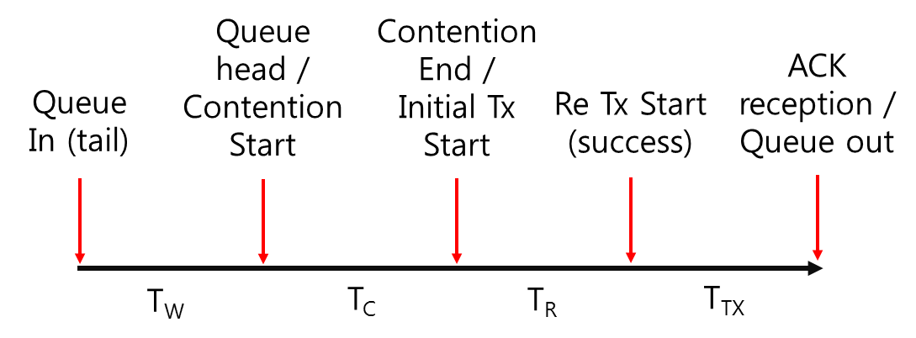
Latency portions – EDCA
T_{W}: Contention waiting time
  Time to transmit previously arrived packets
T_{C}: Contention time
T_{R}: Additional time for retransmission
  Time spent for failed transmission
T_{TX}: Transmission time for successful data frame and ACK

Slide 7
Latency analysis on EDCA
In DL case,
  MCS that maximizes Tput and MCS that minimizes latency can be different
  The latency increases dramatically when traffic is saturated
  The variation in T_{W} is greater than the others
In UL case,
  RTS/CTS shows enhanced performance not only in Tput but also in latency when the number of STAs is above a certain level
  Unlike in DL case, the portion of T_{C},T_{R} by collision increases significantly if the number of STAs increases
  We can enhance latency performance of certain traffic dramatically by allocating AC_VI,VO instead of AC_BE
Simulation results for EDCA are attached in appendix

Slide 8
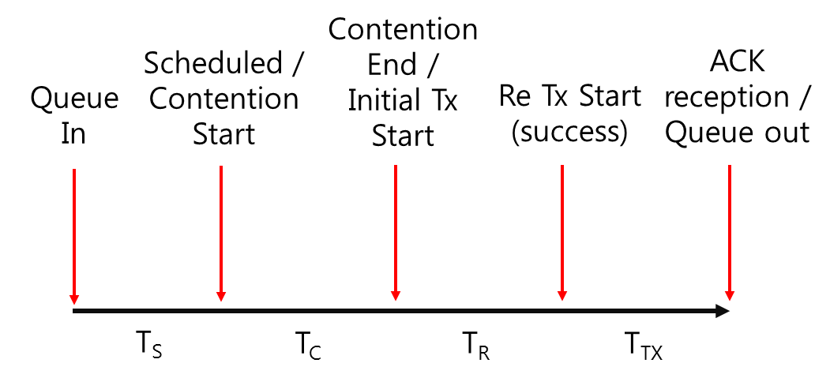
Latency portions – DL OFDMA
T_{S}: Scheduling time
  Time to be scheduled for DL
T_{C}: Contention time
T_{TX}: Transmission time for successful data frame and ACK
T_{R}: Additional time for retransmission

Slide 9
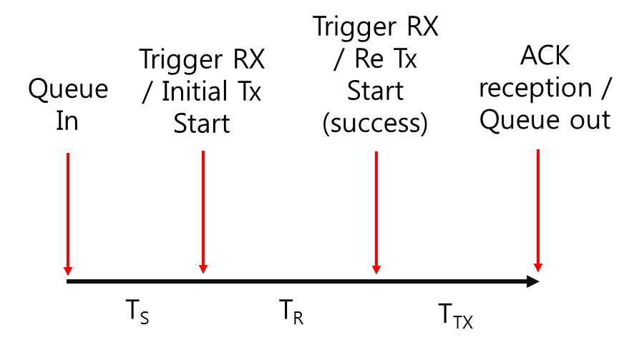
Latency portions – UL OFDMA
T_{S}: Scheduling time
  Time to be scheduled for UL (Including Trigger frame transmission)
  Latency for feedback procedure is not assumed
T_{TX}: Transmission time for successful data frame and ACK
T_{R}: Additional time for retransmission

Slide 10
Simulation setting
AP-STA distance: 15 meter
All STAs are co-located
Channel model: TGnD
Fixed MCS (MCS 9), 80 MHz BW
Traffic model: CBR (20 Mbps), DL or UL only
TX power: 20 dBm(AP), 17 dBm(STA)
Scheduler: 1 RU per 1 STA
  1 RU * 996 tones
  2 RUs * 484 tones
  4 RUs * 242 tones
  8 RUs * 106 tones
  16 RUs * 52 tones

Slide 11
Simulation cases for DL OFDMA
Case 1: Number of STAs
  1, 4, 8, 16 STAs
Case 2: RU sizes
  8 STAs: 8 * 106 / 4 * 242 / 2 * 484 tones
  16 STAs: 16 * 52 / 8 * 106 / 4 * 242 tones
Case 3: Scheduler
  8 STAs: 8 * 106 / 4 * 242 / 2 * 484 tones
  Latency minimized scheduler / Persistent scheduler
    Latency minimized scheduler
      Choose the STAs that have the most delayed frames
    Persistent scheduler
      Assign one RU for the pre-selected STA in every TXOP
      Remaining RUs are selected by latency minimized scheduler

Slide 12
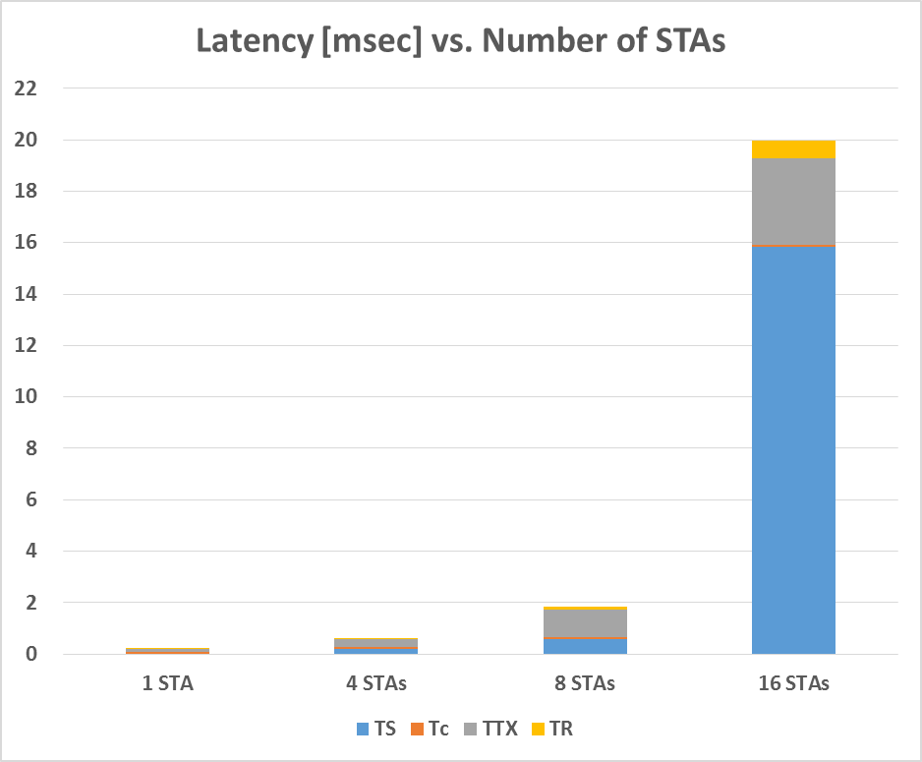
DL Latency analysis:
Case 1 (Number of STAs)
 | Tput [Mbps] | PER [%] | Total Latency [usec]
1 STA | 20.0 | 6.8 | 219
4 STAs | 20.0 | 9.7 | 622
8 STAs | 20.0 | 13.1 | 1,842
16 STAs | 19.9 | 18.3 | 19,951

Slide 13
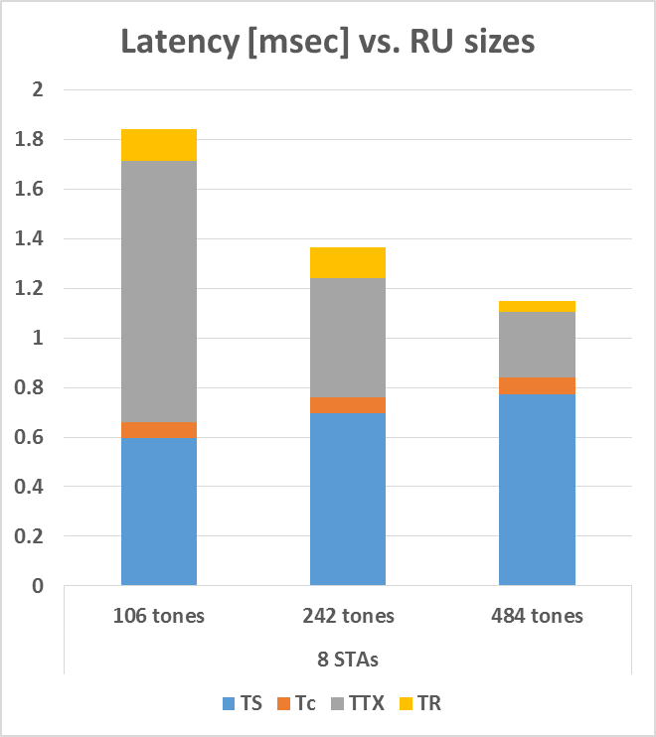
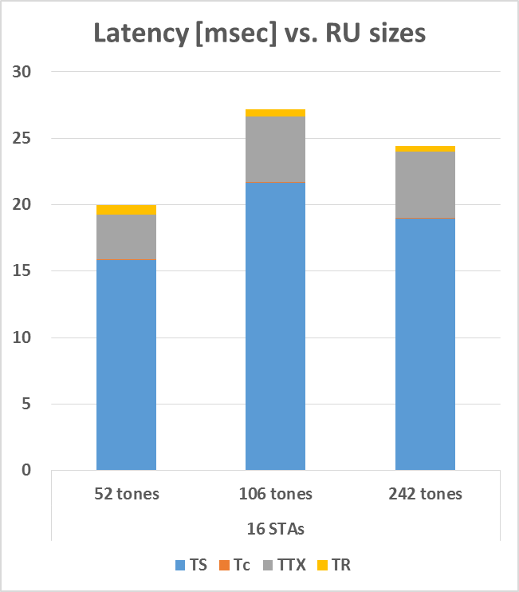
DL Latency analysis: Case 2 (RU sizes)

Slide 14
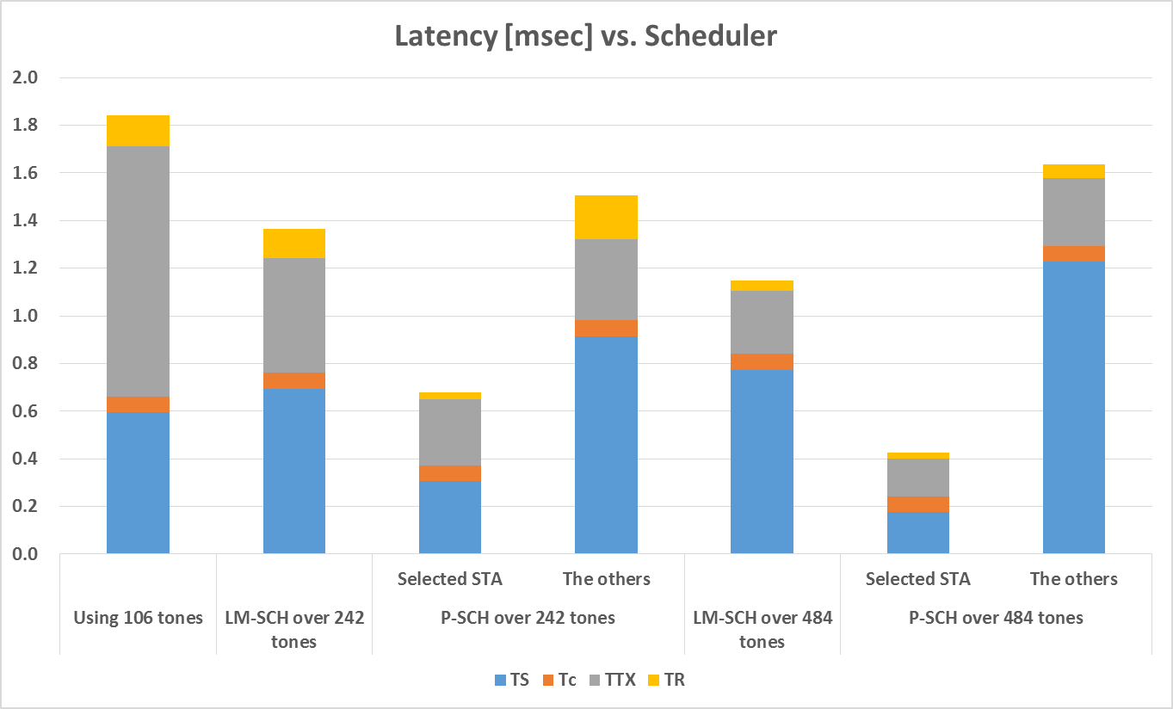
DL Latency analysis: Case 3 (Scheduler)
8 * 106 tones
4 * 242 tones
2 * 484 tones

Slide 15
Observation on DL results
If the network is saturated, changes in RU sizes don’t make meaningful difference on latency performance
If the network isn’t saturated, the larger RU size, the better latency performance in DL
  Even though the T_{S} has increased, the T_{TX} has decreased more in larger RU size
  Like EDCA case, the variation in T_{S} is greater than the others
Persistent scheduler can dramatically improve latency performance of a specific STA
  Performance gain is higher in larger RU size

Slide 16
Simulation cases for UL OFDMA
Case 1: Number of STAs
  2, 4, 8, 16 STAs
  UL TXOP: 4.6 msec or 2 msec
Case 2: RU sizes
  16 STAs: 16 * 52 / 8 * 106 / 4 * 242 tones
Case 3: Scheduler
  16 STAs (52 tones, 106 tones, 242 tones), 10 Mbps per STA
  Latency minimized scheduler / Persistent scheduler
    Latency minimized scheduler
      Choose the STAs that have the most delayed frames
    Persistent scheduler
      Assign one RU for the pre-selected STA in every TXOP
      Remaining RUs are selected by latency minimized scheduler

Slide 17
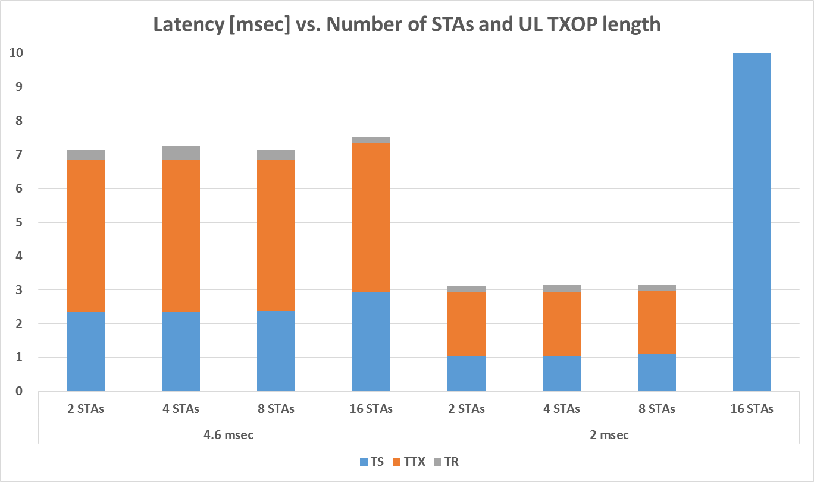
UL Latency analysis: Case 1
(Number of STAs)
297

Slide 18
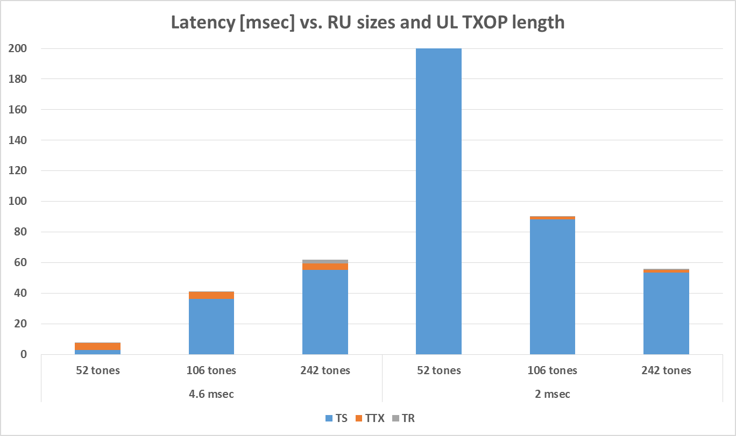
UL Latency analysis: Case 2
(RU sizes)
297

Slide 19
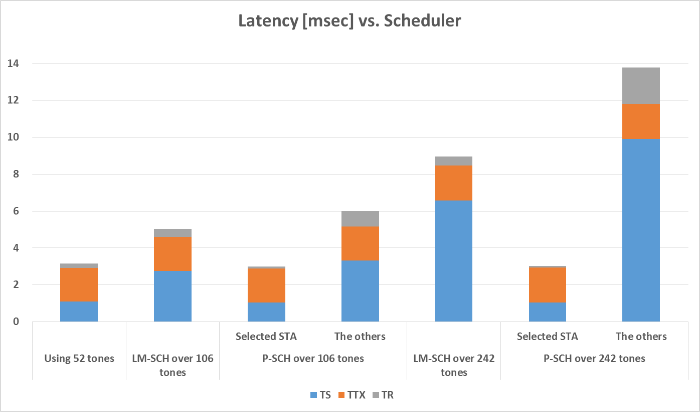
UL Latency analysis: Case 3
(Scheduler)
8 * 106 tones
4 * 242 tones
16 * 52 tones

Slide 20
Observation on UL results
Unlike in DL case, the number of STAs doesn’t affect the latency performance
  However, if the number of STAs increases until the network is saturated, the latency increases rapidly
  The latency performance improves with smaller UL TXOP, but the network can be saturated in less offered traffic load because of the overhead of trigger frame and padding
Unlike in UL EDCA case, only T_{S} is dominant factor because there isn’t contention and collision
  There isn’t T_{C} in UL OFDMA and T_{R} is very low
To reduce latency in UL, it may be recommended that AP more frequently assign a smaller RU to STAs

Slide 21
Expectation on OBSS
Because we assumed single BSS, there wasn’t frame error caused by OBSS interference
  So, T_{R} and T_{C} didn't have a big impact on latency except UL EDCA case
We can assume that the portion of T_{R} and T_{C} increases in OBSS
The worst-case scenario of a rapid increase in latency usually occurs in OBSS or dense environment, the portion of T_{R} and T_{C} may be important factors for handling worst-case
  T_{S} should also be considered as important factor in OFDMA

Slide 22
Further step
Applying TST (time sensitive traffic) model
  We will apply TST which is defined in 11ax Evaluation Methodology document and RTA TIG report
  We will evaluate whether 11ax can satisfy TST requirements
OBSS performance
  We will extend current simulation to OBSS environment
  Worst-case will be considered
We will evaluate latency performance of EHT features
  Multi-band, 16 streams, 320 MHz, etc.

Slide 23
Summary
We conducted in-depth latency analysis on EDCA and OFDMA system
  The latency is divided into several portions and analyzed with simulation
  We could identify some variables that affect latency
  We also were able to check some things to reduce latency by simulation results

Slide 24
References
[1] 11-19-0373-00-0eht-time-sensitive-applications-support-in-eht.pptx
[2] 11-19-0402-01-0eht-reducing-channel-access-delay.pptx
[3] 11-19-0430-00-0eht-low-latency-streaming-capability-for-game-applications.pptx

Slide 25
Appendix I – EDCA results

Slide 26
Simulation setting
AP-STA distance: 45 meter
All STAs are co-located
Channel model: TGnD
Fixed MCS
Traffic model: CBR, DL or UL only, 1500 bytes MPDU
TX power: 20 dBm(AP), 17 dBm(STA)
40, 80, 160 MHz BW in 5 GHz band

Slide 27
Simulation cases for DL EDCA
Case 1: MCS
  MCS 1 ~ 5
  50 Mbps traffic load, 80 MHz BW
Case 2: BW
  BW 40 MHz, 80 MHz, 160 MHz
  50 Mbps traffic load, MCS 4
Case 3: Traffic load
  Traffic load 50 Mbps ~ 200 Mbps
  MCS 4, 80 MHz BW

Slide 28
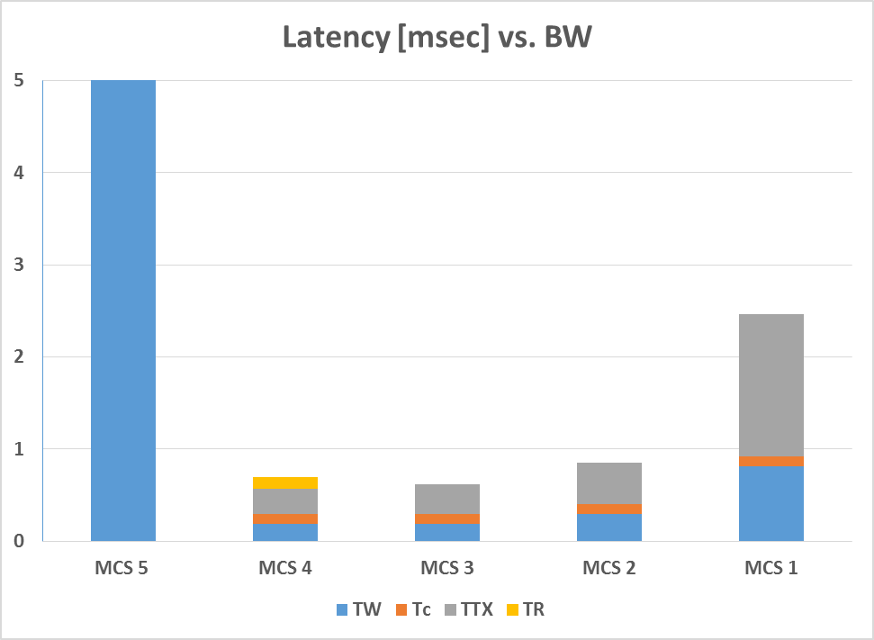
DL Latency analysis: Case 1 (MCS)
 | Tput [Mbps] | PER [%] | Total Latency [usec]
MCS 5 | 47.3 | 46.6 | 15,689
MCS 4 | 50.0 | 6.9 | 694
MCS 3 | 50.0 | 0 | 614
MCS 2 | 50.0 | 0 | 854
MCS 1 | 50.0 | 0 | 2,464
15.7

Slide 29
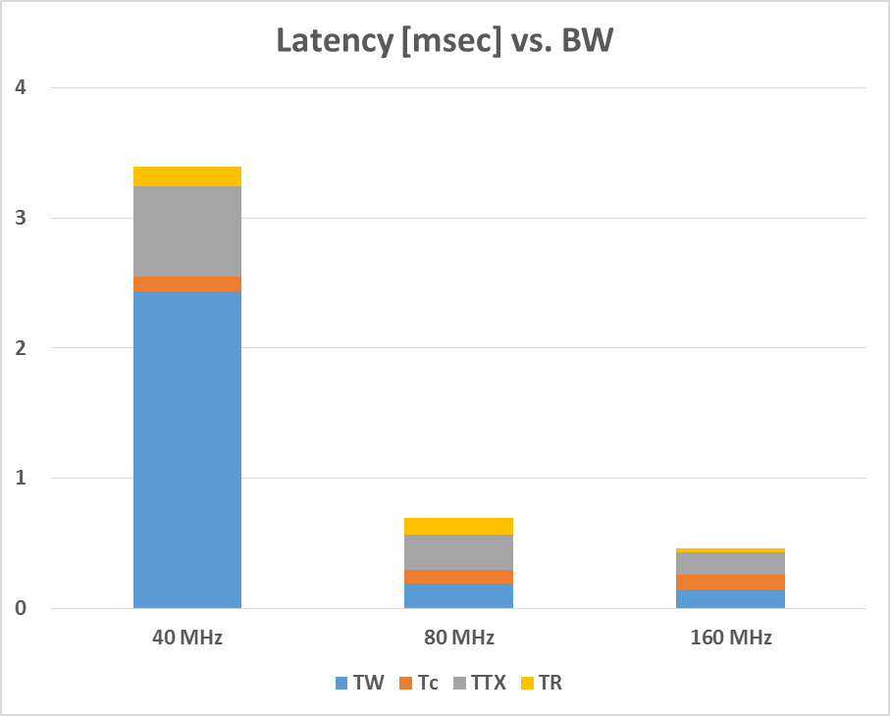
DL Latency analysis: Case 2 (BW)
 | Tput [Mbps] | PER [%] | Total Latency [usec]
40 MHz | 50.0 | 2.2 | 3,392
80 MHz | 50.0 | 6.9 | 694
160 MHz | 50.0 | 6.8 | 463

Slide 30
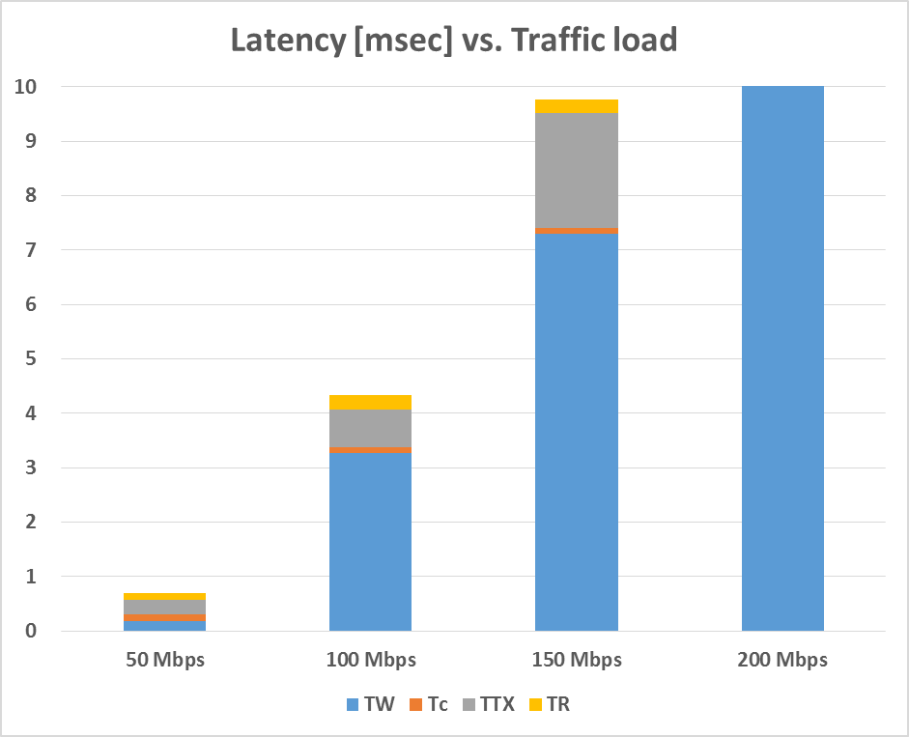
DL Latency analysis: Case 3 (Traffic load)
 | Tput [Mbps] | PER [%] | Total Latency [usec]
50 Mbps | 50.0 | 6.9 | 694
100 Mbps | 100.0 | 5.3 | 4,342
150 Mbps | 147.7 | 4.1 | 9,760
200 Mbps | 159.5 | 4.0 | 73,391
73.4

Slide 31
Simulation cases
Case 1: Number of STAs, 1 ~ 10 STAs
  Traffic load = 10 Mbps per STA, RTS/CTS on/off
Case 2: Number of STAs, 10 ~ 40 STAs
  Traffic load = 1 Mbps per STA, RTS/CTS on/off
Case 3: Access category, 6 STAs
  5 low rate STAs + 1 high rate STA
  High rate STAs: 100 Mbps traffic load, AC_BE/VI/VO
  Low rate STAs: 1 Mbps traffic load per STA, AC_BE only
  RTS/CTS off

Slide 32
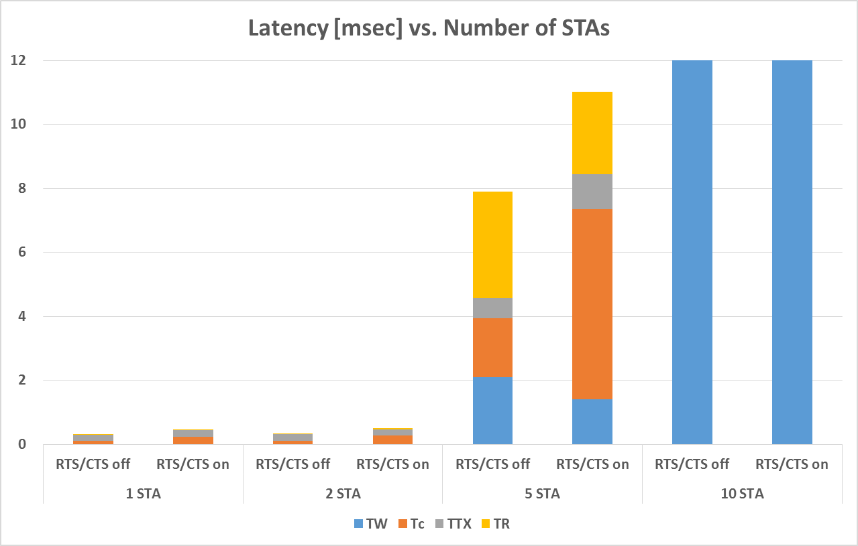
UL Latency analysis: Case 1
(Number of STAs)
635
90.0

Slide 33
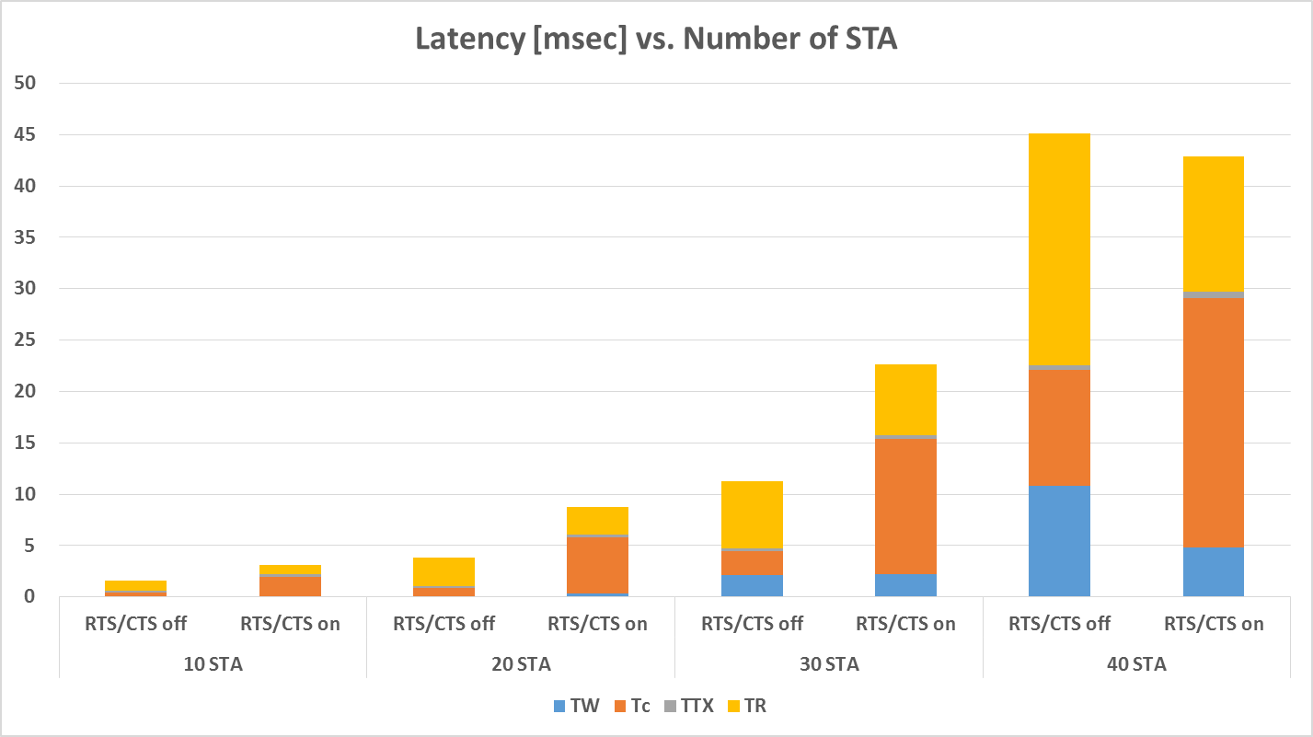
UL Latency analysis: Case 2
(Number of STAs)

Slide 34
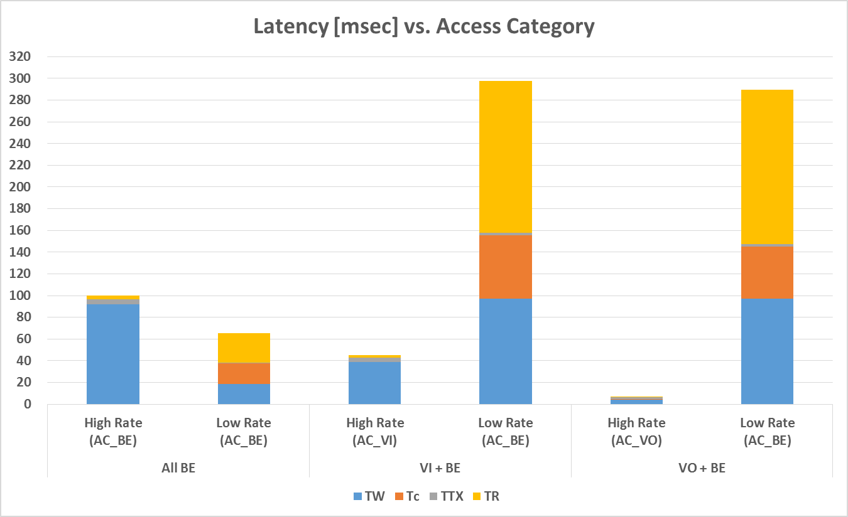
UL Latency analysis: Case 3
(Access Category)

Slide 35
Appendix II – OFDMA results

Slide 36
DL Latency analysis:
Case 1 (Number of STAs)
Detail results
 |  |  |  | Each latency portion [usec]
 | Tput [Mbps] | PER [%] | Total Latency [usec] | T_{S} | T_{C} | T_{TX} | T_{R}
1 STA | 20.0 | 6.8 | 219 | 2 | 66 | 141 | 10
4 STAs | 20.0 | 9.7 | 622 | 192 | 66 | 307 | 57
8 STAs | 20.0 | 13.1 | 1,842 | 595 | 66 | 1052 | 129
16 STAs | 19.8 | 18.3 | 19,951 | 15831 | 66 | 3361 | 693

Slide 37
DL Latency analysis: Case 2 (RU sizes)
Detail results
 |  |  |  |  | Each latency portion [usec]
 |  | Tput [Mbps] | PER [%] | Total Latency [usec] | T_{S} | T_{C} | T_{TX} | T_{R}
8 STAs | 106 tones | 20.0 | 13.1 | 1,842 | 595 | 66 | 1052 | 129
 | 242 tones | 20.0 | 11.6 | 1,365 | 695 | 66 | 481 | 123
 | 484 tones | 20.0 | 8.1 | 1,149 | 774 | 66 | 264 | 45
16 STAs | 52 tones | 20.0 | 18.3 | 19,951 | 15,831 | 66 | 3,361 | 693
 | 106 tones | 20.0 | 14.8 | 27,195 | 21,631 | 66 | 4,917 | 581
 | 242 tones | 19.8 | 9.1 | 24,381 | 18,958 | 66 | 4,973 | 384

Slide 38
DL Latency analysis: Case 3 (Scheduler)
Detail results
 |  |  |  |  | Each latency portion [usec]
 |  | Tput [Mbps] | PER [%] | Total Latency [usec] | T_{S} | T_{C} | T_{TX} | T_{R}
Using 106 tones |  | 20.0 | 13.1 | 1,842 | 595 | 66 | 1,052 | 129
LM-SCH over 242 tones |  | 20.0 | 11.6 | 1,365 | 695 | 66 | 481 | 123
P-SCH over 242 tones | Selected | 20.0 | 5.5 | 680 | 306 | 66 | 277 | 31
 | The others | 20.0 | 10.8 | 1,505 | 915 | 66 | 341 | 183
LM-SCH over 496 tones |  | 20.0 | 8.1 | 1,149 | 774 | 66 | 264 | 45
P-SCH over 496 tones | Selected | 20.0 | 1.5 | 425 | 175 | 66 | 160 | 24
 | The others | 20.0 | 6.9 | 1,637 | 1,227 | 66 | 287 | 57

Slide 39
UL Latency analysis: Case 1
(Number of STAs)
Detail results
 |  |  |  |  | Each latency portion [usec]
 |  | Tput [Mbps] | PER [%] | Total Latency [usec] | T_{S} | T_{TX} | T_{R}
4.6 msec | 2 STAs | 20.0 | 3.4 | 7,127 | 2,347 | 4,501 | 279
 | 4 STAs | 20.0 | 2.6 | 7,256 | 2,347 | 4,485 | 423
 | 8 STAs | 20.0 | 1.3 | 7,120 | 2,387 | 4,453 | 280
 | 16 STAs | 20.0 | 0.8 | 7,534 | 2,934 | 4,405 | 196
2 msec | 2 STAs | 20.0 | 4.2 | 3,128 | 1,045 | 1,901 | 182
 | 4 STAs | 20.0 | 2.8 | 3,137 | 1,050 | 1,885 | 202
 | 8 STAs | 20.0 | 1.7 | 3,155 | 1,106 | 1,853 | 196
 | 16 STAs | 17.2 | 0.8 | 296,560 | 294,730 | 1,805 | 25

Slide 40
UL Latency analysis: Case 2
(RU sizes)
Detail results
 |  |  |  |  | Each latency portion [usec]
 |  | Tput [Mbps] | PER [%] | Total Latency [usec] | T_{S} | T_{TX} | T_{R}
4.6 msec | 52 tones | 20.0 | 0.8 | 7,534 | 2,934 | 4,405 | 196
 | 106 tones | 19.9 | 1.3 | 36,220 | 36,220 | 4,453 | 563
 | 242 tones | 19.9 | 2.5 | 55,117 | 55,117 | 4,485 | 2371
2 msec | 52 tones | 17.2 | 0.8 | 296,560 | 294,730 | 1,805 | 25
 | 106 tones | 19.6 | 1.4 | 90,095 | 88,127 | 1,853 | 114
 | 242 tones | 19.6 | 0.7 | 56,025 | 53,429 | 1,885 | 711

Slide 41
UL Latency analysis: Case 3
(Scheduler)
Detail results
 |  |  |  |  | Each latency portion [usec]
 |  | Tput [Mbps] | PER [%] | Total Latency [usec] | T_{S} | T_{TX} | T_{R}
Using 52 tones |  | 10.0 | 0.9 | 3,169 | 1,102 | 1,805 | 263
L-SCH over 106 tones |  | 10.0 | 1.5 | 5,016 | 2,745 | 1,853 | 418
P-SCH over 106 tones | Selected | 10.0 | 1.3 | 2,985 | 1,046 | 1,853 | 85
 | The others | 10.0 | 1.3 | 5,993 | 3,310 | 1,853 | 830
L-SCH over 242 tones |  | 10.0 | 2.9 | 8,947 | 6,572 | 1,885 | 490
P-SCH over 242 tones | Selected | 10.0 | 2.6 | 3,034 | 1,046 | 1,885 | 103
 | The others | 10.0 | 2.7 | 13,771 | 9,907 | 1,885 | 1,979

Slide 42
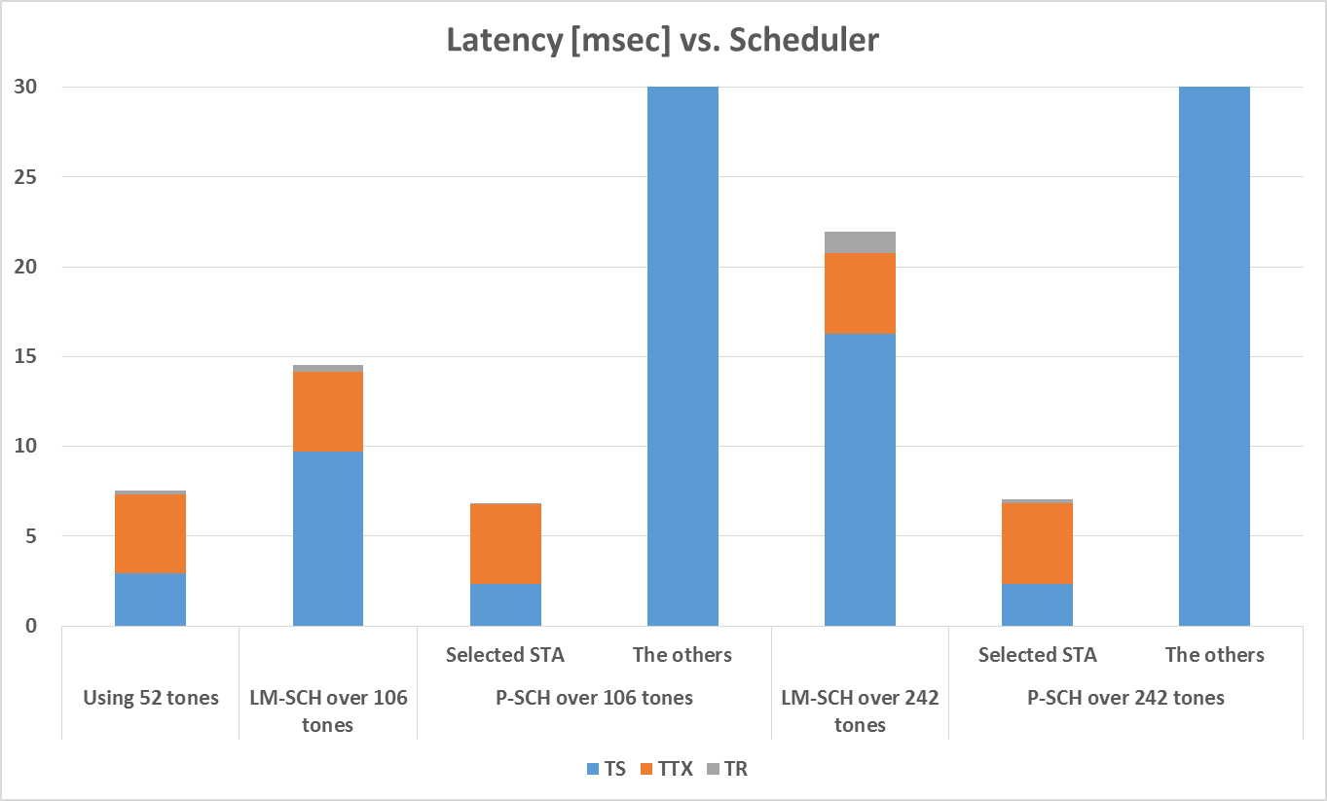
UL Latency analysis: Case 3a
(Scheduler)
8 * 106 tones
4 * 242 tones
214
262
16 * 52 tones

Slide 43
UL Latency analysis: Case 3a
(Scheduler)
Detail results
 |  |  |  |  | Each latency portion [usec]
 |  | Tput [Mbps] | PER [%] | Total Latency [usec] | T_{S} | T_{TX} | T_{R}
Using 52 tones |  | 20.0 | 0.8 | 7,534 | 2,934 | 4,405 | 196
L-SCH over 106 tones |  | 19.9 | 1.3 | 41,236 | 36,220 | 4,453 | 563
P-SCH over 106 tones | Selected | 20.0 | 0.8 | 6,857 | 2,344 | 4,453 | 60
 | The others | 18.7 | 1.4 | 213,854 | 208,540 | 4,453 | 862
L-SCH over 242 tones |  | 19.9 | 2.5 | 61,973 | 55,117 | 4,485 | 2371
P-SCH over 242 tones | Selected | 20.0 | 3.2 | 7,066 | 2,350 | 4,485 | 231
 | The others | 16.9 | 2.7 | 261,582 | 251,508 | 4,485 | 5589

