Slide 1
EUHT Evaluation Modility
Date: 2019-05-06
Authors:

Slide 2
Abstract
This presentation is a follow up work of the proposal about joint submission to ITU as IMT-2020 standard [1].
In this contribution, we present the preliminary results of EUHT [2] simulations on mobility in rural eMBB scenario.
The simulations adhere to the methodology specified by ITU-R for self-evaluating a RAT for IMT-2020 [3].
The preliminary results show that EUHT can meet the ITU requirements on mobility in rural eMBB scenario[4].
Notes:
Here is the abstract.

Slide 3
Abbreviation
RIT ( Radio Interface Technology)
URLLC（Ultra-Reliable and Low Latency Communications）
eMBB（enhanced Mobile Broadband）
mMTC (massive Machine Type Communication)
3GPP R15（3GPP Release 15）
3GPP R16（3GPP Release 16）
NSA（Non-Standalone ）
EUHT（Enhanced Ultra High Throughput）

Slide 4
Outline
Objective
Simulation Configuration
Simulation Assumption
Mobility Simulation Results
Mobility Interruption Time Analysis
Control Plane Latency Analysis
Conclusion
Next Step
References

Slide 5
Objective
In the previous meeting, it was proposed that 11ax and EUHT are combined together to be submitted to ITU as SRIT (set of RIT) [1].
In [1], EUHT is proposed to meet the requirements of the following scenarios
  Rural eMBB, Urban Marco URLLC and Urban Macro mMTC
The self-evaluation results must be submitted together with the technical documents before July 1st according to ITU[5].
The self-evaluation results of EUHT on mobility, control plane latency and mobility interruption time in rural eMBB scenario are shown in this contribution.

Slide 6
Simulation Configuration
Simulation bandwidth : 20 MHz
Carrier Frequency: 4GHz ( Higher Doppler than 700MHz)
BS Tx power : 49 dBm, UE Tx power: 23 dBm
BS Antenna gain: 8 dBi, UE antenna gain: 0 dBi
BS noise figure: 5 dB, UE noise figure : 7 dB
BS antenna configuration : dual polarization 8Tx/8Rx with 8 dBi gain in intended direction.
UE antenna configuration : dual polarization 8Tx/8Rx with with 0 dBi gain.
The complete configuration is specified in the ITU-R guidelines for self-evaluating a RAT ([3]).

Slide 7
Simulation Assumptions
TCH Payload : 1500 Byte
QPSK, 16QAM
LDPC, 1/2, 3/4 code rate, codeword size: 2688
single spatial stream
DPI( Dedicated Reference Symbol Period Interval) in time domain is 8
  Insert one DRS symbol every 8 TCH OFDM symbols
Channel estimation based on 2-Dimension linear interpolation
  Performance will be further improved with L-MMSE channel estimation
Maximum Ratio Combining
Min-sum LDPC decoding

Slide 8
Minimum Requirements
The minimum requirements of mobility in [4] are quoted as follows

Slide 9
Simulation Procedure (1)
The mobility simulation procedure is quoted as follows [3]
Step 1: Run uplink system-level simulations, identical to those for average spectral efficiency, and 5th percentile user spectral efficiency except for speeds taken from Table 4 of Report ITU-R M.2410-0, using link-level simulations and a link-to-system interface appropriate for these speed values, for the set of selected test environment(s) associated with the candidate RITs/SRITs and collect overall statistics for uplink SINR values, and construct CDF over these values for each test environment.
Step 2: Use the CDF for the test environment(s) to save the respective 50th-percentile SINR value.

Slide 10
Simulation Procedure (2)
Step 3: Run new uplink link-level simulations for the selected test environment(s) for either NLOS or LOS channel conditions using the associated speeds in Table 4 of Report ITU‑R M.2410‑0, as input parameters, to obtain link data rate and residual packet error ratio as a function of SINR. The link-level simulation shall use air interface configuration(s) supported by the proposal and take into account retransmission, channel estimation and phase noise impact.
Step 4: Compare the uplink spectral efficiency values (link data rate normalized by channel bandwidth) obtained from Step 3 using the associated SINR value obtained from Step 2 for selected test environments, with the corresponding threshold values in the Table 4 of Report ITU-R M.2410-0.
Step 5: The proposal fulfils the mobility requirement if the spectral efficiency value is larger than or equal to the corresponding threshold value and if also the residual decoded packet error ratio is less than 1%, for all selected test environments. For the selected test environment it is sufficient if one of the spectral efficiency values (using either NLOS or LOS channel conditions) fulfils the threshold.

Slide 11
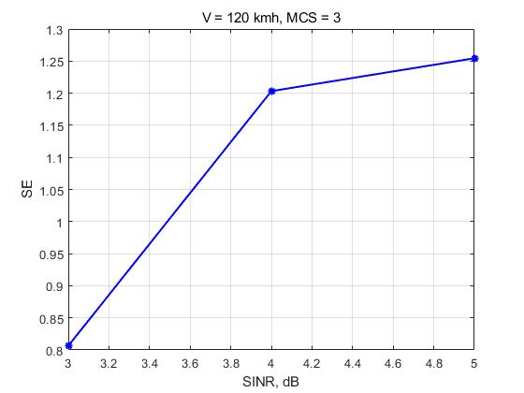
Simulation Results – 120km/h
MCS3: 16QAM, ½ code rate
Median SINR: 4.6dB@120km/h
Spectral Efficiency at 4.6dB is 1.23 bit/s/Hz > 0.8 bit/s/Hz

Slide 12
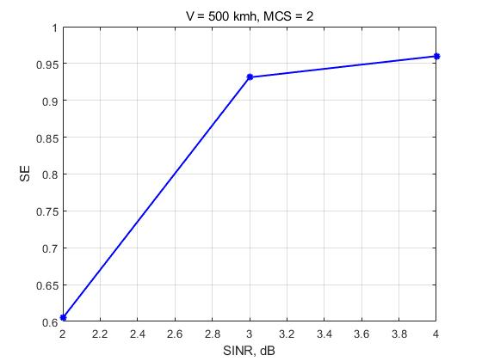
Simulation Results – 500 km/h
MCS2: QPSK, ¾ code rate
Median SINR: 2.9dB@500km/h
Spectral Efficiency at 2.9dB is 0.9 bit/s/Hz > 0.45 bit/s/Hz

Slide 13
Mobility Interruption Time Analysis
The message ‘handover Request’ is send from Source BS to target BS, which carry the information with the resources of the UE
After the source BS received feedback message ‘Handover Response’ from Target BS, the both BS will connect with UE at the same time.
Finally, the Target BS establish connection with UE , and inform the source BS to release UE
the UE can always exchange user plane packets with BS during the mobility transitions with 0ms mobility interruption time

Slide 14
Control plane latency
Step | Description | CP latency (ms)
1 | Delay due to RaPn scheduling period | 0
2 | Transmission of RaPn | 0.5
3 | Processing delay in BS including Rapn detection and Caculation Timing Advance | 2
4 | Assign UL Source for Ra Request | 0.5
5 | UE Processing Delay of Constructing RaReq message,including UEid and bytes will be send | 1
6 | Transmission of Ra Request | 0.5
7 | Processing delay in BS including analysis of Ra Request and Constructing Ra Response | 2
8 | Transmission of Ra Response | 0.5
9 | Processing delay in UE of Ra Response | 1
 | Total delay | 8 ( ITU: 20ms)
Note: This is an example with 2ms frame length. If 1ms frame length is configured ,the CP latency will decrease.

Slide 15
Conclusion
The preliminary evaluation results show that EUHT can meet the following requirements of IMT-2020
  Mobility in rural eMBB scenario
  Mobility Interruption Time
  Control Plane Latency

Slide 16
Next Step
Develop the system level simulation platform and perform average spectral efficiency evaluation in rural eMBB scenario.
Finish the submission documents
  sRIT description : 70% done
  Self Evaluation Report: 40% done
Notes:
如果是sRIT，还需要有额外的系统级描述

Slide 17
Reference
[1] IEEE 802.11-19/0625r0, Proposal to Cooperate to Submit 5G Standards
[2] IEEE 802.11-19/0626r0, EUHT Technical Brief
[3] Report ITU-R M.2412-0 (10/2017), Guidelines for evaluation of radio interface technologies for IMT-2020
[4] Report ITU-R M.2410-0 (11/2017), Minimum requirements related to technical performance for IMT-2020 radio interface(s)
[5] Report ITU-R M.2411-0 (11/2017) , Requirements, evaluation criteria and submission templates for the development of IMT-2020
[6] Document 5D/1050-E, Preliminary Description Template and Self-Evaluation of 3GPP 5G candidate for inclusion in IMT-2020

