Slide 1
Preliminary Results of EUHT Evaluation on Urban Macro URLLC and mMTC
Date: 2019-04-29
Authors:

Slide 2
Abstract
This presentation is a follow up work of the proposal about joint submission to ITU as IMT-2020 standard [1].
In this contribution, we present the preliminary results of EUHT [2] simulations on both urban macro URLLC and mMTC scenario.
The simulations adhere to the methodology specified by ITU-R for self-evaluating a RAT for IMT-2020 [3].
The preliminary results show that EUHT can meet the ITU requirements on both urban macro URLLC and mMTC scenario[4].
Notes:
Here is the abstract.

Slide 3
Abbreviation
RIT ( Radio Interface Technology)
URLLC（Ultra-Reliable and Low Latency Communications）
eMBB（enhanced Mobile Broadband）
mMTC (massive Machine Type Communication)
3GPP R15（3GPP Release 15）
3GPP R16（3GPP Release 16）
NSA（Non-Standalone ）
EUHT（Enhanced Ultra High Throughput）

Slide 4
Outline
Objective
Simulation Calibration
URLLC Simulation
mMTC Simulation
Results
Conclusion
Next Step
References

Slide 5
Objective
In the previous meeting, it was proposed that 11ax and EUHT are combined together to be submitted to ITU as SRIT (set of RIT) [1].
In [1], EUHT is proposed to meet the requirements of the following scenarios
  Rural eMBB, Urban Marco URLLC and Urban Macro mMTC
The self-evaluation results must be submitted together with the technical documents before July 1st according to ITU[5].
As the first step, the self-evaluation results of EUHT on urban URLLC and mMTC scenario are shown in this contribution.

Slide 6
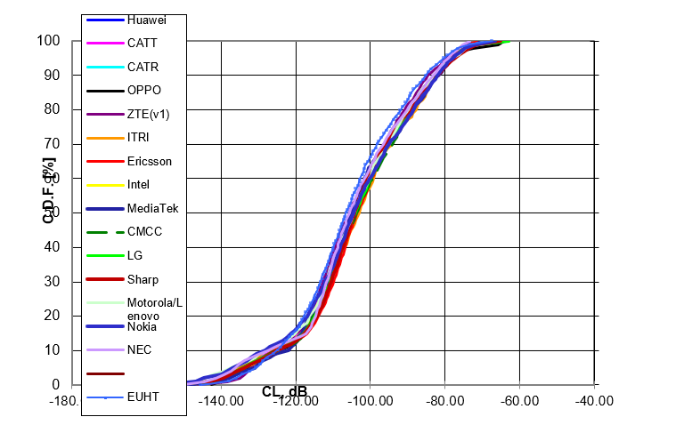
System Level Simulation Calibration – Urban Macro URLLC Coupling Loss
Compare with RT-180010 Summary of email discussion [ITU-R AH 01] Calibration for self-evaluation

Slide 7
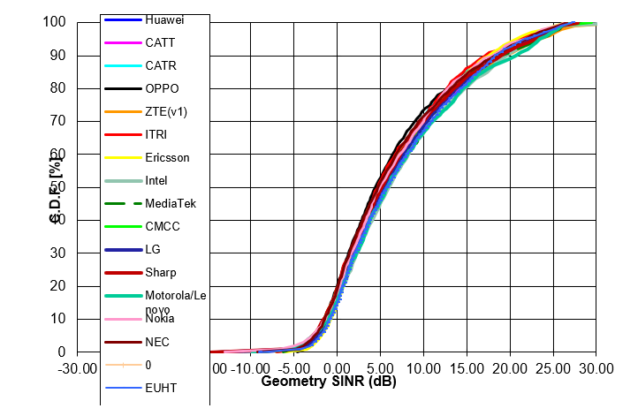
System Level Simulation Calibration
Urban Macro URLLC Geometry SINR
Compare with RT-180010 Summary of email discussion [ITU-R AH 01] Calibration for self-evaluation

Slide 8
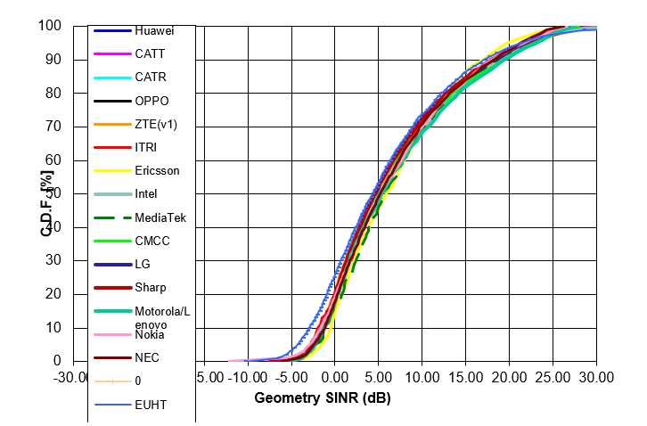
System Level Simulation Calibration
Urban Macro mMTC Geometry SINR
Compare with RT-180010 Summary of email discussion [ITU-R AH 01] Calibration for self-evaluation
Notes:
It is DL

Slide 9
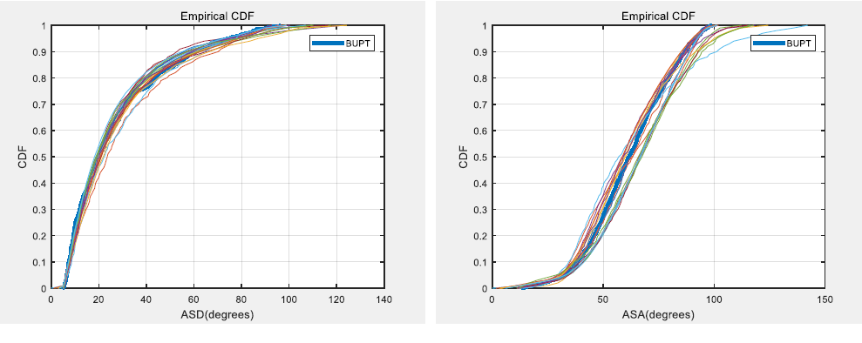
Link Level Simulation Calibration
ASD and ASA
Compare with 3GPP TR38.901

Slide 10
Link Level Simulation Calibration
ZSD and ZSA
Compare with 3GPP TR38.901

Slide 11
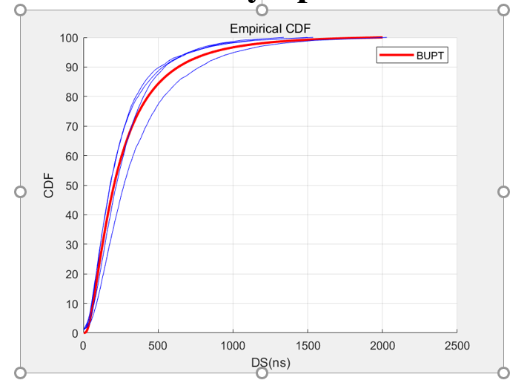
Link Level Simulation Calibration
Delay Spread
Compare with 3GPP TR38.901

Slide 12
Urban Macro URLLC

Slide 13
Simulation Configuration
Simulation bandwidth : 20 MHz
Carrier Frequency: 4GHz
BS Tx power : 49 dBm, UE Tx power: 23 dBm
BS Antenna gain: 8 dBi, UE antenna gain: 0 dBi
BS noise figure: 5 dB, UE noise figure : 7 dB
BS antenna configuration : Omni uniform linear array 8Tx/8Rx with 8 dBi gain in intended direction.
UE antenna configuration : Omni uniform linear array 8Tx/8Rx with with 0 dBi gain.
The complete configuration is specified in the ITU-R guidelines for self-evaluating a RAT ([3]).

Slide 14
Simulation Assumptions
Low overhead Control channel + Traffic channel
Control channel payload: 32 bit
TCH Payload : 32 Byte
QPSK, LDPC, 4/7 code rate, codeword size: 448
single spatial stream
Modulation symbol repetition in frequency domain
Realistic Channel Estimation
Maximum Ratio Combining
Min-sum LDPC decoding

Slide 15
Simulation Procedure (1)
The urban macro URLLC simulation procedure is quoted as follows [3]
The evaluator shall perform the following steps in order to evaluate the reliability requirement using system-level simulation followed by link-level simulations.
Step 1: Run downlink or uplink full buffer system-level simulations of candidate RITs/SRITs using the evaluation parameters of Urban Macro-URLLC test environment see § 8.4.1 below, and collect overall statistics for downlink or uplink SINR values, and construct CDF over these values.
Step 2: Use the CDF for the Urban Macro-URLLC test environment to save the respective 5th percentile downlink or uplink SINR value.
Notes:
For urban macro URLLC, the simulation procedure of ITU is quoted as follows,

Slide 16
Simulation Procedure (2)
Step 3: Run corresponding link-level simulations for either NLOS or LOS channel conditions using the associated parameters in the Table 8-3 of this Report, to obtain success probability, which equals to (1-P_{e}), where P_{e} is the residual packet error ratio within maximum delay time as a function of SINR taking into account retransmission.
Step 4: The proposal fulfils the reliability requirement if at the 5th percentile downlink or uplink SINR value of Step 2 and within the required delay, the success probability derived in Step 3 is larger than or equal to the required success probability. It is sufficient to fulfil the requirement in either downlink or uplink, using either NLOS or LOS channel conditions.

Slide 17
Simulation Results
PER
SINR (dB)
Max Latency < 0.40ms
PER < 10e-5 @ -6.5 SNR

Slide 18
Urban Macro mMTC

Slide 19
Simulation Configuration
Simulation bandwidth : 500 KHz
Carrier Frequency: 700MHz
Inter BS Distance: 500m
UE Tx power class: 23 dBm
Traffic Model: 1 message/2 hours/device
BS noise figure: 5 dB, UE noise figure : 7 dB
BS antenna configuration : Omni uniform linear array 2Rx with 8 dBi gain in intended direction.
UE antenna configuration : Omni uniform linear array 1Tx with with 0 dBi gain.
The complete configuration is specified in the ITU-R guidelines for self-evaluating a RAT ([3]).

Slide 20
Simulation Assumptions
Low overhead Control channel + Traffic channel
Control channel payload: 32 bit
TCH Payload : 32 Byte
QPSK/16QAM, with repetition in frequency domain
LDPC, code rate: 1/2, 4/7, 5/8, 3/4, 7/8
Realistic Channel Estimation
Maximum Ratio Combining
Min-sum LDPC decoding

Slide 21
Simulation Procedure (1)
The “full-buffer system-level simulation followed by link-level simulation” procedure in [3] is adopted, quoted as follows
Step 1: Perform full-buffer system-level simulation using the evaluation parameters for Urban Macro-mMTC test environment, determine the uplink SINR_{i} for each percentile i=1…99 of the distribution over users, and record the average allocated user bandwidth W_{user}.
– In case UE multiplexing on the same time/frequency resource is modelled in this step, record the average number of multiplexed users N_{mux}. N_{mux} = 1 for no UE multiplexing.
Step 2: Perform link-level simulation and determine the achievable user data rate R_{i} for the recoded SINR_{i} and W_{user} values.
– In case UE multiplexing on the same time/frequency resource is modelled in this step, record the average number of multiplexed users n_{mux,i} under SINR_{i} . The achievable data rate for this case is derived by R_{i} = Z_{i}/n_{mux,i}, where aggregated bit rate Z_{i} is the summed bit rate of n_{mux,i} users on W_{user}. n_{mux,i} = 1 for no UE multiplexing.
Notes:
For urban macro URLLC, the simulation procedure of ITU is quoted as follows,

Slide 22
Simulation Procedure (2)
Step 3: Calculate the packet transmission delay of a user as D_{i} = S/R_{i}, where S is the packet size.
Step 4: Calculate the traffic generated per user as T = S/T_{inter-arrival}, where T_{inter-arrival} is the inter‑packet arrival time.
Step 5: Calculate the long-term frequency resource requested under SINR_{i} as B_{i} = T/(R_{i}/W_{user}).
Step 6: Calculate the number of supported connections per TRxP, N = W / mean(B_{i}). W is the simulation bandwidth. The mean of B_{i} may be taken over the best 99% of the SINR_{i} conditions.
Step 7: Calculate the connection density as C = N / A, where the TRxP area A is calculated as A = ISD² × sqrt(3)/6, and ISD is the inter-site distance.

Slide 23
Requirements
The requirement is fulfilled if
the 99th percentile of the delay per user D_{i} is less than or equal to 10s, and
the connection density is greater than or equal to the connection density requirement defined in Report ITU-R M.2410-0, which is 1000 000 devices per km2.

Slide 24
Simulation Results
SE，bit/s/Hz
SINR to Spectral Efficiency
User Density: 1.2676e+08 users/km^2
Notes:
Huawei: 36million; max delay: 3.5ms

Slide 25
Conclusion
The preliminary evaluation results show that EUHT can meet the requirements of URLLC and mMTC of IMT-2020.

Slide 26
Next Step
In the next weeks, we will develop the system level simulation platform and perform more evaluation on URLLC -> mMTC ->rural eMBB.

Slide 27
Reference
[1] IEEE 802.11-19/0625r0, Proposal to Cooperate to Submit 5G Standards
[2] IEEE 802.11-19/0626r0, EUHT Technical Brief
[3] Report ITU-R M.2412-0 (10/2017), Guidelines for evaluation of radio interface technologies for IMT-2020
[4] Report ITU-R M.2410-0 (11/2017), Minimum requirements related to technical performance for IMT-2020 radio interface(s)
[5] Report ITU-R M.2411-0 (11/2017) , Requirements, evaluation criteria and submission templates for the development of IMT-2020
[6] Document 5D/1050-E, Preliminary Description Template and Self-Evaluation of 3GPP 5G candidate for inclusion in IMT-2020

