Slide 1
Investigating the Compliance of Wireless Units with regulatory and normative requirements
Date: 2019-05-14
Authors:
Name | Affiliation | address | Phone | email
Dr. Ammar Alhosainy | Carleton University | Department of Systems and Computer Engineering, Carleton University, Ottawa, Ontario, K1S 5B6, Canada | +1(613)400-8824 | amammar@sce.carleton.ca
Kareem Attiah |  |  |  | kareemattiah@sce.carleton.ca
Shady Alkamhawy |  |  |  | shadyelkamhawy@cmail.carleton.ca
Dr. Ahmad Altalabi |  |  |  | ahmadaltalabi@cmail.carleton.ca
Dr. Mohamed Aslan |  |  |  | maslan@sce.carleton.ca
Trevor Gamblin |  |  |  | tvgamblin@gmail.com
Prof. Ramy Gohary |  |  |  | gohary@sce.carleton.ca
Prof. Ioannis Lambadaris |  |  |  | ioannis@sce.carleton.ca

Slide 2
Goal
Investigate the compliance of the IEEE 802.11 units according to
ETSI EN 301 893 v2.1.1 and proposing a novel Compliance Metric
Agenda
  Hardware Setup
  IEEE 802.11 medium access standard
  ETSI EN 301 893 based Compliance Check
  Proposed Compliance Metric (MC)
  Hardware and Software evolution
  Available resources and Test requirements
  Demo

Slide 3
Guidance
Throughout the experiment steps, procedures, and comparisons we follow:
  European Telecommunications Standards document [1]
  The IEEE standards 802.11-2016 [2] and 802.11-2012 [3]

Slide 4
Hardware Setup
PC/Laptop
Client
Server
UUT
SU/CD
RF Splitter/ Combiner
RF Splitter/ Combiner
USRP
Universal Software Radio Peripheral (USRP)
Unit Under Test (UUT)
Signaling Unit/Companion Device (SU/CD)

Slide 5
Hardware Setup
USRP (NI-B200):
  Sampling Rate: 20 × 10⁶ samples/s (Reading error < 50 ns)
IEEE 802.11 Channel 36 (20 MHz)
  Center frequency is 5.18 GHz
Testing Traffic
  iperf, 100 Mb/s (Full buffer condition)
  UDP (Unidirectional traffic)
  iperf -c [IP] -u -b100M -S 0x00
  (Type Of Service TOS, or DSCP)
PC/Laptop
Client
Server
UUT
SU/CD
RF Splitter/ Combiner
RF Splitter/ Combiner
USRP
Universal Software Radio Peripheral (USRP)
Unit Under Test (UUT)
Signaling Unit/Companion Device (SU/CD)

Slide 6
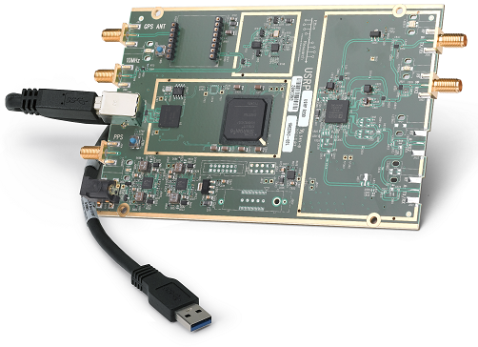
USRP
Coverage frequency of 70 MHz to 6 GHz
56 MHz bandwidth
Up to 61.44 MSample/s quadrature (IQ components)
USB 3.0 connection
USRP B200 SDR Kit

Slide 7
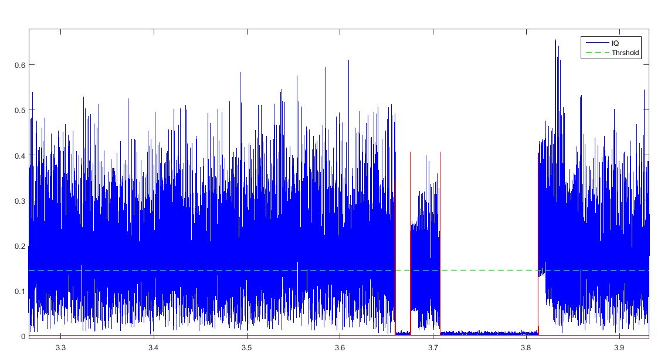
USRP output
Data
ACK/BA
IQ signal magnitude
Time (ms)

Slide 8
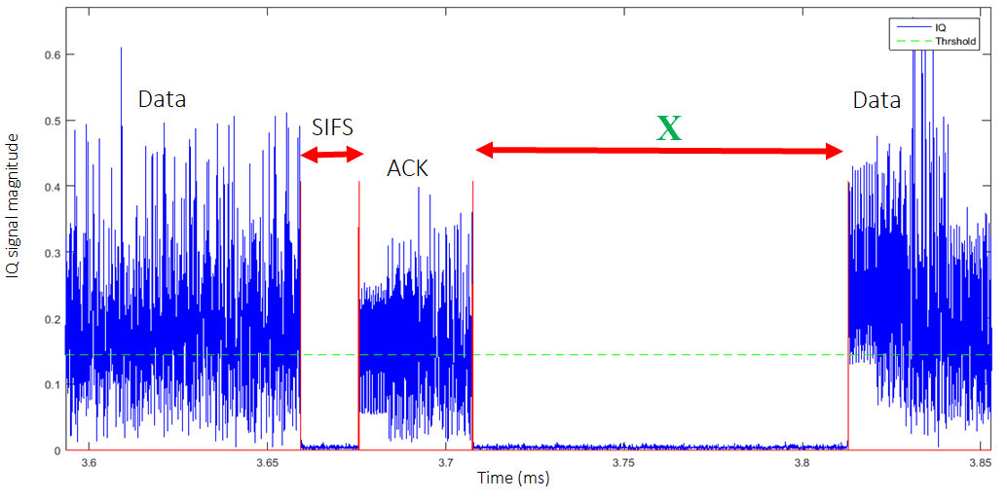
Interframe spaces

Slide 9
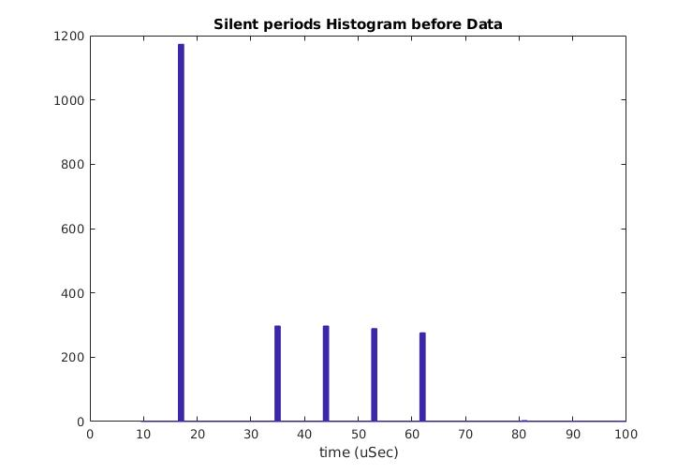
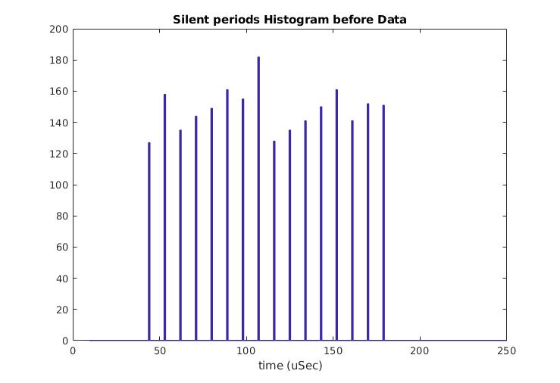
The X duration histogram
16
4
9 𝜇𝑠
9𝜇𝑠
16 𝜇𝑠
43 𝜇𝑠
34 𝜇𝑠

Slide 10
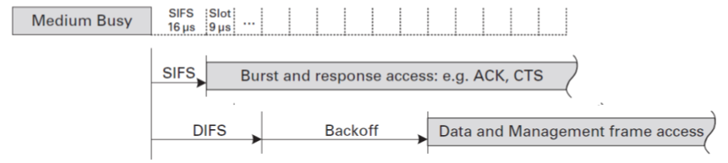

IEEE 802.11 Interframe Spaces
Short Interframe Space (SIFS)
  Associated with ACK, BA, and CTS
  For legacy, HT, and VHT IEEE 802.11
    SIFS = 16 μs
DCF Interframe Space
(DIFS)
  Associated with Data and RTS
  DIFS = SIFS + 2 × slotTime
  For Legacy, HT, and VHT IEEE 802.11
    slotTime = 9 μs, DIFS = 34 μs
Source: Next Generation Wireless LANs, 802.11n and 802.11ac, Cambridge University Press 2008, 2013

Slide 11

Distributed Coordination Function (DCF)
Data Transmission Mechanism (CSMA/CA)
  Sense the medium for a DIFS duration
  Backoff for (n × slotTime), n is a uniform RV ~ [0, CW], initial CW = 15
$$n × slotTime$$
Source: Next Generation Wireless LANs, 802.11n and 802.11ac, Cambridge University Press 2008, 2013

Slide 12
Enhanced Distributed Channel Access (EDCA)
Extension of DCF, introduced in 802.11e
Support prioritized QoS
  Transmission Opportunity (TXOP)
  Arbitration Interframe Space (AIFS)

Slide 13
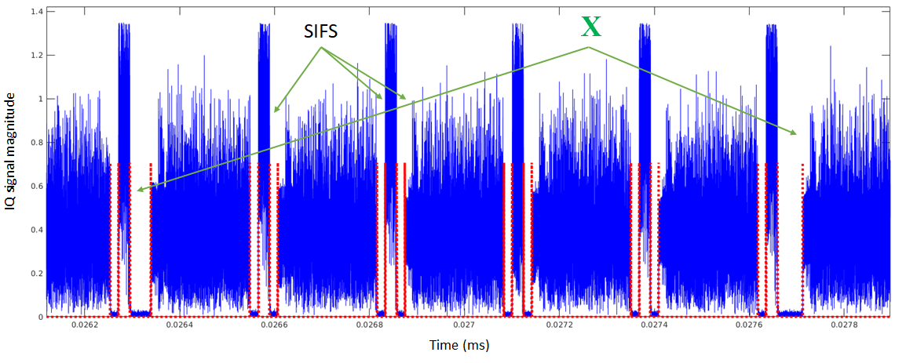

Enhanced Distributed Channel Access (EDCA)
Access Category (AC) | CWmin | CWmax | AIFSN | TXOP/2012 | TXOP/2016
Background (AC_BK) | 15 | 1023 | 7 | 0 | 2.528 ms
Best Effort (AC_BE) | 15 | 1023 | 3 | 0 | 2.528 ms
Video (AC_VI) | 7 | 15 | 2 | 3.008 ms | 4.096 ms
Voice (AC_VO) | 3 | 7 | 2 | 1.504 ms | 2.080 ms
Legacy DCF | 15 | 1023 | 2 | 0 | 0
Transmission Opportunity (TXOP)
Table 9-137 in [2] and Table 8-105 in [3]
n = 0 to 3
TXOP
SIFS = 16 𝜇𝑠
Source: Next Generation Wireless LANs, 802.11n and 802.11ac, Cambridge University Press 2008, 2013

Slide 14
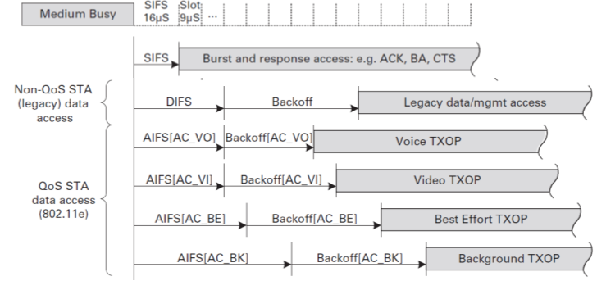
Enhanced Distributed Channel Access (EDCA)
Access Category (AC) | CWmin | CWmax | AIFSN | TXOP/2012 | TXOP/2016
Background (AC_BK) | 15 | 1023 | 7 | 0 | 2.528 ms
Best Effort (AC_BE) | 15 | 1023 | 3 | 0 | 2.528 ms
Video (AC_VI) | 7 | 15 | 2 | 3.008 ms | 4.096 ms
Voice (AC_VO) | 3 | 7 | 2 | 1.504 ms | 2.080 ms
Legacy DCF | 15 | 1023 | 2 | 0 | 0
  Arbitration Interframe Space (AIFS)
  AIFS = SIFS + AIFSN × slotTime
Table 9-137 in [2] and Table 8-105 in [3]
AIFS[AC_VO] = 34 µs
AIFS[AC_VI] = 34 µs
AIFS[AC_BE] = 43 µs
AIFS[AC_BK] = 79 µs
Source: Next Generation Wireless LANs, 802.11n and 802.11ac, Cambridge University Press 2008, 2013

Slide 15
Reading the X histogram (Voice and Best Effort traffic)
Access Category (AC) | CWmin | CWmax | AIFSN | TXOP/2012 | TXOP/2016
Background (AC_BK) | 15 | 1023 | 7 | 0 | 2.528 ms
Best Effort (AC_BE) | 15 | 1023 | 3 | 0 | 2.528 ms
Video (AC_VI) | 7 | 15 | 2 | 3.008 ms | 4.096 ms
Voice (AC_VO) | 3 | 7 | 2 | 1.504 ms | 2.080 ms
Legacy DCF | 15 | 1023 | 2 | 0 | 0
Voice
Best Effort
n ∊ [0 … 15]
TXOP > 0
n ∊ [0 … 3]
9𝜇𝑠
9𝜇𝑠
16 𝜇𝑠
AIFS[BE] = 43 𝜇𝑠
34 𝜇𝑠

Slide 16
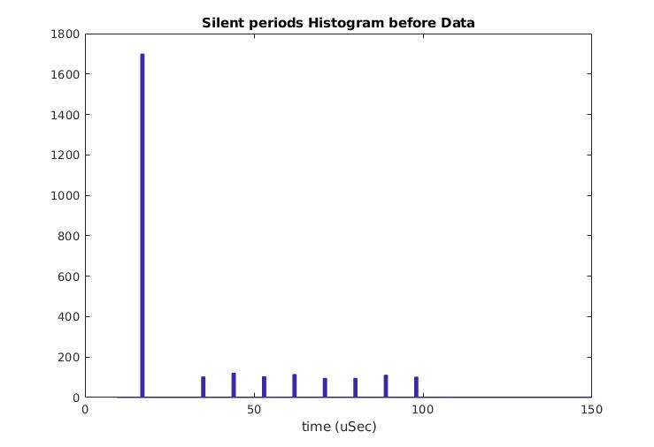
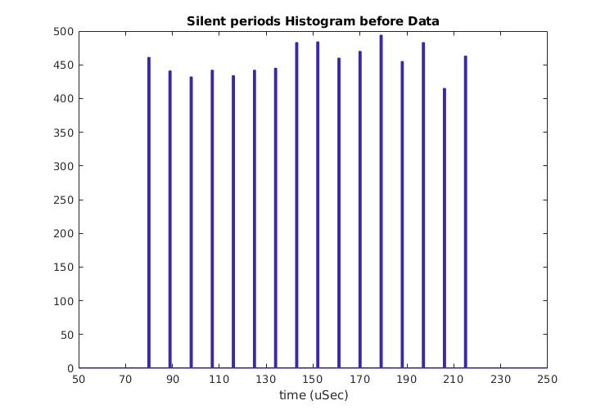
Reading the X histogram
(Video & Background traffic)
Access Category (AC) | CWmin | CWmax | AIFSN | TXOP/2012 | TXOP/2016
Background (AC_BK) | 15 | 1023 | 7 | 0 | 2.528 ms
Best Effort (AC_BE) | 15 | 1023 | 3 | 0 | 2.528 ms
Video (AC_VI) | 7 | 15 | 2 | 3.008 ms | 4.096 ms
Voice (AC_VO) | 3 | 7 | 2 | 1.504 ms | 2.080 ms
Legacy DCF | 15 | 1023 | 2 | 0 | 0
n ∊ [0 … 15]
Video
Background
TXOP > 0
n ∊ [0 … 7]
9 𝜇𝑠
AIFS[BK] = 79 𝜇𝑠

Slide 17
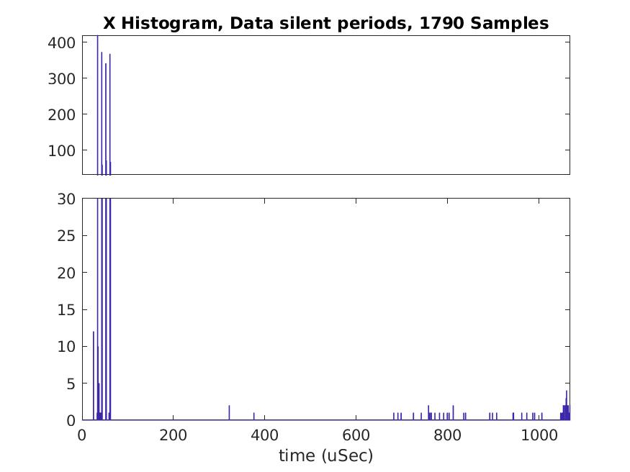
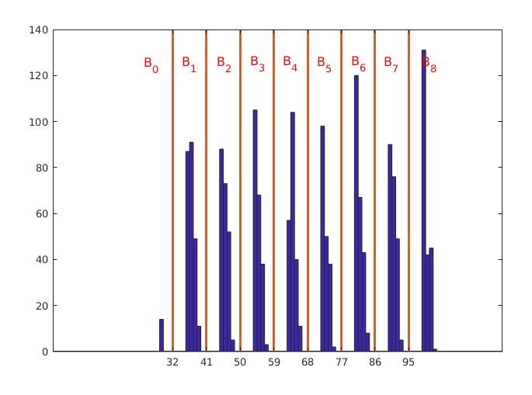
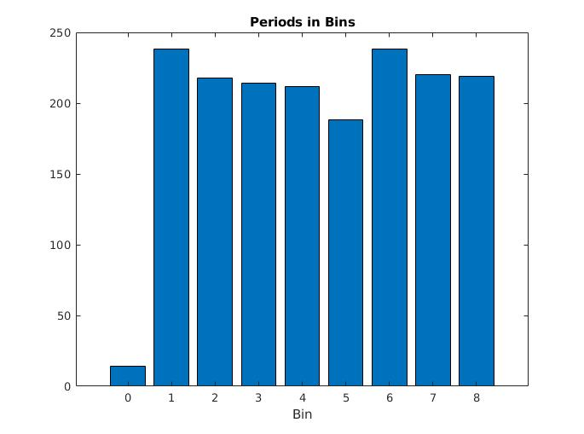
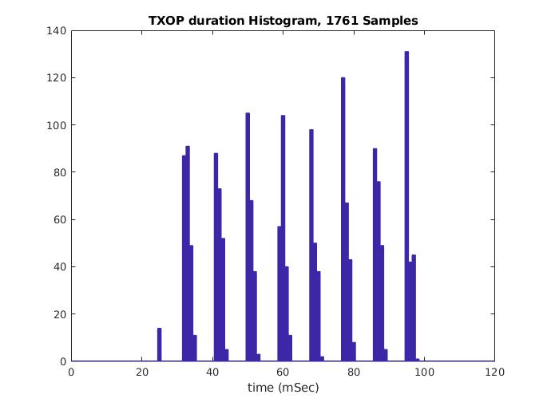
Analyzing compliance with Harmonized Standard (HS)
ETSI EN 301 893
According to ETSI EN 301 893 [1]:
  Classify the silent periods and sort them into a set of bins
    Example: Access category (Video)

Slide 18
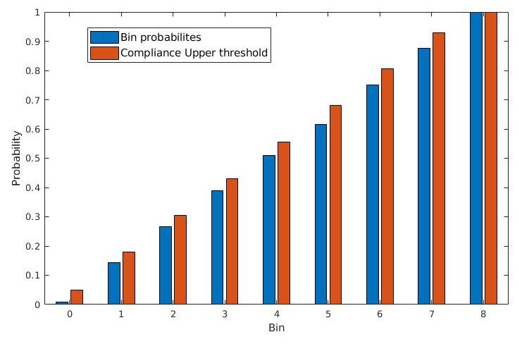
Standard Compliance Check 1, steps
According to ETSI EN 301 893 [1]:
  Convert periods count in each bin into a probability
  Accumulate bin probabilities, compare with the upper threshold
Compliant
so far

Slide 19
Standard Compliance Check 2, steps
According to ETSI EN 301 893 [1]:
  4. Measure the Channel Occupancy Time (COT) = TXOP:
Access Category (AC) | Max COT
Class 1, Background (AC_BK) | 6.00 ms
Class 2, Best Effort (AC_BE) | 6.00 ms
Class 3, Video (AC_VI) | 4.00 ms
Class 4, Voice (AC_VO) | 2.00 ms
Source: Next Generation Wireless LANs, 802.11n and 802.11ac, Cambridge University Press 2008, 2013

Slide 20
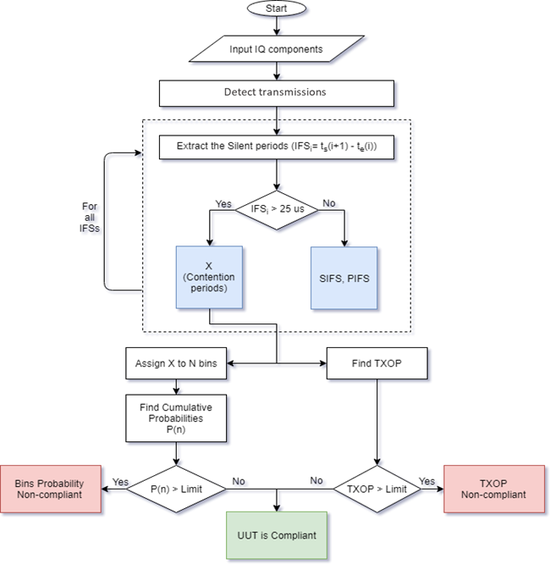
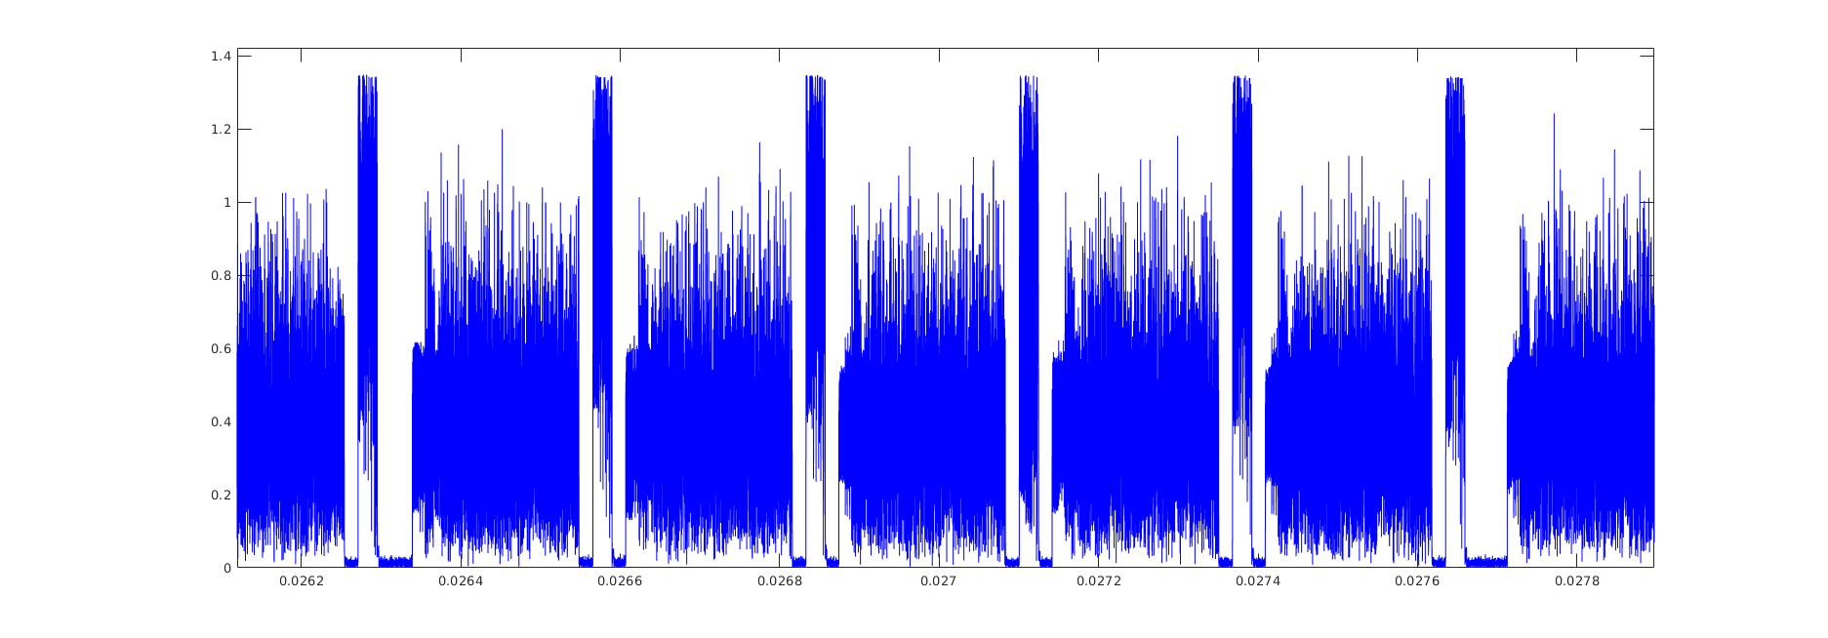
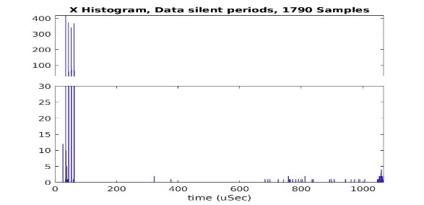

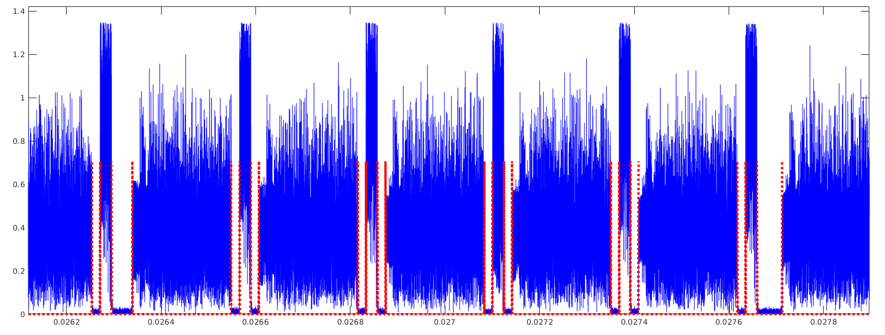

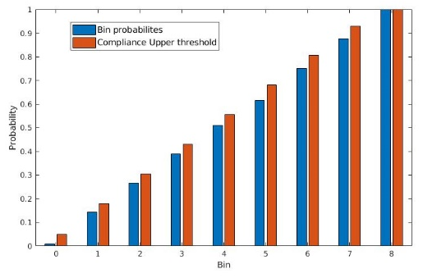

Slide 21
Example product 1: Ericsson AP6321
UUT: Ericsson AP (AP6321), IEEE 802.11n, 5 GHz
Configurations:
All default configurations except:
Channel number 153
Channel bandwidth 20 MHz

Slide 22
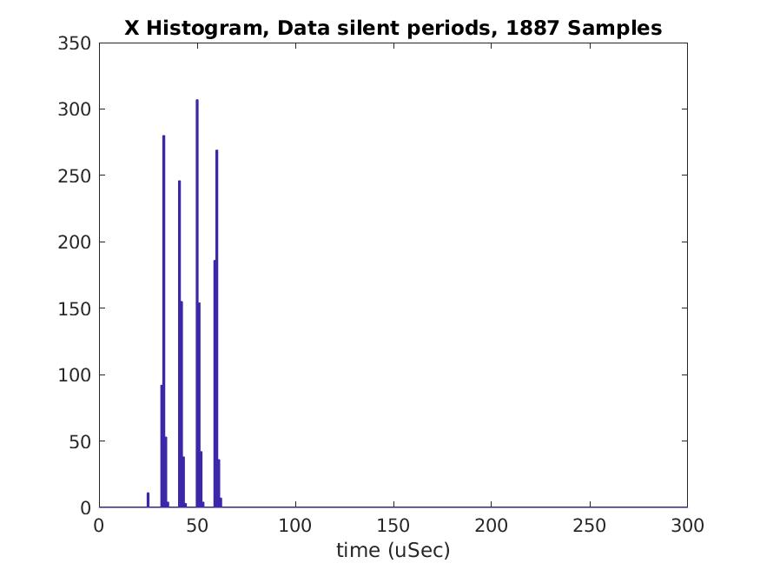
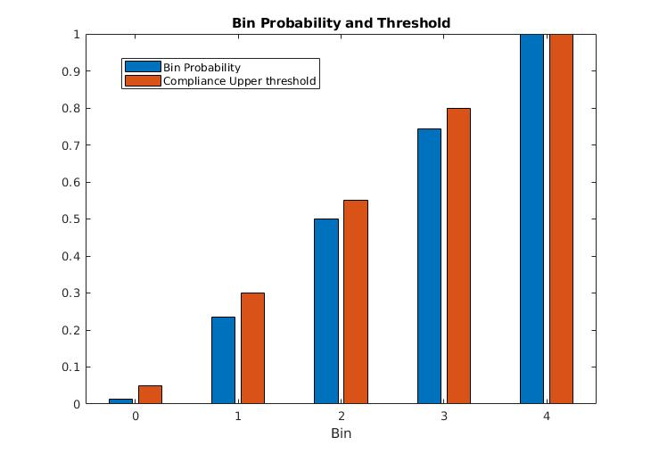
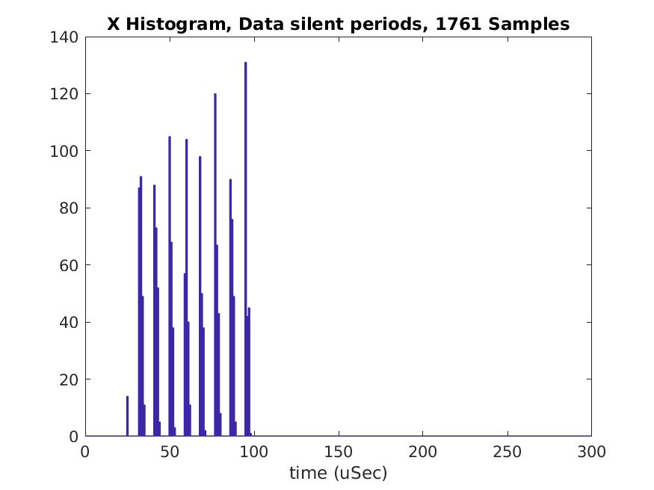
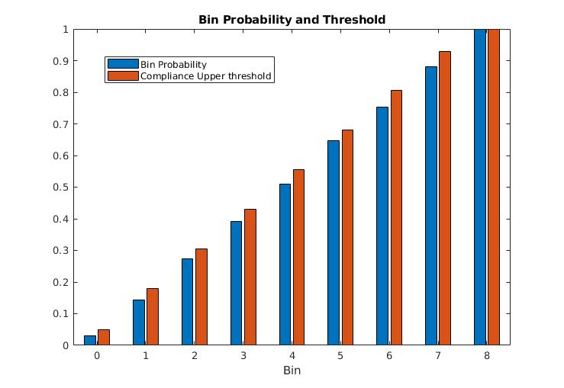
Example product 1: Ericsson AP6321
Priority Class:
Voice
COT (TXOP) Result (Limit) =
1.638 ms (2.0 ms)
Priority Class:
Video
COT (TXOP) Result (Limit) =
3.035 ms (4.0 ms)

Slide 23
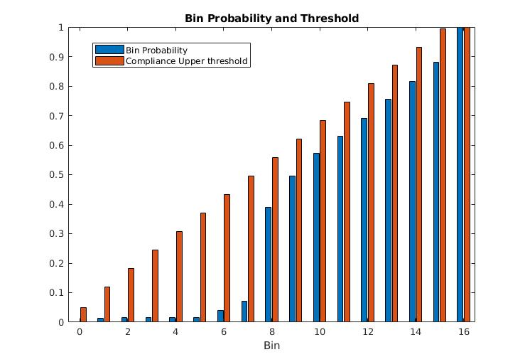
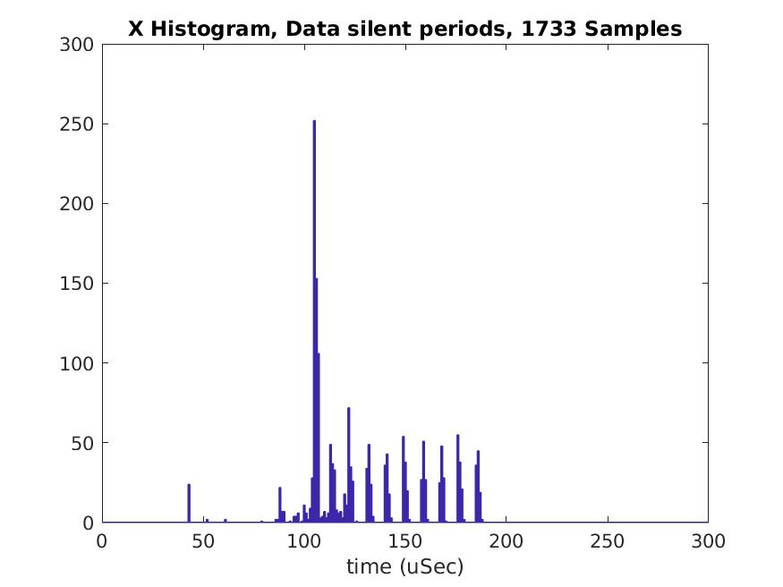
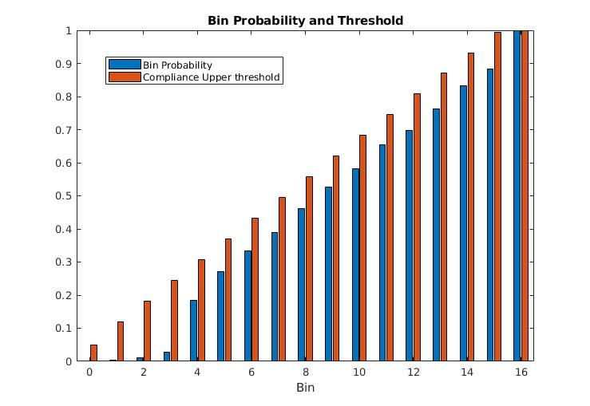
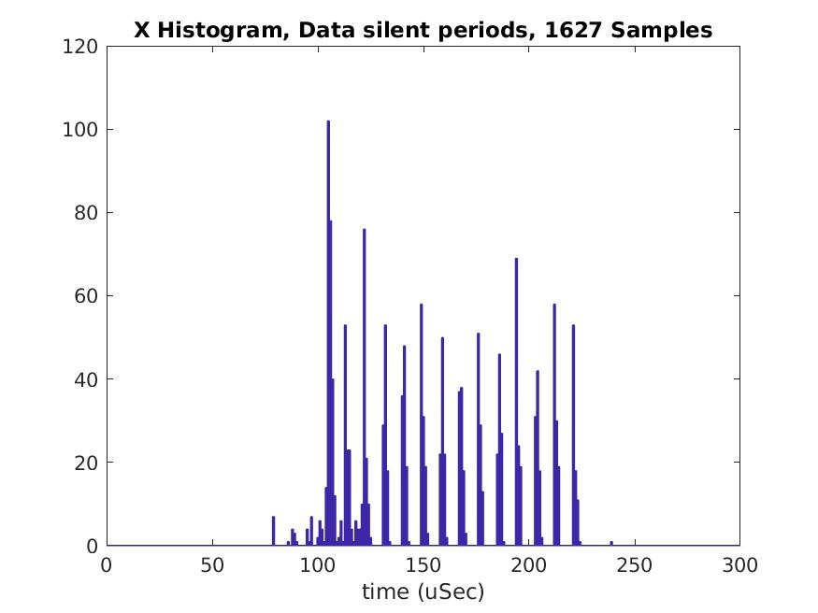
Example product 1: Ericsson AP6321
Priority Class:
Best Effort
COT (TXOP) Result (Limit) =
3.875 ms (6.0 ms)
Priority Class:
Background
COT (TXOP) Result (Limit) =
3.875 ms (6.0 ms)

Slide 24
Example product 2: D-Link DIR-822
UUT: D-Link AP (DIR-822), 802.11n, 5 GHz
Configurations:
All default configurations except:
Channel number 153
Channel bandwidth 20 MHz

Slide 25
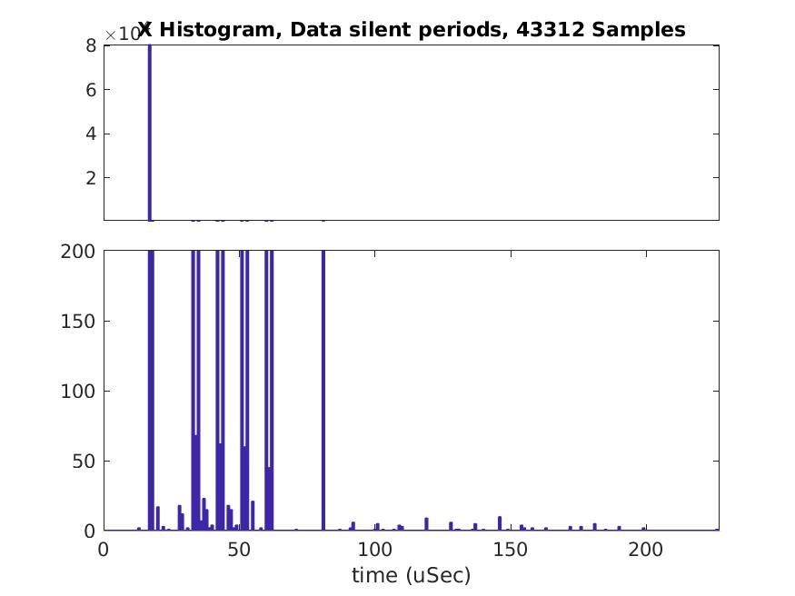
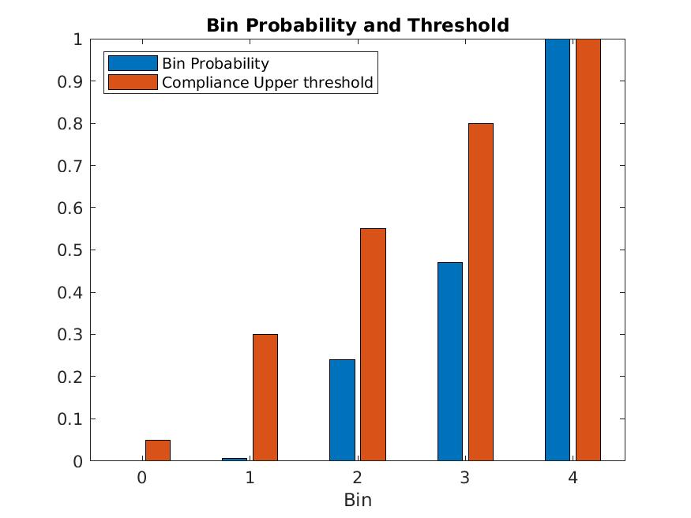
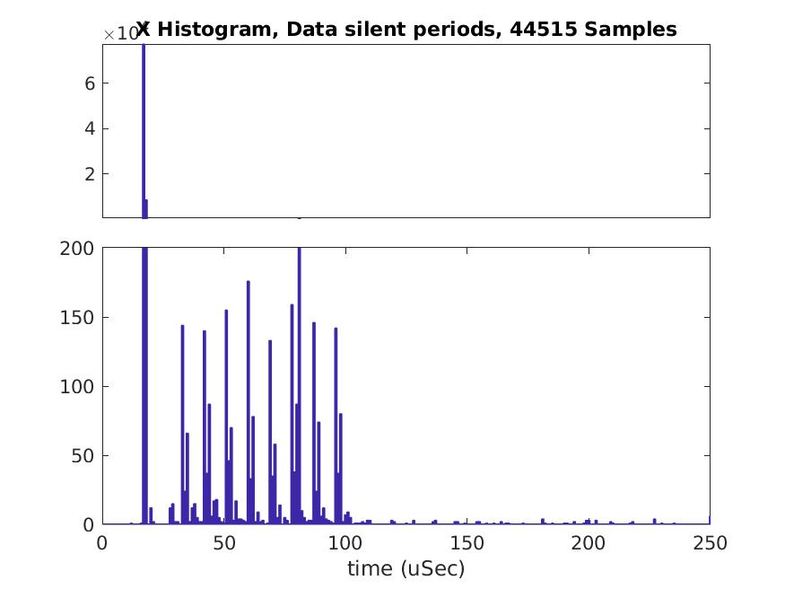
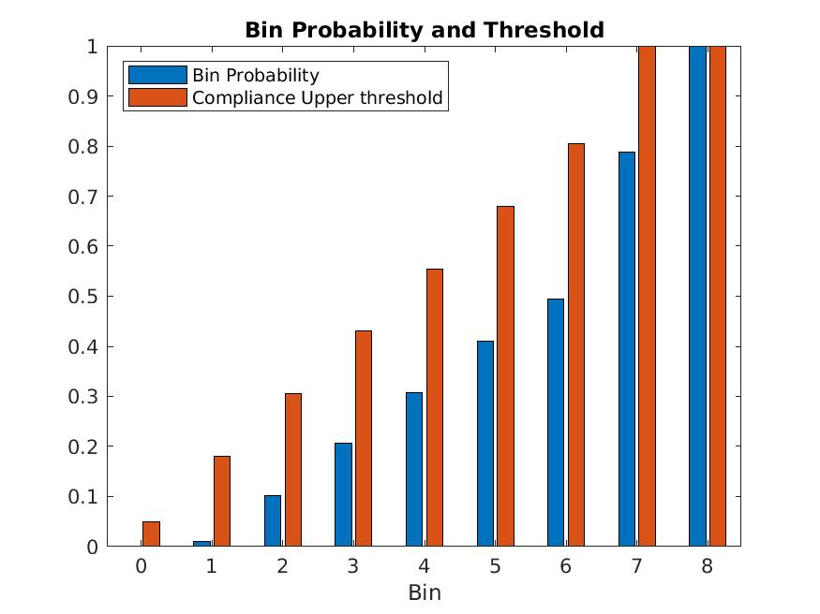
Example product 2: D-Link DIR-822
Priority Class:
Voice
COT (TXOP) Result (Limit) =
2.0751 ms (2.0 ms)
Priority Class:
Video
COT (TXOP) Result (Limit) =
5.8287 ms (4.0 ms)

Slide 26
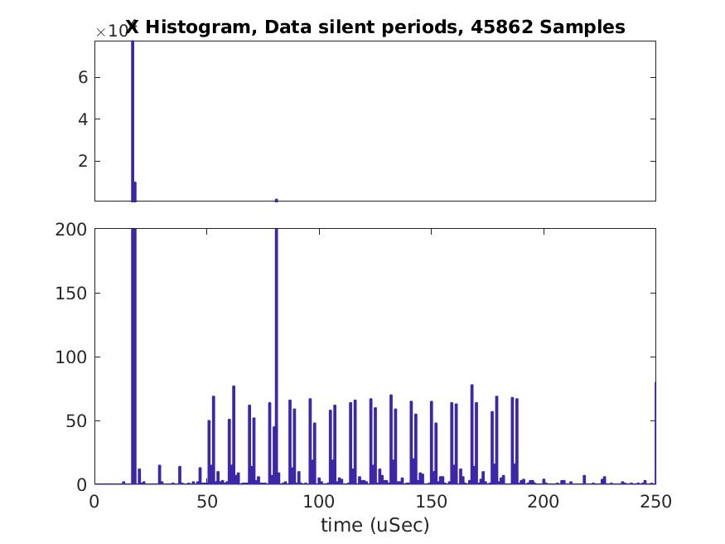
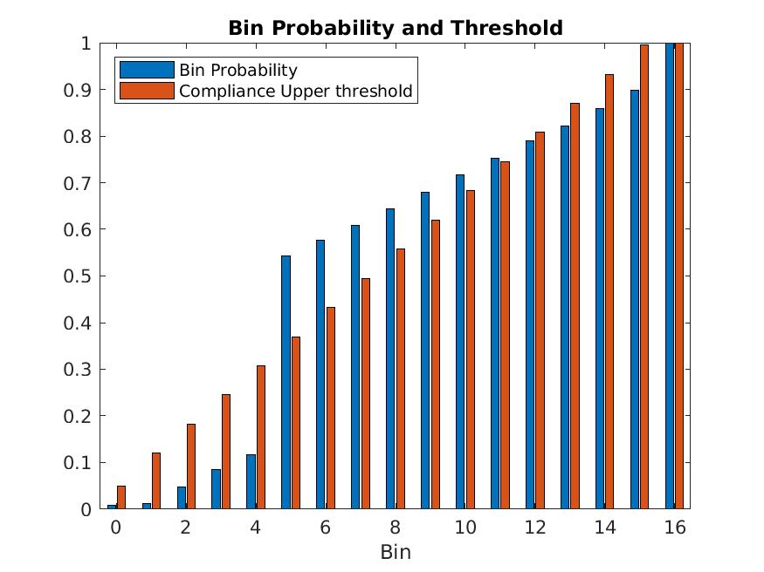
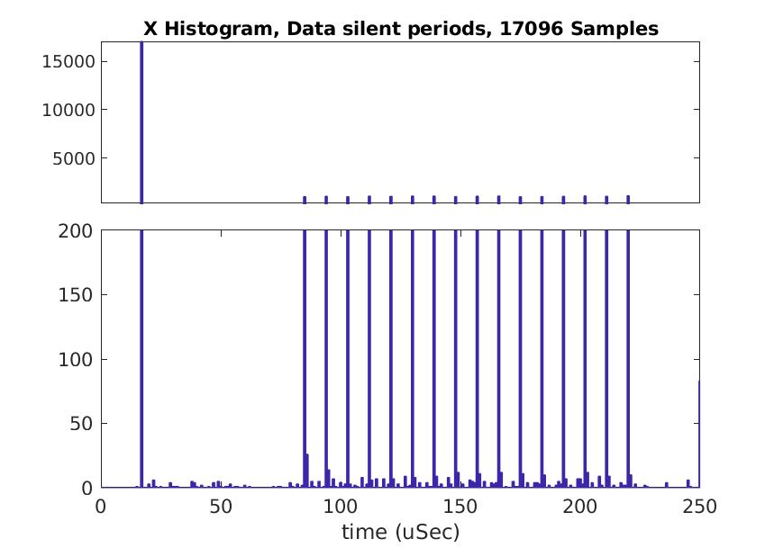
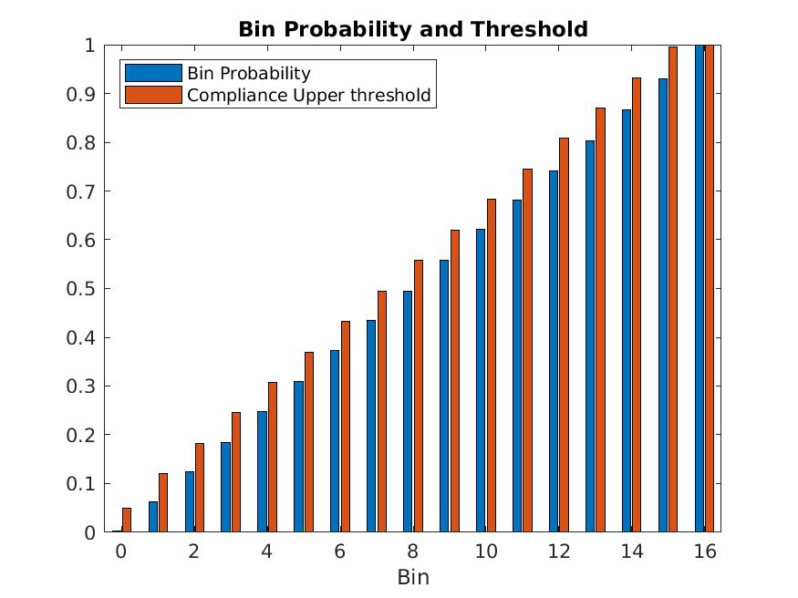
Example product 2: D-Link DIR-822
Priority Class:
Best Effort
COT (TXOP) Result (Limit) =
3.316 ms (6.0 ms)
Priority Class:
Background
COT (TXOP) Result (Limit) =
0.9421 ms (6.0 ms)

Slide 27
Maximum TXOP duration of various products compared to limits permitted in EN 301 893

Slide 28
Summary of the Results
 | Voice |  | Video |  | Best Effort |  | Background
 | COT/TXOP [ms] | Bin Prob. | COT/TXOP [ms] | Bin Prob. | COT/TXOP [ms] | Bin Prob. | COT/TXOP [ms] | Bin Prob.
EN 301 893 COT/TXOP max limit | 2.0 |  | 4.0 |  | 6.0 |  | 6.0
Ericsson AP (AP6321) | 1.4103 | passed | 3.0344 | passed | 0.3361 | passed | 3.8752 | passed
BelAir AP (20E-11R) | 3.9053 | passed | 3.9071 | passed | 3.9072 | passed | 3.9072 | passed
Asus AP (RT-AC68U) | 1.7486 | passed | 15.794 | passed | 15.079 | failed | 15.551 | failed
D-Link AP (DIR-822) | 2.0751 | passed | 5.8287 | passed | 3.316 | failed | 0.94215 | passed
TP-Link AP (Archer C50) | 23.697 | passed | 21.552 | passed | 20.23 | failed | 19.41 | failed
Asus USB client (USB-N53) | 2.9589 | passed | 4.2743 | passed | 1.6221 | passed | 0.2791 | passed
Cisco USB client (WUSB600N) | 2.8468 | passed | 4.4709 | passed | 1.6971 | passed | 0.3685 | passed
D-Link USB client (DWA-160) | 2.8933 | passed | 4.4271 | passed | 1.4715 | passed | 0.3006 | passed
EDIMAX USB client (EW-7822UAC) | 2.9308 | passed | 4.4579 | passed | 1.6079 | passed | 0.9454 | passed

Slide 29
Compliance Metric
Geometric mean of three sub-factors
Backoff Random Number Distribution Factor
Kullback-Leibler divergence (0 to 1)
TXOP Factor
Ratio of TXOP violation (0 to 1)
Aggressiveness/Submissiveness Factor
Tendency of violation (-1 to 1)
Compliance Metric is a percentage (0 % to 100 %)
100 % = fully compliant

Slide 30
Compliance Metric

Slide 31
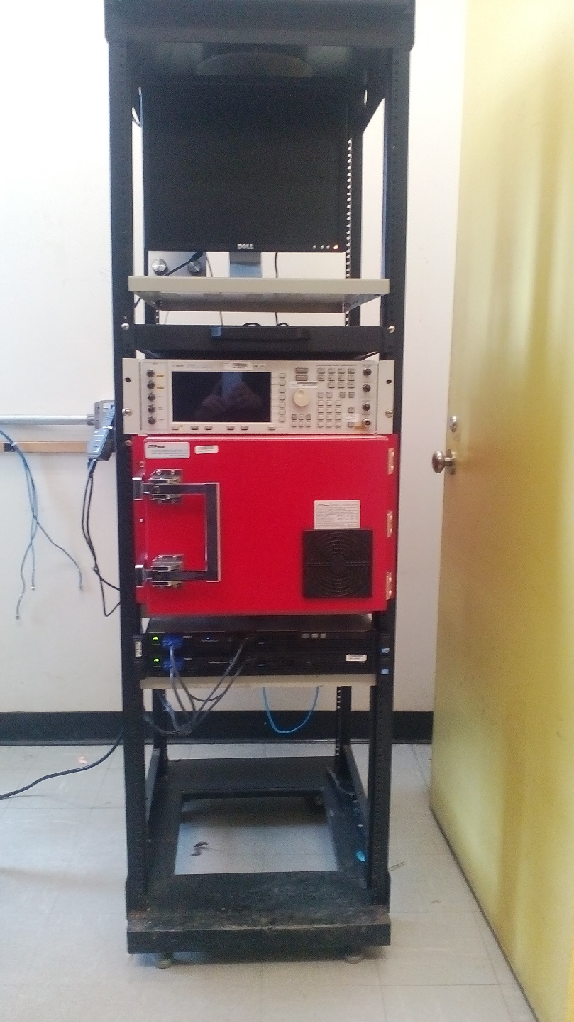
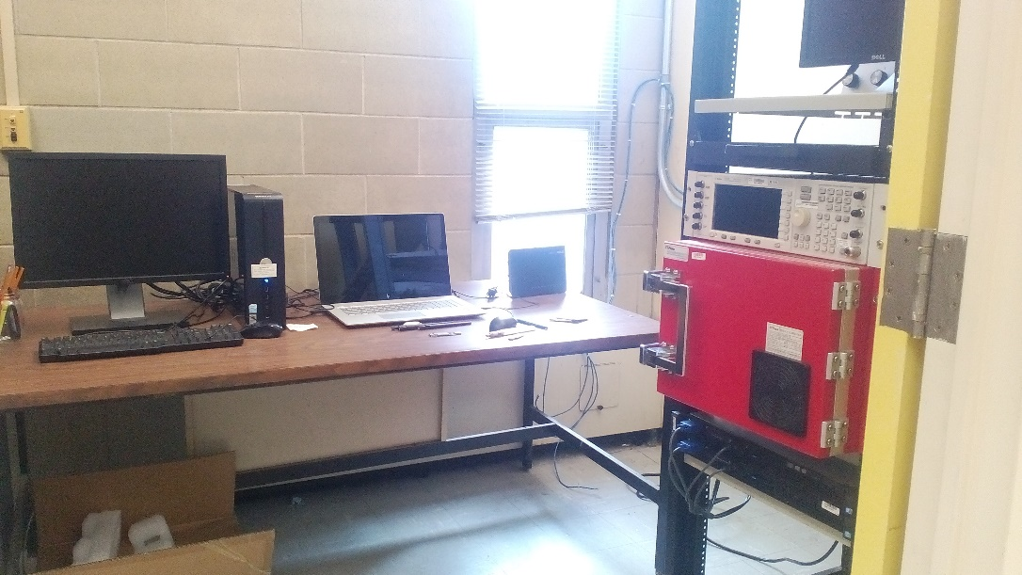
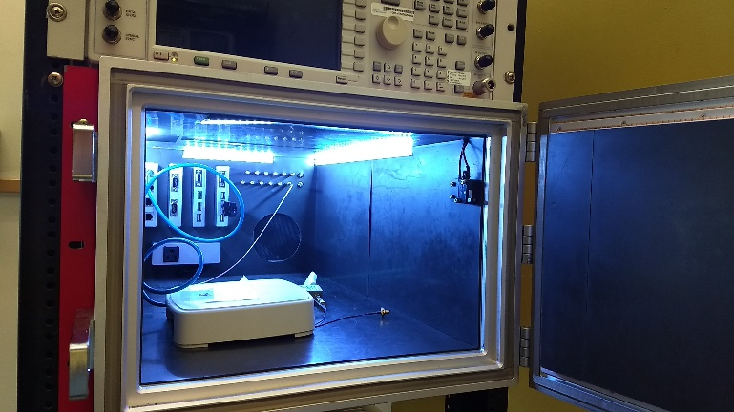
Hardware Evolution
(First version: RF shielding box)
RF shielding box
2 servers
RF Shielding Box
Server 1
Server 2
UUT
SU/CD
USRP

Slide 32
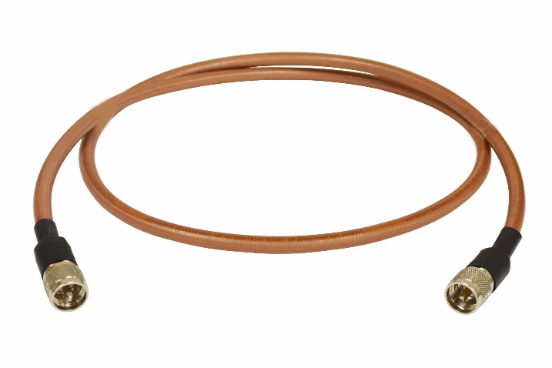
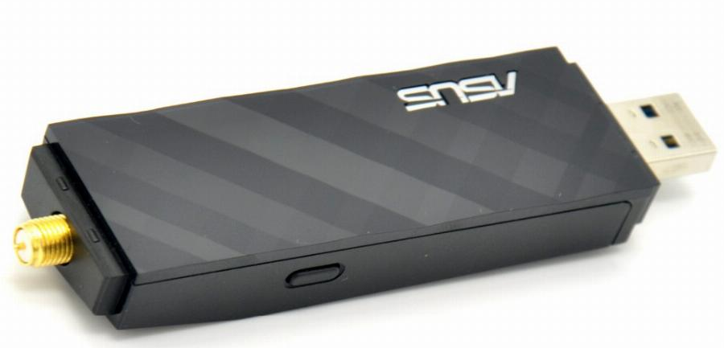
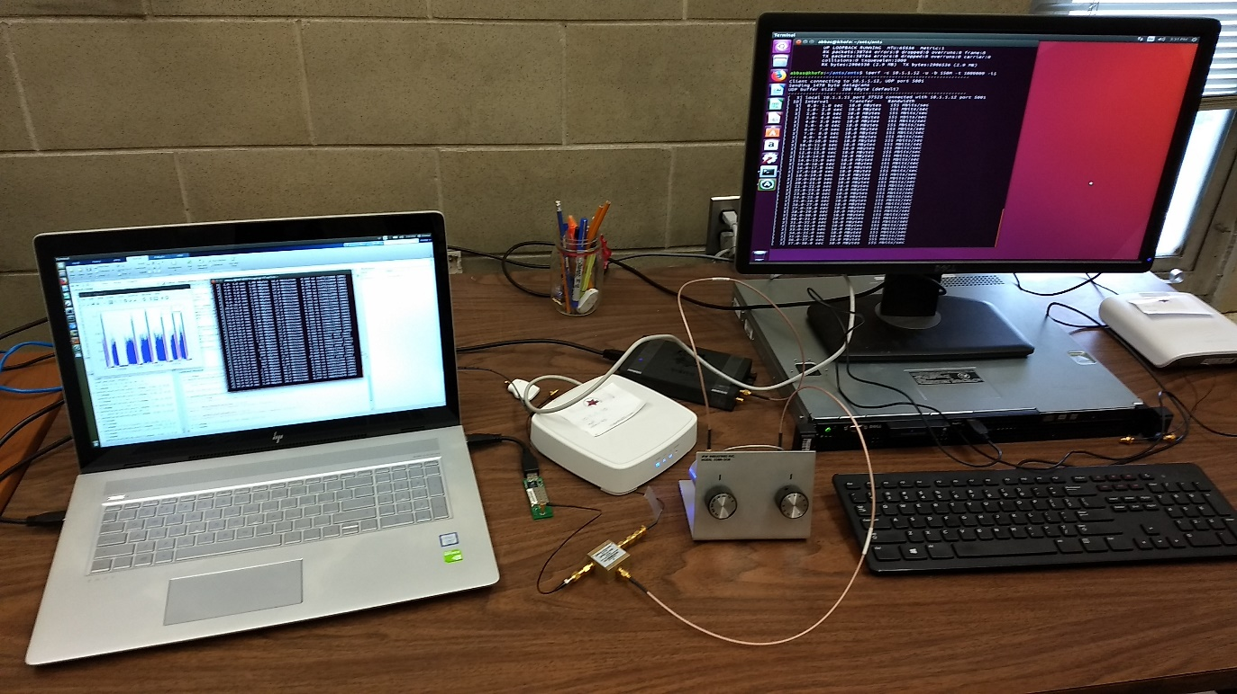
Hardware Evolution
(Second version)
RF Cables
2 servers
Server 1
Server 2
UUT
SU/CD
RF Splitter/ Combiner
USRP

Slide 33
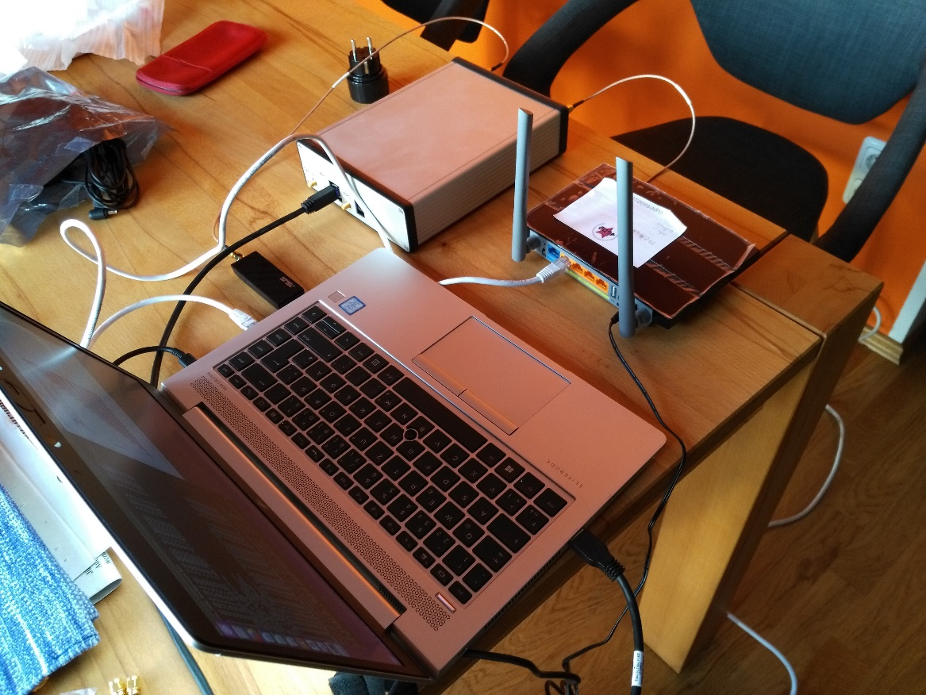
Hardware Evolution
(Current version: Single Machine)
RF cables
One Laptop
PC/Laptop
Client
Server
UUT
SU/CD
USRP

Slide 34
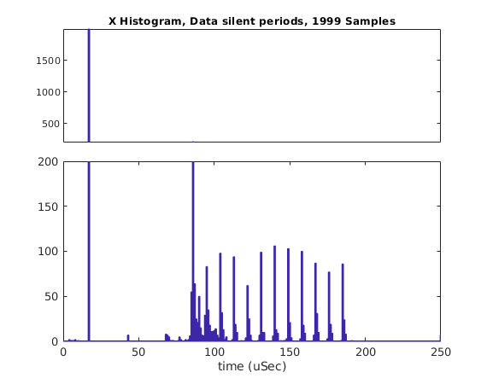
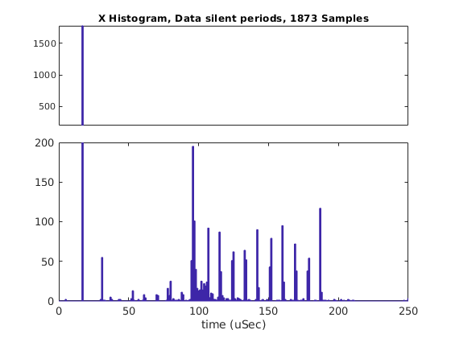
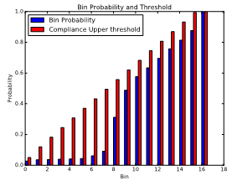
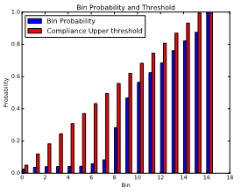
Results Comparisons
Measurements in RF Shielding box
Cabled measurements

Slide 35
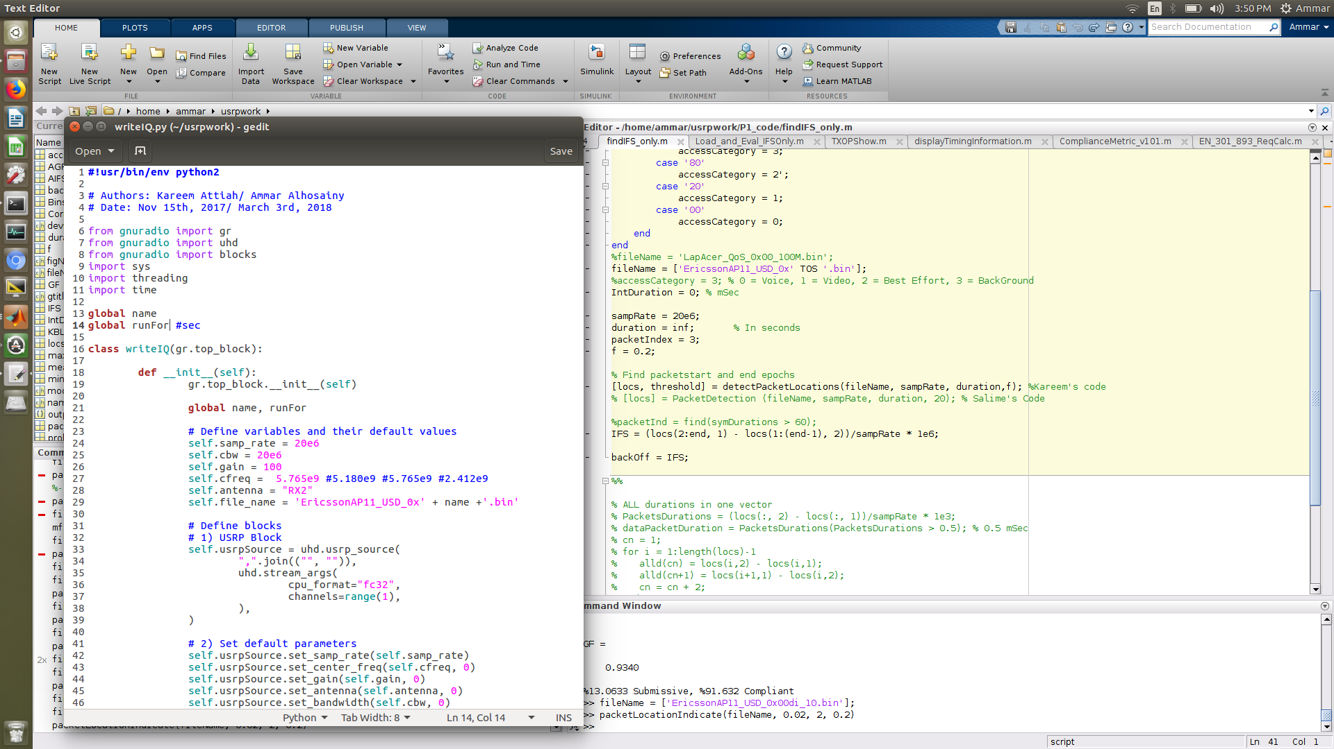
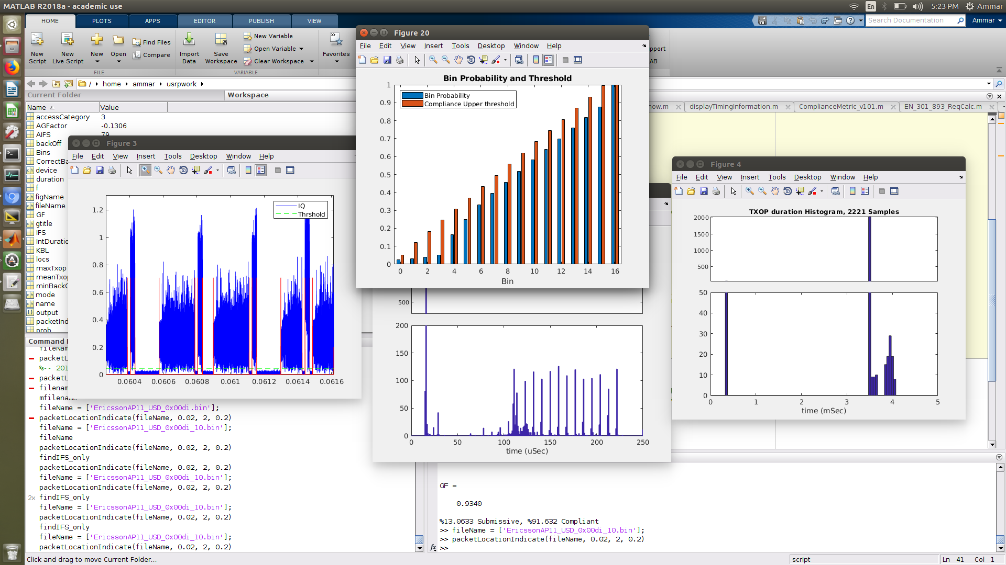
Software Evolution—1st ver.: MATLAB & Python script

Slide 36
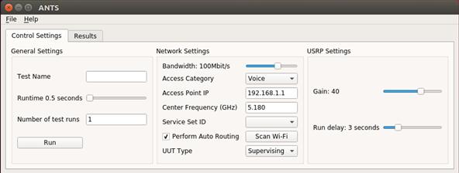

Software Evolution—Reimplementation in Python
Introducing a GUI, no need for MATLAB license

Slide 37




Results Comparisons
MATLAB based evaluation code
Python based evaluation code

Slide 38


Open Source code stored on GitHub: CarletonWirelessLab/ANTS, available under MIT license
https://github.com/CarletonWirelessLab
https://github.com/CarletonWirelessLab/ANTS

Slide 39
Example requirements
Standard PC
  CPU of Intel Core i5 class
    >1.7 GHz recommended
  USB3 support needed
  8 GB RAM, better 16 GB RAM
  Disk space > 20 GB
  1.5 GB / measurement
Ubuntu Linux 16.04
  Python 3 environment
  GNUradio
USRP B200
IEEE 802.11 client
  Companion device
RF cables and splitter
  Attenuators might be helpful
Detailed requirements and Software installation steps are found on GitHub
https://github.com/CarletonWirelessLab/ANTS

Slide 40
Outlook
Further simplification of tests
  “One-button solution”
  Automatic generation of PDF files containing evaluation reports
Public database containing measurement reports
Testing of device compliance with IEEE 802.11a preamble
  IEEE 802.11a RATE and LENGTH in SIGNAL field indicating deferral duration
  Sensitivity at related power threshold
  To become mandatory with next revision of EN 301 893

Slide 41
Published Papers
Journal Paper:
  “Statistical Evaluation of the Behavior of 5 GHz Radio LAN Devices”
    IEEE Transactions on Instrumentation and Measurement, Early access on IEEE explore
Conference Papers:
  “Compliance Evaluation of Wi-Fi Devices”
    The 20th IEEE International Workshop on Signal Processing Advances in Wireless Communications (SPAWC 2019), (SPAWC 2019), Cannes, France, July 2-5, 2019
  “A Soft Metric for Assessing the Compliance of WLAN Devices”
    16th Canadian Workshop on Information Theory (CWIT 2019), Hamilton, ON, Canada, June 2-5, 2019

Slide 42
Demo!

Slide 43
Thank you

Slide 44
References
[1] ETSI EN 301 893 (V2.1.1), “5 GHz RLAN; Harmonised Standard covering the essential requirements of article 3.2 of Directive 2014/53/EU,” European Telecommunications Standards Institute, ETSI EN 301 893 V2.1.1, May 2017.
[2] “IEEE Approved Draft Standard for Information technology—Telecommunications and information exchange between systems - Local and metropolitan area networks—Specific requirements Part 11: Wireless LAN Medium Access Control (MAC) and Physical Layer (PHY) Specifications,” in IEEE P802.11-REVmc/D8.0, August 2016, pp.1-3774, Jan. 1 2016.
[3] “IEEE Standard for Information technology—Telecommunications and information exchange between systems Local and metropolitan area networks—Specific requirements Part 11: Wireless LAN Medium Access Control (MAC) and Physical Layer (PHY) Specifications,” in IEEE Std 802.11-2012 (Revision of IEEE Std 802.11-2007), pp.1-2793, March 29 2012.
[4] Eldad Perahia and Robert Stacey (2013), “Next Generation Wireless LANs 802.11n and 802.11ac,” Cambridge, Cambridge University.

