Slide 1
EUHT standards introduction
Date: 2019-04-20
Authors:

Slide 2
Abstract
This document is a brief introduction to the EUHT standard and includes new features for URLLC and mMTC scenarios.

Slide 3
Abbreviation
URLLC（Ultra-Reliable and Low Latency Communications）
mMTC (massive Machine Type Communication)
EUHT（Enhanced Ultra High Throughput）

Slide 4
Topics
Background
Part I:
  EUHT standard outline
  EUHT MAC Layer Overview
  QoS Guaranteed fast and flexible scheduling
  EUHT PHY transmitter
Part II:
  Features for URLLC
  Features for mMTC

Slide 5
Background
The attached reference document is the translated version of Chinese industry standard, which is announced in 2012. Complete EUHT technical description is provided in the document, which included features of MAC and PHY layers.
It should be noted that there are many new features added in EUHT system since 2012. For example, More bandwidth/SC interval options, More LDPC code options, Higher and Lower MCS, Finer OFDMA, Seamless Handover, Multiple Connection，etc. We are translating the new features and will update the document ASAP.

Slide 6
EUHT standard outline
Chapter
（1~4）
Scope, Normative Reference , Definitions and Abbreviations
Chapter
（5）
System Reference Model
EUHT
Standard
Chapter
（6）
Overview of MAC services
Chapter
（7）
MAC frame format
Chapter
（8）
MAC layer functions
Chapter
（9）
PHY specifications
Slide 6

Slide 7
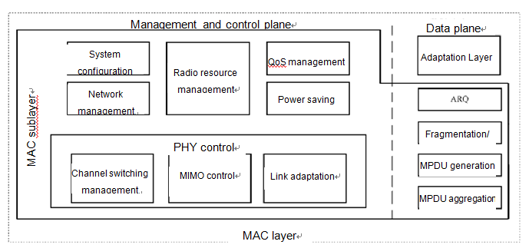
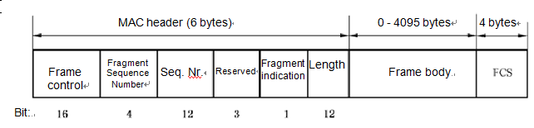

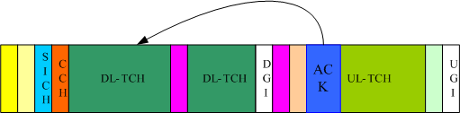
EUHT MAC Layer Overview
Data and Control Plane
A centralized Scheduling MAC mechanism guaranteed the High MAC efficiency in multiple users scenarios
Adaptation layer for QoS classification and the encryption and decryption of upper layer packets
Extremely low overhead MAC layer (6bytes) in MAC MPDU
G-MPDU aggregation for high throughput
Instant-ACK /feedback for low latency

Slide 8
QoS guaranteed fast and flexible scheduling
DL packets queues
QoS guaranteed for different service requirement.(priority QoS scheduling )
Low complexity and fast scheduling
Fast channel state info feedback for fast link adaptation and scheduling
The flexible resources allocation during the Frame. Support a minimum resource to ONE ofdm symbol.
Scheduler UL
CAP
Base on QoS scheduling
Channel
Est
Queue Info
Scheduler
Base on QoS scheduling
STA
Channel Est
UL packets queues

Slide 9
EUHT PHY Transmitter
Adaptive pilot mode for different STA channel conditions
Pilot for phase tracking
BCC
LDPC
  —1344bits
  —2688bits
  —5376bits
Bit stream spatial mapping with high spatial diversity gain
Get frequency diversity gain
DL/ UL MU MIMO (SDMA)
Code rate of 5/8, 7/8 for optimized link adaptation in mid-high SNR region
DL: S/L-Preamble, DL-SCH
UL: UL-SCH, UL-SRCH, UL-RACH
256QAM->1024QAM
UEQM for different stream
TDMA and OFDMA resource allocation

Slide 10
Features for URLLC
More bandwidth/SC interval options
20/40/80MHz 10/20/40 MHz 8/16/32 MHz
78.125KHz 39.0625KHz 31.25KHz
More CP options
1.6/3.2us
More LDPC code options
new LDPC code for 448 bits
Higher and Lower MCS
1024QAM
Seamless Handover
Multiple Connection
Frequency, Adaptation layer for multiple connections

Slide 11
Features for mMTC
More bandwidth/SC interval options
Finer OFDMA
minimum frequency resource allocation unit is 16 subcarriers
High sleep ratio and long sleep duration

Slide 12
Summary
Gives a brief introduction to the existing EUHT standards .
New features for URLLC and mMTC scenarios in EUHT system.

Slide 13
Reference

