Slide 1
Preliminary Results of EUHT Evaluation on Urban Macro URLLC
Date: 2019-04-22
Authors:

Slide 2
Abstract
This presentation is a follow up work of the proposal about joint submission to ITU as IMT-2020 standard [1].
In this contribution, we present the preliminary results of EUHT [2] simulations on urban macro URLLC scenario.
The simulations adhere to the methodology specified by ITU-R for self-evaluating a RAT for IMT-2020 [3].
The preliminary results show that EUHT can meet the ITU requirements on urban macro URLLC scenario[4].

Slide 3
Abbreviation
RIT ( Radio Interface Technology)
URLLC（Ultra-Reliable and Low Latency Communications）
eMBB（enhanced Mobile Broadband）
mMTC (massive Machine Type Communication)
3GPP R15（3GPP Release 15）
3GPP R16（3GPP Release 16）
NSA（Non-Standalone ）
EUHT（Enhanced Ultra High Throughput）

Slide 4
Outline
Objective
Simulation configuration
Simulation assumptions
Simulation procedure
Results
Conclusion
Next Step
References

Slide 5
Objective
In the previous meeting, it was proposed that 11ax and EUHT are combined together to be submitted to ITU as SRIT (set of RIT) [1].
In [1], EUHT is proposed to meet the requirements of the following scenarios
Rural eMBB, Urban Marco URLLC and Urban Macro mMTC
The self-evaluation results must be submitted together with the technical documents before July 1st according to ITU[5].
As the first step, the self-evaluation results of EUHT on urban URLLC scenario are shown in this contribution.

Slide 6
Simulation Configuration
Simulation bandwidth : 20 MHz
Carrier Frequency: 4GHz
BS Tx power : 23 dBm, UE Tx power: 23 dBm
BS Antenna gain: 8 dBi, UE antenna gain: 0 dBi
BS noise figure: 5 dB, UE noise figure : 7 dB
BS antenna configuration : Omni uniform linear array 8Tx/8Rx with 8 dBi gain in intended direction.
UE antenna configuration : Omni uniform linear array 8Tx/8Rx with with 0 dBi gain.
The complete configuration is specified in the ITU-R guidelines for self-evaluating a RAT ([3]).

Slide 7
Simulation Assumptions
Low overhead Control channel + Traffic channel
Control channel payload: 32 bit
TCH Payload : 32 Byte
QPSK, LDPC, 4/7 code rate, codeword size: 448
single spatial stream
Modulation symbol repetition in frequency domain
Realistic Channel Estimation
Maximum Ratio Combining
Min-sum LDPC decoding

Slide 8
Simulation Procedure (1)
The urban macro URLLC simulation procedure is quoted as follows [3]
The evaluator shall perform the following steps in order to evaluate the reliability requirement using system-level simulation followed by link-level simulations.
Step 1: Run downlink or uplink full buffer system-level simulations of candidate RITs/SRITs using the evaluation parameters of Urban Macro-URLLC test environment see § 8.4.1 below, and collect overall statistics for downlink or uplink SINR values, and construct CDF over these values.
Step 2: Use the CDF for the Urban Macro-URLLC test environment to save the respective 5th percentile downlink or uplink SINR value.

Slide 9
Simulation Procedure (2)
Step 3: Run corresponding link-level simulations for either NLOS or LOS channel conditions using the associated parameters in the Table 8-3 of this Report, to obtain success probability, which equals to (1-P_{e}), where P_{e} is the residual packet error ratio within maximum delay time as a function of SINR taking into account retransmission.
Step 4: The proposal fulfils the reliability requirement if at the 5th percentile downlink or uplink SINR value of Step 2 and within the required delay, the success probability derived in Step 3 is larger than or equal to the required success probability. It is sufficient to fulfil the requirement in either downlink or uplink, using either NLOS or LOS channel conditions.

Slide 10
System Level Simulation
According to the simulation procedure, the system level simulation is mainly used to provide SINR statistics
Because the system level simulation platform is not ready yet, we did not actually run the system level simulation to obtain the SINR values. The SINR CDF in [6] is adopted in the link level simulation as the 1st step, in which the 5th percentile value of SINR with the same condition is -1.72dB (from CATT).
Therefore, the target of link level simulation is to achieve
PER < 10e-5 @ -1.72dB SNR under small fading channel

Slide 11
Link Level Simulation
The total transmit power is normalized to 1
The small fading channel implementation is obtain from “IMT2020V2.0”,http://www.zjhlab.net/publications/imt-2020_cm_bupt/.
The channel model is UMA_A. The details of channel model parameters are aligned with ITU evaluation document [3].

Slide 12
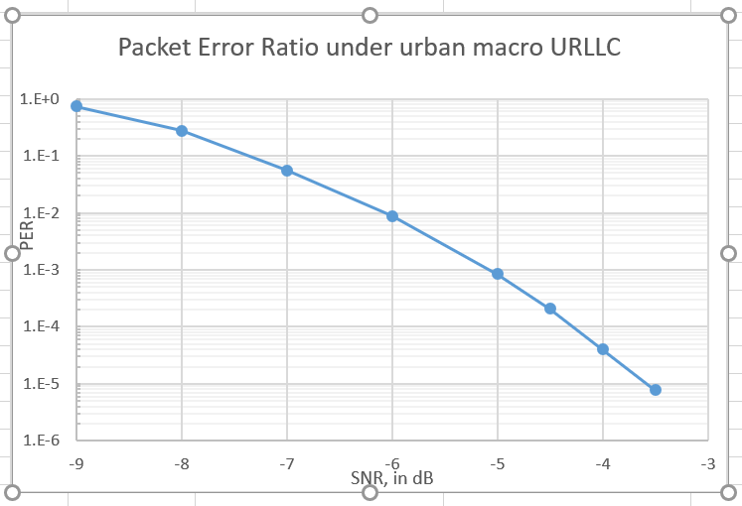
Simulation Results
Max Latency < 0.80ms
PER < 10e-5 @ -3.5 SNR

Slide 13
Conclusion
The preliminary evaluation results show that EUHT can meet the requirements of URLLC of IMT-2020.

Slide 14
Next Step
In the next weeks, we will develop the system level simulation platform and perform more evaluation on URLLC/mMTC/rural eMBB.

Slide 15
Reference
[1] IEEE 802.11-19/0625r0, Proposal to Cooperate to Submit 5G Standards
[2] IEEE 802.11-19/0626r0, EUHT Technical Brief
[3] Report ITU-R M.2412-0 (10/2017), Guidelines for evaluation of radio interface technologies for IMT-2020
[4] Report ITU-R M.2410-0 (11/2017), Minimum requirements related to technical performance for IMT-2020 radio interface(s)
[5] Report ITU-R M.2411-0 (11/2017) , Requirements, evaluation criteria and submission templates for the development of IMT-2020
[6] Document 5D/1050-E, Preliminary Description Template and Self-Evaluation of 3GPP 5G candidate for inclusion in IMT-2020

