Slide 1
EVM Specification for OOK Waveform
Date: 2019-04-12
Authors:

Slide 2
Introduction
EVM (Error Vector Magnitude) is a typical metric for measuring transmit modulation accuracy
For OFDM signal in 11a/n/ac/ad/ax, the EVM is measured for QAM symbols in frequency domain [1][2]
For .11ba, a new formulation may be needed to measure the EVM for OOK symbols in time domain

Slide 3
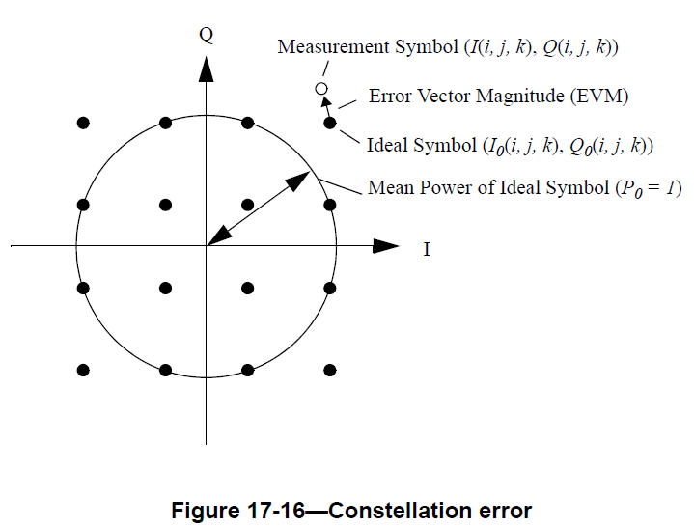
EVM for OFDM Signal
Typically assuming certain capabilities and accuracies for the testing instrument:
Capable of converting the transmitted signal into a stream of complex samples
I/Q amplitude and phase balance
DC offset
Phase noise mitigation
Synchronization in time
Need to consider
Power normalization
Ideal symbol values
(Copied from [1])

Slide 4
EVM for OOK Signal
Assumptions
Measured signal is normalized with average power $=1$
The testing equipment is capable of converting the transmitted signal into a stream of complex samples and measuring the magnitude of samples and accumulate them over On and Off durations
“Off”
“On”
Measurement
Envelope
0
$$\sqrt{2}$$
EVM
Normalized “Constellation” of OOK modulation
Envelope
Measured Samples
On
$$N_{s}=6$$
Off
Time

Slide 5
EVM for OOK Signal (cont.)
Testing Requirements
Sampling rate: $≥\left[80\right] MHz$
During the test, a bandpass filter of which the 3dB-bandwidth is equal to [5$±$0.5] MHz shall be used to obtain the signal on the channel under the test.
The test shall be performed over at least [20] frames ($N_{f}$).
Perfect synchronization
The frame under test, which includes both Sync and HDR/LDR data fields, shall be at least [256] $μ$s long.
Test Frame 1
Test Frame $N_{f}$
L-preamble
WUR Sync
WUR Data
. . . . . . .
L-preamble
WUR Sync
WUR Data

Slide 6
Some Notations
$N_{f}$: Number of tested frames in a measurement duration
$N_{On, k}$: Number of On symbols in k-th test frame
$N_{Off,k}$: Number of Off symbols in k-th test frame
$N_{s}$: Number of samples in On or Off symbol duration (assuming it is the same for both On and Off symbol durations), which is different for 2μs and 4μs symbols
$f_{On}\left(i, j, k\right)$ is the i-th observed sample of signal envelope on the j-th On symbol and the k-th test frame;
$f_{Off}\left(i, j, k\right)$ is the i-th observed sample of signal envelope on the j-th Off symbol and the k-th test frame

Slide 7
Some Notations (cont.)
$P_{0}$: the normalization factor of the received signal in a measurement duration
$$P_{0}=\frac{1}{\sqrt{2} N_{f}N_{s}}\sum_{k=0}^{N_{f}−1}{\frac{1}{N_{on,k}}\sum_{j=0}^{N_{On,k}−1}{\sum_{i=0}^{N_{s}−1}{f_{On}\left(i, j, k\right)}}}$$
Note:
Assuming the testing instrument can obtain the real (I) and imaginary (Q) components of the WUR signal, the envelope functions $f_{On}\left(i, j, k\right)$ in On symbol and $f_{Off}\left(i, j, k\right)$ in Off symbol may respectively be expressed as
$$f_{On}\left(i,j,k\right)=\sqrt{{\left|I_{On}\left(i,j,k\right)\right|}^{2}+{\left|Q_{On}\left(i,j,k\right)\right|}^{2}}$$
and
$$f_{Off}\left(i,j,k\right)=\sqrt{{\left|I_{Off}\left(i,j,k\right)\right|}^{2}+{\left|Q_{Off}\left(i,j,k\right)\right|}^{2}}$$
where
$I_{On}(i,j,k)$, $Q_{On}(i,j,k)$ are the $i$-th observed real and imaginary values in the $j$-th On symbol and the $k$-th test frame, respectively;
$I_{Off}(i,j,k)$, $Q_{Off}(i,j,k)$ are the $i$-th observed real and imaginary values in the $j$-th Off symbol and the $k$-th test frame, respectively;

Slide 8
Some Notations (cont.)
Some options to define the “envelope”:
(the ones for “Off” symbols can be defined in the same way)
Which one should be used in the spec is TBD
$$f_{On}\left(i,j,k\right)=\sqrt{{\left|I_{On}\left(i,j,k\right)\right|}^{2}+{\left|Q_{On}\left(i,j,k\right)\right|}^{2}}$$
$$f_{On}\left(i,j,k\right)={\left|I_{On}\left(i,j,k\right)\right|}^{2}+{\left|Q_{On}\left(i,j,k\right)\right|}^{2}$$
$$f_{On}\left(i,j,k\right)=\left|I_{On}\left(i,j,k\right)\right|+\left|Q_{On}\left(i,j,k\right)\right|$$
$$f_{On}\left(i,j,k\right)=\left|I_{On}\left(i,j,k\right)\right|$$
$$f_{On}\left(i,j,k\right)=\left|Q_{On}\left(i,j,k\right)\right|$$

Slide 9
EVM Expression
Defined normalized sample average for On and Off Symbols:
Then, the averaged RMS of WUR portion of all test frames is
$${\overline{M}}_{On}\left(j,k\right)=\frac{1}{N_{s}P_{0}}\sum_{i=0}^{N_{s}−1}{f_{On}\left(i, j, k\right)},$$
$${\overline{M}}_{Off}\left(j,k\right)=\frac{1}{N_{s}P_{0}}\sum_{i=0}^{N_{s}−1}{f_{Off}\left(i, j, k\right)},$$
$$EVM=20\log_{10}\left(\frac{1}{N_{f}}\sum_{k=0}^{N_{f}−1}{\sqrt{\frac{1}{{(N}_{On,k}+N_{Off,k})}\left(\sum_{j=0}^{N_{On,k}−1}{{\left({\overline{M}}_{On}\left(j,k\right)−\sqrt{2}\right)}^{2}}+\sum_{j=0}^{N_{Off,k}−1}{{\left({\overline{M}}_{Off}\left(j,k\right)\right)}^{2}}\right)}}\right)$$
|I|+|Q|
Time
Normalized Eye Diagram

Slide 10
Simulation
Settings
Fs: 80 MHz
Nonlinear PA: Rapp model, 9dB back-off
ADC model: Kaiser filter where beta = 0.5
RX filter: 5th order 5 MHz Butterworth
Options for defining the “envelope”
$$f_{env1}\left(I,Q\right)={\left|I\right|}^{2}+{\left|Q\right|}^{2}$$
$$f_{env2}\left(I,Q\right)=\sqrt{{\left|I\right|}^{2}+{\left|Q\right|}^{2}}$$
$$f_{env3}\left(I,Q\right)=\left|I\right|+\left|Q\right|$$
$$f_{env4}\left(I,Q\right)=\left|I\right|$$
$$f_{env5}\left(I,Q\right)=\left|Q\right|$$

Slide 11
Simulation Results
HDR | $$f_{env1}$$ | $$f_{env2}$$ | $$f_{env3}$$ | $$f_{env4}$$ | $$f_{env5}$$
Example 1 [3] | -26.81 | -23.92 | -23.05 | -16.84 | -16.18
Example 2 [3] | -33.85 | -25.24 | -24.32 | -21.10 | -20.39
Example 3 [3] | -24.19 | -23.06 | -17.36 | -12.90 | -13.02
Example 4 [4] | -24.23 | -22.87 | -21.43 | -12.73 | -12.77
LDR | $$f_{env1}$$ | $$f_{env2}$$ | $$f_{env3}$$ | $$f_{env4}$$ | $$f_{env5}$$
Example 1 [3] | -32.32 | -30.04 | -27.30 | -22.20 | -22.01
Example 2 [3] | -37.66 | -31.18 | -27.33 | -20.44 | -22.98
Example 3 [3] | -32.41 | -30.56 | -22.69 | -18.68 | -21.03
Example 4 [4] | -27.75 | -27.42 | -25.89 | -16.73 | -16.17
Propose using $f_{env2}\left(I,Q\right)=\sqrt{{\left|I\right|}^{2}+{\left|Q\right|}^{2}}$ as the reference
Propose requirement: EVM(HDR)= -20 dB, EVM(LDR) = -15 dB

Slide 12
References
[1] IEEE P802.11REMmd “Part 11: Wireless LAN Medium Access Control (MAC) and Physical Layer (PHY) Specifications”, 2019
[2] “IEEE P802.11ax™/D3.0, Amendment 6: Enhancements for High Efficiency WLAN”, 2018
[3] IEEE P802.11ba/D2.0, 2019
[4] Alphan Sahin, et al., “OOK Waveform for FDMA”, IEEE 11-18/0682r2, 2018

