Slide 1
Nulling and coordinated beamforming
Date:03/10/2019
Authors:

Slide 2
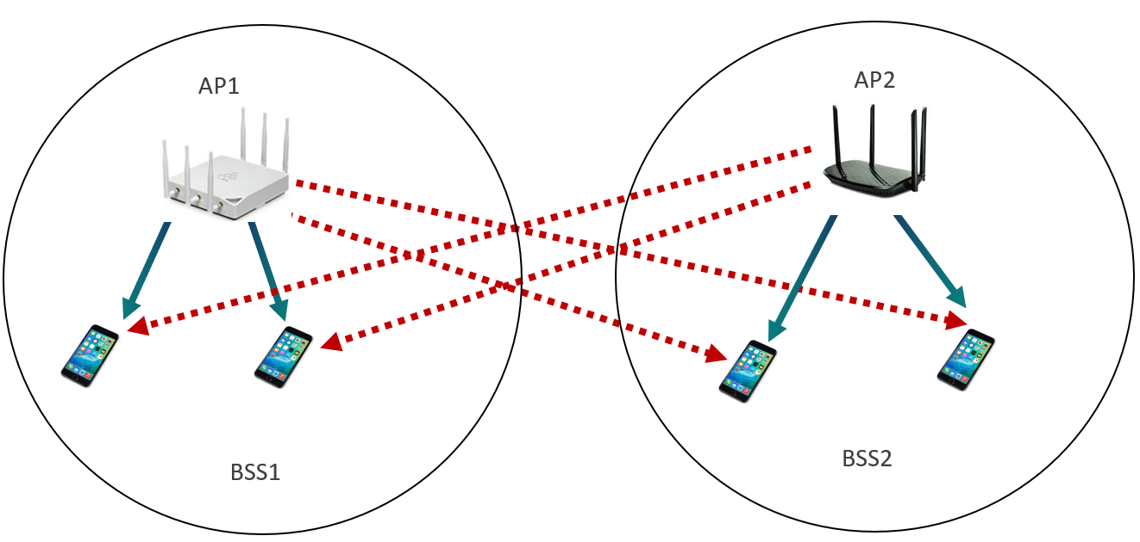
Coordinated BF
Coordinated BF was introduced in [1]
Independently operating APs creating nulls to avoid mutual interference between OBSS
No joint operation
Some Channel information exchange needed (not real-time requirement)

Slide 3
Questions about coordinated BF
Which STAs do we null towards?
Depending on number of AP antennas, number of simultaneous nulls is limited
Can digital BF be used to create a broad null in the general direction of an OBSS?
What does a received signal using a “nulling” precoding matrix really look like?

Slide 4
Nulling with digital BF
Purpose:
Verify what the received signal using a “nulling” precoding matrix really looks like
Steps involved in verification:
Send an NDP towards a target OBSS STA
Collect compressed channel feedback (AP – STA channel)
Channel D instance
Calculate precoding matrices that create null towards the STA
Transmit a precoded signal using these precoding matrices and observe the received signal (in the time domain) at the OBSS STA

Slide 5
Nulled waveform at the receiver
Signal is not zero in the time-domain
Preamble still arrives at full power (precoding may help)
Periodic bursts of energy appear around the symbol transitions, even in part of the signal that is precoded

Slide 6
Further analysis
Precoding assumes circular convolution
This assumption is typically not valid inside (most of) the guard interval
During the guard interval, signal is not nulled, causing a burst of energy
Duration of the burst will depend on length of channel impulse response

Slide 7
Synchronized system
A synchronized system chooses FFT input samples “between” bursts
Nulling still happens in the frequency domain
MU-MIMO and BF are naturally synchronized correctly

Slide 8
Unsynchronized system
An unsynchronized system will see interference
Even if nulling BF matrices are derived from the correct channel
Each symbol corrupted/affected by energy burst
In coordinated BF, the victim system and interferer are not synchronized

Slide 9
Maintaining synchronization
Proper synchronization is key to achieving nulling (in the frequency domain)
Receiving (“victim”) STA is unsynchronized to the OBSS AP
STA synchronizes to a signal being sent to it, not to the interfering signal
To have the required synchronization, the transmitting STA needs to synchronize to ongoing transmission
STA may learn identity of active transmitter and receiver and can finetune the precoding matrix accordingly
No need for broad null or compromise precoding matrix

Slide 10
Conclusion
Nulling using digital BF does not guarantee absence of interference
To have nulling, interferer and victim need to be symbol synchronized
In that case, canceling happens in the frequency domain
Precoding of preamble needs to be considered as well
One synchronization mechanism was proposed here

Slide 11
References
[1] Terminology for AP Coordination, IEEE 802.11-18/1926r2

