Slide 1
Feasibility of 4096QAM
Date:04/11/2019
Authors:

Slide 2
OFDM modulation sizes
In 802.11, the supported maximum modulation size has been increasing gradually
Initially OFDM supported BPSK, QPSK, 16QAM and 64QAM
256QAM was introduced in 11ac
1024QAM was introduced in 11ax
4096QAM has been suggested for EHT in multiple submissions (see [1], [2])
The goal of this submission is to understand the requirements needed to support 4096 QAM

Slide 3
4096 QAM and beamforming
It has been suggested that BF may be the key to support of 4096 QAM
With BF, 4096 QAM can be supported at lower SNR
Most BF gain for lower number of streams
Caveat: We still need to consider Rx EVM
Not affected by beamforming
Both effects are evaluated in this submission through simulation

Slide 4
Evaluation methodology
Effect of beamforming is simulated in Gaussian channel (Rayleigh distributed)
Complex-valued Gaussian channel
Calculate BER as function of SNR
For various values of N_TX
Rx EVM requirements is estimated by simulating performance in flat channel

Slide 5
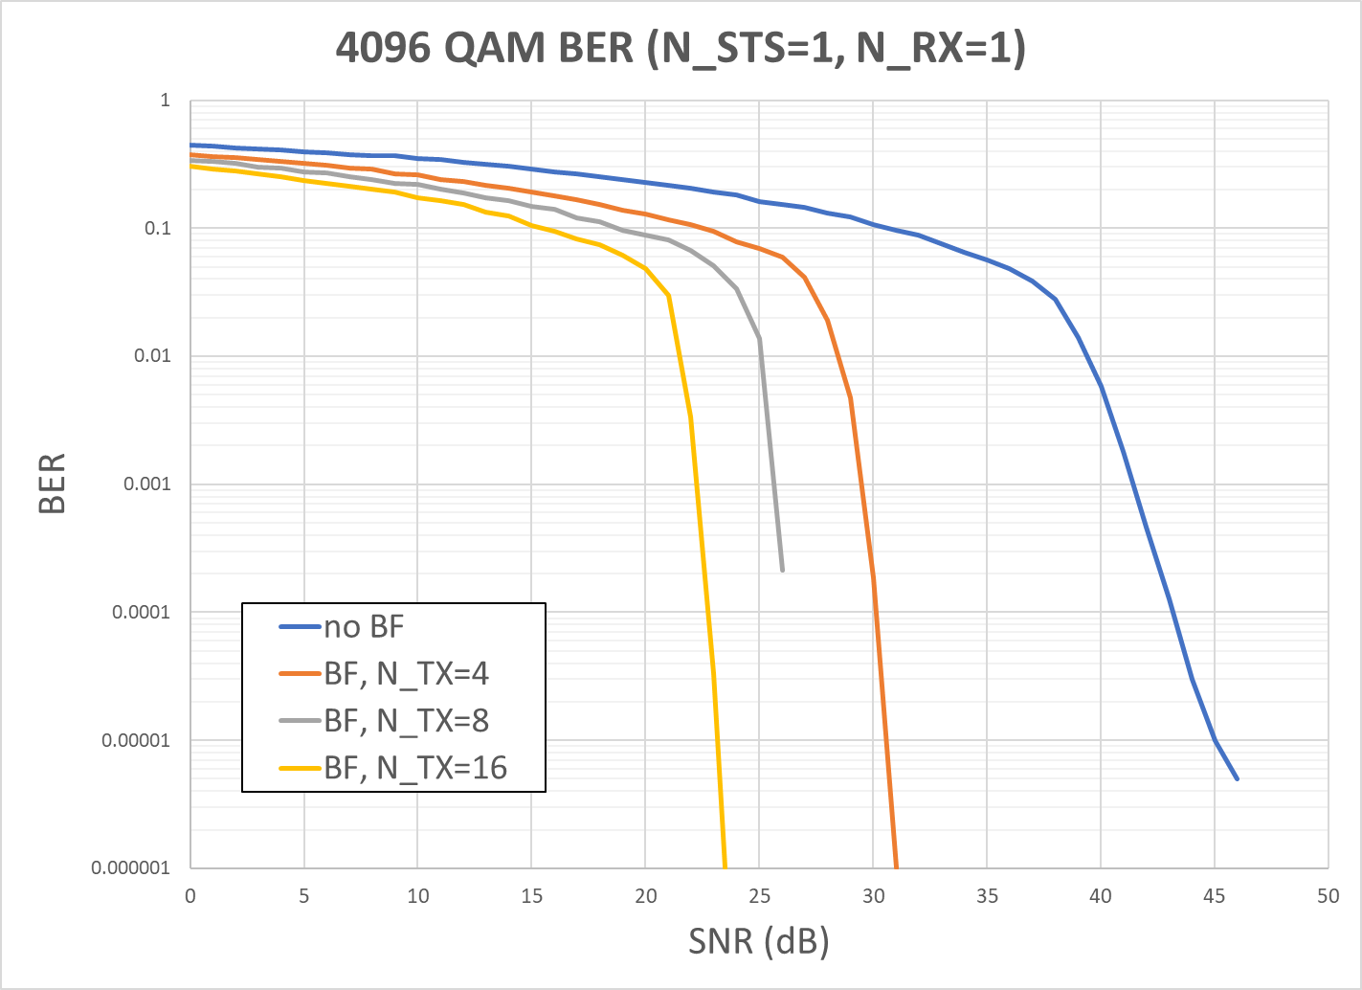
Beamforming results in Gaussian channel

Slide 6
Beamforming results - analysis
Without beamforming, required channel SNR is above 45 dB
Not practically feasible
Beamforming with N_TX=4 reduces the SNR requirement to about 30 dB
N_TX=8 and N_TX=16 provide additional 3 and 6 dB BF gain respectively
Beamforming is essential in making the use of 4096 QAM feasible

Slide 7
Rx EVM consideration
In reality, the signal at the receiver will be further affected by Rx EVM
Effectively creating an additional noise proportional to the level of the received signal
Previous simulation results effectively assume unlimited Rx EVM
Rx EVM is not changed by beamforming
But can be improved with extra Rx antennas
To get an understanding of the required Rx EVM, we simulate 4096 QAM in a flat channel

Slide 8
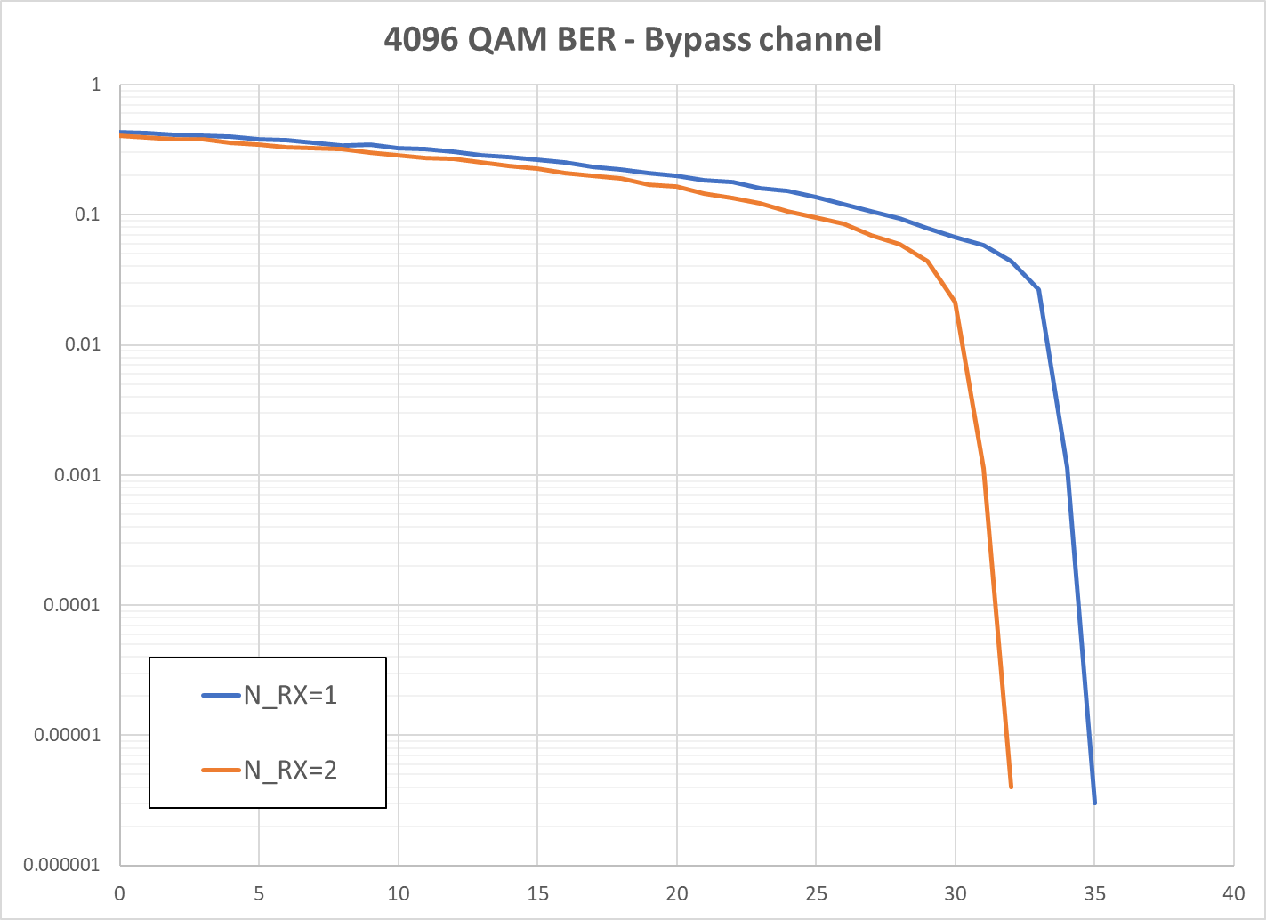
Flat channel results

Slide 9
Rx EVM discussion
About 35 dB Rx EVM is needed to reliably receive 4096 QAM
Additional Rx antennas can further reduce this number
Beamforming is still essential to improve channel SNR
Channel SNR is no longer the limiting factor

Slide 10
Conclusions
BF can reduce the required channel SNR significantly
Devices still need about ~35 dB Rx EVM
EVM requirement can be relaxed when extra Rx antennas are used
Overall 4096 QAM appears feasible in certain configurations
Using Tx BF
Low number of streams (simulations were done for N_STS=1)
Strict Rx EVM requirement or multiple Rx antennas

Slide 11
References
[1] Overview of PHY Features for EHT, IEEE 802.11-18/1967r0
[2] Discussions on the PHY features for EHT, IEEE 802.11-18/1461r1

