Slide 1
Motion Booklet for IEEE 802.11 TGbd
Date: 2019-03-14
Authors:

Slide 2
Abstract
Booklet for the TGbd motions related to FRD and SFD.
Motions are consecutively numbered since the formation of the task group.

Slide 3
March 2019
FRD & SFD Motions
Motion #1 -- #7
Vancouver, BC, Canada

Slide 4
FRD&SFD Motion #1
Move to update the 11bd FRD according to the changes captured in document 11-19/0511r1.
Moved: Bahar Sadeghi
Seconded: Joseph Levy
Result: Passed unanimous

Slide 5
FRD&SFD Motion #2
Move to add the following text to section 3 in 11bd SFD.
  “ 11bd PPDU format includes L-STF, L-LTF, and L-SIG fields as shown in Figure 3.x
    L-STF means short training field of 11p.
    L-LTF means long training field of 11p.
    L-SIG means signal field of 11p.”
Moved: Dongguk Lim
Seconded: Hongyuan Zhang
Result: 33Y/0N/9A, passed
L-STF
L-LTF
L-SIG
11bd PPDU
Figure 3.x 11bd PPDU format

Slide 6
FRD&SFD Motion #3
Move to add the following text to section 3 in 11bd SFD.
  “11bd supports the 10MHz bandwidth PPDUs.
  11bd supports the 20MHz bandwidth PPDUs. ”
Mover: Dongguk Lim
Second: Hongyuan Zhang
Result: Passed unanimous

Slide 7
FRD&SFD Motion #4
Move to add the following text to section 3 in 11bd SFD.
  “In 20MHz bandwidth, L-STF, L-LTF, and L-SIG for 10MHz PPDU are duplicated as shown in the figure below.”
Mover: Dongguk Lim
Second: Hongyuan Zhang
Result: 25Y/0N/19A, passed
10MHz
L-STF
L-LTF
L-SIG
10MHz
L-STF
L-LTF
L-SIG
11bd PPDU

Slide 8
FRD&SFD Motion #5
Move to add the following text into Section 3 of SFD
  “11bd amendment shall support LDPC”
Mover: Prashant Sharma
Second: Hongyuan Zhang
Result: Passed unanimous

Slide 9
FRD&SFD Motion #6
Move to add the following text into Section 3 of SFD
  “An 11bd STA shall be capable of the following operations:
    To decode 11p PPDUs with TBD receive sensitivity threshold (TBD value is -85dBm or lower).
    To transmit PPDU format up on request from upper layer, the PPDU format can be either 11p PPDU or 11bd PPDU.”
Mover: Rui Cao
Second: Hongyuan Zhang
Result: 27Y/0N/14A, passed

Slide 10
FRD&SFD Motion #7
Move to add the following text into Section 3 of SFD
  “An 11bd STA shall indicate the NGV capability in MAC level, when transmitting an 11p PPDU”
Mover: Rui Cao
Second: Hongyuan Zhang
Result: passed unanimous

Slide 11
MaY 2019
FRD & SFD Motions
Motion #8 -- #16
Atlanta, GA, USA

Slide 12
FRD&SFD Motion #8
Move to add the following text to section 3 in 11bd SFD
“11bd shall support the same subcarrier spacing in both 10 MHz PPDU and 20MHz PPDU”
Mover: Dongguk Lim
Second: Hongyuan Zhang
Result: Passed unanimously

Slide 13
FRD&SFD Motion #9
Move to add the following text to section 3 in 11bd SFD
“11bd PPDU includes a NGV-Signal field to indicate the transmission information”
“ The location of NGV-SIG field is TBD”
Mover: Dongguk Lim
Second: Hongyuan Zhang
Result: Passed unanimously

Slide 14
FRD&SFD Motion #10
Move to add the following text to section 3 in 11bd SFD
“11bd PPDU design shall support Midamble(s) in Data field.
Midamble is composed by long training field, with design TBD.
Midamble periodicity is TBD. “
Mover: Dongguk Lim
Second: Hongyuan Zhang
Result: 8Y/1N/8A Passed

Slide 15
FRD&SFD Motion #11
Move to add the following text to section 3.1 of the SFD:
“11bd devices shall support 256 QAM. The 256 QAM constellation mapping is the same as that defined in 21.3.10.9 (Constellation mapping)”
Mover: Hongyuan Zhang
Second: Dongguk Lim
Result: 15Y/2N/10A, PASSED

Slide 16
FRD&SFD Motion #12
Move to add the following text to Section 3.1 of the SFD:
“11bd devices shall support LDPC codes, with the same code structure and coding methods as defined in 19.3.11.7 (LDPC Codes)”
Mover: Hongyuan Zhang
Second: Dongguk Lim
Result: Passed unanimously

Slide 17
FRD&SFD Motion #13
Move to add the following text to section 3.1 of the SFD:
“10MHz 11bd Data symbol shall use 11ac 20MHz OFDM numerology. “
Mover: Prashant Sharma
Second: Dongguk Lim
Result: Passed unanimously

Slide 18
FRD&SFD Motion #14
Move to add the following text to section 3 in 11bd SFD
“Operation of 11bd device with 10MHz bandwidth is allowed in a 20MHz channel.”
Mover: Insun Jang
Second: Dongguk Lim
Result: 15Y/6N/9A, Failed
Move to table the motion
Moved: Hiroshi Mano Second: Michael Fischer
Passed unanimously
Move to remove the table of the motion
Moved: James Lepp Second: Michael Fischer
Passed unanimously

Slide 19
FRD&SFD Motion #15
Move to include the following text to section 3 in 11bd SFD
“11bd only supports single spatial stream PPDU when operating on OCB broadcast mode .”
Mover: Hongyuan Zhang
Second: Dongguk Lim
Result: Passed unanimously

Slide 20
FRD&SFD Motion #16
Move to include the following text to section 3 in 11bd SFD
“When an 11bd STA transmits an 11p group-addressed or unicast PPDU, the Duration/ID field of a frame in an 11p PPDU indicates that transmitter of the PPDU is an NGV capable STA.”
Mover: Liwen Chu
Second: Michael Fischer
Result: Passed unanimously

Slide 21
July 2019
FRD & SFD Motions
Motion #17 -- #26
Vienna, Austria

Slide 22
FRD&SFD Motion #17
Move to include the following text to section 3 in 11bd SFD
“11bd supports round-trip-time (RTT) ranging for 10 MHz and 20 MHz bandwidth PPDUs.”
Mover: Stephan Sand
Second: Ioannis Sarris
Result: Passed with unanimous consent

Slide 23

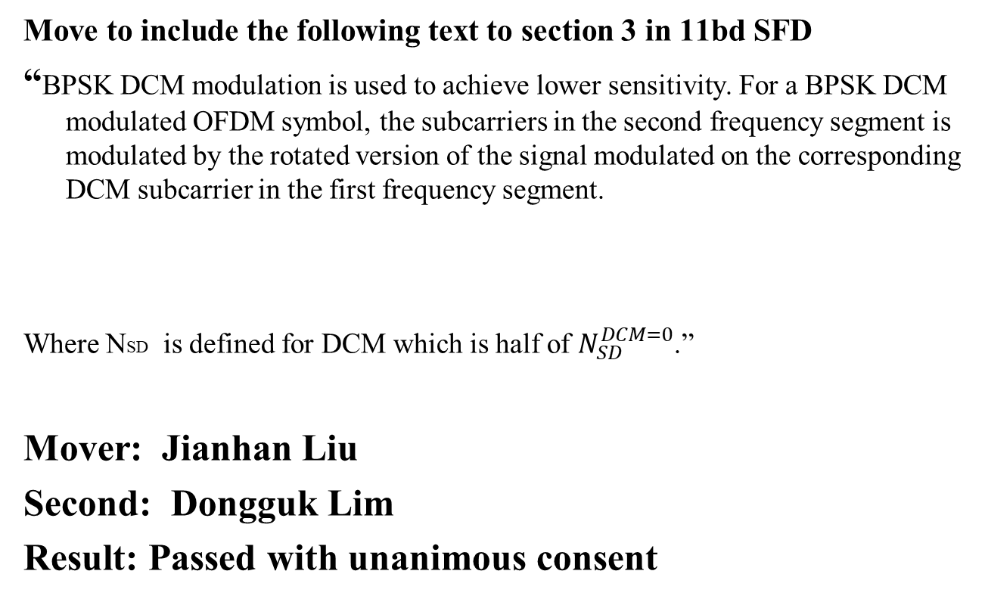
FRD&SFD Motion #18
Move to include the following text to section 3 in 11bd SFD
“BPSK DCM modulation is used to achieve lower sensitivity. For a BPSK DCM modulated OFDM symbol, the subcarriers in the second frequency segment is modulated by the rotated version of the signal modulated on the corresponding DCM subcarrier in the first frequency segment.
Where NSD is defined for DCM which is half of $N_{SD}^{DCM=0}$.”
Mover: Jianhan Liu
Second: Dongguk Lim
Result: Passed with unanimous consent

Slide 24
FRD&SFD Motion #19
Move to include the following text to section 3 in 11bd SFD
“ 11bd shall support adaptive repetition of 11p PPDU when operating on OCB broadcast mode in 10MHz bandwidth.
The signaling of the adaptive repetition is TBD.
The time between repeated 11p PPDUs is TBD.”
Mover: James Lepp
Second: Dongguk Lim
Result: 16Y/0N/11A

Slide 25
FRD&SFD Motion #20
Move to include the following text to section 3 in 11bd SFD
“In an 11bd PPDU, the RATE field shall be set to the value representing 3 Mb/s in the 10 MHz channel spacing column of Table 17-6 (Contents of the SIGNAL field.”
Mover: Dongguk Lim
Second: Hongyuan Zhang
Result: Passed with unanimous consent

Slide 26
FRD&SFD Motion #21
Move to include the following text to section 3 in 11bd SFD
“ NGV-SIG is located right after the RL-SIG in 11bd PPDU.”
Mover: Dongguk Lim
Second: Hongyuan Zhang
Result: Passed with unanimous consent

Slide 27
FRD&SFD Motion #22
Move to include the following text to section 2.1 in 11bd FRD
“The 802.11bd amendment shall improve transmission reliability under congested communication environment compared to IEEE Std 802.11™-2016 operating in 5.9 GHz band .”
Mover: Hanseul Hong
Second: Ronny Kim
Result: Passed with unanimous consent

Slide 28
FRD&SFD Motion #23
Move to include the following text to section 3 in 11bd SFD
“11bd PHY shall define only one PPDU format.”
Mover: Rui Cao
Second: Jianhan Liu
Result: Passed with unanimous consent

Slide 29
FRD&SFD Motion #24
Move to include the following text to section 3 in 11bd SFD
“ The preamble of 11bd PPDU shall include repeated LSIG symbol after LSIG.”
Mover: Rui Cao
Second: Dongguk Lim
Result: Passed with unanimous consent

Slide 30
FRD&SFD Motion #25
Move to include the following text to section 3 in 11bd SFD
“ -11bd PPDU shall boost L-STF by x1dB when data portion is modulated with BPSK or BPSK with DCM, with x1 > 0, and x1 value TBD.
- 11bd PPDU shall boost L-LTF by x2dB when data portion is modulated with BPSK or BPSK with DCM, with x2 > 0, and x2 value TBD.”
Mover: Rui Cao
Second: Jianhan Liu
Result: Passed with unanimous consent

Slide 31
FRD&SFD Motion #26
Move to include the following text to section 3 in 11bd SFD
“11bd supports two spatial streams for unicast transmissions as an optional feature.”
Mover: Rui Cao
Second: Dongguk Lim
Result: Passed with unanimous consent

Slide 32
September 2019
FRD & SFD Motions
Motion #27 -- #54
Hanoi, Vietnam

Slide 33
FRD&SFD Motion #27
(DCN:11-19/1619r0)
Move to add the following text to Section 3.2 of 11bd SFD:
“For each frame carried in a 11bd PPDU, one MPDU Delimiter shall be used to indicate the length of the frame in octets.”
Mover: Liwen Chu
Second: Hongyuan Zhang
Result: Approved by unanimous consent
Bo Sun (ZTE)

Slide 34
FRD&SFD Motion #28
(DCN:1470r0)
Move to include the following text to section 3.1 of 11bd SFD
11bd L-STF shall be boosted by 3dB when NGV data portion is modulated with BPSK.
11bd L-LTF shall be boosted by 3dB when NGV data portion is modulated with BPSK.
Mover: Prashant Sharma
Second: Hongyuan Zhang
Result: Y6/N4/A5. Failed

Slide 35
FRD&SFD Motion #29
(DCN:11-19/1162r0)
Move to make the following changes in 11bd SFD
Remove Section 4.1 Physical Layer
Add the following text in Section 4.2
“11bd supports enabling DMG operation when dot11OCBActivated is true.”
Mover: Hiroyuki Motozuka
Second: Bahar Sadeghi
Result: Approved by unanimous consent

Slide 36
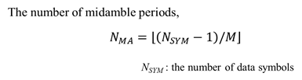
FRD&SFD Motion #30
(DCN: 11-19/1151r3)
Move to include the following text to section 3 of 11bd SFD
Mover: Yujin Noh
Second: Rui Cao
Result: Y9/N0/A4. Approved

Slide 37
FRD&SFD Motion #31
(DCN: 11-19/1151r3)
Move to include the following text to section 3 of 11bd SFD
“11bd PPDU shall support at least two values of midamble periodicity.
Midamble periodicity is TBD.”
Mover: Yujin Noh
Second: Dongguk Lim
Result: Approved by unanimous consent

Slide 38
FRD&SFD Motion #32
(DCN: 11-19/1151r3)
[Motion was amended---refer to the minutes]
Move to include the following text to section 3 of 11bd SFD
“11bd PPDU shall support Midamble periodicity indication in number of OFDM symbols in the Data field. “
Mover: Yujin Noh
Second: Dongguk Lim
Result: Approved by unanimous consent

Slide 39
FRD&SFD Motion #33
(DCN: 11-19/1152r2)
Move to include the following text to section 3 of 11bd SFD
“11bd shall support 2x Compressed NGV-LTF.
Midamble is the same format as NGV-LTF.”
Mover: Yujin Noh
Second: Rui Cao
Result: Y9/N0/A6. Approved

Slide 40
FRD&SFD Motion #34
(DCN: 11-19/1152r2)
Move to include the following text to section 3 of 11bd SFD
“NGV-Signal field shall include 1 bit to indicate NGV-LTF format.
The first option is 2x compressed LTF.
The second option is non-compressed LTF.”
Mover: Yujin Noh
Second: Dongguk Lim
Result: Y8/N1/A5. Approved

Slide 41
FRD&SFD Motion #35
(DCN:11-19/1502r1 )
Move to include the following text to section 3.2 of 11bd SFD
“11bd enables at least one of A-MPDU or A-MSDU operation to work for broadcast OCB.”
Mover: James Lepp
Second: Joseph Levy
Result: Y6/N6/A4. Failed

Slide 42
FRD&SFD Motion #36
(DCN:11-19/1502r1 )
Move to include the following text to section 3.2 of 11bd SFD
“11bd enables both A-MSDU and A-MPDU operation to work for unicast OCB and not to exceed the constraints on A-MSDU in A-MPDU as defined in 802.11ac.’
Mover: James Lepp
Second: Joseph Levy
Result: Approved by unanimous consent

Slide 43
FRD&SFD Motion #37
(DCN:11-19/1503r1 )
Move to include the following text to 11bd FRD
“802.11bd considers mechanisms for power saving in NGV.”
Mover: James Lepp
Second: Rui Yang
Result: Approved by unanimous consent

Slide 44
FRD&SFD Motion #38
(DCN:1503r2, tabled, see minutes )
Move to include the following text to section 3.2 of 11bd SFD
“802.11bd amendment will allow Wake-up Radio (WUR) for OCB in 5.9GHz.”
Mover: James Lepp
Second: Hanseul Hong
Result:

Slide 45
FRD&SFD Motion #39
(DCN: 11-19/1472r1)
Move to include the following text to section 3 of 11bd SFD
“The Midamble and NGV-LTF format of 11bd 10MHz PPDU shall use Repeated LTF or Repeated compressed LTF for NGV-Data modulated with BPSK”
Mover: Rui Cao
Second: Dongguk Lim
Result: Approved by unanimous consent

Slide 46
FRD&SFD Motion #40
(DCN: 11-19/1472r1)
Move to include the following text to section 3 of 11bd SFD
“11bd shall use two bits in NGV-SIG to signal the Midamble periodicity.”
Mover: Rui Cao
Second: Dongguk Lim
Result: Approved by unanimous consent

Slide 47
FRD&SFD Motion #41
(DCN: 11-19/1472r1)
Move to include the following text to section 3 of 11bd SFD
“One of the Midamble periodicity values is 4.”
Mover: Rui Cao
Second: Dongguk Lim
Result: Y9/N0/A6 Approved

Slide 48
FRD&SFD Motion #42
(DCN: 11-19/1473r0)
Move to include the following text to section 3 of 11bd SFD
“11bd 20MHz PPDU Data symbol shall use 11ac 40MHz OFDM downclock by 2.”
Mover: Rui Cao
Second: Dongguk Lim
Result: Approved by unanimous consent

Slide 49
FRD&SFD Motion #43
(DCN: 11-19/1480/r2)
Move to include the following text to 11bd SFD
  “-A 20MHz channel includes two contiguous 10MHz channels
  -20MHz channel access shall use sensing and backoff procedure for both of 10MHz channels
  -20MHz channel access shall use only one backoff counter
  -Two contiguous 10MHz channels shall use the same receive sensitivity level”
Mover: Insun Jang
Second: Dongguk Lim
Result: Approved by unanimous consent

Slide 50
FRD&SFD Motion #44
(DCN:11-19/1480r2)
Move to include the following text to 11bd SFD
  “20MHz channel access performs a backoff procedure based on the channel states of two contiguous 10MHz channels
    The backoff counter decreases when two contiguous 10MHz channels are idle
      Idle states are checked by TBD sensing methods (e.g., Packet detection, GI detection, energy detection)
    More details are TBD.”
Mover: Insun Jang
Second: James Lepp
Result: Approved by unanimous consent

Slide 51
FRD&SFD Motion #45
(DCN:11-19/1478r2)
Move to include the following text to section 3 of 11bd SFD
“ When channel busy is indicated in the secondary channel and the duration of channel use is not known (e.g., NAV, packet detection), channel state shall be determined to be idle for a TBD IFS (e.g., AIFS, EIFS) sensing period before it resumes the backoff procedure.”
Mover: Hanseul Hong
Second: Ronny Kim
Result: Approved by unanimous consent

Slide 52
FRD&SFD Motion #46
(DCN:11-19/1484r3)
Move to include the following text to section 3 of the 11bd SFD
  “ The NGV-SIG field carries information required to interpret 11bd PPDU. The NGV-SIG field is composed of 24 data bits.
  The contents for 24 data bits are TBD”
  The NGV-SIG symbol shall be BCC encoded at rate, R = 1/2, be interleaved, be mapped to a BPSK constellation.”
Mover: Dongguk Lim
Second: Rui Cao
Result: Approved by unanimous consent

Slide 53
FRD&SFD Motion #47
(DCN:11-19/1484r3)
Move to include the following text to section 3 of the 11bd SFD
  “The preamble of 11bd PPDU shall include repeated NGV-SIG after NGV-SIG.”
Mover: Rui Cao
Second: Insun Jang
Result: Y7/N0/A4 Approved

Slide 54
FRD&SFD Motion #48
(DCN:11-19/1484r3)
Move to include the following text to section 3 of the 11bd SFD
  “The RNGV-SIG is configured identically to the NGV-SIG.”
Mover: Insun Jang
Second: Rui Cao
Result: Y8/N0/A2 Approved

Slide 55
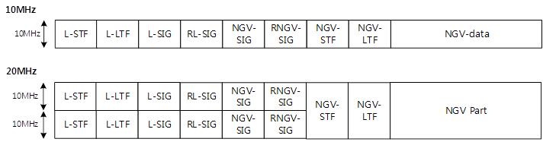
FRD&SFD Motion #49
(DCN:11-19/1485r2)
Move to include the following text to section 3 of the 11bd SFD
  ““The preamble of 11bd PPDU shall include NGV-STF and NGV-LTF after repeated NGV-SIG.
  The composition of NGV-STF and NGV-LTF is TBD”
Mover: Insun Jang
Second: Bahar Sadeghi
Result: Approved by unanimous consent

Slide 56
FRD&SFD Motion #50
(DCN:11-19/1471r1)
Move to include the following text to section 3 of the 11bd SFD
  “The NGV-STF in 11bd 10MHz PPDU shall use 11ac 20MHz VHT-STF with 2x downclock.”
  “The NGV-LTF in 11bd 10MHz PPDU shall use 11ac 20MHz VHT-LTF with 2x downclock.”
Mover: Rui Cao
Second: Bahar Sadeghi
Result: Approved by unanimous consent

Slide 57
FRD&SFD Motion #51
(DCN:11-19/1471r1)
Move to include the following text to section 3 of the 11bd SFD
  “The NGV-STF in 11bd 20MHz PPDU shall use 11ac 40MHz VHT-STF with 2x downclock.”
  “The NGV-LTF in 11bd 20MHz PPDU shall use 11ac 40MHz VHT-LTF with 2x downclock.”
Mover: Rui Cao
Second: Yujin Noh
Result: Approved by unanimous consent

Slide 58
FRD&SFD Motion #52
(DCN:11-19/1473r1)
Move to include the following text to section 3 of the 11bd SFD
  “11bd 20MHz PPDU Data symbol shall use 11ac 40MHz OFDM downclock by 2”
Mover: Rui Cao
Second: Bahar Sadeghi
Result: Approved by unanimous consent

Slide 59
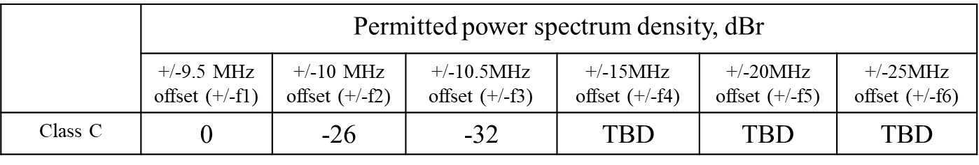
FRD&SFD Motion #53
(DCN:11-19/1473r1)
Move to include the following text to section 3 of the 11bd SFD
Mover: Rui Cao
Second: Bahar Sadeghi
Result: Approved by unanimous consent

Slide 60
FRD&SFD Motion #54
(DCN:11-19/1484r3)
Move to include the following text to section 3 of the 11bd SFD
  “RL-SIG is modulated same as L-SIG”
Mover: Dongguk Lim
Second: Rui Cao
Result: Approved by unanimous consent

Slide 61
November 2019
FRD & SFD Motions
Motion #55 -- #70
Kona, HI, USA

Slide 62
FRD&SFD Motion #55
(DCN:11-19/1805r1)
Move to add the following text to section 3.2 of the 11bd SFD
“The MAC service interface (MAC_SAP and MLME_SAP) shall be extended to provide higher layers with the ability to control NGV transmissions and receive status regarding NGV receptions and the radio environment when operating with dot11OCBActivated = TRUE.”
Mover: Alessio Filippi
Second: James Lepp
Result: Approved by unanimous consent

Slide 63
FRD&SFD Motion #56
(DCN:11-19/1849r3)
Move to add the following text to the spec-framework document of 11bd
  “For the 10MHz transmission, the NGV-LTF-1x sequence on subcarriers[-28:28] is given by following sequence
    NGV-LTF-1x_{(-28:2:28)} = [1 1 -1 1 -1 -1 1 1 1 -1 1 1 1 1 0 -1 1 -1 -1 -1 -1 -1 1 -1 -1 -1 1 1 -1]”
Mover: Dongguk Lim
Second: Insun Jang
Result: Approved by unanimous consent

Slide 64
FRD&SFD Motion #57
(DCN:11-19/1849r3)
Move to add the following text to the spec-framework document of 11bd
  “For the 20MHz transmission, the NGV-LTF-1x sequence on subcarriers[-58:58] is given by following sequence
    NGV-LTF-1x_{(-58:2:58)} = [1 -1 1 -1 -1 1 1 1 -1 1 1 1 1 1 -1 1 -1 -1 -1 -1 -1 1 -1 -1 -1 1 1 -1 1 0 1 -1 -1 1 -1 1 1 -1 -1 -1 1 -1 -1 -1 -1 -1 1 -1 1 1 1 1 1 -1 1 1 1 -1 -1] «
Mover: Dongguk Lim
Second: Insun Jang
Result: Approved by unanimous consent

Slide 65
FRD&SFD Motion #58
(DCN:11-19/1849r3)
Move to add the following text to the spec-framework document of 11bd
  “The same number of pilot tones are used in NGV-LTF-1x, NGV-LTF-2x and data field.
    In 10MHz, 4 pilot tones shall be inserted.
    In 20MHz, 6 pilot tones shall be inserted.
  The pilot tones use the even tone indices defined for data field.
    In 10MHz, the tone indices are [±8, ±22 ].
    In 20MHz, the tone indices are [±54, ±26, ±12]. ”
Mover: Dongguk Lim
Second: Insun Jang
Result: Approved by unanimous consent

Slide 66
FRD&SFD Motion #59
(DCN:11-19/1826r2)
Move to add the following text to the 11bd SFD
“One of the Midamble Periodicity is 8.”
Mover: Prashant Sharma
Second: Dongguk Lim
Result: Approved by unanimous consent

Slide 67
FRD&SFD Motion #60
(DCN:11-19/1826r2)
Move to add the following text to the 11bd SFD
“One of the Midamble Periodicity is 16.”
Mover: Prashant Sharma
Second: Dongguk Lim
Result: Approved by unanimous consent

Slide 68
FRD&SFD Motion #61
(DCN:11-19/1826r2)
Move to add the following text to the 11bd SFD
“Only three Midamble periodicity options are defined in 11bd. The fourth option is Reserved.”
Mover: Prashant Sharma
Second: Dongguk Lim
Result: 13Y/5N/10A, Failed

Slide 69
FRD&SFD Motion #62
(DCN:11-19/1784r2)
Move to add the following text to the 11bd SFD
“NGV shall allow Mulitcast reception feedback. Upper layer initiates the Ack request and selects the recipients.”
Mover: Bahar Sadeghi
Second: James Lepp
Result: 13Y/5N/7A, Failed
Motion to amend to text shown above
Moved: Bahar; Seconded: Joseph Levy
11Y/0N/9A, Passed

Slide 70
FRD&SFD Motion #63
(DCN:11-19/1824r1)
Move to add the following text to the 11bd SFD
“NGV PPDU modulated with BPSK and DCM shall power boost L-STF and L-LTF by 3dB.”
Mover: Rui Cao
Second: Dongguk Lim
Result: Approved by unanimous consent

Slide 71
FRD&SFD Motion #64
(DCN:11-19/1824r1)
Move to add the following text to the 11bd SFD
“NGV PPDU modulated with BPSK shall power boost L-STF and L-LTF by 3dB.”
Mover: Rui Cao
Second: Dongguk Lim
Result: Approved by unanimous consent

Slide 72
FRD&SFD Motion #65
(DCN:11-19/1824r1)
Move to add the following text to the 11bd SFD
“NGV SIG field shall include the following bits with bit order TBD:
• BW: 1 bit
• MCS: 4 bits
• Nss: 1 bit
• Midamble periodicity: 2 bits
• LDPC Extra symbol: 1bit
• LTF format: 1 bit
• Tail bit: 6 bits.”
Mover: Rui Cao
Second: Dongguk Lim
Result: Approved by unanimous consent

Slide 73
FRD&SFD Motion #66
(DCN:11-19/1824r1)
Move to add the following text to the 11bd SFD
Mover: Ioannis Sarris
Second: Joseph Levy
Result: Approved by unanimous consent
NGV adds a new spectrum mask definition for 20 MHz Class C2
 | Permitted power spectral density, dBr
 | +/-9.5 MHz offset (+/-f1) | +/-10 MHz offset (+/-f2) | +/-10.5MHz offset (+/-f3) | +/-15MHz offset (+/-f4) | +/-25MHz offset (+/-f5)
Class-C2 20MHz | 0 | -26 | -32 | -40 | -50

Slide 74
FRD&SFD Motion #67
(DCN:11-19/1824r1)
Move to add the following text into Section 3 of 11bd SFD?
• “NGV SIG field shall use 4-bit CRC.”
Moved by: Rui Cao
Seconded: Dongguk Lim
Result: Approved by unanimous consent

Slide 75
FRD&SFD Motion #68
(DCN:11-19/1824r1)
Move to add the following text into Section 3 of 11bd SFD?
• “NGV-LTF and Midamble field shall use repeated NGV-LTF-2x when NGV Data is modulated using BPSK-1/2 with DCM.”
Moved by: Rui Cao
Second: Dongguk Lim
Result: Approved by unanimous consent

Slide 76
FRD&SFD Motion #69
(DCN:11-19/1824r1)
Move to add the following text into Section 3 of 11bd SFD?
• “Repeated NGV-LTF-2x is constructed by repeating the IFFT output of NGV-LTF-2x and pre-append one cyclic prefix of duration 1.6us.”
Moved by: Rui Cao
Second: Alessio Filippi
Result: 16Y/0N/5A, Passed

Slide 77
FRD&SFD Motion #70
(DCN:11-19/1824r1)
Move to add the following text into Section 3 of 11bd SFD?
• “NGV-LTF-2x, NGV-LTF-1x and Data symbols shall define the same pilot location.”
Moved by: Rui Cao
Seconded: Alessio Filippi
Result: 15Y/0N/5A, PASSED

Slide 78
January 2020
FRD & SFD Motions
Motion #71 -- #88
Irvine, CA, USA

Slide 79
FRD&SFD Motion #71
(DCN:11-19/1973r2 )
Move to include the following text to section 3.2 of the 11bd SFD
“20 MHz channel consists of two contiguous 10 MHz channel:
-In one 10 MHz channel (denoted as OCB primary channel), the channel sensing with PD and ED with NAV setting method shall be applied.
When the OCB primary channel is sensed as channel busy, the backoff procedure on the OCB primary channel shall be same as the backoff procedure of 10 MHz transmission.”
Mover: Hanseul Hong
Second: Ronny Kim
Result: 12Y/0N/10A, PASSED

Slide 80
FRD&SFD Motion #72
(DCN:11-19/1973r2 )
Move to include the following text to section 3.2 of the 11bd SFD
“When OCB secondary channel is sensed busy and the duration of channel busy is not known, after the channel state transitions from busy to idle, EIFS interval shall be used to detect if the channel remains idle before resuming the backoff procedure.
When OCB secondary channel is sensed busy and the duration of channel busy is known, after the channel state transitions from busy to idle, AIFS interval shall be used to detect if the channel remains idle before resuming the backoff procedure.
Note: STA is not required to decode the duration of channel busy on the OCB secondary channel.”
Mover: Hanseul Hong
Second: Ronny Kim
Result: Approved by unanimous consent
Motion was amended, see the details in the minutes

Slide 81
FRD&SFD Motion #73
(DCN:11-19/1973r2 )
Move to include the following text to section 3.2 of the 11bd SFD
“The decision of whether the STA is allowed to use 10 MHz fallback mechanism, as specified in the baseline 802.11 specification, is indicated by the upper layer.”
Mover: Hanseul Hong
Second: Ronny Kim
Result: Approved by unanimous consent

Slide 82
FRD&SFD Motion #74
(DCN:11-20/0046r4 )
Move to include the following text to section 3 of the 11bd SFD
“For 20 MHz operation, the minimum CCA sensitivity on the secondary 10 MHz channel shall be -85 dBm for NGV and legacy 802.11p PPDUs, and shall be -65 dBm for any other signal.”
Mover: Rui Cao
Second: Dongguk Lim
Result: Approved by unanimous consent

Slide 83
FRD&SFD Motion #75
(DCN:11-20/0045r3 )
Move to include the following text to section 3 of the 11bd SFD
“LDPC is the only coding scheme for the data portion of 11bd PPDU.”
Mover: Rui Cao
Second: Dongguk Lim
Result: 7Y/2N/11A, PASSED

Slide 84
FRD&SFD Motion #76
(DCN:11-20/0045r3 )
Move to include the following text to section 3 of the 11bd SFD
“Only three Midamble periodicity are defined in 11bd. The fourth option is Reserved.”
Mover: Rui Cao
Second: Dongguk Lim
Result: Approved by unanimous consent

Slide 85
FRD&SFD Motion #77
(DCN:11-20/0045r3 )
Move to include the following text to section 3 of the 11bd SFD
“L-STF and L-LTF power boost and repeated NGV-LTF only apply to 11bd transmission using 10MHz bandwidth, one spatial stream and BPSK modulation.”
Mover: Rui Cao
Second: Dongguk Lim
Result: Approved by unanimous consent

Slide 86
FRD&SFD Motion #78
(DCN:11-20/0045r3 )
Move to include the following text to section 3 of the 11bd SFD
“NGV-LTF-1x only applies to 11bd transmissions with one spatial stream.”
Mover: Rui Cao
Second: Dongguk Lim
Result: Approved by unanimous consent

Slide 87
FRD&SFD Motion #79
(DCN:11-20/0044r2 )
Move to include the following text to section 3 of the 11bd SFD
“NGV SIG includes 2 PHY version bits and 2 Reserved bits.”
Mover: Rui Cao
Second: Dongguk Lim
Result: Approved by unanimous consent

Slide 88
FRD&SFD Motion #80
(DCN:11-20/0044r2 )
Move to include the following text to section 3 of the 11bd SFD
“The 24-bit NGV SIG content table is defined as below.”
Mover: Rui Cao
Second: Dongguk Lim
Result: Approved by unanimous consent
Bit | Field | Number of bits | Description
B0-B1 | PHY version | 2 | Set 0 for 11bd, other three options are reserved for future generations.
B2 | Bandwidth | 1 | Set 0 for 10MHz, set 1 for 20MHz.
B3-B6 | MCS | 4 | MCS table
B7 | Nss | 1 | Set 0 for 1 ss, and set 1 for 2ss.
B8-B9 | Midamble Periodicity | 2 | Set 0 for 4 symbols, set 1 for 8 symbols, set 2 for 16 symbol. Value 3 is reserved.
B10 | LTF format | 1 | Set 0 for uncompressed LTF; set 1 for compressed LTF.
B11 | LDPC Extra OFDM Symbol | 1 | Set to 1 if the LDPC PPDU encoding process results in an extra OFDM symbol as described in 21.3.10.5.4 (LDPC coding). Set to 0 otherwise.
B12-B13 | Reserved | 2 | Reserved and set to 1.
B14-B17 | CRC | 4 | CRC calculated as in 19.3.9.4.4 (CRC calculation for HTSIG).
B18-B23 | Tail | 6 | Used to terminate the trellis of the convolutional decoder. Set to 0.

Slide 89
FRD&SFD Motion #81
(DCN:11-20/0044r2 )
Move to include the following text to section 3 of the 11bd SFD
“11bd defines the following MCS table.”
Mover: Rui Cao
Second: Dongguk Lim
Result: Approved by unanimous consent
MCS index | Modulation | Code rate
0 | BPSK | ½
1 | QPSK | ½
2 | QPSK | ¾
3 | 16QAM | ½
4 | 16QAM | ¾
5 | 64QAM | 2/3
6 | 64QAM | ¾
7 | 64QAM | 5/6
8 | 256QAM | ¾
9 | 256QAM | 5/6
10 | BPSK with DCM | 1/2

Slide 90

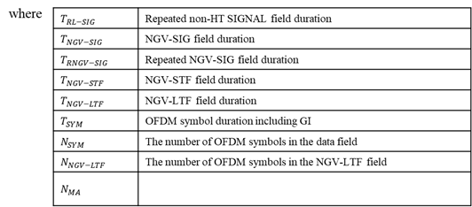
FRD&SFD Motion #82
(DCN:11-19/1863r2 )
Move to include the following text to section 3 of the 11bd SFD
“
Note: remove the N_MA row
Mover: Yujin Noh
Second: Dongguk Lim
Result: Approved by unanimous consent

Slide 91
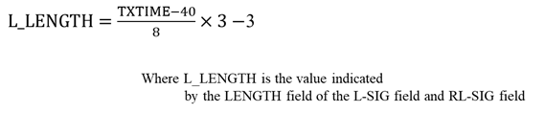
FRD&SFD Motion #83
(DCN:11-19/1863r2 )
Move to include the following text to section 3 of the 11bd SFD
“
Mover: Yujin Noh
Second: Dongguk Lim
Result: Approved by unanimous consent

Slide 92
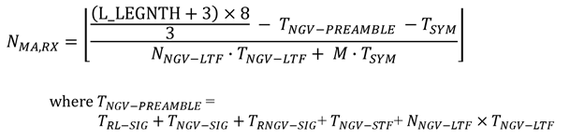
FRD&SFD Motion #84
(DCN:11-19/1863r2 )
Move to include the following text to section 3 of the 11bd SFD
“
Mover: Yujin Noh
Second: Dongguk Lim
Result: Approved by unanimous consent

Slide 93
FRD&SFD Motion #85
(DCN:11-19/1863r2 )
Move to include the following text to section 3 of the 11bd SFD
“
Mover: Yujin Noh
Second: Dongguk Lim
Result: Approved by unanimous consent

Slide 94
FRD&SFD Motion #86
(DCN:11-19/1863r2 )
Move to include the following text to section 3 of the 11bd SFD
“
Mover: Yujin Noh
Second: Dongguk Lim
Result: Approved by unanimous consent

Slide 95
FRD&SFD Motion #87
(DCN:11-19/1864r1 )
Move to include the following text to section 3 of the 11bd SFD
“
Mover: Yujin Noh
Second: Dongguk Lim
Result: Approved by unanimous consent
  The function τk, BW is used to represent a rotation of the tones.

Slide 96
FRD&SFD Motion #88
(DCN:11-19/1969r2, SP2 )
Move to include the following text to section 3 of the 11bd SFD
Mover: Rui Cao
Second: Dongguk Lim
Result: Approved by unanimous consent
  Within a 20MHz channel, one 10MHz channel is OCB primary 10MHz channel, another 10MHz channel is OCB secondary 10MHz channel.
  The OCB primary 10MHz channel is decided by upper layer.

