Slide 1
Motion Booklet for IEEE 802.11 TGbd
Date: 2019-03-14
Authors:

Slide 2
Abstract
Booklet for the TGbd motions related to FRD and SFD.
Motions are consecutively numbered since the formation of the task group.

Slide 3
March 2019
FRD & SFD Motions
Motion #1 -- #7
Vancouver, BC, Canada

Slide 4
FRD&SFD Motion #1
Move to update the 11bd FRD according to the changes captured in document 11-19/0511r1.
Moved: Bahar Sadeghi
Seconded: Joseph Levy
Result: Passed unanimous

Slide 5
FRD&SFD Motion #2
Move to add the following text to section 3 in 11bd SFD.
  “ 11bd PPDU format includes L-STF, L-LTF, and L-SIG fields as shown in Figure 3.x
    L-STF means short training field of 11p.
    L-LTF means long training field of 11p.
    L-SIG means signal field of 11p.”
Moved: Dongguk Lim
Seconded: Hongyuan Zhang
Result: 33Y/0N/9A, passed
L-STF
L-LTF
L-SIG
11bd PPDU
Figure 3.x 11bd PPDU format

Slide 6
FRD&SFD Motion #3
Move to add the following text to section 3 in 11bd SFD.
  “11bd supports the 10MHz bandwidth PPDUs.
  11bd supports the 20MHz bandwidth PPDUs. ”
Mover: Dongguk Lim
Second: Hongyuan Zhang
Result: Passed unanimous

Slide 7
FRD&SFD Motion #4
Move to add the following text to section 3 in 11bd SFD.
  “In 20MHz bandwidth, L-STF, L-LTF, and L-SIG for 10MHz PPDU are duplicated as shown in the figure below.”
Mover: Dongguk Lim
Second: Hongyuan Zhang
Result: 25Y/0N/19A, passed
10MHz
L-STF
L-LTF
L-SIG
10MHz
L-STF
L-LTF
L-SIG
11bd PPDU

Slide 8
FRD&SFD Motion #5
Move to add the following text into Section 3 of SFD
  “11bd amendment shall support LDPC”
Mover: Prashant Sharma
Second: Hongyuan Zhang
Result: Passed unanimous

Slide 9
FRD&SFD Motion #6
Move to add the following text into Section 3 of SFD
  “An 11bd STA shall be capable of the following operations:
    To decode 11p PPDUs with TBD receive sensitivity threshold (TBD value is -85dBm or lower).
    To transmit PPDU format up on request from upper layer, the PPDU format can be either 11p PPDU or 11bd PPDU.”
Mover: Rui Cao
Second: Hongyuan Zhang
Result: 27Y/0N/14A, passed

Slide 10
FRD&SFD Motion #7
Move to add the following text into Section 3 of SFD
  “An 11bd STA shall indicate the NGV capability in MAC level, when transmitting an 11p PPDU”
Mover: Rui Cao
Second: Hongyuan Zhang
Result: passed unanimous

Slide 11
MaY 2019
FRD & SFD Motions
Motion #8 -- #16
Atlanta, GA, USA

Slide 12
FRD&SFD Motion #8
Move to add the following text to section 3 in 11bd SFD
“11bd shall support the same subcarrier spacing in both 10 MHz PPDU and 20MHz PPDU”
Mover: Dongguk Lim
Second: Hongyuan Zhang
Result: Passed unanimously

Slide 13
FRD&SFD Motion #9
Move to add the following text to section 3 in 11bd SFD
“11bd PPDU includes a NGV-Signal field to indicate the transmission information”
“ The location of NGV-SIG field is TBD”
Mover: Dongguk Lim
Second: Hongyuan Zhang
Result: Passed unanimously

Slide 14
FRD&SFD Motion #10
Move to add the following text to section 3 in 11bd SFD
“11bd PPDU design shall support Midamble(s) in Data field.
Midamble is composed by long training field, with design TBD.
Midamble periodicity is TBD. “
Mover: Dongguk Lim
Second: Hongyuan Zhang
Result: 8Y/1N/8A Passed

Slide 15
FRD&SFD Motion #11
Move to add the following text to section 3.1 of the SFD:
“11bd devices shall support 256 QAM. The 256 QAM constellation mapping is the same as that defined in 21.3.10.9 (Constellation mapping)”
Mover: Hongyuan Zhang
Second: Dongguk Lim
Result: 15Y/2N/10A, PASSED

Slide 16
FRD&SFD Motion #12
Move to add the following text to Section 3.1 of the SFD:
“11bd devices shall support LDPC codes, with the same code structure and coding methods as defined in 19.3.11.7 (LDPC Codes)”
Mover: Hongyuan Zhang
Second: Dongguk Lim
Result: Passed unanimously

Slide 17
FRD&SFD Motion #13
Move to add the following text to section 3.1 of the SFD:
“10MHz 11bd Data symbol shall use 11ac 20MHz OFDM numerology. “
Mover: Prashant Sharma
Second: Dongguk Lim
Result: Passed unanimously

Slide 18
FRD&SFD Motion #14
Move to add the following text to section 3 in 11bd SFD
“Operation of 11bd device with 10MHz bandwidth is allowed in a 20MHz channel.”
Mover: Insun Jang
Second: Dongguk Lim
Result: 15Y/6N/9A, Failed
Move to table the motion
Moved: Hiroshi Mano Second: Michael Fischer
Passed unanimously
Move to remove the table of the motion
Moved: James Lepp Second: Michael Fischer
Passed unanimously

Slide 19
FRD&SFD Motion #15
Move to include the following text to section 3 in 11bd SFD
“11bd only supports single spatial stream PPDU when operating on OCB broadcast mode .”
Mover: Hongyuan Zhang
Second: Dongguk Lim
Result: Passed unanimously

Slide 20
FRD&SFD Motion #16
Move to include the following text to section 3 in 11bd SFD
“When an 11bd STA transmits an 11p group-addressed or unicast PPDU, the Duration/ID field of a frame in an 11p PPDU indicates that transmitter of the PPDU is an NGV capable STA.”
Mover: Liwen Chu
Second: Michael Fischer
Result: Passed unanimously

Slide 21
July 2019
FRD & SFD Motions
Motion #17 -- #26
Vienna, Austria

Slide 22
FRD&SFD Motion #17
Move to include the following text to section 3 in 11bd SFD
“11bd supports round-trip-time (RTT) ranging for 10 MHz and 20 MHz bandwidth PPDUs.”
Mover: Stephan Sand
Second: Ioannis Sarris
Result: Passed with unanimous consent

Slide 23

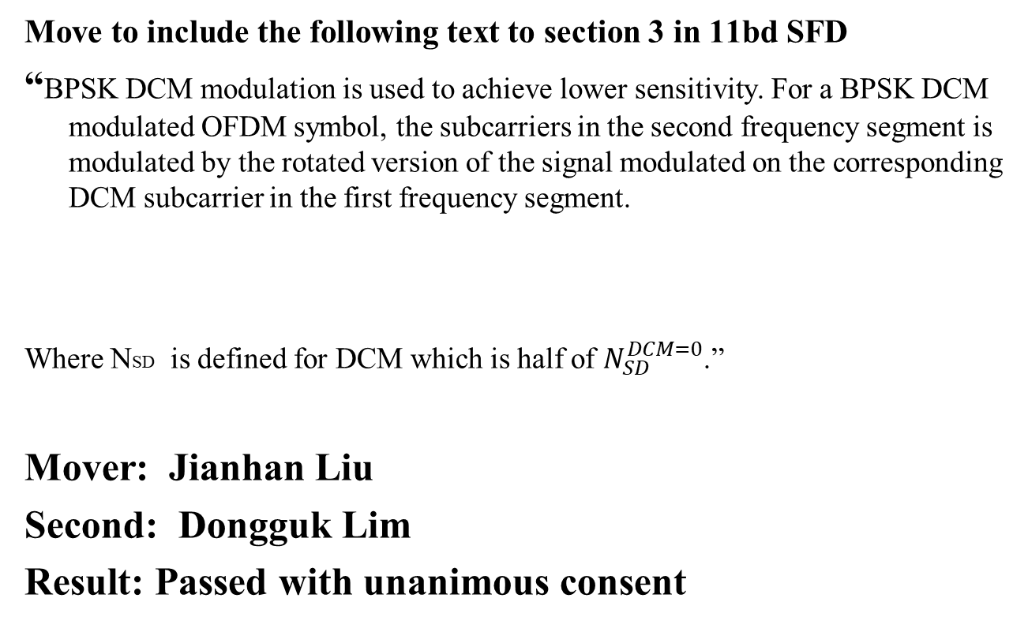
FRD&SFD Motion #18
Move to include the following text to section 3 in 11bd SFD
“BPSK DCM modulation is used to achieve lower sensitivity. For a BPSK DCM modulated OFDM symbol, the subcarriers in the second frequency segment is modulated by the rotated version of the signal modulated on the corresponding DCM subcarrier in the first frequency segment.
Where NSD is defined for DCM which is half of $N_{SD}^{DCM=0}$.”
Mover: Jianhan Liu
Second: Dongguk Lim
Result: Passed with unanimous consent

Slide 24
FRD&SFD Motion #19
Move to include the following text to section 3 in 11bd SFD
“ 11bd shall support adaptive repetition of 11p PPDU when operating on OCB broadcast mode in 10MHz bandwidth.
The signaling of the adaptive repetition is TBD.
The time between repeated 11p PPDUs is TBD.”
Mover: James Lepp
Second: Dongguk Lim
Result: 16Y/0N/11A

Slide 25
FRD&SFD Motion #20
Move to include the following text to section 3 in 11bd SFD
“In an 11bd PPDU, the RATE field shall be set to the value representing 3 Mb/s in the 10 MHz channel spacing column of Table 17-6 (Contents of the SIGNAL field.”
Mover: Dongguk Lim
Second: Hongyuan Zhang
Result: Passed with unanimous consent

Slide 26
FRD&SFD Motion #21
Move to include the following text to section 3 in 11bd SFD
“ NGV-SIG is located right after the RL-SIG in 11bd PPDU.”
Mover: Dongguk Lim
Second: Hongyuan Zhang
Result: Passed with unanimous consent

Slide 27
FRD&SFD Motion #22
Move to include the following text to section 2.1 in 11bd FRD
“The 802.11bd amendment shall improve transmission reliability under congested communication environment compared to IEEE Std 802.11™-2016 operating in 5.9 GHz band .”
Mover: Hanseul Hong
Second: Ronny Kim
Result: Passed with unanimous consent

Slide 28
FRD&SFD Motion #23
Move to include the following text to section 3 in 11bd SFD
“11bd PHY shall define only one PPDU format.”
Mover: Rui Cao
Second: Jianhan Liu
Result: Passed with unanimous consent

Slide 29
FRD&SFD Motion #24
Move to include the following text to section 3 in 11bd SFD
“ The preamble of 11bd PPDU shall include repeated LSIG symbol after LSIG.”
Mover: Rui Cao
Second: Dongguk Lim
Result: Passed with unanimous consent

Slide 30
FRD&SFD Motion #25
Move to include the following text to section 3 in 11bd SFD
“ -11bd PPDU shall boost L-STF by x1dB when data portion is modulated with BPSK or BPSK with DCM, with x1 > 0, and x1 value TBD.
- 11bd PPDU shall boost L-LTF by x2dB when data portion is modulated with BPSK or BPSK with DCM, with x2 > 0, and x2 value TBD.”
Mover: Rui Cao
Second: Jianhan Liu
Result: Passed with unanimous consent

Slide 31
FRD&SFD Motion #26
Move to include the following text to section 3 in 11bd SFD
“11bd supports two spatial streams for unicast transmissions as an optional feature.”
Mover: Rui Cao
Second: Dongguk Lim
Result: Passed with unanimous consent

Slide 32
September 2019
FRD & SFD Motions
Motion #27 -- #xx
Hanoi, Vietnam

Slide 33
FRD&SFD Motion #27
(DCN:11-19/1619r0)
Move to add the following text to Section 3.2 of 11bd SFD:
“For each frame carried in a 11bd PPDU, one MPDU Delimiter shall be used to indicate the length of the frame in octets.”
Mover: Liwen Chu
Second:
Result:
Bo Sun (ZTE)

Slide 34
FRD&SFD Motion #28
(DCN:1470r0)
Move to include the following text to section 3.1 of 11bd SFD
11bd L-STF shall be boosted by 3dB when NGV data portion is modulated with BPSK.
11bd L-LTF shall be boosted by 3dB when NGV data portion is modulated with BPSK.
Mover: Prashant Sharma
Second:
Result:

Slide 35
FRD&SFD Motion #29
(DCN:11-19/1162r0)
Move to make the following changes in 11bd SFD
Remove Section 4.1 Physical Layer
Add the following text in Section 4.2
“11bd supports enabling DMG operation when dot11OCBActivated is true.”
Mover: Hiroyuki Motozuka
Second:
Result:

Slide 36
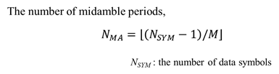
FRD&SFD Motion #30
(DCN: 11-19/1151r3)
Move to include the following text to section 3 of 11bd SFD
Mover: Yujin Noh
Second:
Result:

Slide 37
FRD&SFD Motion #31
(DCN: 11-19/1151r3)
Move to include the following text to section 3 of 11bd SFD
“11bd PPDU shall support at least two values of midamble periodicity.
Midamble periodicity is TBD.”
Mover: Yujin Noh
Second:
Result:

Slide 38
FRD&SFD Motion #32
(DCN: 11-19/1151r3)
Move to include the following text to section 3 of 11bd SFD
“11bd PPDU shall support Midamble periodicity indication that indicates the Midamble periodicity in number of OFDM symbols in the Data field. “
Mover: Yujin Noh
Second:
Result:

Slide 39
FRD&SFD Motion #33
(DCN: 11-19/1152r2)
Move to include the following text to section 3 of 11bd SFD
“11bd shall support 2x Compressed NGV-LTF.
Midamble is the same format as NGV-LTF.”
Mover: Yujin Noh
Second:
Result:

Slide 40
FRD&SFD Motion #34
(DCN: 11-19/1152r2)
Move to include the following text to section 3 of 11bd SFD
“NGV-Signal field shall include 1 bit to indicate NGV-LTF format.
The first option is 2x compressed LTF.
The second option is non-compressed LTF.”
Mover: Yujin Noh
Second:
Result:

Slide 41
FRD&SFD Motion #35
(DCN:11-19/1502r1 )
Move to include the following text to section 3.2 of 11bd SFD
“11bd enables at least one of A-MPDU or A-MSDU operation to work for broadcast OCB.”
Mover: James Lepp
Second:
Result:

Slide 42
FRD&SFD Motion #36
(DCN:11-19/1502r1 )
Move to include the following text to section 3.2 of 11bd SFD
“11bd enables both A-MSDU and A-MPDU operation to work for unicast OCB and not to exceed the constraints on A-MSDU in A-MPDU as defined in 802.11ac.’
Mover: James Lepp
Second:
Result:

Slide 43
FRD&SFD Motion #37
(DCN:11-19/1503r1 )
Move to include the following text to 11bd FRD
“802.11bd considers mechanisms for power saving in NGV.”
Mover: James Lepp
Second:
Result:

Slide 44
FRD&SFD Motion #38
(DCN:1503r2 )
Move to include the following text to section 3.2 of 11bd SFD
“802.11bd amendment will allow Wake-up Radio (WUR) for OCB in 5.9GHz.”
Mover: James Lepp
Second:
Result:

Slide 45
FRD&SFD Motion #39
(DCN: 11-19/1472r1)
Move to include the following text to section 3 of 11bd SFD
“The Midamble and NGV-LTF format of 11bd 10MHz PPDU shall use Repeated LTF or Repeated compressed LTF for NGV-Data modulated with BPSK”
Mover: Rui Cao
Second:
Result:

Slide 46
FRD&SFD Motion #40
(DCN: 11-19/1472r1)
Move to include the following text to section 3 of 11bd SFD
“11bd shall use two bits in NGV-SIG to signal the Midamble period.”
Mover: Rui Cao
Second:
Result:

Slide 47
FRD&SFD Motion #41
(DCN: 11-19/1472r1)
Move to include the following text to section 3 of 11bd SFD
“One of the Midamble periods is 4.”
Mover: Rui Cao
Second:
Result:

Slide 48
FRD&SFD Motion #42
(DCN: 11-19/1473r0)
Move to include the following text to section 3 of 11bd SFD
“11bd 20MHz PPDU Data symbol shall use 11ac 40MHz OFDM downclock by 2.”
Mover: Rui Cao
Second:
Result:

Slide 49
FRD&SFD Motion #43
(DCN: 11-19/1480/r2)
Move to include the following text to 11bd SFD
  “-A 20MHz channel includes two contiguous 10MHz channels
  -20MHz channel access shall use sensing and backoff procedure for both of 10MHz channels
  -20MHz channel access shall use only one backoff counter
  -Two contiguous 10MHz channels shall use the same receive sensitivity level”
Mover: Insun Jang
Second:
Result:

Slide 50
FRD&SFD Motion #44
(DCN:11-19/1480r2)
Move to include the following text to 11bd SFD
  “20MHz channel access performs a backoff procedure based on the channel states of two contiguous 10MHz channels
    The backoff counter decreases when two contiguous 10MHz channels are idle
      Idle states are checked by TBD sensing methods (e.g., Packet detection, GI detection, energy detection)
    More details are TBD.”
Mover: Insun Jang
Second:
Result:

Slide 51
FRD&SFD Motion #45
(DCN:11-19/1478r2)
Move to include the following text to section 3 of 11bd SFD
“ When channel busy is indicated in the secondary channel and the duration of channel use is not known (e.g., NAV, packet detection), channel state shall be determined to be idle for a TBD IFS (e.g., AIFS, EIFS) sensing period before it resumes the backoff procedure.”
Mover: Hanseul Hong
Second:
Result:

Slide 52
FRD&SFD Motion #46
(DCN:11-19/1484r3)
Move to include the following text to section 3 of the 11bd SFD
  “The NGV-SIG field carries information required to interpret 11bd PPDU. The NGV-SIG field is composed of 24 data bits.
  The contents for 24 data bits are TBD”
  The NGV-SIG symbol shall be BCC encoded at rate, R = 1/2, be interleaved, be mapped to a BPSK constellation.”
Mover: Dongguk Lim
Second:
Result:

Slide 53
FRD&SFD Motion #47
(DCN:11-19/1484r3)
Move to include the following text to section 3 of the 11bd SFD
  “The preamble of 11bd PPDU shall include repeated NGV-SIG after NGV-SIG.”
Mover: Dongguk Lim
Second:
Result:

Slide 54
FRD&SFD Motion #48
(DCN:11-19/1484r3)
Move to include the following text to section 3 of the 11bd SFD
  “The RNGV-SIG is configured identically to the NGV-SIG.”
Mover: Dongguk Lim
Second:
Result:

Slide 55
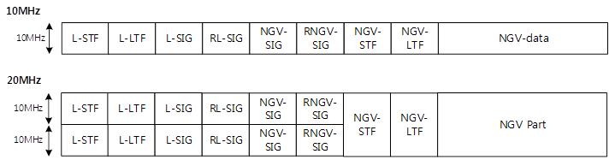
FRD&SFD Motion #49
(DCN:11-19/1485r2)
Move to include the following text to section 3 of the 11bd SFD
  ““The preamble of 11bd PPDU shall include NGV-STF and NGV-LTF after repeated NGV-SIG.
  The composition of NGV-STF and NGV-LTF is TBD”
Mover: Dongguk Lim
Second:
Result:

Slide 56
FRD&SFD Motion #50
(DCN:11-19/1471r1)
Move to include the following text to section 3 of the 11bd SFD
  “The NGV-STF in 11bd 10MHz PPDU shall use 11ac 20MHz VHT-STF with 2x downclock.”
  “The NGV-LTF in 11bd 10MHz PPDU shall use 11ac 20MHz VHT-LTF with 2x downclock.”
Mover: Rui Cao
Second:
Result:

Slide 57
FRD&SFD Motion #51
(DCN:11-19/1471r1)
Move to include the following text to section 3 of the 11bd SFD
  “The NGV-STF in 11bd 20MHz PPDU shall use 11ac 40MHz VHT-STF with 2x downclock.”
  “The NGV-LTF in 11bd 20MHz PPDU shall use 11ac 40MHz VHT-LTF with 2x downclock.”
Mover: Rui Cao
Second:
Result:

Slide 58
FRD&SFD Motion #52
(DCN:11-19/1473r1)
Move to include the following text to section 3 of the 11bd SFD
  “11bd 20MHz PPDU Data symbol shall use 11ac 40MHz OFDM downclock by 2”
Mover: Rui Cao
Second:
Result:

Slide 59
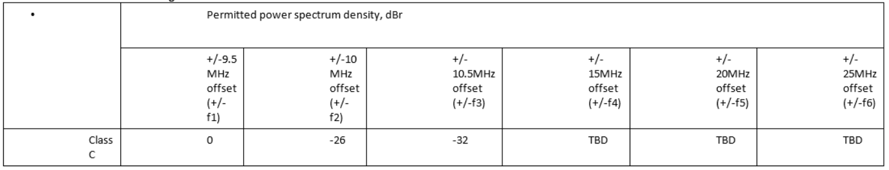
FRD&SFD Motion #53
(DCN:11-19/1473r1)
Move to include the following text to section 3 of the 11bd SFD
Mover: Rui Cao
Second:
Result:

Slide 60
FRD&SFD Motion #54
(DCN:11-19/1484r3)
Move to include the following text to section 3 of the 11bd SFD
  “RL-SIG is modulated same as L-SIG”
Mover: Dongguk Lim
Second:
Result:

