Slide 1
Simulation Results in Hospital Ward Environment
Date: 2019-03-13
Authors:

Slide 2
Summary
Current Status of Simulation Methodology
  Two documents proposed for PHY evaluation methodology
  11-19-0186-03 : PHY Evaluation Methodology
  11-19-0272-01 : PHY Evaluation Methodology Simulation Calibration
  Only multi carrier modulation, DCO-OFDM, is mentioned for PHY evaluation in doc. 11-19-0186-03.
  To support possible other application, single carrier modulation format should
  be considered in order to generalize PHY evaluation methodology.
It is needed to investigate the single carrier modulation other than OFDM
  Single carrier modulation need to be considered for IoT application
  Link level simulation for single carrier (OOK, 4PAM, 8PAM) is presented
  BER and throughput are shown based on the CIR models for hospital ward environment
  Single Carrier and Multi Carrier need to be considered for support
  of various data rate and the complexity of implementation

Slide 3
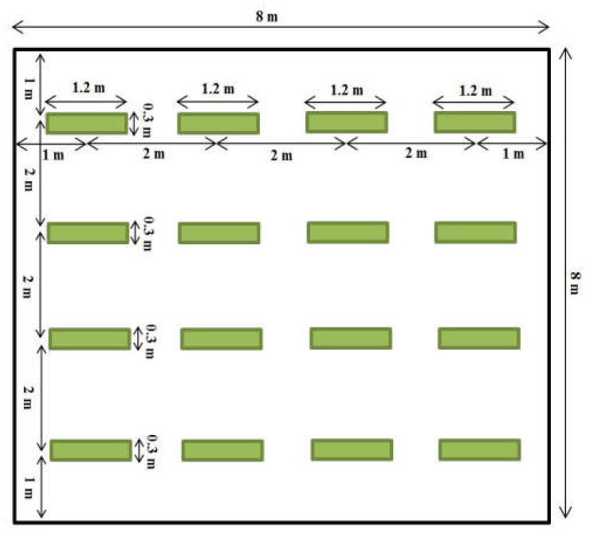
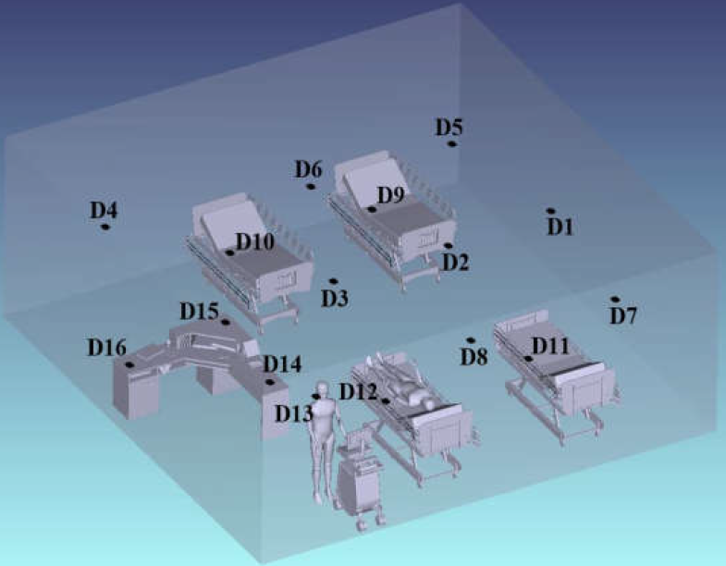
System Model
  Scenario for Transmitter
  Scenario for Receiver
Hospital Ward in Enterprise Scenario
  Dimension : 8m x 8m x 3m
  LED Transmitter, 16 PD based Photo Detector

Slide 4
Set of Simulation Scenario and Parameters
 | Scenario Name | Topology | Management | Channel Model | Traffic profile [tentative]
1 | Hospital ward | B - Dense small BSSs e.g. ~8 m × 8 m × 3 m size, ~1-3m inter AP distance, 4 STAs/light, P2P pairs | Managed | Indoor- Office | Enterprise
Parameter | Value
Number of bits | 3,000,000
Number of repeated counts | 100
TX beam angle of AP | 90 degrees
Point of Rx | D1
noise floor | -70dBm
Channel Impulse Response(CIR) | D1 [4]

Slide 5
BER Simulation Results

Slide 6
Simulation Results for Throughput

Slide 7
Conclusion
It is observed that simulation for single carrier modulation
is investigated in the hospital ward environment.
8-PAM seems to be effective regarding the tradeoff between BER and throughput for applying hospital ward environment
It is considerable that other modulation including single carrier rather than OFDM need to considered for providing the various data rate and real application.

Slide 8
References
[1] S. Dimitrov and H. Haas, “Principles of LED Light Communications
: Towards Networked Li-Fi” Cambridge University Press, 2015.
[2] Z. Ghassemlooy, W. Popoola, and S. Rajbhandari, “Optical wireless
communications: system and channel modelling with Matlab®“ CRC
Press, 2012.
[3] Oliver Luo,.“ 11-18-0556-01-00lc-modulation-schemes
-for-optical-wireless-communications”, IEEE TGbb, March 2018.
[4] Murat Uysal. et al. “11-18-1582-04-00bb-ieee-802-TGbb-reference
-channel-models-for-indoor-environments”, IEEE TGbb, November 2018.

