Slide 1
Multi-AP Transmission Procedure
Date: 2019-03-11
Authors:
Name | Affiliation | Address | Phone | Email
Sungjin Park | LG Electronics | 19, Yangjae-daero 11gil, Seocho-gu, Seoul 137-130, Korea |  | allean.park@lge.com
Ensung Park |  |  |  | esung.park@lge.com
Jeongki Kim |  |  |  | jeongki.kim@lge.com
Jinsoo Choi |  |  |  | js.choi@lge.com
Kiseon Ryu | LG Electronics | 10225 Willow Creek Rd, San Diego, CA, USA |  | kiseon.ryu@lge.com

Slide 2
Introduction
The Multi-AP transmission has been discussed as candidate features for adoption in 802.11 EHT. [1]
There are many types of Multi-AP coordinated transmission that have been discussed in EHT study group.
  Distributed MIMO [2], [3], [4], [7]
  Coordinated BF [3], [7], [8]
  Coordinated OFDMA [3], [5], [6], [7], [8]
  Coordinated SR [6], [8]
To support the Multi-AP transmission in EHT, the feasible procedure needs to be discussed.

Slide 3
Motivation
In order that the Distributed MIMO and the Coordinated BF are used, the Multi-AP sounding procedure should be preceded.
  To acquire the CSI between the Slave APs and STAs
In addition, the Coordinated OFDMA and the Coordinated SR also may also need the Multi-AP sounding procedure to be preceded to achieve the improvement of performance of the Multi-AP transmission.
  To acquire and allocate more appropriate RU/CH to the recipient STA in the Multi-AP coordination
After performing the Multi-AP sounding, the Multi-AP coordinated transmission may be followed.
In this contribution, we discuss the general procedure to support all types of the Multi-AP transmission schemes.

Slide 4
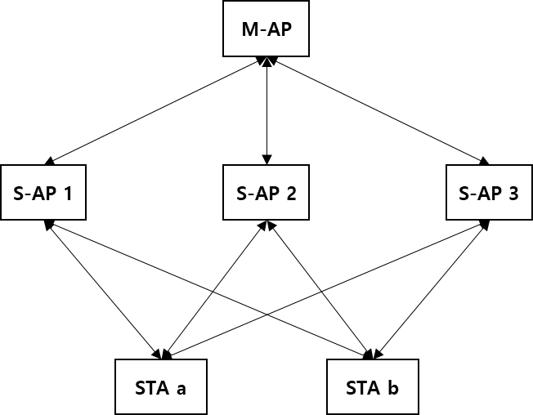
Multi-AP environment assumption
We consider the following assumptions in this document.
  The Slave APs which are the candidates of Multi-AP transmission can hear the master AP.
  The STAs which are the recipients of Multi-AP transmission can hear the Slave APs.
  The Master AP may not hear the STAs, but the Master AP is aware of STA’s existence.
  The STAs may be located at the edge area in the coverage of the Slave APs.
wireless
Master AP (M-AP)
- Being a role of the AP coordinator
Slave AP (S-AP)
- Participating in the Multi-AP transmission coordinated by Master AP
wireless

Slide 5
Multi-AP transmission procedure
Multi-AP sounding
  Reference signal transmission from Slave APs to non-AP STAs by the Master AP’s coordination
  Reference signal feedback from non-AP STAs to Slave APs and a Master AP
Multi-AP selection
  Data transmitted to slave APs that are involved in the Multi-AP transmission
Multi-AP transmission
  Distributed MIMO
  Coordinated BF
  Coordinated OFDMA
  Coordinated SR

Slide 6
Reference signal transmission in Multi-AP sounding
To achieve the improved performance of the Multi-AP coordinated transmission, the Multi-AP sounding should be performed beforehand.
The M-AP transmits MAP(Multi-AP) trigger frame to the S-APs in order to initiate the sounding.
A S-AP receiving the MAP trigger frame sends a MAP(Multi-AP) NDPA frame and MAP(Multi-AP) NDP packet.
  To acquire the channel information between each S-AP and each STA.
The following slides show several options to transmit a reference signal.

Slide 7
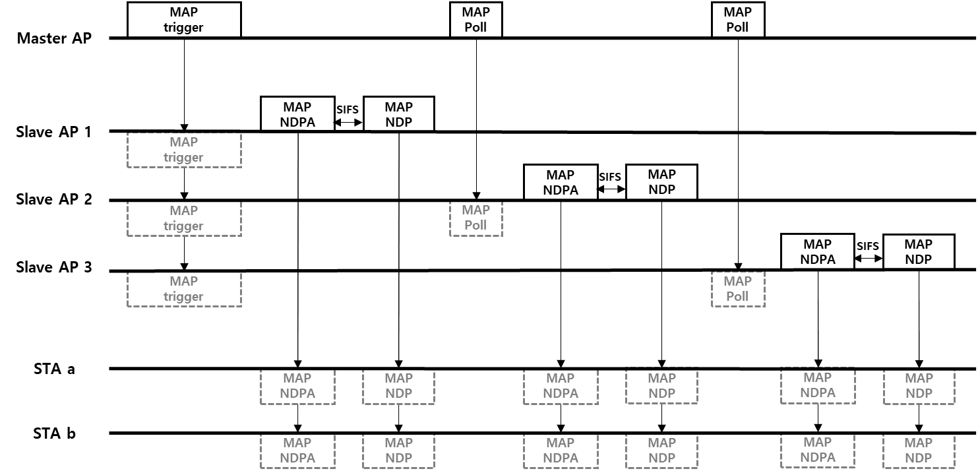
Reference signal transmission
(Option 1: Transmission sequentially based on M-AP polling)
MAP NDP PPDU format
Slave AP 1
Slave AP 2
Slave AP 3
L-part | SIG-A | STF | LTF
L-part | SIG-A | STF | LTF
L-part | SIG-A | STF | LTF

Slide 8
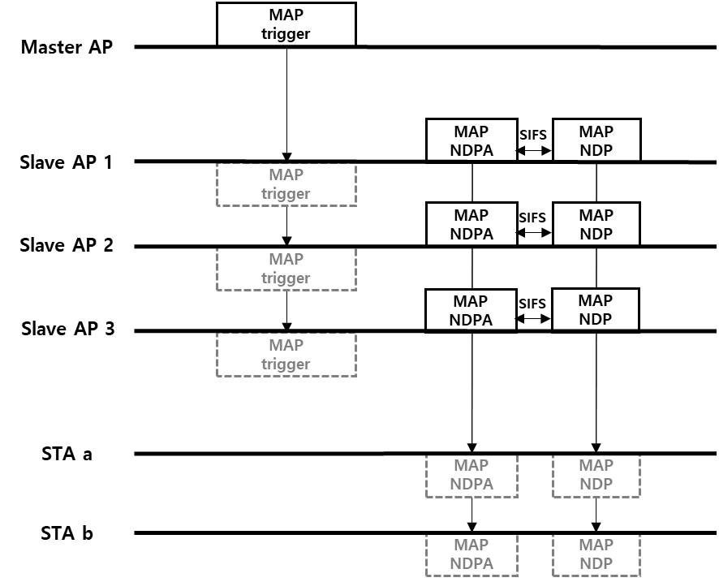
Reference signal transmission
(Option 2: Transmission using tone selection per S-AP)
Stringent synchronization requirement among the Slave APs
- Additional frames for synchronization may be needed.
MAP NDP PPDU format
Slave AP 1
Slave AP 2
Slave AP 3

Slide 9
Reference signal transmission
(Option 3: Transmission using DL MU-MIMO LTF)
Stringent synchronization requirement among the Slave APs
- Additional frames for synchronization may be needed.
Total number of LTF symbols depends on the sum of antennas of all Slave APs
MAP NDP PPDU format
Slave AP 1
Slave AP 2
Slave AP 3
L-part | SIG-A | STF | LTF | LTF | … | LTF

Slide 10
Comparison of reference signal transmission options
 | Option 1 | Option 2 | Option 3
Descriptions | Reusing conventional NDP per S-AP Transmitting each NDP consecutively | Reusing conventional NDP with assigning different tones to each S-AP Transmitting NDP at the same time | Reusing conventional NDP(Considering all S-APs as one AP) Transmitting NDP at the same time
Considerations | Depending on the total number of participating S-APs, the time overhead increase gradually | Depending on the coherent BW, the accuracy of channel estimation is affected Stringent synchronization | Need fine residual CFO compensation in each S-AP before NDP transmission Stringent synchronization
The reference signal transmission should be defined considering time overhead, complexity both on AP side and STA side and channel estimation accuracy.

Slide 11
Reference signal feedback in Multi-AP sounding
The recipient STA should send a MAP reference feedback frame to its associated S-AP in response to the MAP NDPA frames and the MAP NDP packets.
The S-AP receiving the MAP reference feedback frame from the recipient STA should send it to M-AP.
  The feedback information will also be used to determine the Multi-AP transmission type.
  M-AP can send a MAP feedback trigger to receive MAP reference feedback simultaneously.

Slide 12
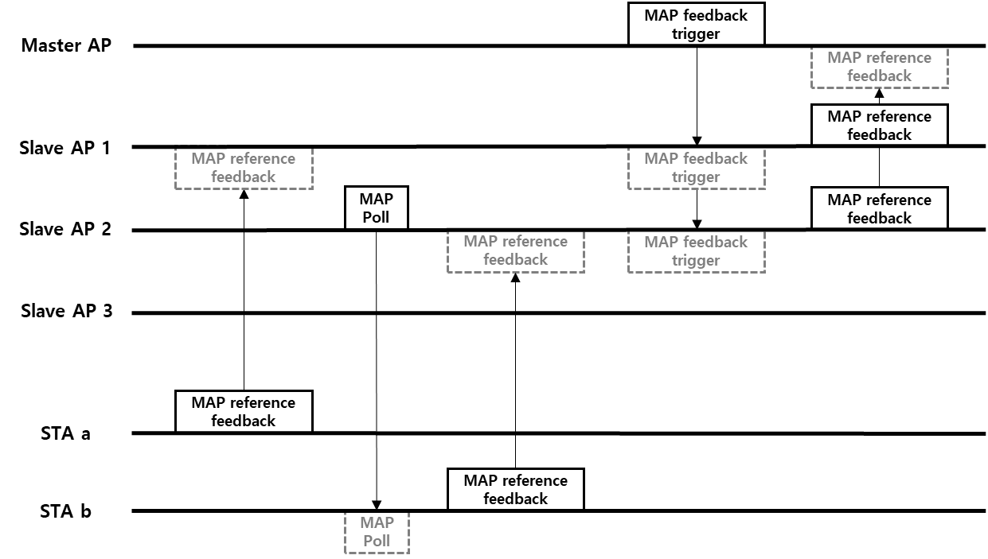
Example of reference signal feedback procedure
Using UL OFDMA
MAP reference feedback contents
STA a
S-AP 1 feedback | S-AP 2 feedback | S-AP 3 feedback
STA b
S-AP 1 feedback | S-AP 2 feedback | S-AP 3 feedback

Slide 13
Multi-AP selection
The M-AP can inform S-APs of being selected for the Multi-AP transmission.
  The M-AP decides which S-APs are suitable for the Multi-AP transmission based on the channel feedback between the each S-AP and each STA.
For it, M-AP sends to the selected S-APs the Data frame containing the Multi-AP selection information. (E.g., the recipient STA’s identification)
S-APs send to M-AP a BA frame in response to the Data frame.
M-AP can reselect the S-AP based on the reception of BA.

Slide 14
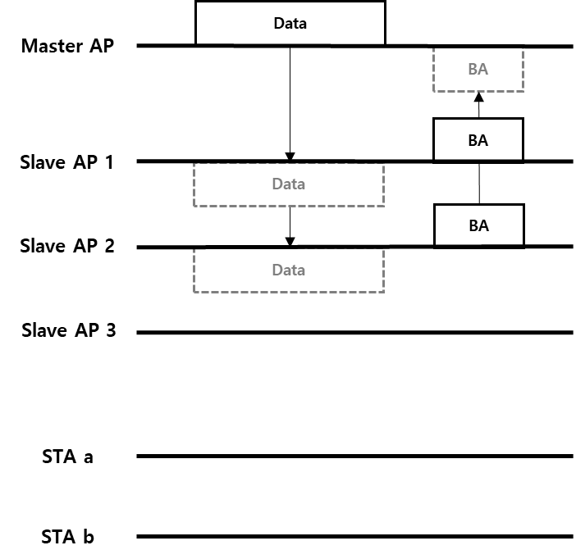
Example of Multi-AP selection
Data transmission to Slave AP 1 and Slave AP 2 which are selected
BA frames may be sent by UL OFDMA

Slide 15
Multi-AP transmission
The M-AP initiates the Multi-AP transmission by sending the MAP trigger frame.
  Including the Multi-AP transmission type (e.g., Distributed MIMO, Coordinated BF, Coordinated OFDMA, or Coordinated SR, etc.)
  May include the information for the recipient STAs to send BlockAck (e.g., RU allocation, etc.)
    Slave-AP includes this information in the Multi-AP data frame and STA sends a BlockAck in response to Multi-AP data frame by using this information.
And then Slave-APs that received the MAP trigger frame send the data by using the Multi-AP transmission.
  Including the information for decoding the PSDU (e,g., the recipient STAs’ ID(s) and the transmission information such as MCS, PSDU length, Nss, and etc.)
  May need new PPDU format when the trigger based PPDU cannot include this information.

Slide 16
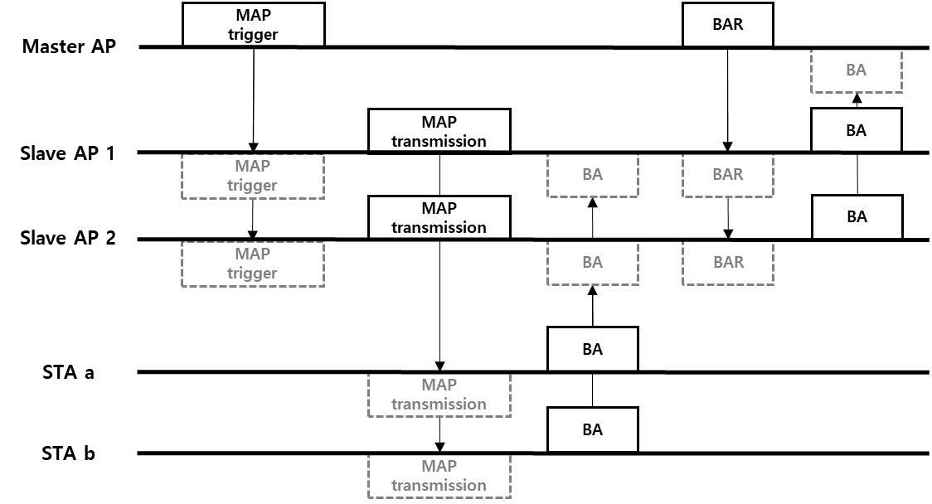
Example of
Multi-AP transmission procedure
M-AP indicates which MAP TX would be used
M-AP controls the STAs for sending BA
Including the information
for decoding PSDU per each STA

Slide 17
Conclusion
We discussed a general procedure with the Multi-AP sounding, Multi-AP selection, and Multi-AP transmission to support all types of the Multi-AP transmissions.
Detailed procedure for each type of the Multi-AP transmission needs further study.

Slide 18
Reference
[1] IEEE 802.11-18/1231r1, EHT draft proposed PAR, Laurent Cariou (Intel)
[2] IEEE 802.11-18/1439r0, Constrained Distributed MU-MIMO, Ron Porat (Broadcom)
[3] IEEE 802.11-18/1926r2, Terminology for AP Coordination, Sameer Vermani (Qualcomm)
[4] IEEE 802.11-18/1510r1, AP Coordinated beamforming for EHT, Hongyuan Zhang (Marvell)
[5] IEEE 802.11-18/1155r1, Multi-AP Enhancement and Multi-Band Operations, Jianhan Liu (Mediatek)
[6] IEEE 802.11-19/103r0, AP-Coordination-in-EHT, Jason Yuchen Guo (Huawei)
[7] IEEE 802.11-18/1461r1, Discussions on the PHY Features for EHT, Xiaogang Chen (Intel)
[8] IEEE 802.11-19/0071r0, Coordinated Multi-AP Transmission for EHT, Kome Otri (InterDigital)

