Slide 1
Comment resolution on CID 20175
Date: 2019-03-10
Authors:
Name | Affiliation | Address | Phone | Email
Zhou Lan | Broadcom Inc. | 250 Innovation Drive San Jose, CA 95134 | +1 408 254 6084 | zhou.lan@broadcom.com
Chunyu Hu |  |  |  | chunyu.hu@broadcom.com

Slide 2
CID 20175
CID | Commenter | clause | Comment | Proposed Change | Resolution
20175 | Chunyu Hu | 26.2.7 | The MU EDCA procedure is lack of an explicit or implicit signaling mechanism that allows AP or non-AP STAs to exit current MU EDCA backoff period when AP stops triggering. The lack of the mechanism can cause non-AP STAs' UL traffic being delayed significantly. | Define an explicit or implicit signaling mechanism to solve this problem. | Revised – Agree in principle. Refer to IEEE 802.11-19/0427r0 for discussions TGax editor to make the changes shown in 11-19/xxxr0

Slide 3
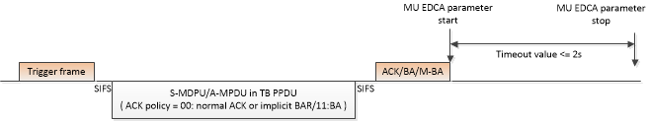
Background
802.11 AX AP includes MU EDCA Parameter Set element in Beacon and Probe Response frames. MU EDCA parameter sets are defined for one or more ACs, each of which may have different priority, usually lower, with respect to legacy EDCA parameters to favor UL MU transmissions.
If an AP has transmitted MU EDCA parameters for a certain AC, the STA that received the MU EDCA parameters switches to use MU EDCA parameters for that AC when the STA receives a Basic Trigger frame and successfully transmits QoS Data frames for the corresponding AC carried in the HE Trigger-based PPDU. The STA uses the MU EDCA parameters for the duration (i.e.Timeout value) defined in the HEMUEDCATimer [AC] field of the MU EDCA Parameters element
However, when an AP wants the corresponding STA to terminate the current MU EDCA time out value (<=2s), there is no mechanism defined in the current spec to do so. The STA has to wait for the remaining time to finish without being triggered, during which time the STA cannot shift back to regular EDCA mode

Slide 4
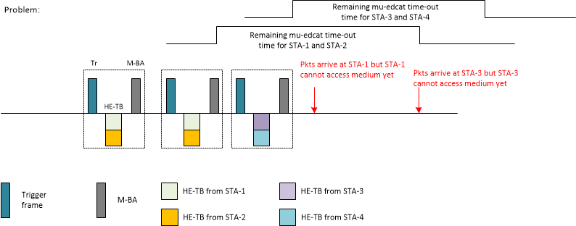
Problem Description
The following diagram illustrates a scenario where an AP has decided to temporarily stop transmitting triggers. After the AP has stopped transmitting triggers, new traffic arrives at STAs that had been receiving triggers
Those STAs continue to use MU-EDCA access parameters and can only revert to normal EDCA parameters after the MU EDCA timeout
  This creates increased latency which affects latency sensitive applications and RTT measurements used by flow control protocols (e.g. TCP)

Slide 5
Possible Solutions to the Problem
  Reduce MU EDCA time-out value
    This might not be possible
      The AP selects the timeout value based on its estimate of DL and UL network load
      The AP may need to interleave DL and UL transmission/scheduling
      The AP might have many active links involved in UL OFDMA
        It might take a long time to service all STAs
        Hence the need for a large MU-EDCA time-out
    MU EDCA time-out value is broadcast in Beacons and it takes a few Beacons to update
      This makes on-the-fly MU EDCA parameter modification challenging
      Traffic and links are dynamic
      Beacon update method makes MU EDCA parameter changing at fine time granularity (e.g. tens of ms) challenging
  Introduce policy to allow STAs to send QoS-Null to request AP to schedule UL
    STA UL traffic can interfere with AP’s scheduled traffic, either DL or UL.
    Causes increased congestion
  AP sends UORA before stopping current UL OFDMA trigger transmissions
    UORA is an optional feature
    Needs AP to continue transmitting one or more triggers for STA to count down OBO
      To ensure that all STAs have had a chance to respond
Notes:
Disable UL MU – not preferred as a regular behavior!

Slide 6
Proposal
Mechanism-1: AP signals all STAs that it ends current UL scheduling period and all associated STAs can exit MU-EDCA mode
  A-control field
    Send QoS Null frame that carries A-Control indicating termination of MU EDCA
  Trigger frame (e.g. new trigger type, utilize trigger reserved bit etc)
    Broadcast RA, all receivers obey the bit
  HE action frame indicating termination of MU EDCA
Mechanism-2: have an inactivity time-out value, if STAs in MU-EDCA mode observe AP not initiating any transmission (RTS, DATA) for this time-out value, then STAs in MU-EDCA mode can switch to SU-EDCA mode
  Suggest such a time-out value to be at least 2-3 maximum PPDU duration to give AP multiple opportunities to finish ongoing transmission(s) and next trigger(s)

Slide 7
Straw Poll
SP1: Do you accept one of the following signaling method to terminate the MU EDCA as the comment resolution of CID 208
  Option 1: A-Control
  Option 2: New trigger frame (TBD)
  Option 3: HE action frame
  Option 4: have an inactivity time-out mechanism to terminate MU-EDCA period at STAs

