Slide 1
PHY Misclassification Issue
Date: 2019-03-11
Authors:

Slide 2
Preambles

Slide 3
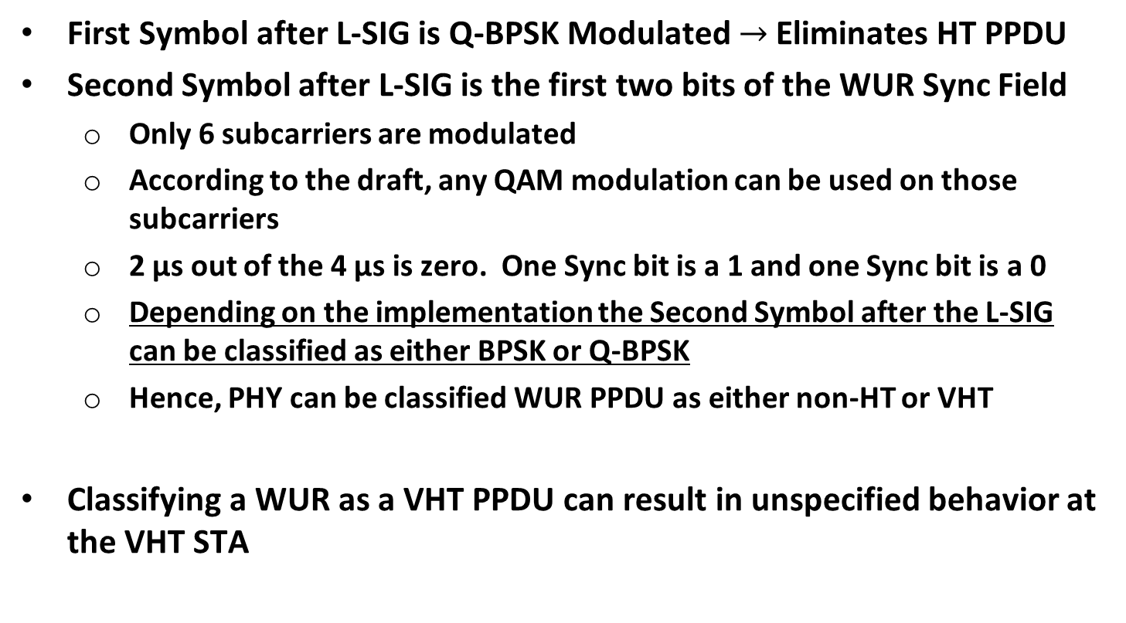
VHT STA Performing PHY Classification on a WUR PPDU
First Symbol after L-SIG is Q-BPSK Modulated $→$ Eliminates HT PPDU
Second Symbol after L-SIG is the first two bits of the WUR Sync Field
  Only 6 subcarriers are modulated
  According to the draft, any QAM modulation can be used on those subcarriers
  2 µs out of the 4 µs is zero. One Sync bit is a 1 and one Sync bit is a 0
  Depending on the implementation the Second Symbol after the L-SIG can be classified as either BPSK or Q-BPSK
  Hence, PHY can be classified WUR PPDU as either non-HT or VHT
Classifying a WUR as a VHT PPDU can result in unspecified behavior at the VHT STA

