Slide 1
Reducing Channel Access Delay
Date: 2019-03-10
Authors:

Slide 2
Abstract
Reducing latencies is one of the targets for EHT
  This is especially important in reliable low-latency (RLL) communications
The channel access delay is the main components in total WLAN latency, and is heavily dependent on how busy the primary channel is, e.g. due to other BSSs
  Total WLAN latency = “time at when packet arrives to sender MAC” – “time at when the packet leaves the receivers MAC to upper layers”
Some work has been done to decrease the channel access delay as such
  802.11ax spatial reuse framework
  802.11ax OFDMA framework (scheduling)
    For low-latency, contention-based access may still be the best option, as scheduling causes always some delay
We propose introducing a new feature in EHT to mitigate channel access delay:
  Multiple primary channels

Slide 3
Reliable Low Latency Communication
There are many use cases for RLL communications:
  Gaming,
  Industrial applications,
  Augmented Reality,
  ...
The reliability and latency requirements of the use cases vary, but are often in the order of:
  1ms – 10ms latency with 99% - 99.9999% reliability
In this presentation, we assume the latency requirement of 2ms or below for 99.9% of packets
  In e.g. cloud gaming 10ms delay is required. In such case 2ms one-way delay budget for the WLAN part might be suitable

Slide 4
Reliable Low Latency Communication in OBSS environment
If the environment, in which the RLL communications are needed, is isolated, such as in a factory:
  it may be possible to dedicate some channels to RLL communications, which would help on meeting the requirements
Otherwise (if there are OBSSs):
  it is not possible to guarantee a free channel, and RLL communications need to share the channel with non-RLL communications, or even other radio technologies
In such an OBSS environment, it is hard to provide RLL
  If the primary channel, e.g. happens to be busy for couple of 2ms TxOPs, the access delay will be already too long
  This is especially true in case of the OBSS is managed by another entity

Slide 5
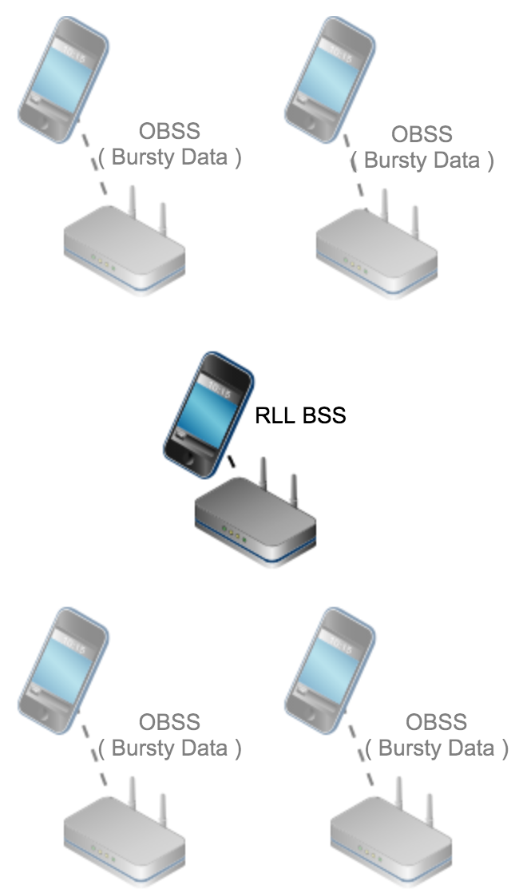
Simulation Scenario
Indoor scenario with single room where all the devices are within -62dBm sensing range
80MHz of available spectrum
4 ‘OBSS' APs – each using its own 20MHz channel
  One broadband STA associated to each of the APs
  Bursty (4Mb burst) data transmissions on each AP/channel. The load is varied.
A 5th 'RLL' AP
  The AP is put to any of the 20MHz channels, and stays there
  One RLL STA associated this AP
  1500B packet every 250ms (= 48kbps)
  99.9th percentile delay should be below 2ms

Slide 6
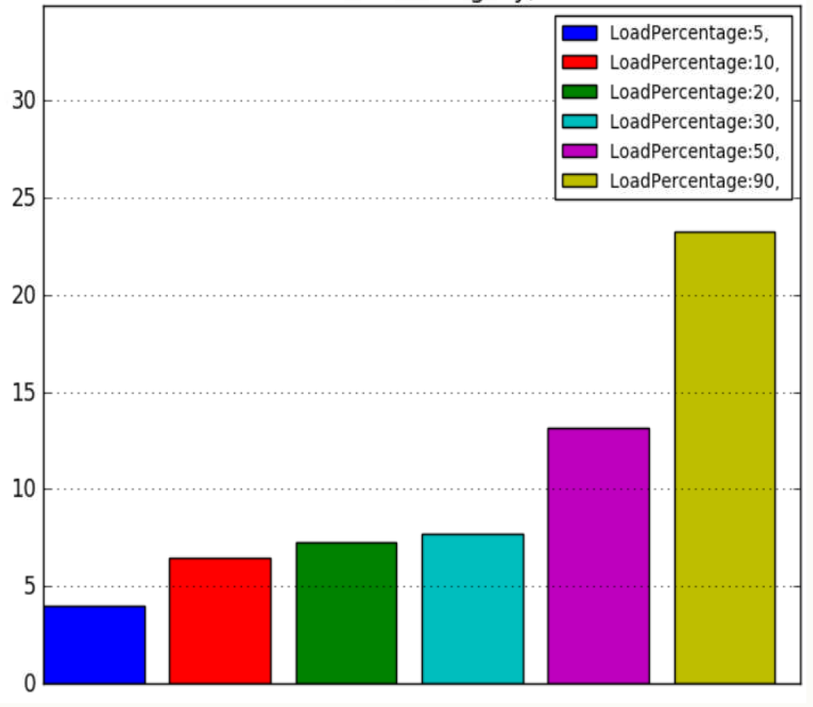
Simulation results (one primary channel)
The figure presents the 99.9th percentile delays of the RLL STA with different load percentages on the OBSS
It is visible that even with the lowest load of 5%, the 99.9th delay percentile is 4ms, which is above the required 2ms
When load on the OBSSs increases, the 99.9% delay goes even higher
99.9th percentile delay
2ms

Slide 7
Problem: busy primary channel
The problem of busy primary channel is most visible in the presence of RLL communications
There are often scattered unused resources that could be more efficiently used, if the primary channel would not be such a limiting factor [1]
  There are “WLAN white spaces” out there, that should be used more efficiently
Limiting the channel access to the single primary channel conditions causes these problems and makes the channel access inefficient

Slide 8
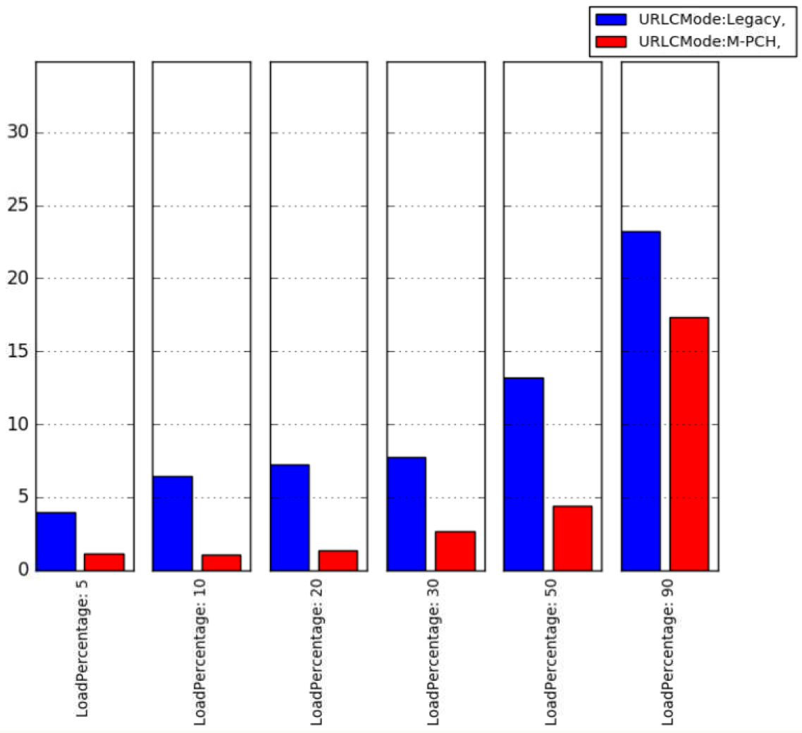
Simulation Results (multiple primary channels)
The figure presents the 99.9th percentile delays of the RLL STA with different load percentages on the OBSS
  with legacy RLL BSS operation and when using multiple primary channels (M-PCH) for the RLL BSS
M-PCH increases the chances to find a free channel, instead of sticking to a busy one
With lower OBSS loads, there is naturally almost always a free channel, which will reduce the channel access delay significantly
Up to 20% OBSS load can be tolerated while providing the QoS
99.9th percentile delay
2ms

Slide 9
Solution: Multiple primary channels
An AP uses all the 20MHz channels within the maximum bandwidth as primary channels
  Associated STAs should use the same set of channels as primary channels
Each STA and AP simultaneously runs an EDCA on each of the 20MHz primary channels
  Independent EDCA per channel, i.e. independent backoff counters, NAVs,
  When any of the 20MHz primary channels and the communication peer is idle, transmission can occur
In receiving side, STAs and APs try to simultaneously find the synchronization signal from all the 20MHz primary channels
  When sync is achieved, STAs lock to that signal for reception
The usual transmission bandwidths from 20MHz to 160MHz can be used with the solution

Slide 10
Summary
Channel access delay is a key factor for reliable low latency communications
We propose that the EHT group investigates the possibility of decreasing the channel access delays
One way to do this is to introduce a new feature that utilizes multiple primary channels per device

Slide 11
References
[1] IEEE 802.11-17/1699r7 - Introducing multiple primary channels to exploit unused resources scattered in multiple channels/bands
[2] IEEE 802.11-19/108r1 - Discussion on Multi-Band for EHT

