Slide 1
Simulation of Potential PHY Technology
for NGV
Date: 2019-03-11
Authors:
Name | Affiliation | Address | Email
LiNan | ZTE Corporation |  | li.nan25@zte.com.cn
Lv Jianfeng |  |  | lv.jianfang@zte.com.cn
Jia Qichen |  |  | jia.qichen@zte.com.cn
SunBo |  |  | sun.bo1@zte.com.cn
FangYonggang |  |  | yfang@ztetx.com

Slide 2
Abstract
NGV would adopt new PHY technologies, such as new numerology, midamble, antenna diversity, etc., to fulfill the requirement of higher throughput than 802.11p in high mobility environments at the speeds up to 250 km/h.
Several protential PHY technologies have been proposed for NGV[1][2].
This proposal provides simulation results about the performance of downclock 802.11ac OFDM for NGV.

Slide 3
Simulation Assumptions
Simulation parameter | Value
Carrier frequency | 5.9GHz
Bandwidth | 10MHz
Coding | LDPC
Midamble | ON, using VHT LTF
packet Length | 500 Bytes
Channel Model | C2C Channel Model[3]
Scenario | HighwayNLOS, HighwayLOS, RuralLOS
MCS | MCS 0(BPSK,1/2) ，MCS 2（QPSK 3/4） MCS 4（16-QAM 3/4）, MCS 6 （64-QAM 3/4）
CP | 1.6us
Doppler Model | Pure Doppler
OFDM numerology | 11ac 20MHz subcarrier spacing: 156.25kHz
 | 11ac 40MHz subcarrier spacing: 78.125kHz
 | 11ac 80MHz subcarrier spacing: 39.0625 kHz

Slide 4
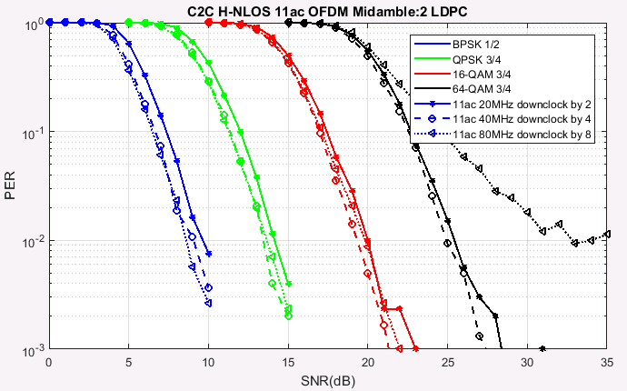
Simulation Results(H-NLOS)

Slide 5
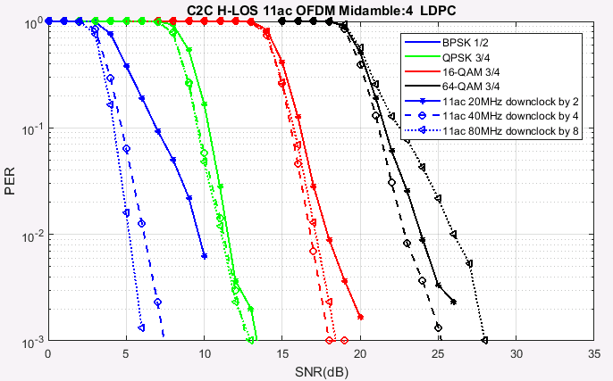
Simulation Results(H-LOS)

Slide 6
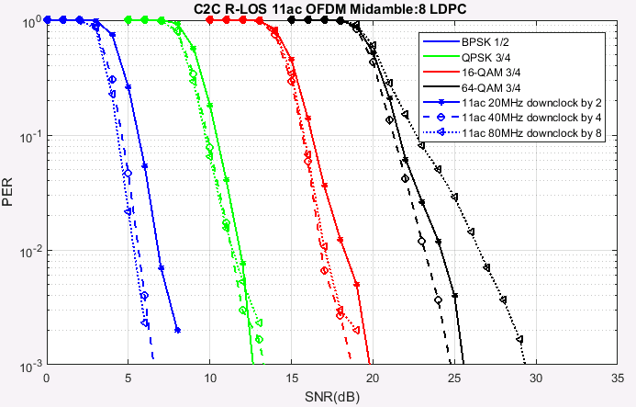
Simulation Results(R-LOS)

Slide 7
Observation and Analysis
802.11ac OFDM numerology downclock for NGV10MHz signal improves spectrum efficiency by increasing the number of data subcarriers compared with 802.11a.
  For example, the number of data subcarriers for 802.11a is 48, while the number of data subcarrier for 802.11ac 20MHz is 52.
From the simulation results, we observe
  802.11ac 80MHz downclock has relative poor performance than 11ac 20MHz and 40MHz downclock. This may be because that 80MHz has narrower subcarrier spacing, which might be easily affected by subcarrier frequency offset.
  Downclock from 802.11ac OFDM for NGV provides acceptable performance for each MCS.
  Midambles, inserted every 2/4/8 OFDM symbols under high/medium/low doppler scenarios[2], can effectively improve channel estimation accuracy for data portion under various doppler scenario.

Slide 8
Summary
Simulation results about possible PHY designs for NGV are shown in this proposal.
NGV 10MHz signal can be achieved by downclocking 802.11ac 20MHz/40MHz/80MHz signal by 2/4/8. The simulation results shows that constructing10MHz PPDU with 802.11ac downclock could be a possible and simple way for NGV.
Future study could focus on:
  Baseline NGV10MHz PPDU format design
  A minimum technical set to achieve the throughput requirement of NGV
  Simulation calibration with others for suitable channel model of NGV

Slide 9
Reference
[1] 11-19-0009-00-00bd-consideration-on-features-for-11bd
[2] 11-19-0016-00-00bd-potential-phy-designs-for-ngv
[3] 11-14-0259-00-0reg-v2v-radio-channel-models
[4] 11-19-0017-04-00bd-simulation-of-ngv-channel-models

