Slide 1
Proposed way forward on TGbb PHY
Date: March 10, 2019
Authors:

Slide 2
Abstract
This presentation aims to provide an overview on how to gradually integrate the physical layer capability for LC into 802.11. The goal is to minimize initial efforts for a working solution and allow necessary optimization for higher throughput and enhanced robustness in frequency-selective channels.

Slide 3
Introduction
TGbb has developed the whole framework for integrating LC into 802.11.
For PHY, following task group documents are relevant
  Usage model doc. 11-18/1109r5: industrial, medical, enterprise, home
  Channel models and CIRs in docs. 11-18/1582r4 and 11-18/1603/r2
  Frontend models in doc. 11-18/1574r5 and 11-19/0087r1
  Call for proposals in doc. 11-18/2039r1
  Evaluation methodology for PHY and MAC in doc. 11-19/0187r1
The exact LC waveform and wavelength to be used will be specified by future TGbb proposals.
This contribution merely reflects recent discussions among TGbb members which indicate at least two promising approaches.
The intention is to stimulate discussion in TGbb and 802.11 WG and obtain feedback on these approaches before proposals are formally submitted.

Slide 4
Characteristics of LC PHYs
LC requires a non-negative and real-valued baseband-signal.
Bipolar signals can be turned non-negative by adding a DC-bias before transmission.
It is removed by using a high-pass filter before reception.
optical
channel
TX
DSP
+
Driver & LED
Photo-diode
High-pass
RX
DSP
DC

Slide 5
Option 1) Use existing 802.11 PHYs for LC
Complex OFDM-baseband signals are real-valued after up-conversion to the carrier frequency f_{c}.
For LC, one could simply change f_{c} to a low carrier (“low IF”), yielding a real-valued baseband signal.
Data
IFFT
CP
Up-con-
version
Re(.)
LED
f_{c}

Slide 6
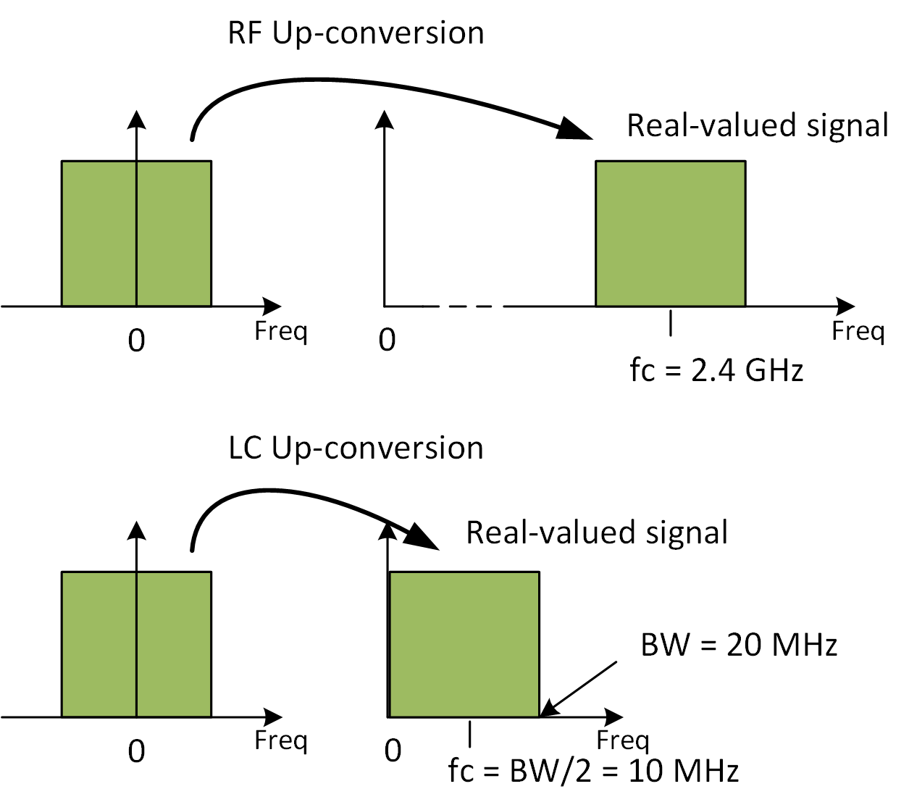
Using existing 802.11 PHYs for LC (2)
RF frontend up-converts
baseband signals onto e.g.
f_{c}=2.4 GHz.
LC frontend up-converts
baseband onto low IF e.g.
f_{c}=BW/2 + Δ.
  Δ is to be agreed depending on signal mask design.
This way, any complex-valued baseband signal (i.e. any existing IEEE 802.11 PHY) can be used to facilitate LC.

Slide 7
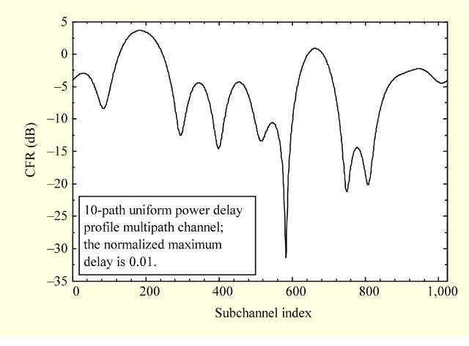
Why an optimized PHY is needed for LC?
In RF NLOS channels, bit-interleaved coded modulation (BICM) works very well. BICM is the concept behind all existing 802.11 OFDM PHYs.
BICM first creates redundancy and then permutes the bits in a code-word randomly over all subcarriers. In a rare fading event, lost bits can be repaired in the FEC by using the redundant bits which are likely to be correct.
In LC NLOS channels, however, the concept of BICM is likely to fail.
LC NLOS has a 1st order low-pass behavior [1]. Assuming a bandwidth of 100 MHz and 20 MHz cut-off frequency, 80% of the bits are lost in a fade.
LC
RF

Slide 8
LC-optimized PHY needs adaptive bitloading
Factory scenario in TGbb [2] using 200 MHz OFDM PHY [3]. Results are available in [4].
w/o adaptive bitloading
with adaptive bitloading
With bitloading, LC is more robust in NLOS channels.

Slide 9
Option 2) Use a LC-optimized PHY
The LC-optimized PHY apparently needs adaptive bitloading
  Adaptive bitloading is widely used in LC R&D papers
  Brings enhanced mobility support and optimized PHY performance
  Seamless operation in both, LOS and NLOS channel conditions
802.11 has discussed but never supported adaptive bitloading
  Adaptive bitloading brings additional complexity and overhead
  New control channels have to be defined
  Segmentation to map fixed-length code-words on variable-rate symbols
Ways to bring adaptive bitloading into 802.11
  Integrate G.hn as LC-optimized PHY under 802.11 MAC
    G.hn/G.vlc is already used in many LC demos and early products → may be faster
  Integrate adaptive bitloading in next-gen 802.11 RF PHY → SG EHT

Slide 10
Use existing and LC-optimized PHY under 802.11 MAC
802.11 MAC could integrate existing and optimized PHY
Use existing 802.11 PHY as a common, mandatory OFDM PHY (except 11ad, ay).
A legacy preamble is prepended to new LC PHYs. Legacy preamble is sent by using an existing 802.11 OFDM PHY. The switch is set in the legacy signaling field.
    a) Legacy 802.11 PHY is used (e.g. 11a/g, n, ac, ax) → reuse 802.11 PHY also for LC
    b) LC-optimized PHY is used (e.g. G.hn/G.vlc) → optimize performance for LC
802.11
MAC
Existing
PHY for LC
LC-Optimized
PHY

Slide 11
References
[1] V. Jungnickel, V. Pohl, S. Nonnig and C. von Helmolt, "A physical model of the wireless infrared communication channel," in IEEE Journal on Selected Areas in Communications, vol. 20, no. 3, pp. 631- 640, April 2002.
[2] https://mentor.ieee.org/802.11/dcn/18/11-18-1237-02-00bb-ieee-802-11bb-reference-channel-models-for-vehicular-communications.pdf
[3] ITU-T recommendation G.9660-2015
[4] P. W. Berenguer, V. Jungnickel and J. K. Fischer, "The benefit of frequency-selective rate adaptation for optical wireless communications," 2016 10th International Symposium on Communication Systems, Networks and Digital Signal Processing (CSNDSP), Prague, 2016, pp. 1-6.

Slide 12
Possible implementation using either legacy PHY or LC-optimized PHY
a) Legacy PHY (e.g. 802.11ax)
legacy preamble
legacy PHY preamble
legacy PHY data
L-STF
L-LTF
L-SIG
RL-SIG
HE-SIGA
HE-SIGB
HE-STF
HE-DATA
b) LC-optimized PHY (e.g. G.vlc)
legacy preamble
LC-optimized PHY preamble
LC-optimized PHY data
L-STF
L-LTF
L-SIG
LC-STF
LC-LTF
LC-SIG
LC-ATF
LC-DATA
blue fields are the same except some content of L-SIG
legay preamble is always transmitted in 20 MHz mode

