Slide 1
Joint Processing MU-MIMO – Update
Date: 2019-03-11
Authors:
Name | Affiliations | Address | Phone | email
Ron Porat | Broadcom |  |  | ron.porat@broadcom.com
Srinath Puducheri | Broadcom

Slide 2
Abstract
This contribution follows our previous contribution 19/0094 and adds simulation results for asymmetric links
We examine the impact of asymmetric links on the performance gains under ideal conditions and with phase offset due to imperfect synchronization as detailed in 19/0094
We also provide results with per-AP constant power in addition to total AP constant power

Slide 3
Simulation Description (1)
Simulation methodology (from 0094) - we compare the joint processing MU-MIMO performance of multiple APs relative to a baseline comprising of TDMA between APs:
We evaluate two cases for joint-processing: “fixed total power” and “fixed per-AP power”
  The baseline remains the same for both cases
Path-loss matrix for 2 AP joint processing:
  X is varied across 10, 20dB and means higher path loss relative to the baseline 0dB
  The X-axis “AP-STA SNR” for the joint-processing results assumes X=0
Baseline for 2 AP: 50% time-sharing between:
    AP1=[4], STA=[2 2], Nss=[2 1], path-loss matrix = [0;0], and
    AP2=[4], STA=[2], Nss=[2], path-loss matrix = [0]
  This means the baseline always has strong links (0dB) and only the joint AP scheme suffers from some weak links
 | AP1 | AP2
STA1 | 0 | X
STA2 | 0 | 0
STA3 | X | 0

Slide 4
Simulation Description (2)
Path-loss matrix for 4 AP joint processing:
Baseline for 4 AP: 25% time-sharing between:
    AP1=[4], STA=[2 2], Nss=[2 1], path-loss matrix = [0;0],
    AP2=[4], STA=[2], Nss=[2], path-loss matrix = [0],
    AP3=[4], STA=[2 2], Nss=[2 1], path-loss matrix = [0;0],
    AP4=[4], STA=[2], Nss=[2], path-loss matrix = [0]
  Equivalent to baseline for 2 AP with AP3 = AP1 and AP4 = AP2 (4AP+6STA vs. 2AP+3STA)
  Slightly optimistic to assume baseline with 6 strong (0dB) links
 | AP1 | AP2 | AP3 | AP4
STA1 | 0 | 0 | X | X
STA2 | 0 | X | 0 | X
STA3 | 0 | X | X | 0
STA4 | X | 0 | 0 | X
STA5 | X | 0 | X | 0
STA6 | X | X | 0 | 0

Slide 5
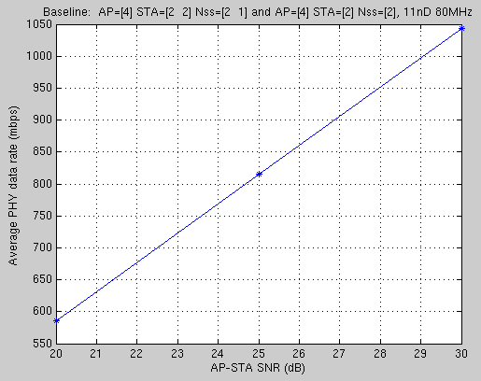
Baseline Tput

Slide 6
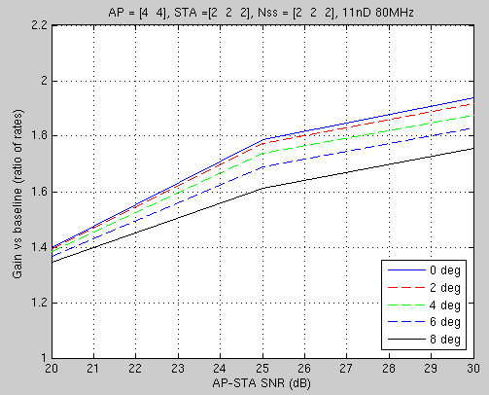
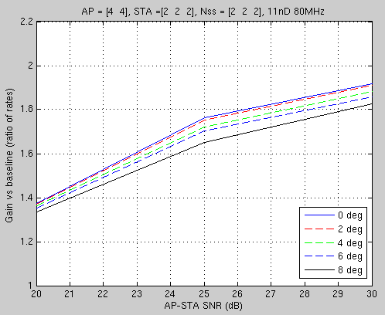
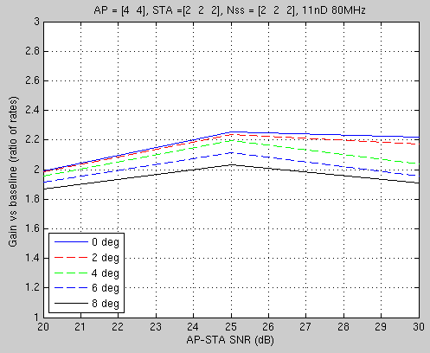
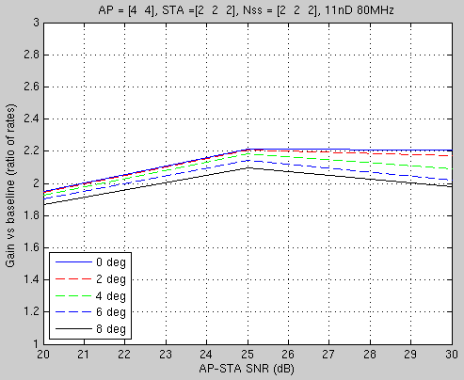
Joint 2AP Results
    Total power fixed
    X=10dB
    Total power fixed
    X=20dB
    Per-AP power fixed
    X=10dB
    Per-AP power fixed
    X=20dB

Slide 7
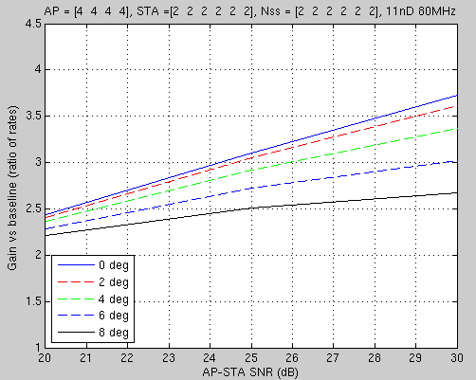
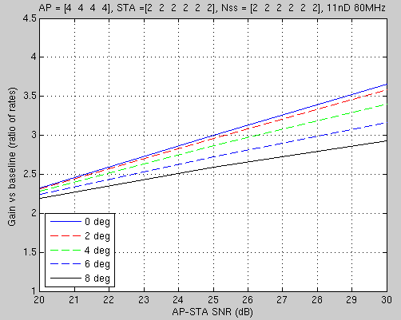
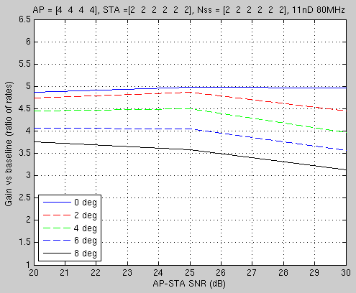
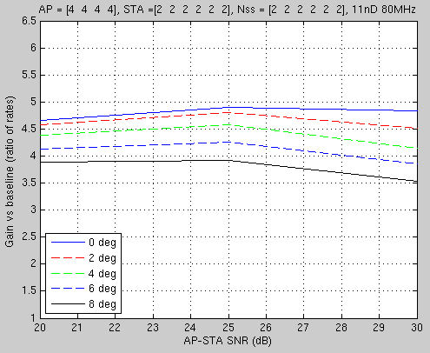
Joint 4AP Results
    Total power fixed
    X=10dB
    Total power fixed
    X=20dB
    Per-AP power fixed
    X=10dB
    Per-AP power fixed
    X=20dB

Slide 8
Observations & Summary
Very high joint MU gains are still maintained even at the 20dB asymmetric link level. This is due to the fact that gains come from the increased number of spatial streams (and not just array gain as in the case of joint SU beamforming).
The impact of slave to master phase drift is reduced with increasingly weaker links which actually helps lessen the degradation in performance. In other words the dispersion between 0 degrees error and 8 degrees error is reduced substantially in some cases with the performance of 8 degrees error very stable for different values of X.
The proposed scheme generally seems robust to various configurations, so there appears no need to perfectly tailor its use to only specific set of good scenarios.

