Slide 1
Definition of WUR Signal Bandwidth
Date: 2019-03-11
Authors:

Slide 2
Abstract
This contribution provides justification of why the WUR signal bandwidth needs to be defined and how to do so.

Slide 3
Justification to Define the WUR Signal Bandwidth
There are different ways to generate WUR OOK waveform
  Using .11n/ac OFDM numerology is one of the options
To implement a typical WUR receiver (consume < 1mW), e.g., envelope detector, the signal bandwidth needs to be known for designing the radio front-end (e.g., the BPF) of the receiver
Specifying the WUR signal bandwidth is important to ensure the interoperability between devices from different vendors and the performance of the network with WUR
However, in 11ba D2.0, the WUR signal bandwidth is not explicitly defined

Slide 4
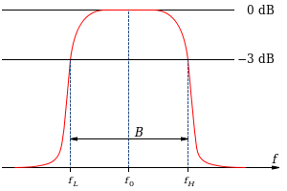

Method to Define the WUR Signal Bandwidth
The bandwidth of a signal can typically defined based on 3-dB (or $X$-dB) principle
  The signal bandwidth in Hertz refers to the frequency range in which the signal’s power spectral density is above 3 dB threshold relative to the max within the frequency range
Figure copied from https://en.wikipedia.org/wiki/Bandwidth_(signal_processing)

Slide 5
Examples from Annex AB of D2.0 for LDR
B = ~4 MHz

Slide 6
Examples from Annex AB of D2.0 for HDR
B = ~4.3 MHz

Slide 7
Suggestion to the spec draft
Add the following text in 31.2.12 (WUR transmit specification) in a new subclause:
  The 3dB-bandwidth of baseband signals in WUR-Sync, WUR-Data and WUR Padding fields shown in Figure 31-1(WUR PPDU format), Figure 31-2(WUR FDMA PPDU for 40 MHz channel widths) and Figure 31-3(WUR FDMA PPDU for 80 MHz channel widths) shall not exceed 4.4 MHz.

Slide 8
SP
Do you agree to the CR for CID 2062 included in IEEE802.11-19/0382r0?
Y/N/A:

