Slide 1
Performance on Multi-Band Operation
Date: 2019-03-11
Authors:
Name | Affiliation | Address | Phone | Email
Insun Jang | LG Electronics | 19, Yangjae-daero 11gil, Seocho-gu, Seoul 137-130, Korea |  | insun.jang@lge.com
Jinsoo Choi |  |  |  | js.choi@lge.com
Jeongki Kim |  |  |  | jeongki.kim@lge.com
Suhwook Kim |  |  |  | suhwook.kim@lge.com
Sungjin Park |  |  |  | allean.park@lge.com

Slide 2
Abstract
This presentation :
provides the simulation results to show the efficiency on multi-band operation using PHY/MAC integrated simulator

Slide 3
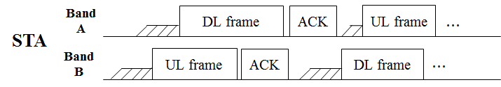
Introduction
Recap: Multi-band Operation to further improve the efficiency have been discussed [1-6], e.g., called Full Duplex over Multi-band (FD-MB) [5], [6] and Multi-channel FDD [4], enabling simultaneous (independent) DL/UL Tx over multi-bands
However, any observable results haven’t been shown yet for the operation
Therefore, in this contribution, we show the efficiency on multi-band operation using PHY/MAC integrated simulator in terms of throughput and latency

Slide 4
Overview of Simulation Setup
We compare the single-band operation in 11ax and the multi-band operation in EHT with the same size of total bandwidth
Single-band Operation in 11ax
  The band uses 11ax features for the data exchange
Multi-band Operation in EHT
  Simultaneous (independent) DL/UL Tx over multi-bands is considered
  Each band uses 11ax features for the data exchange (since any features haven’t been defined yet in EHT)
Performance Metric
  We measure the performance of BSSs of 11ax and EHT, respectively
  (Aggregated) BSS Throughput / (Average) Latency
    Latency means time taken from that MAC receives a packet till that PHY starts transmitting

Slide 5
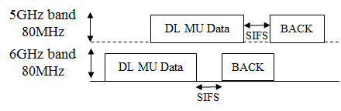
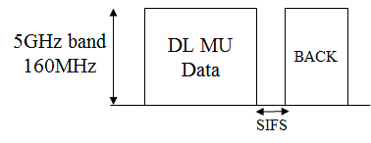
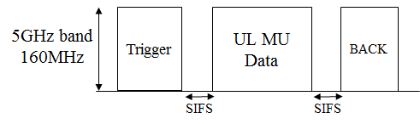
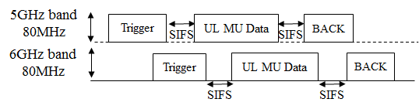
Simulation Setup:
Single band vs. Multi bands (Operation)
Single band (11ax): 5GHz band 160MHz
Multi-band (EHT) : 5GHz band 80MHz + 6GHz band 80MHz
Traffic Model | Single band (11ax) | Multi-band (EHT)
DL only
UL only

Slide 6
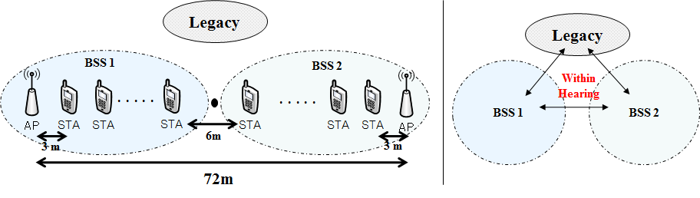
Simulation Setup: Topology
Topology consists of 2 BSSs where each includes 1 AP and 10 STAs
  In one BSS, the AP and STAs are located sequentially with a distance of 3 meters
  All STAs are within hearing distance, i.e., Preamble detection between all STAs is possible
2 BSSs are 11ax BSSs (single-band) or EHT BSSs (multi-band) which are the target we measure

Slide 7
Simulation Setup: Topology (Cont’d)
Primary channel of each band is set to the same channel
To compare the performance of single band and multi-band, we generate the interference from legacy STAs (e.g., 11ac/ax)
  The interference is generated only for 80MHz in 5GHz band, which is within hearing distance from 2 BSSs
  It is assumed that the legacy STAs are co-located and have the simulation parameters in common with 2 BSSs
  More STAs, More interference in this topology

Slide 8
Simulation Setup: Parameters
 | Single band | Multi-band
Simulator Type | PHY/MAC Integrated simulator
BSS Bandwidth / band | 160MHz / 5GHz | 80MHz / 5GHz + 80MHz / 6GHz
Tx Power (AP/STA) | 26 / 20 dBm | 23 / 17dBm
Traffic Rate | 20Mbps* | 10Mbps per band*
Antenna Gain (AP/STA) | 0/-2 dBi
Traffic Model | DL only, UL only (CBR)
RU | 242
Noise Figure / Floor | 0 / -101dBm per 20MHz
Rate Control Algorithm | Fixed MCS 4 (Data rate: 43.9Mbps)
MSDU size (bytes) / TXOP length | 1472 / DL only: 3ms, UL only: 4.6ms
Feedback | GENIE
Max Retx | 10
Symbol length | 16usec (OFDMA)
Metrics | Throughput, *Latency
Queue Size | AP: 2000 * # of associated STA, STA:2000
In this simulation, the value of traffic rate makes the queue filled sufficiently, so that STAs can use TXOP fully

Slide 9
  Results: Weak Interference
Weak Interference includes 10 Legacy STAs
For each case, Simulation running time is 100s
Tput [Mbps] | Single band (11ax) | Multi-band (EHT)
DL only | 127.3 | 149.6 (18% ↑)
UL only | 111 | 140.8 (26.8%↑)
Latency [ms] | Single band (11ax) | Multi-band (EHT)
DL only | 1586.8 | 1444.4 (9% ↓)
UL only | 1838.8 | 1761.4 (4% ↓)

Slide 10
  Results: Strong Interference
Strong Interference includes 20 Legacy STAs
For each case, Simulation running time is 100s
Tput [Mbps] | Single band (11ax) | Multi-band (EHT)
DL only | 94.9 | 144.6 (52% ↑)
UL only | 105.1 | 149 (43%↑)
Latency [ms] | Single band (11ax) | Multi-band (EHT)
DL only | 2149.8 | 1677.7 (22% ↓)
UL only | 2007.3 | 1560 (23% ↓)

Slide 11
Observation
The main factor of throughput/latency gain is the flexibility of band usage, thereby preventing the waste of resources
  Multi-band in EHT can utilize the 6GHz bandwidth regardless of the legacy interference
In denser environments (i.e., more interference), the gain of multi-band operation can be further improved

Slide 12
Further Step
We need to elaborate the simulation results by implementing several features such as
  More various and valid environments
    6GHz interference, Non-hearable, …
  Aggregation (to increase peak throughput for one target STA)
  Additional Features (e.g., mutual cooperation [6])
  ….

Slide 13
Summary
In this contribution, we have provided the simulation results for showing the efficiency of multi-band operation
We observed that the flexibility of multi-band operation can improve the performance in terms of throughput and latency
We will elaborate the PHY/MAC integrated simulator in order to show the efficiency of multi-band operation by including various environments and features

Slide 14
References
[1] 802.11-18/1155r1 Multi-AP Enhancement and Multi-Band Operations
[2] 802.11-18/1161r0 EHT Technology Candidate Discussions
[3] 802.11-18/1171r0 View on EHT Objectives and Technologies
[4] 802.11-18/1518r0 EHT Multi-Channel Operation
[5] 802.11-18/1525r1 EHT features for Multi-Band Operation
[6] 802.11-18/1908r0 Overview of Full Duplex over Multi- Band (FD-MB) for EHT

