Slide 1
20MHz Channel Access in 11bd
Date: 2019-05-13
Authors:
Name | Affiliation | Address | Phone | Email
Insun Jang | LG Electronics | 19, Yangjae-daero 11gil, Seocho-gu, Seoul 137-130, Korea |  | insun.jang@lge.com
Dongguk Lim |  |  |  | dongguk.lim@lge.com
Jinsoo Choi |  |  |  | js.choi@lge.com
Jeongki Kim |  |  |  | jeongki.kim@lge.com
Eunsung Park |  |  |  | esung.park@lge.com
Suhwook Kim |  |  |  | suhwook.kim@lge.com

Slide 2
Introduction
In the last meeting, TGbd decided to support the transmission of 10MHz and 20MHz bandwidth PPDUs for 11bd STAs to increase the throughput [1]
To transmit 10MHz bandwidth PPDUs,
  11bd STAs can just sense and access a 10MHz channel like 11p
To transmit 20MHz bandwidth PPDUs,
  11bd STAs have to be able to access a 20MHz channel
  However, there is no way to access 20MHz channel yet in 11bd
For 20MHz transmission, the first thing we have to consider is how 11bd STAs should access the 20MHz channel, which is discussed in this contribution

Slide 3
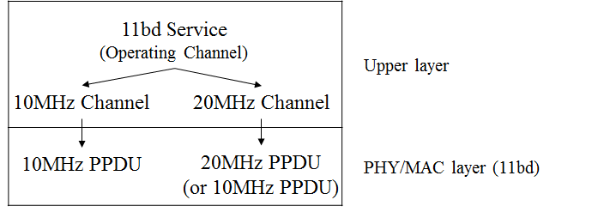
Service and Bandwidth in 11bd
DSRC services and their operating channel are decided by upper layers, thereby the available bandwidth depending on the operating channel will be decided by upper layer
There is a good chance that the 20MHz channel access depends on which 11bd services operate on which channels in the DSRC spectrum

Slide 4
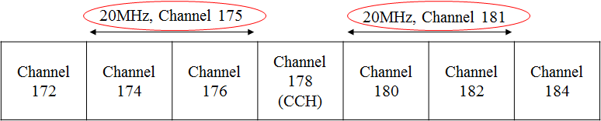
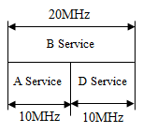
Discussion: Channel Utilization
There are a few DSRC channels in 5.9GHz for different countries
  Difficulty in accommodating a lot of V2X services in the near future
If a 20MHz channel is assigned for only transmitting 20MHz PPDU with any service, the number of available channel is very low during a sync interval
  Example for US
It would be better to improve the channel utilization if we can accommodate different 11bd services operating either by 10MHz or 20MHz width in one 20MHz channel

Slide 5
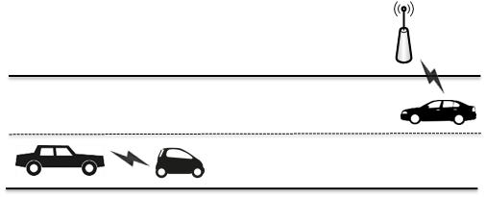
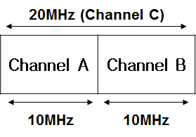
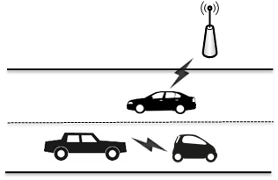
Example of Coexistence
V2V service with 10MHz channel A and V2I service with 20MHz channel C, and channel C is composed of channels A and B
  How to Contend for the 10MHz channel A with the coexistence of services operating 10MHz channel and 20MHz channel?
Independent Access
to channel A
(Out of coverage)
After a while
Simultaneous Access
to channel A
(In coverage)

Slide 6
Requirements
In a 20MHz channel, all 11bd STAs operating in 10MHz or 20MHz channel shall transmit and receive PPDUs without any problems
  Especially, 11bd STAs operating in 20MHz channel have to be able to receive 10MHz PPDU (which is transmitted from 11bd STAs operating in 10MHz channel)
Consequently, it requires a 10MHz channel where 11bd STAs first sense and access
Therefore, we can reuse the static bandwidth operation from 11n as a legacy Wi-Fi system using wide bandwidth
  It introduce the concept of primary channel which means a channel that STAs first operate (sense and access) in common

Slide 7
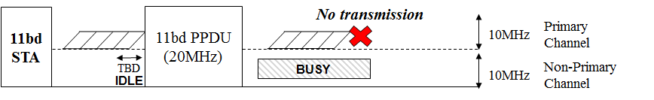
Static Bandwidth Operation in 11bd
11bd STAs first sense and access a 10MHz Primary Channel
  We can follow back-off rules for 10MHz of 11p without modifications
Transmission
  To extend to 20MHz and transmit 20MHz 11bd PPDU, we can follow the original static bandwidth operation (used in 11n)
  Specifically, if the non-primary channel (called secondary channel) were idle during a TBD interval and with a TBD sensitivity when the back-off count of primary channel becomes zero, 20MHz 11bd PPDU can be transmitted. If not (i.e., busy), no PPDU can be transmitted
Reception
  11bd STAs can receive 10MHz or 20MHz 11bd PPDU using the signaling information (e.g., BW, MCS) decoded through the 10MHz primary channel

Slide 8
Interoperability and Fairness for 11p STAs
In the last meeting, TGbd already decided to transmit PPDU format up on request from upper layer, the PPDU format can be either 11p PPDU or 11bd PPDU [2]
For 20MHz channel operating 11bd services, it is likely that the portion of 11bd PPDUs are significant by the request from upper layer (i.e., no 11p packets are detected)
It doesn’t make the impact on 11p STAs; therefore, it doesn’t lead to the interoperability and fairness problem for 11p STAs

Slide 9
Fairness between 11bd STAs
Depending on the sensitivity and sensing interval for the secondary channel, there can be unfairness on 11bd STAs operating in the secondary channel
To give a priority to 20MHz PPDU transmission,
  We can reuse the original values of interval and sensitivity (as in 11n)
  Interval: PIFS
  Receive sensitivity: -75dBm
To maintain fairness,
  We can modify the values for the fairness
  For example, same as the value in the primary channel
  Interval: AIFS
  Receive sensitivity: -85dBm

Slide 10
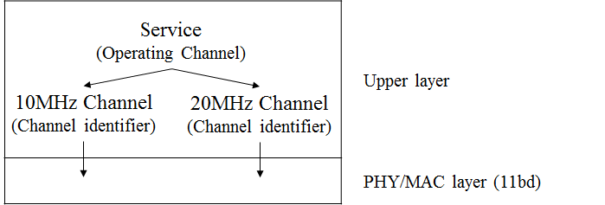
Setting of Primary Channel in 11bd
  According to 11p and IEEE 1609.4, operating channels (10MHz and/or 20MHz) are indicated by using primitives from upper layer
  In this way, operating channels in 11bd can be also indicated from upper layer
  The information of Channel identifier as a parameter includes Country String, Operating class, Channel Number
  Note that the concept of Primary/Secondary channel has been defined in PHY/MAC layer not upper layer
  In legacy system using wide bandwidth (e.g., 11n), the primary channel index is indicated in Beacon frame but there is no concept of Beacon transmission in OCB mode

Slide 11
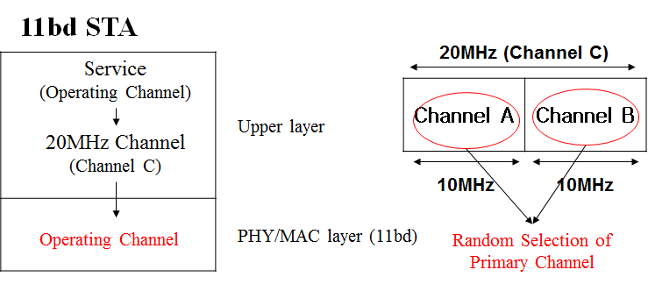
Setting of Primary Channel in 11bd (Cont’d)
  Instead of any signaling, 11bd STAs can set the 10MHz primary/secondary channel in a 20MHz operating channel depending on the channel information from upper layers
Option 1: Random Selection of Primary channel
  Operation of 11bd STA
    An 11bd STA operates a 20MHz channel indicated by the upper layer
    An 11bd STA selects the 11bd primary channel randomly as one of two 10MHz in the 20MHz operating channel
  Without any problems, the static bandwidth operation can be performed because the L-part is duplicated for each 10MHz in 20MHz PPDU format

Slide 12
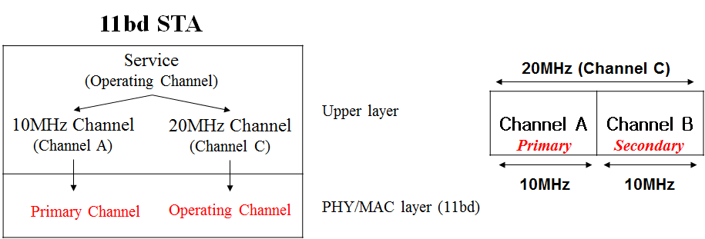
Setting of Primary Channel in 11bd (Cont’d)
Option 2: Use of additional 10MHz channel information
  Upper layer indicates an additional 10MHz channel information
  Operation of 11bd STA
    An 11bd STA operates the 20MHz channel indicated by the upper layer
    An 11bd STA sets the 11bd primary channel by the 10MHz channel
  Without any problems, the static bandwidth operation can be performed

Slide 13
Summary
In this contribution, we have discussed the 20MHz channel access in 11bd and observed that the static bandwidth operation based on a 10MHz primary channel is needed to mitigate the restriction of the DSRC spectrum
To enable the static bandwidth operation, 11bd STAs can set the 10MHz primary channel in a 20MHz operating channel based on the channel information indicated from upper layers

Slide 14
SP #1
Do you agree to support that a 20MHz channel in 11bd can accommodate different 11bd services operating either by 10MHz or 20MHz width
Y/N/A

Slide 15
SP #2
Do you agree to add the following text into 11bd SFD?
  To transmit 20MHz bandwidth PPDU, an 11bd STA shall operate on a 11bd primary channel
    11bd primary channel means a 10MHz channel that 11bd STAs first sense and access to transmit 20MHz bandwidth PPDU
Y/N/A

Slide 16
SP #3
Do you agree to add the following text into 11bd SFD?
  To transmit 20MHz bandwidth PPDU, an 11bd STA shall perform the following action,
    Transmit a 20 MHz PPDU on 11bd primary channel and 11bd secondary channel if 11bd secondary channel was idle during a TBD interval immediately preceding the start of the TXOP with TBD sensitivity threshold
      11bd secondary channel means the 10MHz channel as one of 20MHz channel except for the 10MHz primary channel
Y/N/A

Slide 17
SP #4
Which option do you prefer for 11bd STAs to set the 10MHz primary channel in a 20MHz operating channel?
  Option 1: Random Selection
  Option 2: Use of additional 10MHz channel information
  Abs

Slide 18
References
[1] 802.11-19/0332r2 PHY designs for 11bd
[2] 802.11-19/0341r1 NGV Backward Interoperability: Follow-up

