Slide 1
Performance Analysis of Outer RS Coding Scheme
Date: 2019-03-12
Authors:

Slide 2
Abstract
Outer Reed Solomon (RS) Code was proposed in [1] and further analyzed in [2].
The following results are based on simulator [2] analyzing the influence of different performance metrics, MCS, and channels:
PER/Throughput vs. E_{b}/N₀ or SNR:
BPSK/QPSK/16-QAM/64-QAM and different coding rates
AWGN, highway LoS and NLoS
Results show that carful selection of performance metric needed to evaluate performance gains of novel schemes.

Slide 3
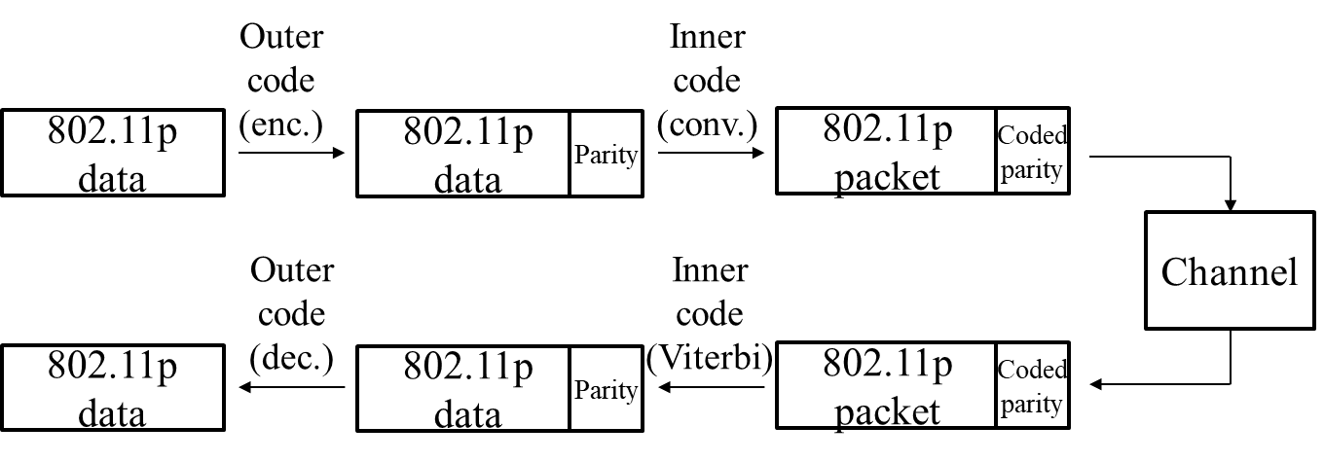
Introduction
Outer Reed Solomon (RS) code proposed in [1]:
Fig. 1 – Reed Solomon outer coding (taken from [1])

Slide 4
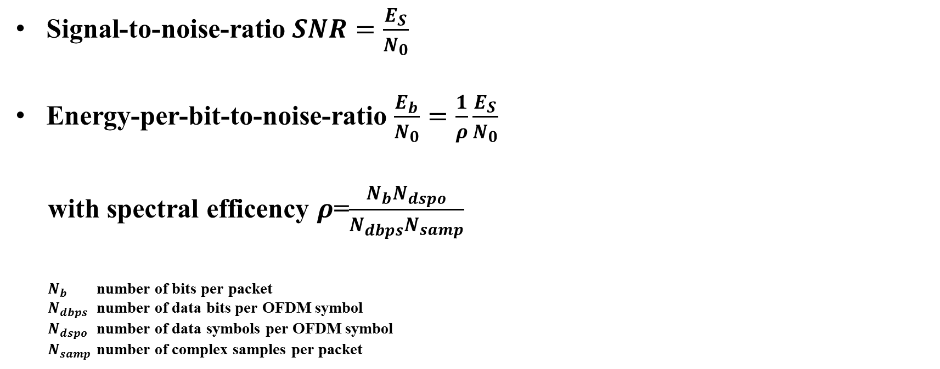
Definitions
Signal-to-noise-ratio $SNR=\frac{E_{S}}{N_{0}}$
Energy-per-bit-to-noise-ratio $\frac{E_{b}}{N_{0}}=\frac{1}{ρ}\frac{E_{S}}{N_{0}}$
with spectral efficency $ρ$=$\frac{N_{b}N_{dspo}}{N_{dbps}N_{samp}}$
$N_{b}$ number of bits per packet
$N_{dbps}$ number of data bits per OFDM symbol
$N_{dspo}$ number of data symbols per OFDM symbol
$N_{samp}$ number of complex samples per packet

Slide 5
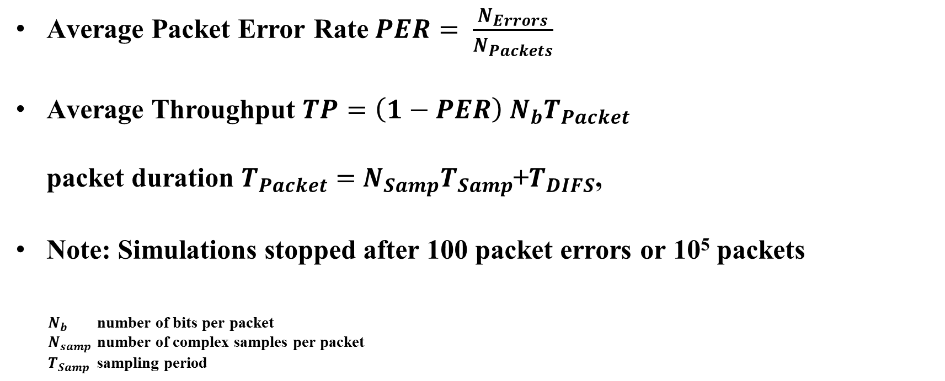
Definitions
Average Packet Error Rate$PER= \frac{N_{Errors}}{N_{Packets}}$
Average Throughput $TP=\left(1−PER\right) N_{b}T_{Packet}$
packet duration $T_{Packet}=$ $N_{Samp}T_{Samp}$+$T_{DIFS}$,
Note: Simulations stopped after 100 packet errors or 10⁵ packets
$N_{b}$ number of bits per packet
$N_{samp}$ number of complex samples per packet
$T_{Samp}$ sampling period

Slide 6
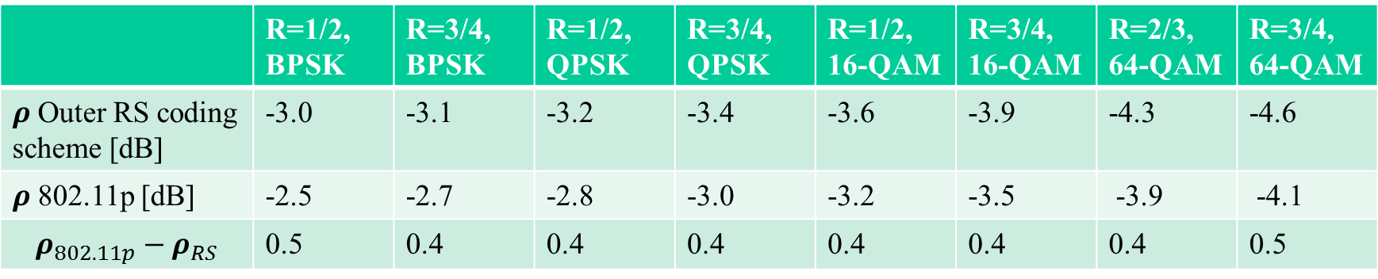
Spectral Efficency for Different MCS
 | R=1/2, BPSK | R=3/4, BPSK | R=1/2, QPSK | R=3/4, QPSK | R=1/2, 16-QAM | R=3/4, 16-QAM | R=2/3, 64-QAM | R=3/4, 64-QAM
$ρ$ Outer RS coding scheme [dB] | -3.0 | -3.1 | -3.2 | -3.4 | -3.6 | -3.9 | -4.3 | -4.6
$ρ$ 802.11p [dB] | -2.5 | -2.7 | -2.8 | -3.0 | -3.2 | -3.5 | -3.9 | -4.1
$$ρ_{802.11p}−ρ_{RS}$$ | 0.5 | 0.4 | 0.4 | 0.4 | 0.4 | 0.4 | 0.4 | 0.5

Slide 7
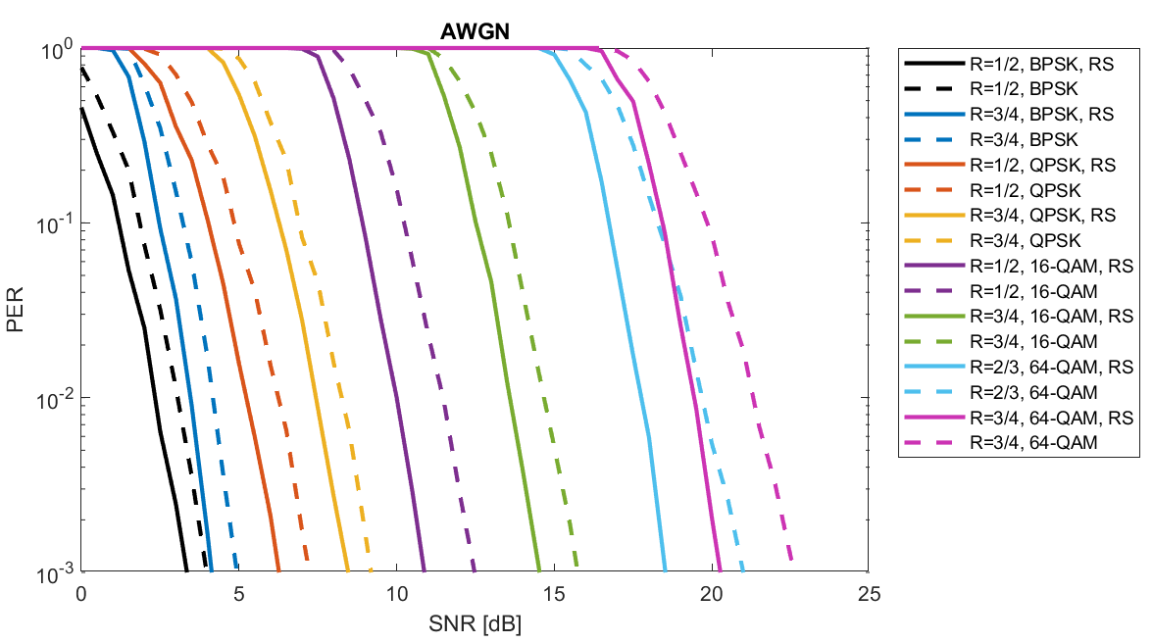
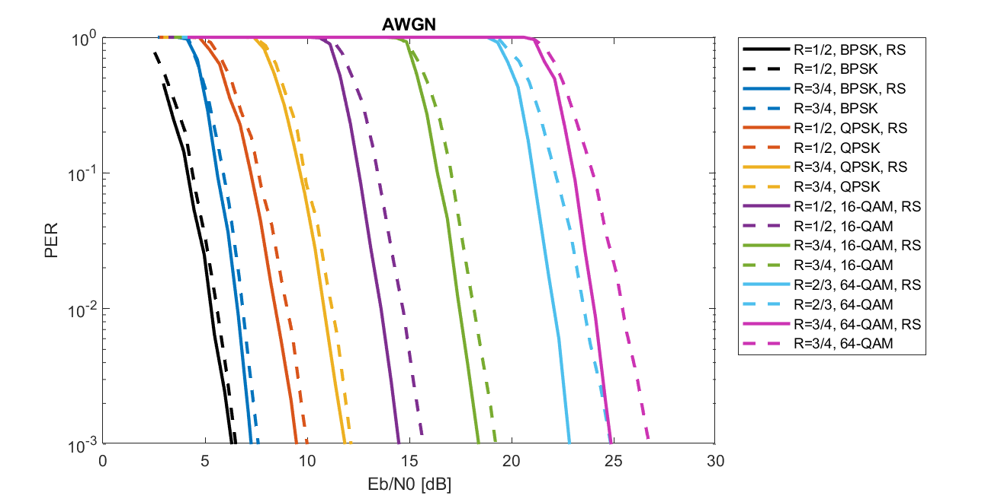
AWGN (1/2)
Comparison of PER in relation to SNR and E_{b}/N₀:
PER vs. E_{b}/N₀ for fair comparison, accounts for additional energy on overhead
Marginal gain for BPSK/QPSK/16-QAM, significant gain only for 64-QAM

Slide 8
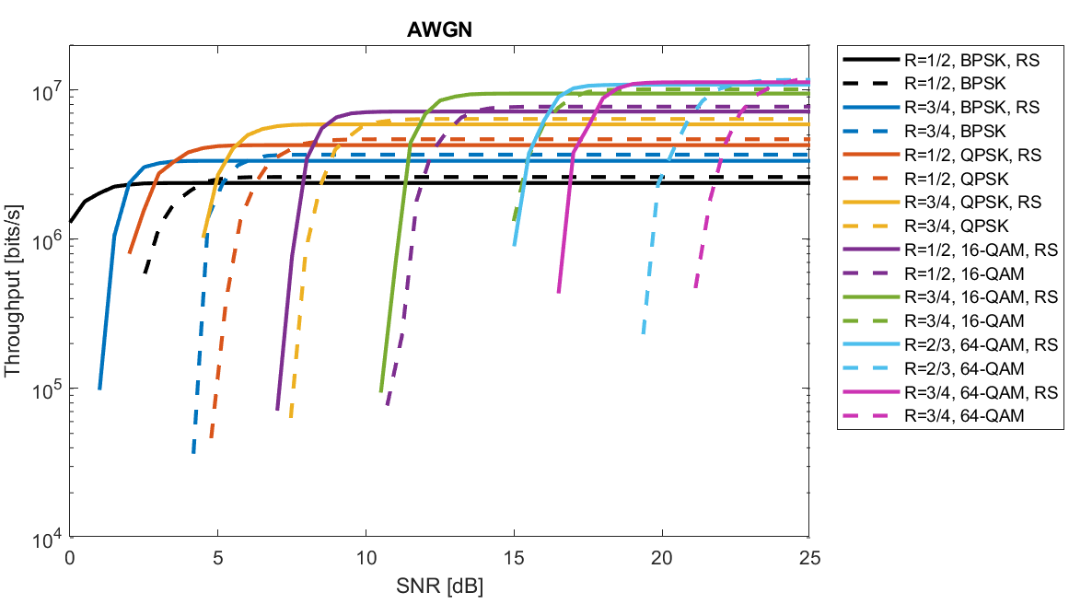
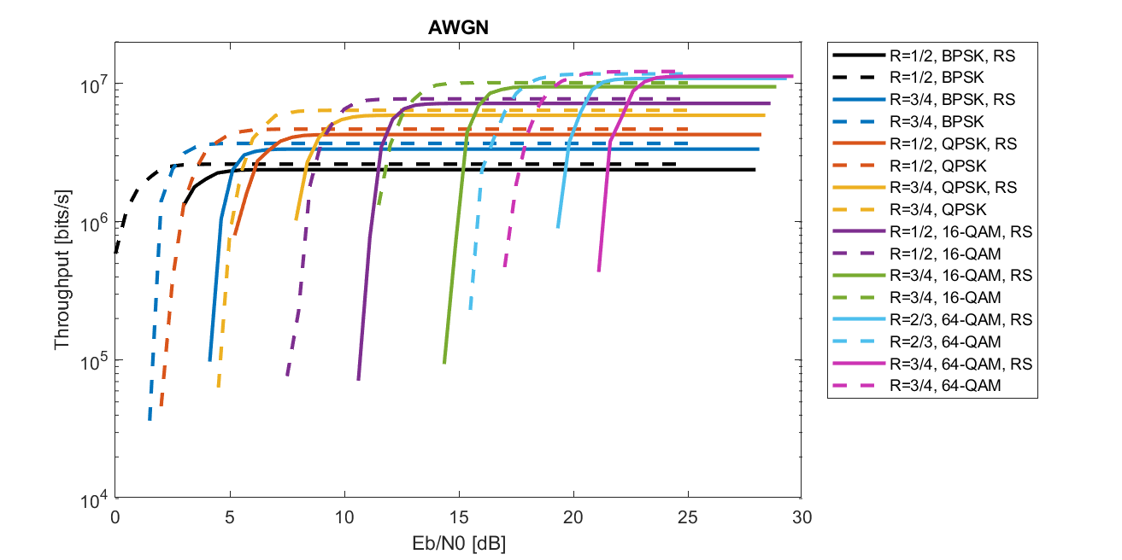
AWGN (2/2)
Comparison of throughput in relation to SNR and E_{b}/N₀:
Throughput vs. E_{b}/N₀ for fair comparison, accounts for additional energy on overhead and channel use
Outer RS coding scheme has lower throughput for all MCS and AWGN

Slide 9
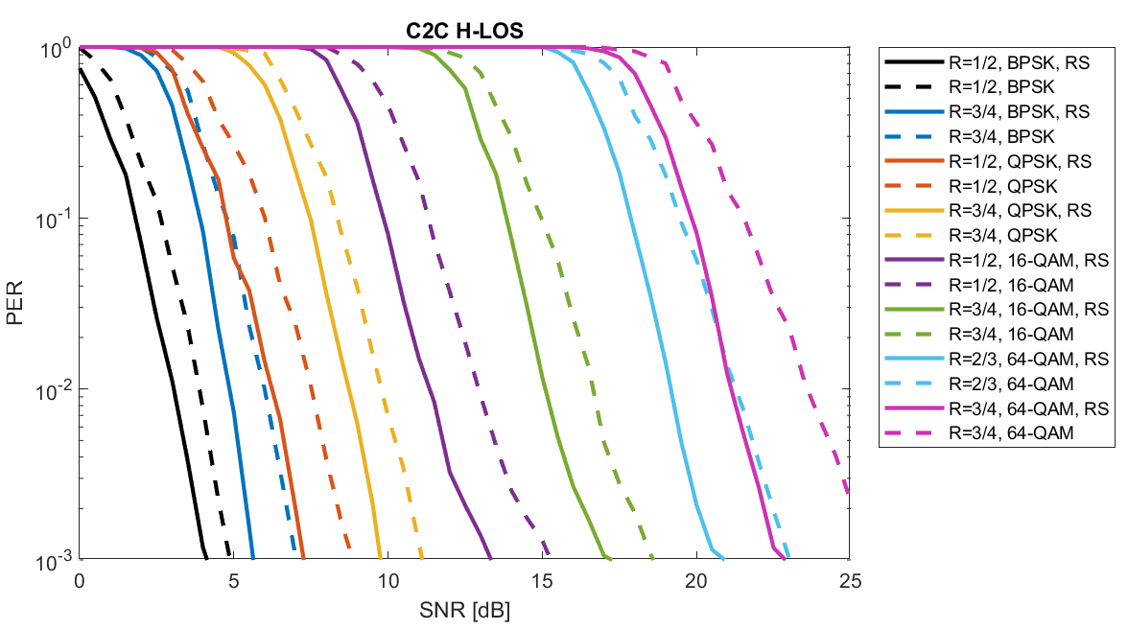
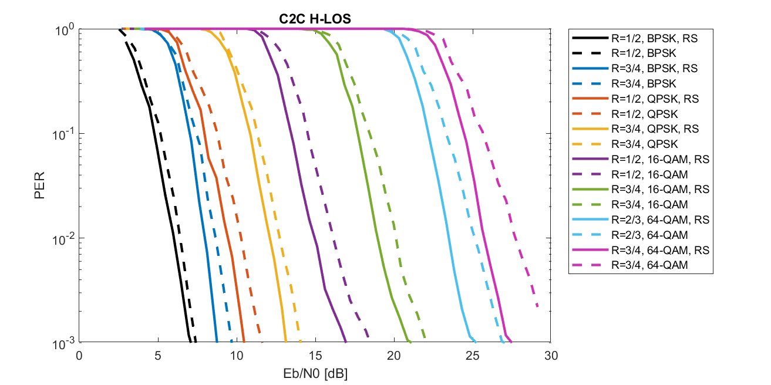
Highway LoS (1/2)
Comparison of PER in relation to SNR and E_{b}/N₀:
PER vs. E_{b}/N₀ for fair comparison, accounts for additional energy on overhead
Marginal gain for BPSK/QPSK/16-QAM, significant gain only for 64-QAM

Slide 10
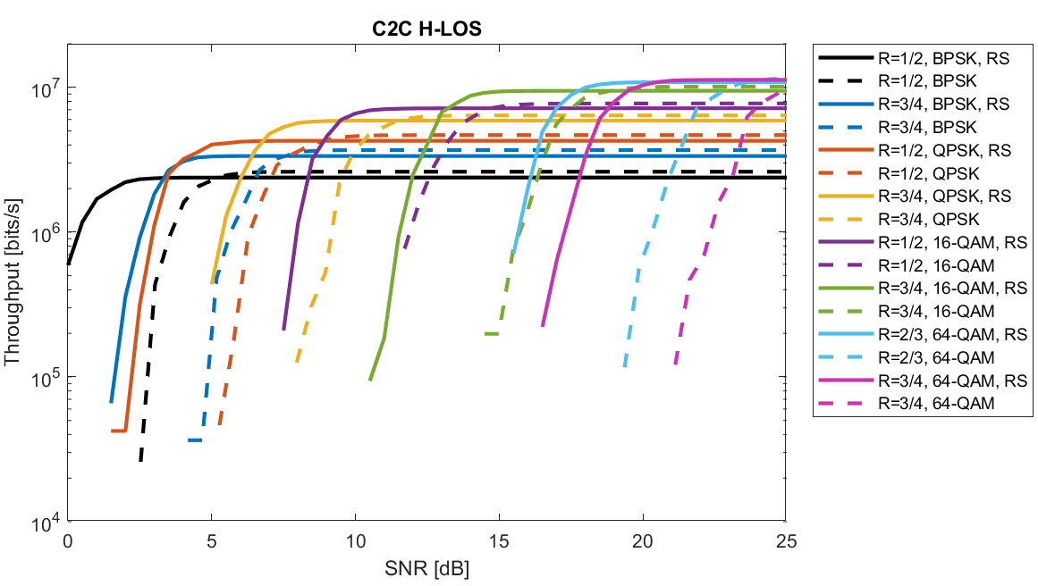
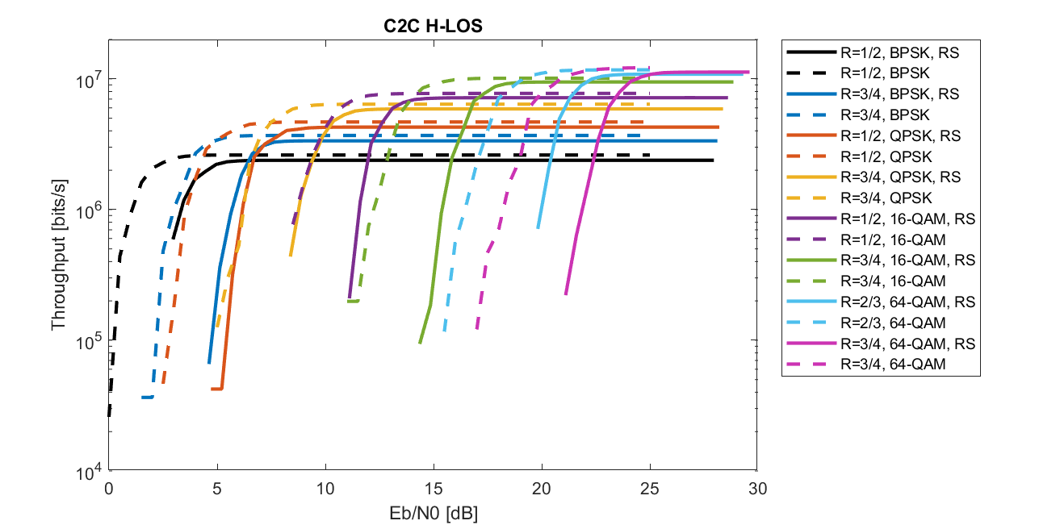
Highway LoS (2/2)
Comparison of throughput in relation to SNR and E_{b}/N₀:
Throughput vs. E_{b}/N₀ for fair comparison, accounts for additional energy on overhead and channel use
Outer RS coding scheme has lower throughput for all MCS and Highway LoS channel

Slide 11
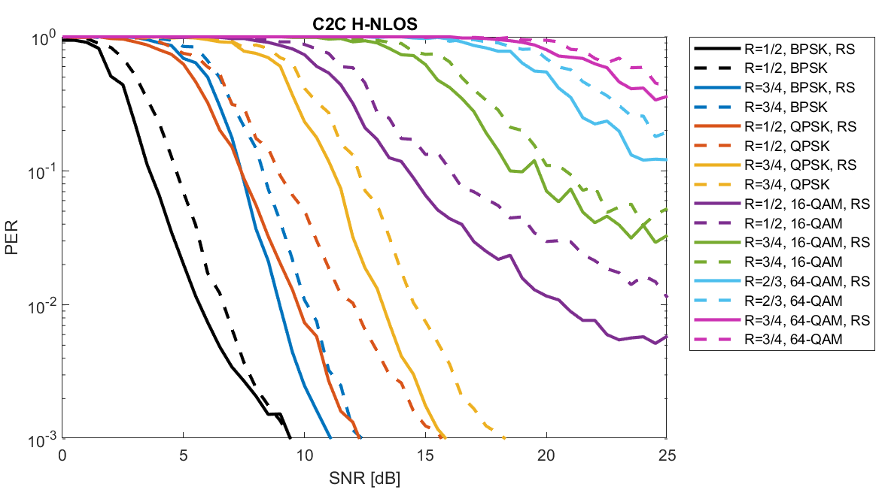
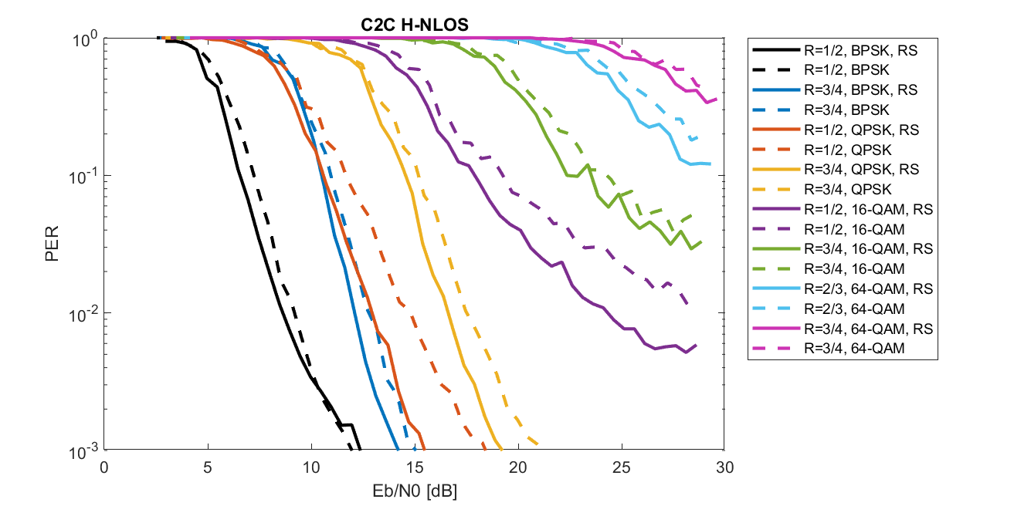
Highway NLoS (1/2)
Comparison of PER in relation to SNR and E_{b}/N₀:
PER vs. E_{b}/N₀ for fair comparison, accounts for additional energy on overhead
Marginal gain for BPSK/QPSK(R=3/4), possibly significant gains for QPSK(R=1/2),16-QAM, 64-QAM

Slide 12
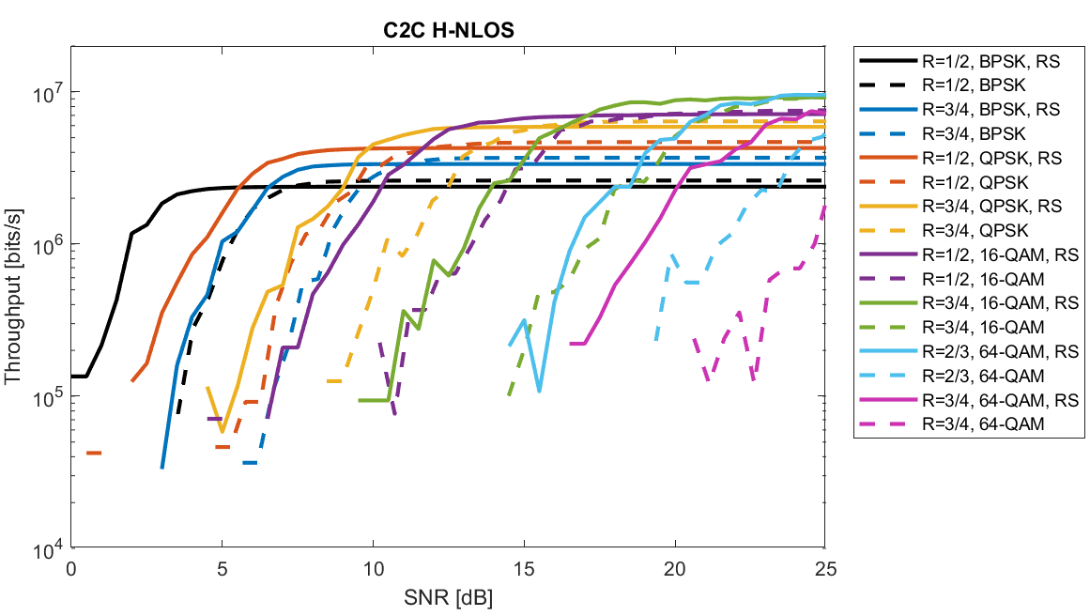
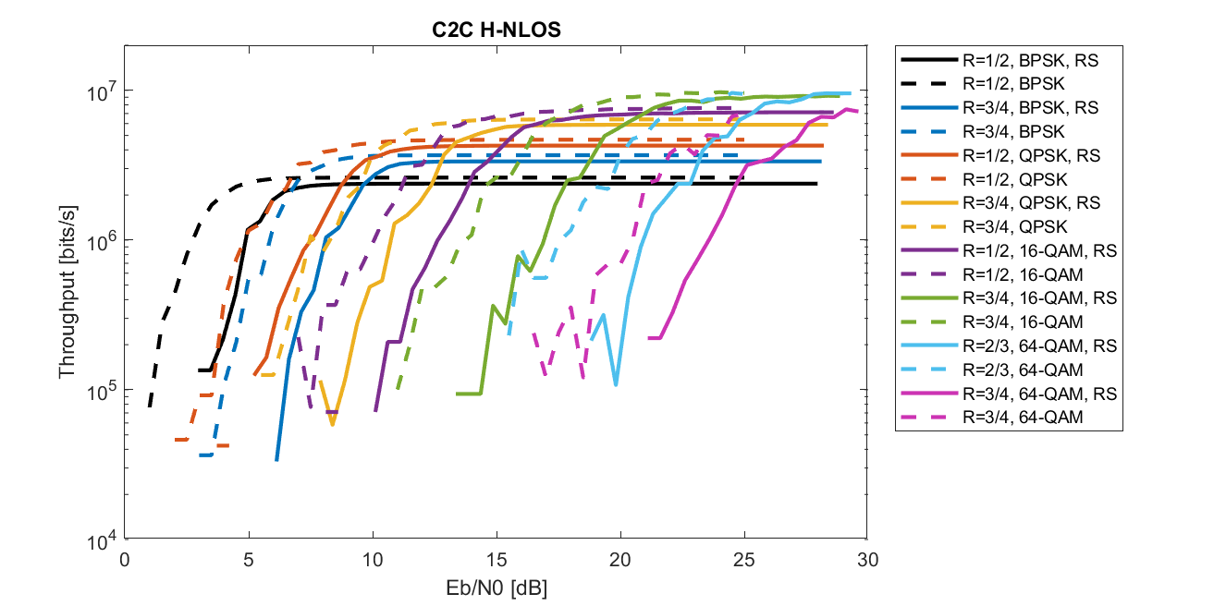
Highway NLoS (2/2)
Comparison of throughput in relation to SNR and E_{b}/N₀:
Throughput vs. E_{b}/N₀ for fair comparison, accounts for additional energy on overhead and channel use
Outer RS coding scheme has lower throughput for all MCS and Highway NLoS channel

Slide 13
Conclusions
PER vs. E_{b}/N₀ and PER vs. SNR:
  PER vs. E_{b}/N₀ for fair comparison: Accounts for additional energy on overhead
  Marginal gains for outer RS coding scheme for BPSK/QPSK/16-QAM
  Significant gain only for 64-QAM
Throughput vs. E_{b}/N₀ and Throughput vs. SNR:
  Throughput vs. E_{b}/N₀ for fair comparison:
  Accounts for additional energy on overhead and channel use
  Outer RS coding scheme has lower throughput for all MCS and channels (AWGN, H-LoS, H-NLoS)
→ Careful selection of metric to evaluate performance gains of novel schemes

Slide 14
References
[1] O. Haran, “Backward compatible PHY feasibility,” IEEE 802.11-18/1214r0
[2] I. Sarris, "V2X Reed-Solomon Simulation Model," IEEE 802.11-18/1956r1.

