Slide 1
MAC Architectures for EHT Multi-band Operation
Date: 2019-03-12
Authors:

Slide 2
Introduction
Multi-band Operation
One of candidate features discussed in EHT TIG/SG
Traffic steering, single association/authentication state, multi-band aggregation, etc. (Appendix)
In this presentation,
We classify the potential architectures : Independent MAC, Distributed MAC, Unified MAC
Review operations that can be supported by these architectures

Slide 3
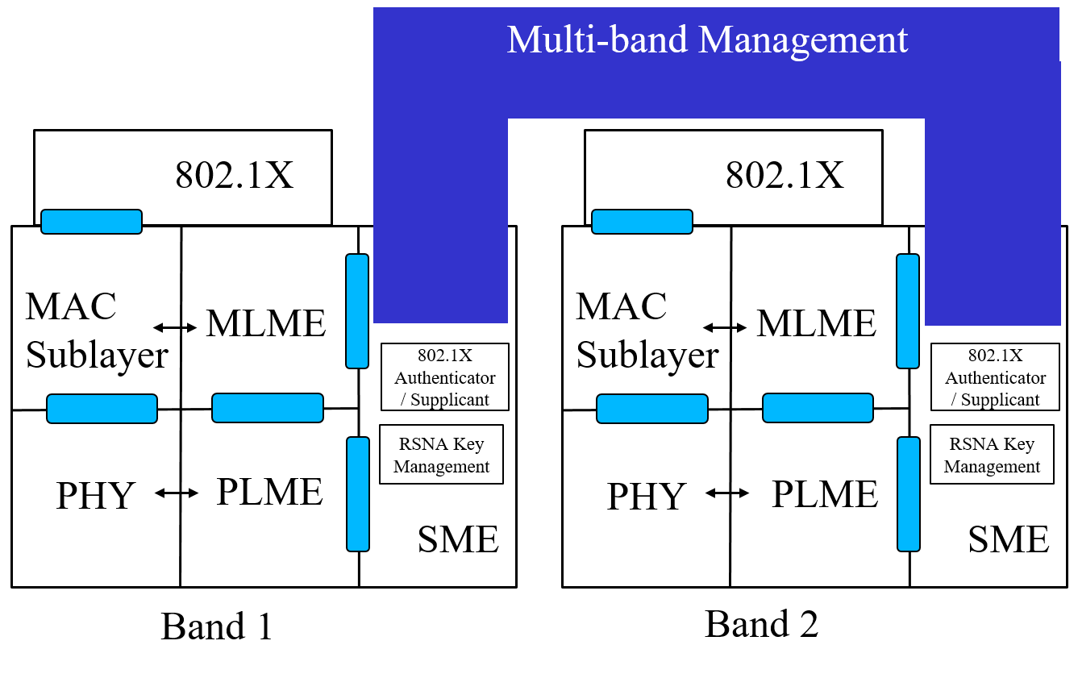
Independent MAC
Independent MAC-SAP, association state, MLME, data plane
Asynchronous transmission
Upper layer link aggregation (e.g. 802.1AX-2014) for load balancing and traffic steering
Non-transparent FST [7]

Slide 4
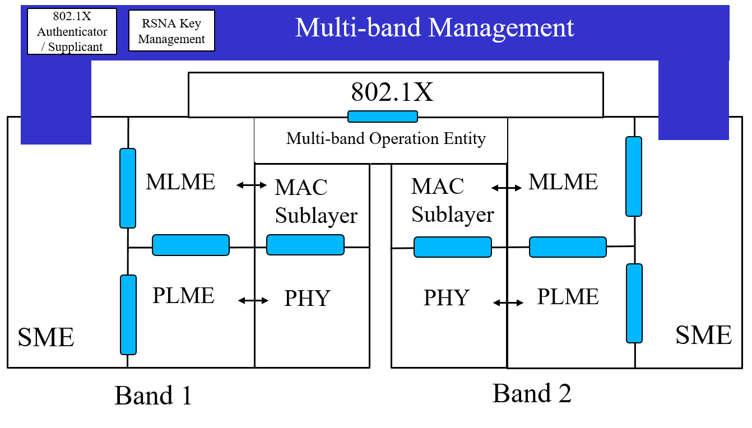
Distributed MAC
Single MAC-SAP, authentication
Shared management info, sequence counter, PN counter, etc.
Independent per-band queueing
Single association state, Data/MGMT split (e.g. idle mode in band A/active mode in band B, update system information in band A only, etc.)
Transparent FST [7]

Slide 5
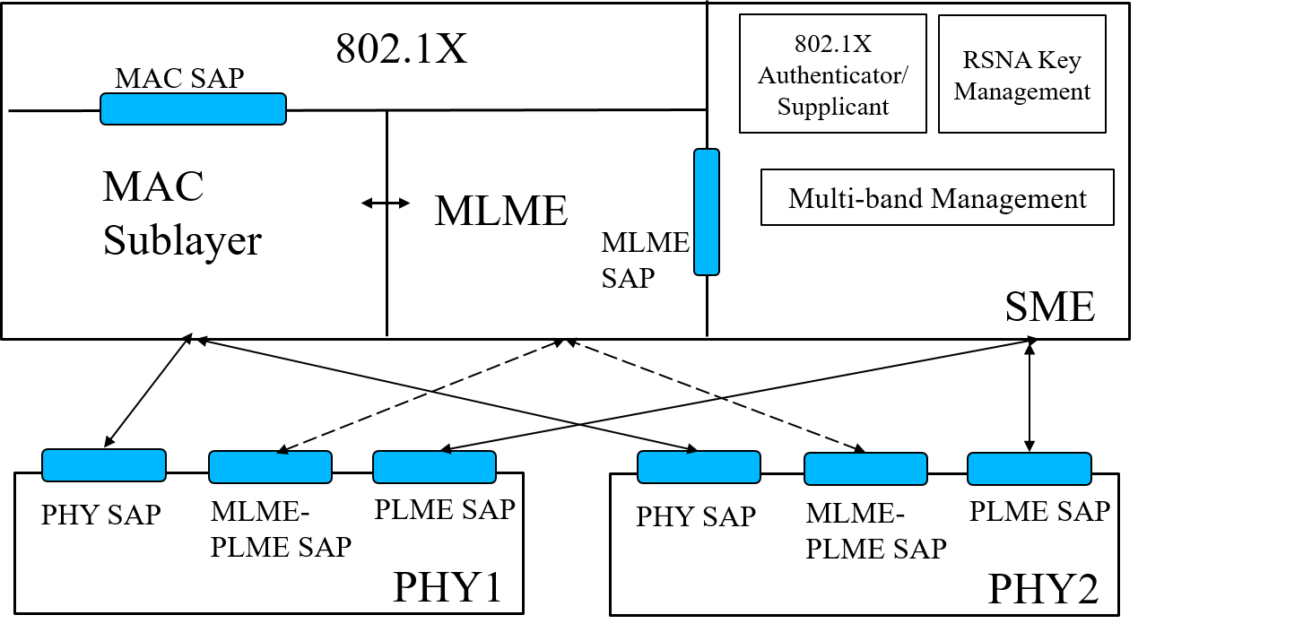
Unified MAC
Single MLME and MAC Sublayer
Unified queueing
Synchronous transmission, MAC retransmissions on other bands, buffer status/ CCA status indications of band A on band B

Slide 6
Summary
Independent MAC, Distributed MAC, Unified MAC
Multi-band operation features supported varies among the architectures
Encourage discussion:
EHT multi-band device reference model to assist technical contributions on multi-band operation

Slide 7
References
[1] 11-18/1184r1, “Follow up discussions on Throughput Enhancement”
[2] 11-18/1518r0, “EHT Multi-Channel Operation”
[3] 11-18/1525r1, “EHT features for Multi-Band Operation”
[4] 11-18/1155r1, “Multi-AP Enhancement and Multi-Band Operations”
[5] 11-18/1908r0, “Overview of Full Duplex over Multi-Band for EHT”
[6] 11-19/108r1, “Discussion on Multi-Band for EHT”
[7] IEEE Standard 802.11™-2016

Slide 8
Appendix
EHT multi-band operation discussed features [1,2,3,4,5,6]
Asynchronous transmission
Traffic steering (e.g. AC_VO on band A and AC_BE on band B)
FDD (e.g. DL MSDU on band A/ UL MSDU on band B)
Single association state/authentication state across the bands
Data/MGMT split (e.g. idle mode in band A, active mode in band B, update system information in band A only, etc.)
Synchronous transmission
MAC retransmissions on other bands
Buffer Status/ CCA status reporting of band A on band B
Dynamic MPDU duplication for real-time application robustness/latency

