Slide 1
Car-2-Car
- A survey on CAM statistics
Date: 2019-03-07
Authors:
F. Berens, FBConsulting; V. Martinez, NXP; E. Perraud, Renault

Slide 2
Abstract
The Car2Car Communication Consortium has performed a set of evaluation measurements to get an overview over the statistics of CAM messages in real implementations and deployments
CAM messages are non-deterministic in time and size
  Period varies from 1Hz to 10Hz depending on the generation rules based on speed, heading and acceleration
  Size varies from around 200 bytes to up to more than 700 Bytes depending on the environment and security content
A detailed report is available under:
  https://www.car-2-car.org/fileadmin/documents/General_Documents/C2CCC_TR_2052_Survey_on_CAM_statistics.pdf
A realistic performance simulation need to take these variations into account
F. Berens, FBConsulting; V. Martinez, NXP; E. Perraud, Renault

Slide 3
Overview
  Introduction
  CAM structure overview & generation rules
  Overall architecture & CAM generation agnostic to access layer technology
  Traces collected
  CAM sizes: variation versus time
  CAM sizes: Distribution shape & statistics
  CAM: time intervals (variation vs time)
  CAM: time intervals (distributions)
  Duty cycles (specific to IEEE 802.11p access layer)
  Summary, key observations

Slide 4
Introduction
The study provides a comprehensive analysis of ITS-G5 message traces collected in real test-drives in Europe in 2018.
Currently focusing on CAM
  Following versions to include more messages types
Traces have been collected in standard traffic conditions and standard drives.
  Should be representative of most driving situations in Europe.
  Collected by car makers (VW, Renault), in different locations, with different ITS-G5 hardware equipment from different vendors.
Full study available under:
https://www.car-2-car.org/fileadmin/documents/General_Documents/C2CCC_TR_2052_Survey_on_CAM_statistics.pdf
F. Berens, FBConsulting; V. Martinez, NXP; E. Perraud, Renault

Slide 5
What is a ‘CAM message’?
C-ITS works by sharing data between road participants
Cooperative Awareness Message one of the basic C-ITS message types:
  Exchanged ad-hoc between cars multiple times per second
    No infrastructure required
    Comparable to USA ‘BSM’: Basic Safety Message
  Containing information on position, direction, speed, etc
  Crucial input for many safety related use cases
    Electronic Emergency Brake Light
    Intersection Collision warning
  Cryptographically integrity protected (but not encrypted)
  Frequency and size depends on situation
    → Focus of this study
F. Berens, FBConsulting; V. Martinez, NXP; E. Perraud, Renault

Slide 6
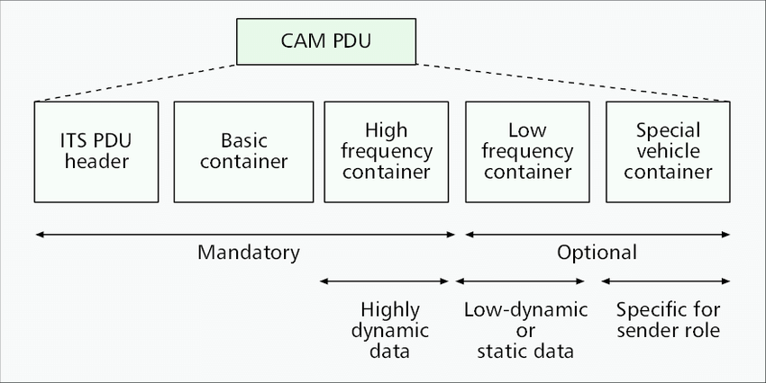
CAM structure overview & generation rules
CAM generation triggers:
Position: A change in position by more than 4m
Heading: A change of direction of equal or more than +/- 4°
Change of speed: A change of speed equal to or larger than 0,5m/sec
Otherwise: Generate a message after 1 second max
F. Berens, FBConsulting; V. Martinez, NXP; E. Perraud, Renault

Slide 7
Overall architecture & CAM generation agnostic to access layer technology
RHS/CAA
TS 102 539-1
ICRW
TS 102 539-2
LCRW
TS 102 539-3
Applications
CAM
EN 302 637-2
DENM
EN 302 637-3
LDM
TS 102 724
Facilities
TS 103 097/102 94x Security
TS 102 723-x Cross-Layer Ifx
TS 102 894-2 Common Data Directory
Network & Transport
GeoNetworking EN 302 636-4-1/2
BTP
EN 302 636-5-1
DCC - TS 103 141
Access
technology
Access Layer
IEEE802.11p and 11bd
Access Layer
LTE-V2X
… or …
F. Berens, FBConsulting; V. Martinez, NXP; E. Perraud, Renault

Slide 8
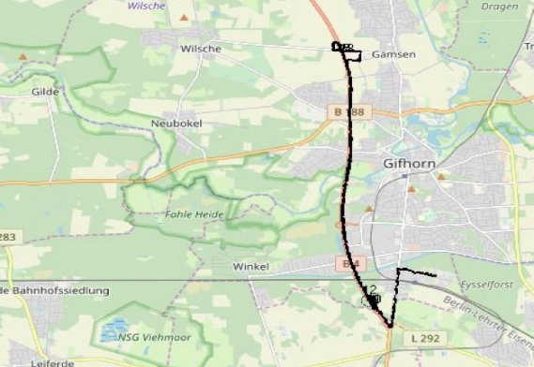
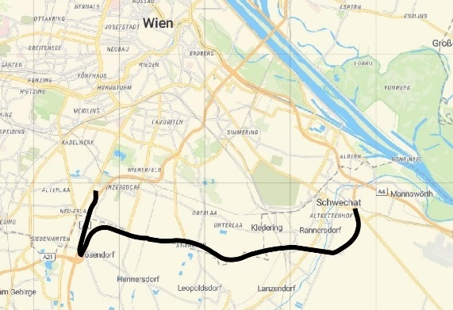
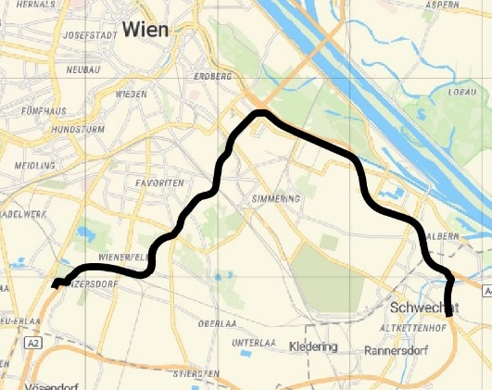
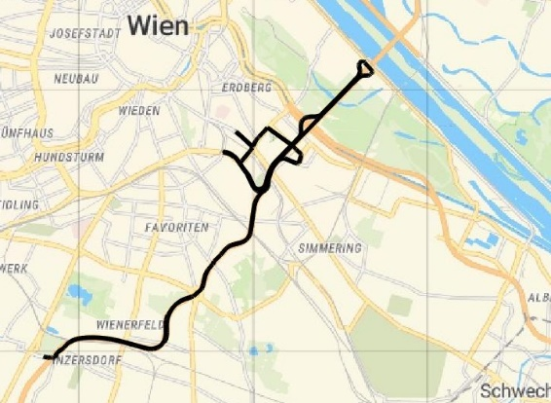
Traces collected
Trace name | Company providing trace | Type of drive environment | Location where trace was recorded | Standard | Facilities layer profile
“VW urban” | VW | Urban | Gifhorn, Germany | ETSI ITS-G5 | C2C_CC profile 1.3
“VW suburban” | VW | Suburban | Gifhorn, Germany | ETSI ITS-G5 | C2C_CC profile 1.3
“VW highway” | VW | Highway (slow) | Gifhorn, Germany | ETSI ITS-G5 | C2C_CC profile 1.3
“Renault urban” | Renault | Urban | Vienna, Austria | ETSI ITS-G5 | SCOOP 1.2, 2.4.1
“Renault suburban” | Renault | Suburban | Vienna, Austria | ETSI ITS-G5 | SCOOP 1.2, 2.4.1
“Renault highway” | Renault | Highway | Vienna, Austria | ETSI ITS-G5 | SCOOP 1.2, 2.4.1
VW urban
VW suburban
VW highway
Renault urban
Renault suburban
Renault highway
F. Berens, FBConsulting; V. Martinez, NXP; E. Perraud, Renault

Slide 9
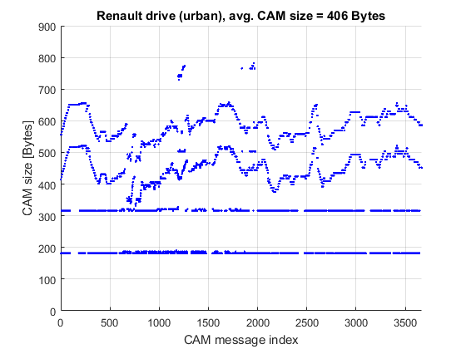
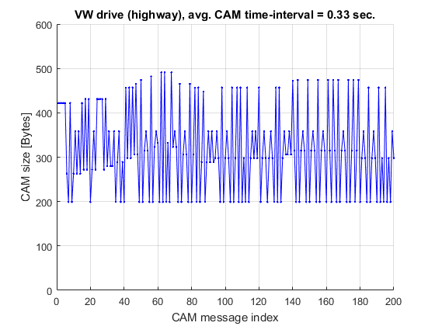
CAM sizes: variation versus time
Example1: Renault urban
Example2: VW highway (detail)
Observation #1: CAM size keeps changing from one message to the next, for all the drives.
F. Berens, FBConsulting; V. Martinez, NXP; E. Perraud, Renault

Slide 10
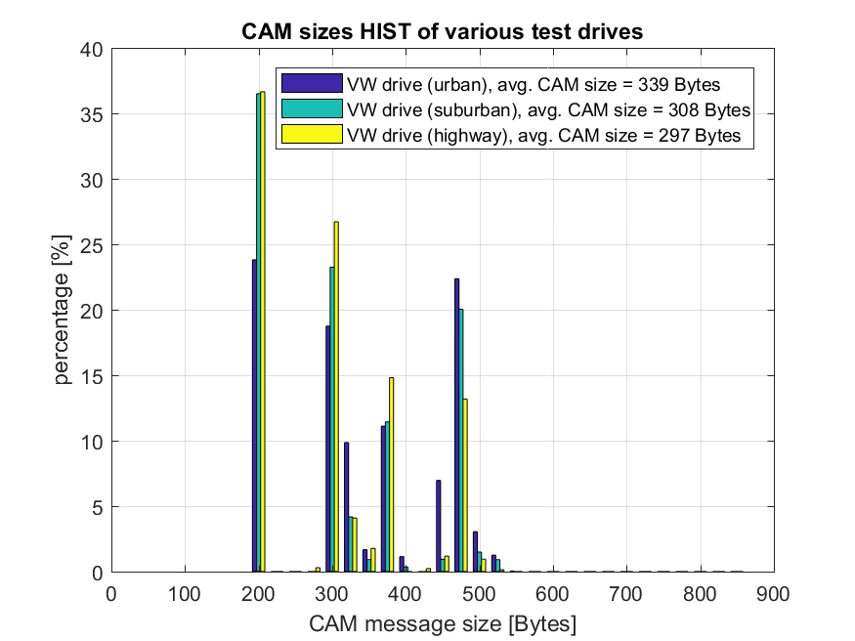
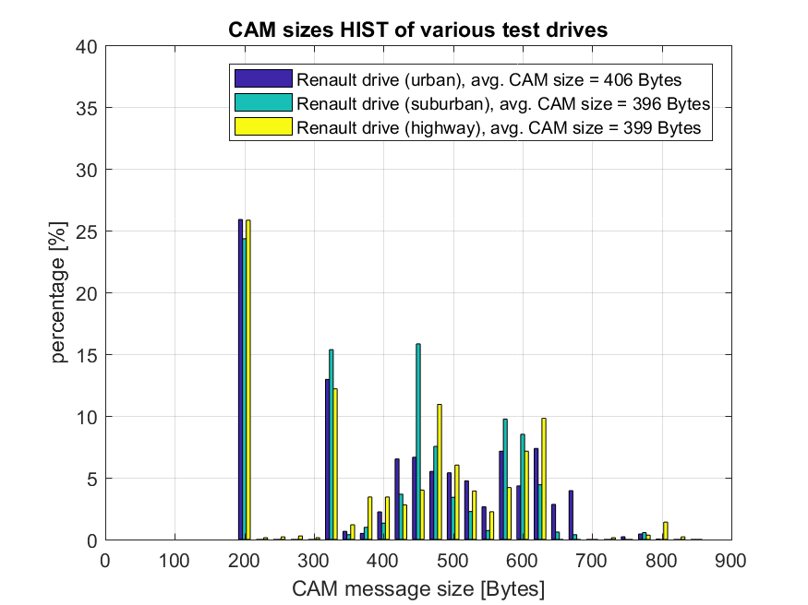
CAM sizes: Distribution shape & statistics
Observation #2: The set of possible CAM sizes is very diverse, for all test drives.
Observation #3: Significant differences in the upper part of the CAM distribution
Observation #5: The average CAM sizes is typically around 350 Bytes
Trace | CAM sizes, mean value | CAM sizes, min value | CAM sizes, max value
VW urban | 339 Bytes | 199 Bytes | 526 Bytes
VW suburban | 308 Bytes | 199 Bytes | 504 Bytes
VW highway | 297 Bytes | 199 Bytes | 500 Bytes
Renault urban | 406 Bytes | 182 Bytes | 782 Bytes
Renault suburban | 396 Bytes | 182 Bytes | 765 Bytes
Renault highway | 399 Bytes | 182 Bytes | 807 Bytes
Overall average | 357 Bytes
F. Berens, FBConsulting; V. Martinez, NXP; E. Perraud, Renault

Slide 11
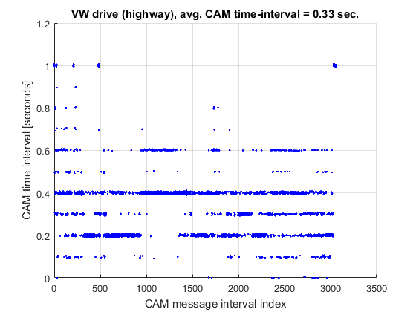
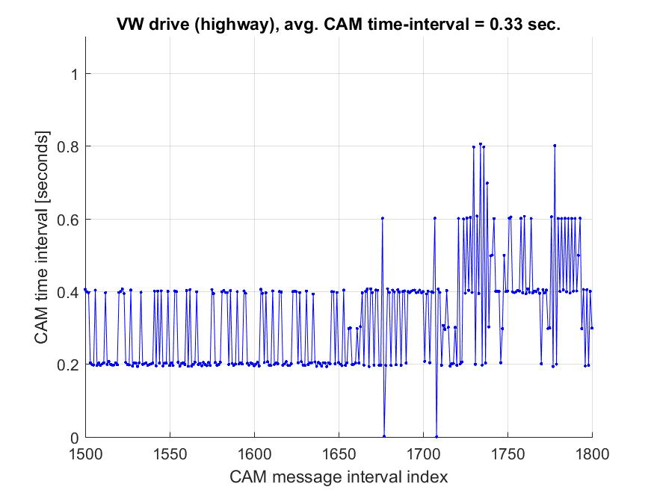
CAM: time intervals (variation vs time)
Observation #8: In practice, the CAM time-interval very often changes from one message to the next, observed in all the drives.
Note: quantisation of time interval is due to discrete GPS update frequency
F. Berens, FBConsulting; V. Martinez, NXP; E. Perraud, Renault

Slide 12
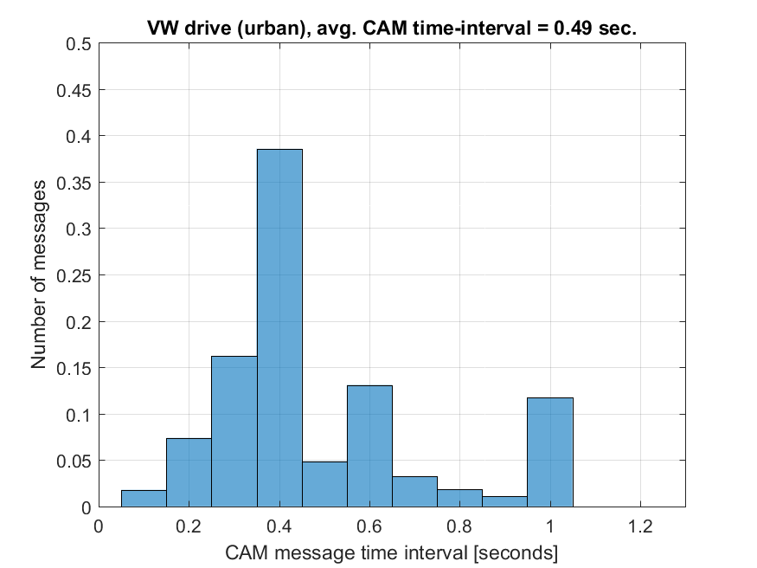
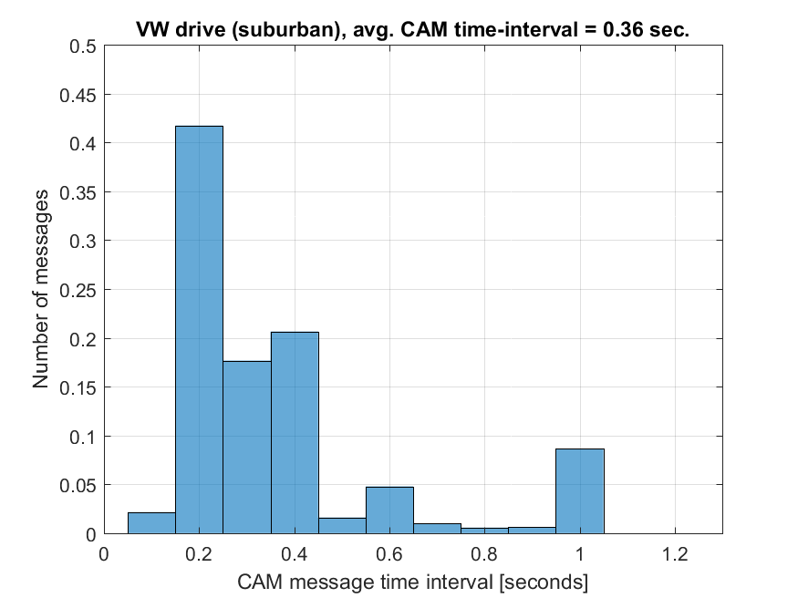
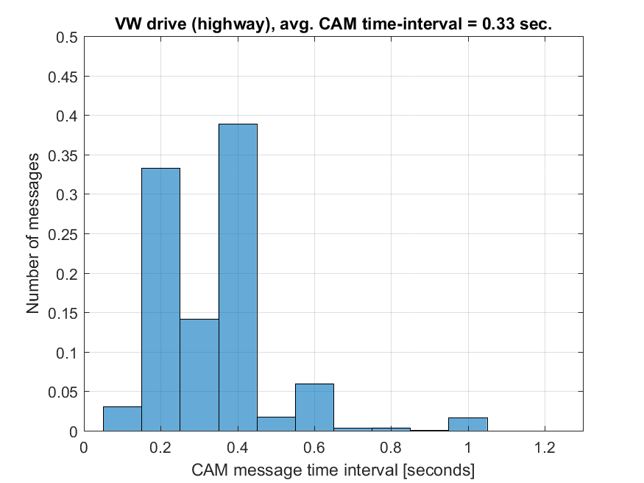
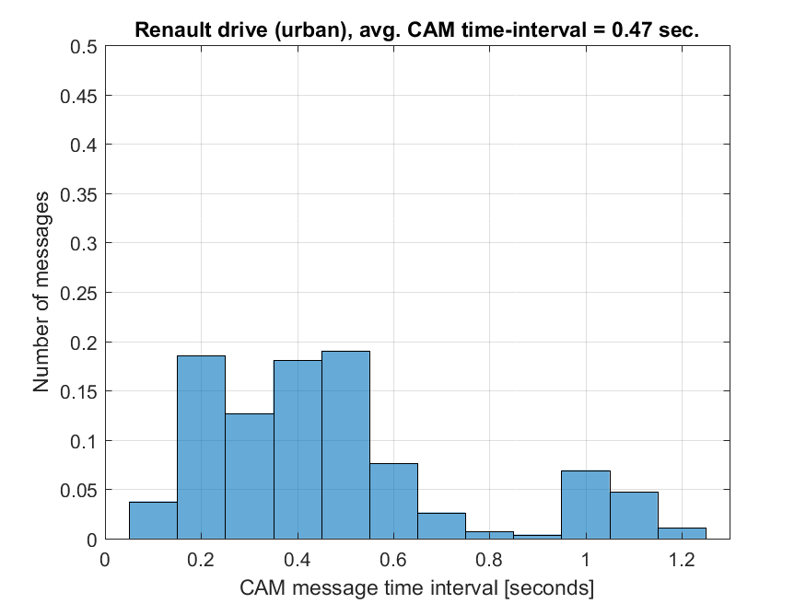
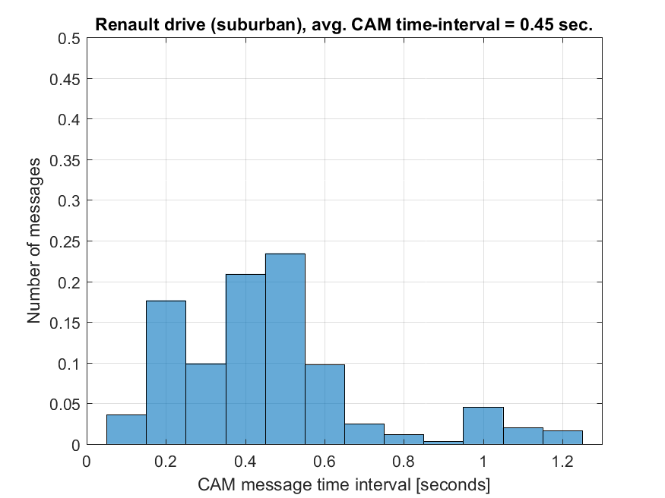
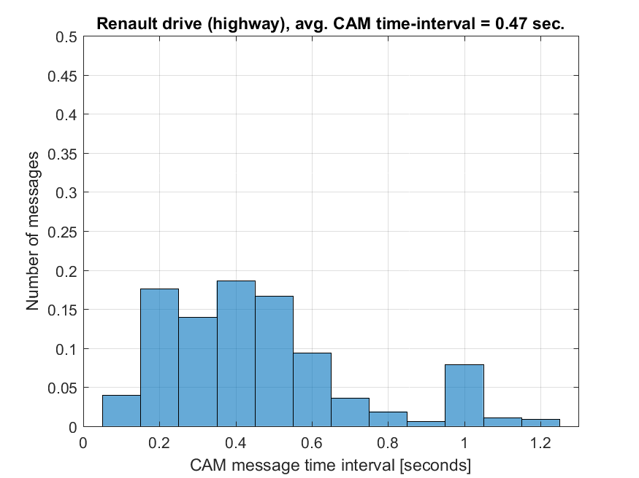
CAM: time intervals (distributions)
Observation #9: The distribution of the CAM time-interval is very diverse, and heavily depend on the drive scenario.
Observation #10: The average values of the time-intervals vary between 0.33 and 0.47 seconds.
F. Berens, FBConsulting; V. Martinez, NXP; E. Perraud, Renault

Slide 13
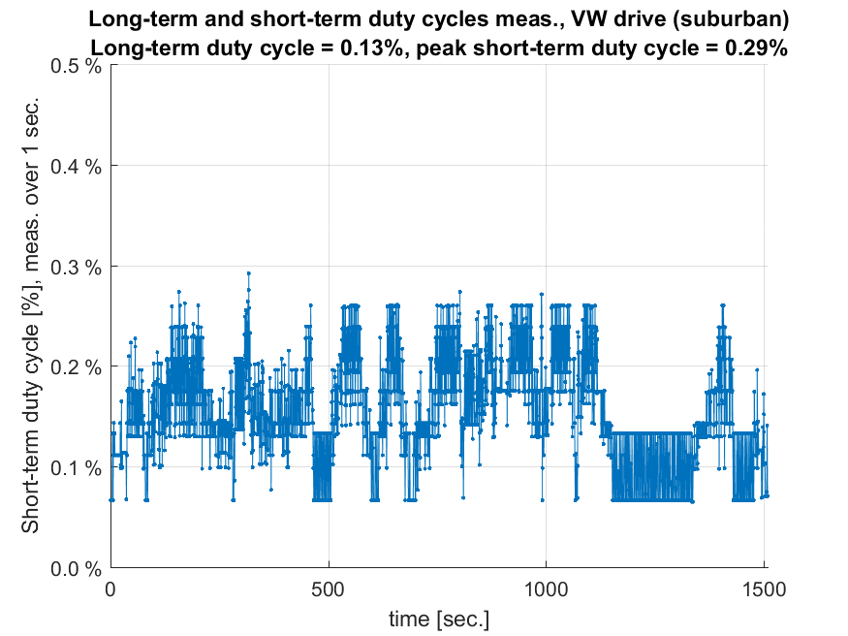
Duty cycles based on IEE802.11 access layer
Trace | Total duration of all packets | Duration of test drive | Long-term duty cycle | Max peak short-term duty cycle (1 sec. meas.)
VW urban | 1.33 sec. | ~21 min. | 0.10% | 0.26%
VW suburban | 1.94 sec. | ~25 min. | 0.13% | 0.29%
VW highway | 1.37 sec. | ~27 min. | 0.13% | 0.27%
Renault urban | 2.18 sec. | ~30 min. | 0.12% | 0.40%
Renault suburban | 1.37 sec. | ~18 min. | 0.13% | 0.41%
Renault highway | 0.84 sec. | ~12 min. | 0.12% | 0.39%
Observation #12: The long-term duty cycles are consistently measured between 0.10% and 0.13%, for all test drives.
This is compliant with the requirement of long-term duty cycle of max. 1%, by a comfortable margin.
→ Several hundreds of vehicles can be supported even without DCC (congestion control)
Example: VW suburban
F. Berens, FBConsulting; V. Martinez, NXP; E. Perraud, Renault

Slide 14
Summary, key observations
Observation ID | Observation summary
Observation #1 | CAM size keeps changing from one message to the next, for all the drives.
Observation #2 | The set of possible CAM sizes is very diverse, for all test drives.
Observation #3 | Significant differences in the upper part of the CAM distribution, per manufacturer or facilities layer profiles
Observation #4 | Only between 25% and 35% of the messages do not contain certificates.
Observation #5 | The average CAM sizes is typically around 350 Bytes
Observation #6 | The approximate CAM size distributions can be observed: Distribution starts around 190 Bytes Typically, 30% of the messages are below 300 Bytes Typically, more than 50% of the messages are above 350 Bytes Typically, more than 30% of the messages are above 450 Bytes
Observation #7 | Speed and number of pathHistory entries are heavily correlated.
Observation #8 | In practice, the CAM time-interval very often changes from one message to the next, observed in all the drives.
Observation #9 | The distribution of the CAM time-interval is very diverse, and heavily depend on the drive scenario.
Observation #10 | The average values of the time-intervals vary between 0.33 and 0.47 seconds.
Observation #11 | In average, roughly only 50% of the time-interval deltas is zero
Observation #12 | The duty cycles are consistently measured between 0.10% and 0.13%, for all test drives.
Observation #13 | The short-term (1-second) duty cycles peaks are measured between 0.26% and 0.41%.
Note: blue observations are only explained in https://www.car-2-car.org/fileadmin/
documents/General_Documents/C2CCC_TR_2052_Survey_on_CAM_statistics.pdf
F. Berens, FBConsulting; V. Martinez, NXP; E. Perraud, Renault

Slide 15
Conclusion
CAM generation based on ETSI EN 302 637–2 is a highly dynamic and non-deterministic process
The dynamic generation rule guarantees an efficient resource usage since only actually required information are send out (spectrum efficiency)
Future message sets will have similar dynamic behaviour
802.11bd access layer need to take these dynamic behaviour into account
Simulation assumptions for access layer should model this behaviour by:
  Packet size should be variable and not fixed to 300bytes
  Packet delivery timing should be dynamic
  Statistics can be derived from presented measurements
F. Berens, FBConsulting; V. Martinez, NXP; E. Perraud, Renault

