Slide 1
Simulation of NGV PHY
Date: 2019-03-11
Authors:

Slide 2
Abstract
This contribution presents some aspects of NGV PHY simulation. Best practices and reference implementations are presented for:
Channel models
Oversampling
Power Amplifier (PA) model
Phase noise
Carrier Frequency Offset (CFO)
Open source 802.11p model available at https://github.com/u-blox/ubx-v2x

Slide 3
Channel Models
Topic 1

Slide 4
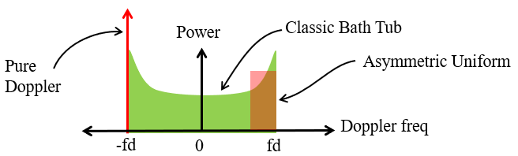
Channel models
The Car-2-Car channel models [1] are a good basis for the evaluation of PHY performance under time and frequency-selective propagation conditions
These are tap-delay models defined by a sets of delay, power and Doppler spectra
In [1], the Doppler spectra after the 1st tap are defined as “Half-Bathtub”
A more mathematically accurate description would be “Asymmetric Jakes” with limits [0, f_{d}]

Slide 5
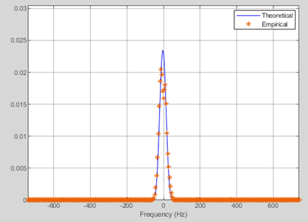
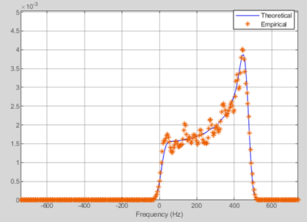
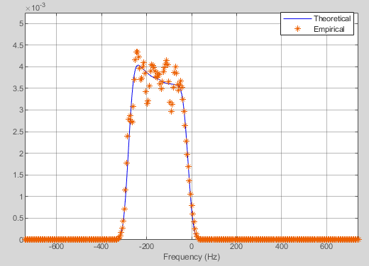
Channel models
MATLAB’s comm.RicianChannel allows for such spectrum definitions per channel tap
A reference definition is available in the ubx-v2x model
 | Tap1 | Tap2 | Tap3 | Units
Power | 0 | -14 | -17 | dB
Delay | 0 | 83 | 183 | ns
Doppler | 0 | 492 | -295 | Hz
Profile | Static | HalfBT | HalfBT
Table 1: Rural LOS Parameters
Tap1
Tap2
Tap3
Fig. Example of Doppler spectrum per channel tap for Rural LoS

Slide 6
Enhanced channel models
A set of even more challenging channel models have been proposed in [2]
A reference implementation is also available in the ubx-v2x model
Name | Tap1 | Tap2 | Tap3 | Tap4 | Tap5 | Units
Power | 0 | -3 | -4 | -7 | -15 | dB
Delay | 0 | 220 | 266 | 475 | 630 | ns
Doppler | 0 | -142 | -542 | -155 | 320 | Hz
Profile | Static | Half BT | Half BT | Half BT | Half BT
Table 3: Crossing NLOS Parameters
Name | Tap1 | Tap2 | Tap3 | Units
Power | 0 | -12 | -15 | dB
Delay | 0 | 84 | 183 | ns
Doppler | 0 | 94 | -1176 | Hz
Profile | Static | Half BT | Half BT
Name | Tap1 | Tap2 | Tap3 | Tap4 | Units
Power | 0 | -11 | -13 | -17 | dB
Delay | 0 | 167 | 433 | 600 | ns
Doppler | 0 | 1941 | -1176 | -391 | Hz
Profile | Static | Half BT | Half BT | Half BT
Table 1: Rural LOS Parameters
Table 4: Highway LOS Parameters
Name | Tap1 | Tap2 | Tap3 | Tap4 | Units
Power | 0 | -11 | -13 | -15 | dB
Delay | 0 | 222 | 334 | 533 | ns
Doppler | 0 | 224 | 1173 | 588 | Hz
Profile | Static | Half BT | Half BT | Half BT
Name | Tap1 | Tap2 | Tap3 | Tap4 | Tap5 | Units
Power | 0 | -2 | -5 | -7 | -15 | dB
Delay | 0 | 100 | 500 | 867 | 1152 | Ns
Doppler | 0 | 50 | 1157 | -2352 | 1573 | Hz
Profile | Static | Half BT | Half BT | Half BT | Half BT
Table 2: Urban Approaching LOS Parameters
Table 5: Highway NLOS Parameters

Slide 7
Oversampling
Topic 2

Slide 8
Oversampling
Contribution 19/0017r4 proposed the use of oversampling (8x) when simulating NGV
Oversampling is useful for investigations on
  Spectrum mask compliance
  PA non-linearity
  Multi Channel Operation
  Adjacent channel rejection

Slide 9
Oversampling
Rural LoS – 300 bytes
Investigation of baseband performance is not affected by oversampling on its own
  Baseband equivalence holds
Example: PER vs SNR
  10 MHz vs 40 MHz
  No significant difference in performance observed
10 MHz (no oversampling)
40 MHz (oversampling x4)

Slide 10
Power Amplifier model
Topic 3

Slide 11
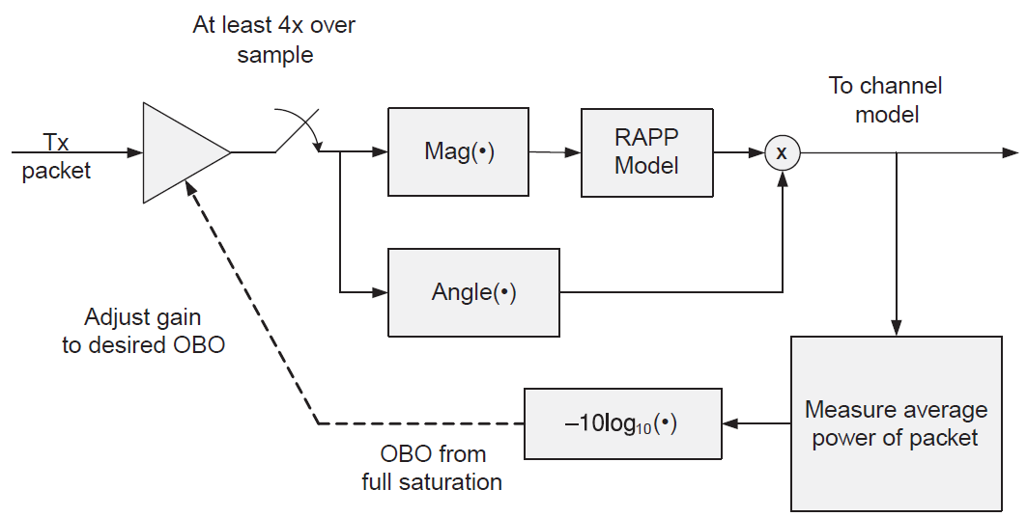
Power Amplifier model
Model introduced in 11-00/294
RAPP model
Indicative parameters
  p = 3
  Output back-off (OBO) = 8 dB
Fig. Power amplifier model, taken from [3]

Slide 12
Phase noise
Topic 4

Slide 13
Phase noise
Usually modelled with a pole-zero model (11-03/814r31)
  PSD(0) = -100 dBc/Hz
  pole frequency f_{p} = 250 kHz
  zero frequency f_{z} = 7905.7 kHz
PSD(0) = -100 dBc/Hz produces a negligible effect in PER performance
Higher values are more realistic

Slide 14
Carrier Frequency Offset
Topic 5

Slide 15
Carrier Frequency Offset
CFO is often modelled as a uniformly distributed R.V. between -40 and 40 ppm
This is a very pessimistic scenario with extreme values derived from the maximum allowed frequency error at both ends
The state-of-the-art 802.11p chipsets have frequency errors of 5ppm or less (some even on the ppb region)
Also, the distribution of total CFO error is not uniform due to the additive effect between the error in Tx and Rx
P(ω)
-40
-10
10
40
ω
ω_{Tx+Rx} : U(-40, 40) ppm
ω_{Tx} : U(-5, 5) ppm + ω_{Rx} : U(-5, 5) ppm

Slide 16
Conclusions
Some recommendations for 11p/NGV PHY simulation were given from a V2X silicon provider’s perspective
Our goal is to help aligning our simulation methodologies to be able to take the best possible decisions for 11bd
Ideally we should match the real-world performance as closely as possible while maintaining a low simulation complexity
All information presented here is available for evaluation as open source software
Comments or proposals for improvement of this work are always welcome

Slide 17
References
[1] M. Kahn, "IEEE 802.11 Regulatory SC DSRC Coexistence Tiger Team V2V Radio Channel Models," IEEE 802.11-14/0259r0.
[2] P. Alexander et. al, "Cohda-GM V2X Fading Channels".
[3] E. Perahia et. al, “Next Generation Wireless LANs”.

