Slide 1
Considerations on NGV PHY design
Date: 2019-03-11
Authors:

Slide 2
Abstract
This contribution presents a number of investigations regarding potential features of an NGV PHY. These attempt to quantify the performance and evaluate the suitability of such features.
Open source 802.11p model available at:
  https://github.com/u-blox/ubx-v2x
Model with potential NGV features available at:
  https://github.com/u-blox/ubx-v2x/tree/ngv_ldpc_mce

Slide 3
Introduction
The investigations presented here are focusing on:
Channel tracking
Forward error correction
OFDM tone plan
Wherever possible, an attempt is made to quantify the performance of each feature individually. We are hoping to give an insight on the suitability of these methods as candidate technologies for 802.11bd

Slide 4
Channel Tracking
Topic 1

Slide 5
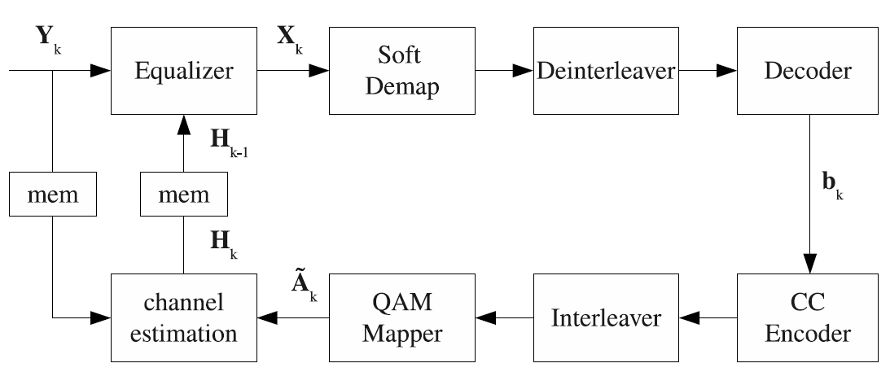
Data-Aided Channel Estimation (DACE)
802.11a/g frame format was designed assuming that the channel coherence time is greater than the maximum packet duration
This assumption is violated in most V2X scenarios even at moderate speeds
Current state-of-the-art V2X chipsets usually involve a Data-Aided Channel Estimation (DACE) scheme for tracking the wireless channel
Fig. Block diagram of DACE, taken from [1]

Slide 6
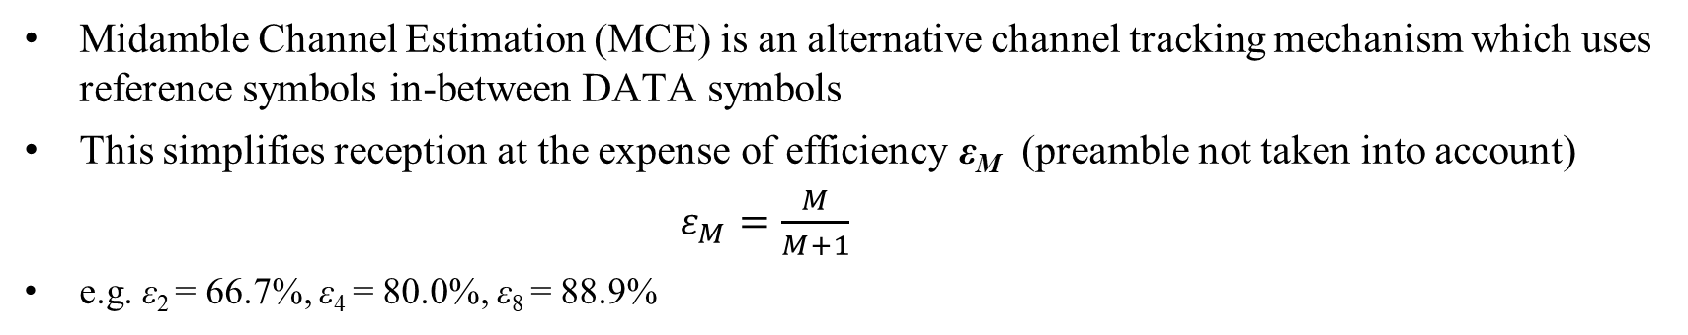
Midamble Channel Estimation (MCE)
Midamble Channel Estimation (MCE) is an alternative channel tracking mechanism which uses reference symbols in-between DATA symbols
This simplifies reception at the expense of efficiency ε_{M} (preamble not taken into account)
$ε_{Μ}=\frac{Μ}{Μ+1}$
e.g. ε₂ = 66.7%, ε₄ = 80.0%, ε₈ = 88.9%
802.11p
STF
LTF
SIG
DATA
DATA
DATA
DATA
DATA
DATA
DATA
DATA
DATA
DATA
Midamble format (e.g. M=4)
STF
LTF
SIG
DATA
DATA
DATA
MID
DATA
DATA
DATA
DATA
MID
DATA
M=4
M=4

Slide 7
DACE vs MCE - Simulation parameters
PHY:
  Standard 802.11p with DACE
  802.11p with midamble fields (½ LTF) and MCE
Channel models [2]:
  Rural LoS
  Highway NLoS
MCS: 0-7
Payload length: 400 bytes

Slide 8
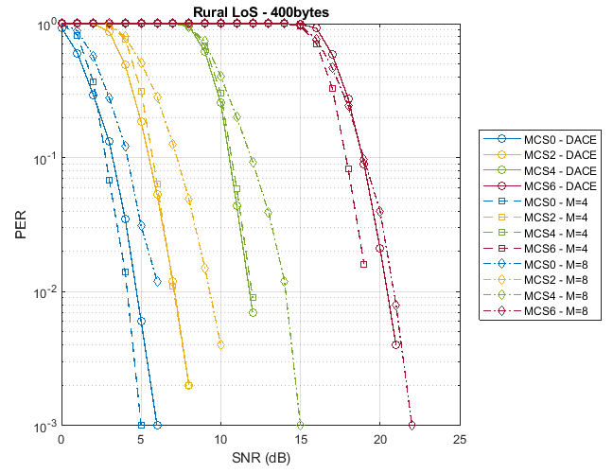
DACE vs MCE - Rural LoS PER
DACE imposes a time offset between channel estimation and symbol equalization
This offset depends on the MCS and Viterbi trace-back length
A new estimate is obtained on every DATA OFDM symbol (allows averaging)
MCE also has a time offset between 1 and M symbols (no averaging possible)
PER vs SNR tests in low-mobility show
  MCE M=4, similar or better performance than DACE
  MCE M=8, worse performance than DACE

Slide 9
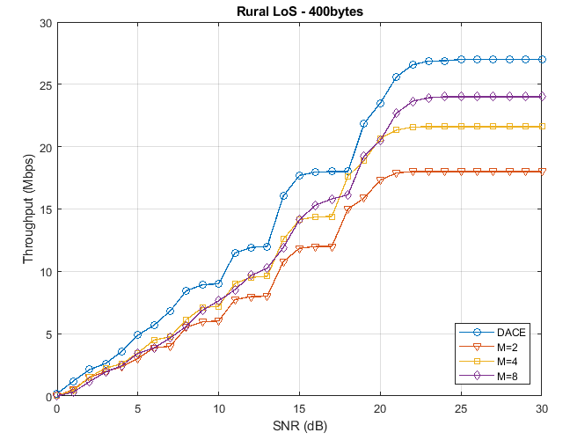
DACE vs MCE - Rural LoS Throughput
Throughput tests in low-mobility show:
DACE performance is globally better than MCE
Top throughput is reduced as expected
  DACE: ε = 100%
  MCE:
    ε₂ = 66.7%
    ε₄ = 80.0%
    ε₈ = 88.9%

Slide 10
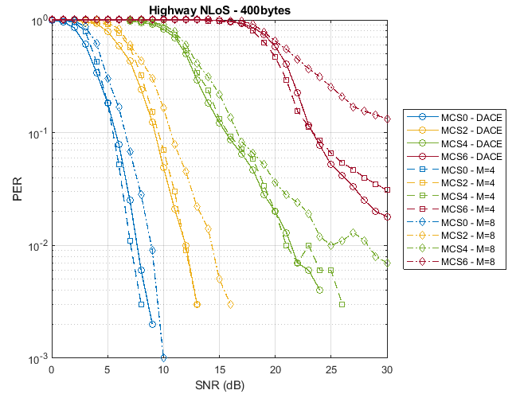
DACE vs MCE – Highway Non-LoS PER
PER vs SNR tests in high-mobility show:
MCE M=4, similar performance to DACE
MCE M=8, worse performance than DACE

Slide 11
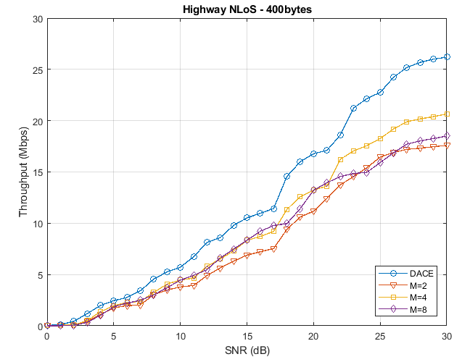
DACE vs MCE – Highway Non-LoS Throughput
Throughput tests in high-mobility show:
DACE performance is globally better than MCE
M=4 seems to give the best tradeoff between the different MCE schemes

Slide 12
Forward Error Correction
Topic 2

Slide 13
Forward Error Correction
The use of enhanced FEC schemes are obvious candidates for 802.11bd
LDPC was introduced with 802.11n
Provides significant gains in standard indoor/low-mobility scenarios
Here the performance of LDPC is evaluated in V2X scenarios
The high latency of LDPC decoding* makes it unsuitable for use in conjunction with a DACE scheme
*as defined in 802.11n

Slide 14
BCC vs LDPC - Simulation parameters
PHY:
  Standard 802.11p with BCC & DACE
  802.11p with LDPC & MCE
Channel models:
  Rural LoS
  Highway NLoS
MCS: 0-7
Payload length: 400 bytes

Slide 15
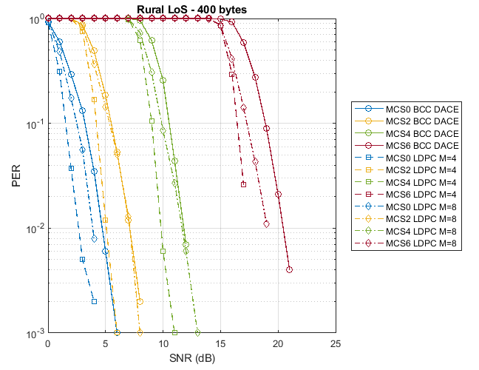
BCC vs LDPC – Rural LoS PER
PER vs SNR tests in low-mobility show:
LDPC gives a 2-3 dB enhancement in PER performance compared to DACE
Performance also depends on the MCE scheme used

Slide 16
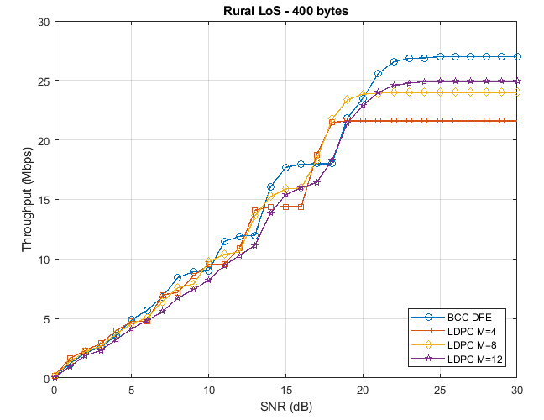
BCC vs LDPC – Rural LoS Throughput
Throughput tests in low-mobility show:
In low/mid SNR regime, DACE & BCC performance is similar to MCE & LDPC
In high SNR regime, DACE & BCC performance is higher than MCE & LDPC as expected

Slide 17
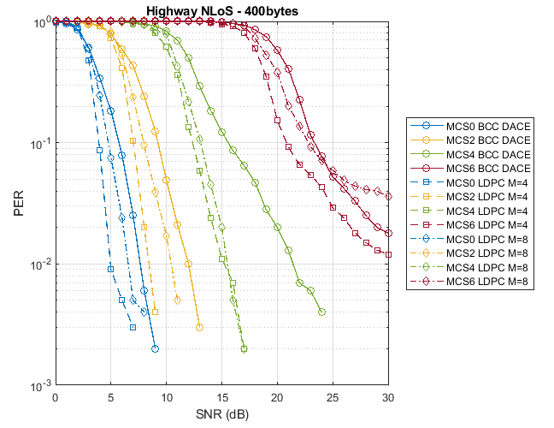
BCC vs LDPC – Highway Non-LoS PER
PER vs SNR tests in high-mobility show:
LDPC gives a 1-2 dB enhancement compared to DACE
Again, performance also depends on the MCE scheme used

Slide 18
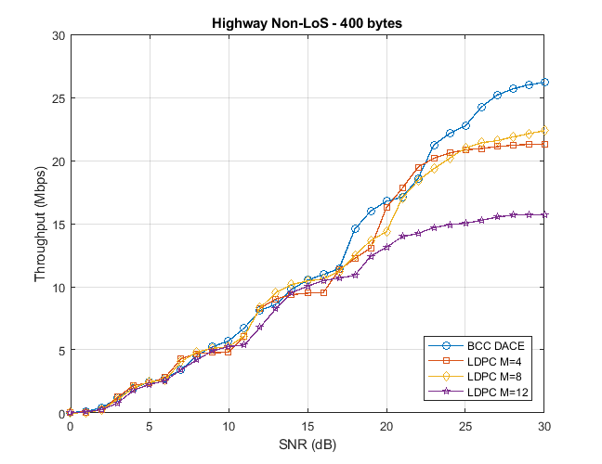
BCC vs LDPC – Highway Non-LoS Throughput
Throughput tests in high-mobility show:
DACE & BCC performance is similar or better than MCE & LDPC
MCE with M=4 or 8 seem to give the best tradeoff between the different schemes

Slide 19
OFDM Tone Plan
Topic 3

Slide 20
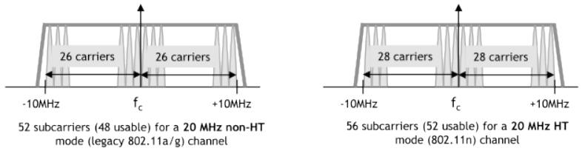
OFDM Tone Plan
Previous contributions have presented the possibility of adopting the OFDM tone plan of 802.11n/ac or derivatives
Here we only want to give a word of caution regarding the compliance of the proposed schemes with the Class C spectrum mask

Slide 21
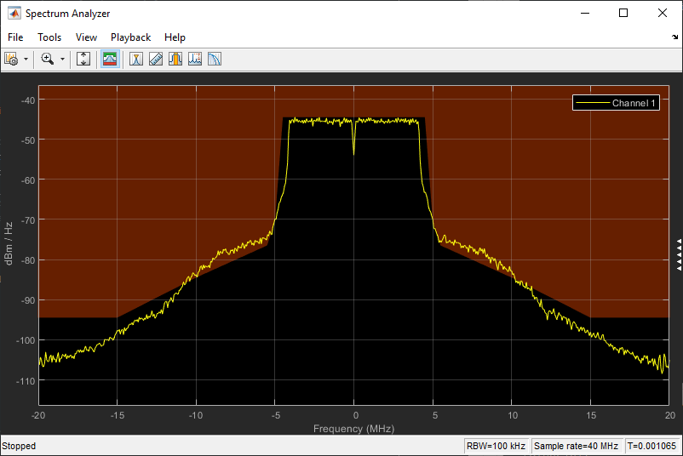
OFDM Tone Plan
Compliance with a Class-C spectrum mask is crucial for V2X systems
This allows transmit power levels up to 33 dBm (EIRP)
Compliance with this mask is not straight-forward
Example: a typical 802.11a transmitter fails to comply with the Class-C requirements

Slide 22
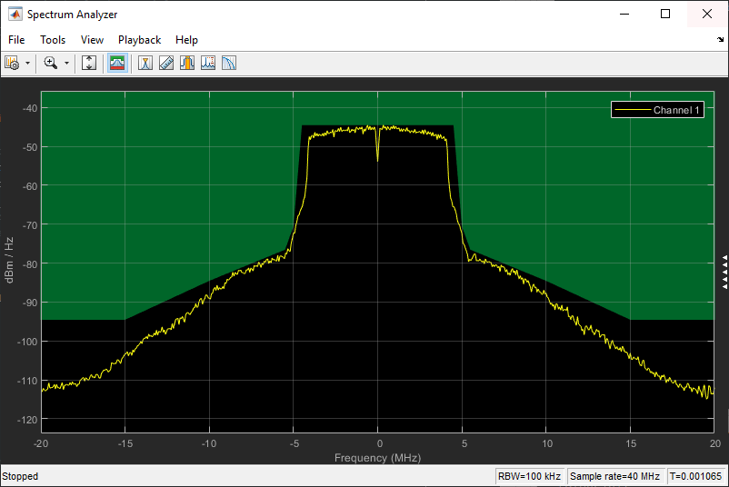
OFDM Tone Plan
Time-domain windowing and spectral shaping help to achieve compliance
The penalty is a small EVM degradation and slightly higher complexity

Slide 23
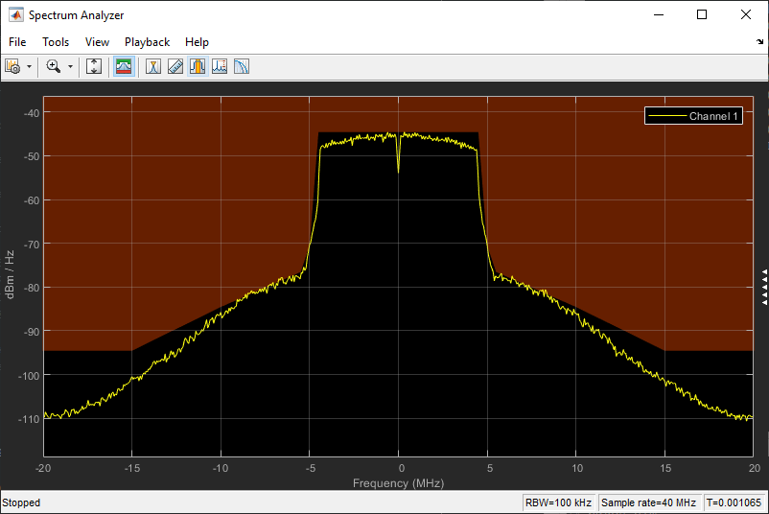
OFDM Tone Plan
If we apply the 802.11n tone plan (extra 2 subcarriers on both sides) to the previous configuration compliance with Mask C is lost
Additional shaping and windowing is possible, but this should be taken into account when designing the PHY

Slide 24
Conclusions
Channel tracking
From a throughput perspective DACE seems to perform better than MCE under both low and high-mobility scenarios
MCE has the added benefit of lower complexity but it is the presenter’s view that 802.11bd should not aim for lower complexity but higher performance/robustness
Forward Error Correction
BCC & DACE performance is in most cases on par or better than LDPC & MCE
BCC offers lower complexity and interoperability with legacy devices
OFDM Tone Plan
Compliance with a Class-C spectrum mask is crucial for V2X systems
Adoption of 802.11n/ac tone plans increases the difficulty to achieve compliance

Slide 25
References
[1] A. Agnoletto, “Data Decoding Aided Channel Estimation Techniques for OFDM Systems in Vehicular Environment,” March 2010.
[2] M. Kahn, "IEEE 802.11 Regulatory SC DSRC Coexistence Tiger Team V2V Radio Channel Models," IEEE 802.11-14/0259r0.

