Slide 1
PHY designs for NGV
Date: 2019-03-10
Authors:
Name | Affiliation | Address | Phone | Email
Yujin Noh | Newracom | 25361 Commercentre Dr Lake Forest, CA 92630 |  | yujin.noh at newracom.com
Yongsuk Hwang |  |  |  | ys.hwang at newracom.com

Slide 2
Background
For 11bd, advanced PHY candidates have been considered to achieve higher throughput and better reliability [1][2].
  So far some documents provided initial simulation results to show how much gain 11bd can get as a guideline [3][4].
In this contribution, with additional simulation results, FEC coding and Midamble are intensely taken into account to help the group yield concrete results.

Slide 3
LDPC
LDPC is a feature of 802.11 to get additional coding gain to improve throughput.
11n, 11ac and 11ax have an LDPC code defined
  Here, given 802.11ac OFDM numerology downclocked by 2 for 10 MHz PPDU, the same 802.11ac LDPC PPDU encoding process could be applied for 11bd

Slide 4
Midamble
Preamble
DATA_1
Midamble
DATA_2
Midamble
DATA_k
M data symbols
M data symbols
M data symbols
It is a technique accepted in 802.11ax to mitigate Doppler impact. [5][6]
Midamble field is inserted in every M (e.g. 4) data symbols for recently estimated channel information.
  For example, the number of Midamble field N_{MA}
N_{SYM} : the number of data symbols in PSDU

Slide 5
NGV PPDU formats in simulation 1/2
11p
11p with Midamble (L-LTF) inserted every 4 data symbols (MA4)
…
ONLY BCC
LSTF
L-LTF
LSIG
DATAs
LSTF
L-LTF
LSIG
4 DATAs
MA
4 DATAs
…
2 GI
2 LTF sequences
Reuse L-LTF (two OFDM symbols) as Midamble
Channel estimation gain allowed for all data symbols as 11p
Seems redundant

Slide 6
NGV PPDU formats in simulation 2/2
BCC and LDPC
11p with MA4 (Half of L-LTF or HL-LTF)
11ac 20MHz downclocked by 2 (DC2) with MA4 (VHT-LTF)
LSTF
L-LTF
LSIG
4 DATAs
MA
4 DATAs
…
1 GI
1 LTF sequence
Use modified L-LTF (one OFDM symbol) as Midamble
Only first 4 data OFDM symbols potentially benefit channel estimation gain by L-LTF
Reuse 11ac PPDU format except for VHT-SIG-B not present.
Use VHT-LTF as Midamble
Extra data tones are given
BCC and LDPC applied
Legacy Preambles
VHT SIG
VHT SIG
VHT STF
VHT LTF
4 DATAs
MA
4 DATAs
…

Slide 7
Simulation Parameters
General configuration:
  1 TX, 1 RX, 1 SS, 300 bytes
# of channel realizations: 10,000
C2C Channel Model
  12.5ns sampling rate, tapped delay line with Doppler shift
  channel power distribution with the total power normalized to 1.
Impairments
  PA Non-linearity : RAPP PA model with p = 3.
  Carrier Frequency Offset : fixed 20 ppm
  Phase noise with a pole-zero model
    PSD(0) = -100 dBc/Hz
    Pole frequency fp = 250 kHz
    Zero frequency fz = 7905.7 kHz
Rx processing:
  Ideal timing and Ideal PPDU detection
  CFO estimation and compensation in preamble portion
  Pilot tracking in data portion

Slide 8
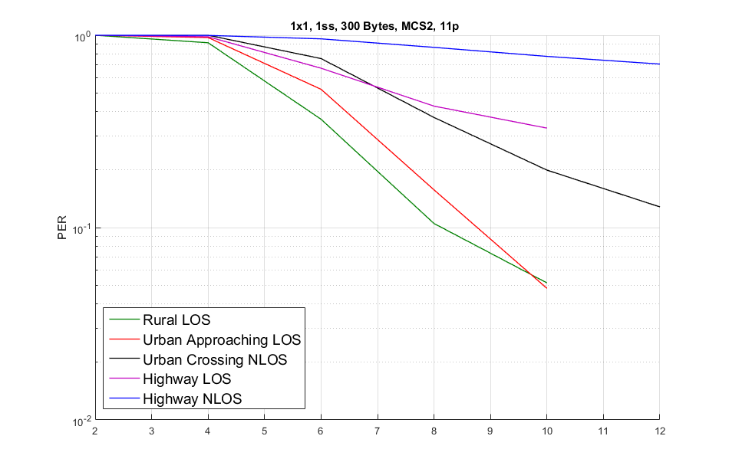
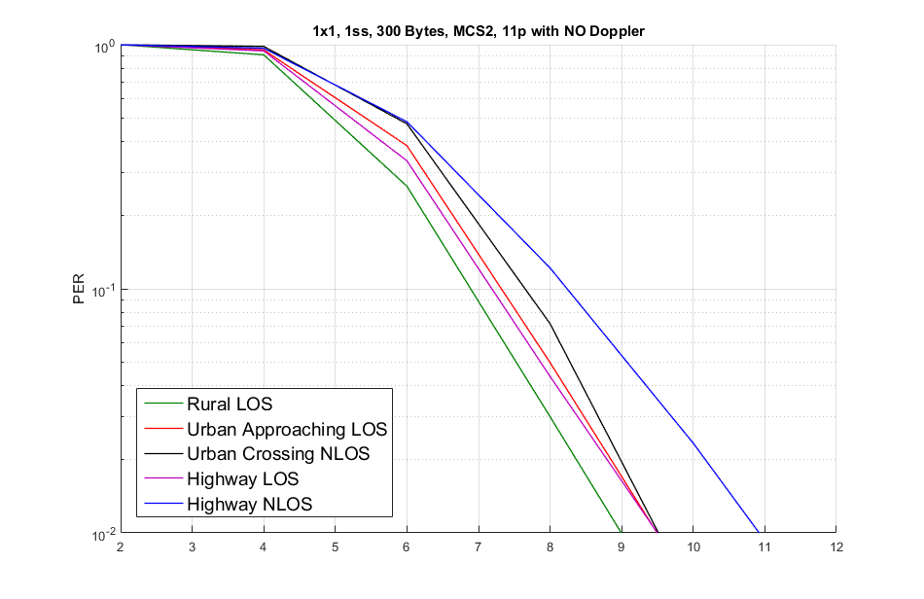
Doppler Effect on C2C Channel Models
252 km/hr
max differential
144km/hr
max differential
The left figure shows 11p performance with simple pilot tracking implemented which assumes stationary circumstance that is common for 11 devices.
How well Doppler effect to be under control at receiver could make a big performance difference especially for Highway LOS and Highway NLOS.
  Curve of Highway LOS even possibly close to curve of Urban Approaching LOS

Slide 9
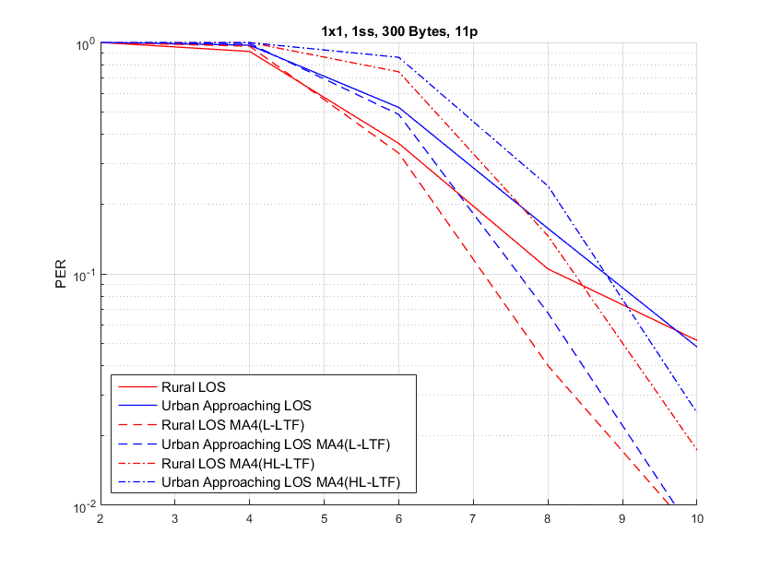
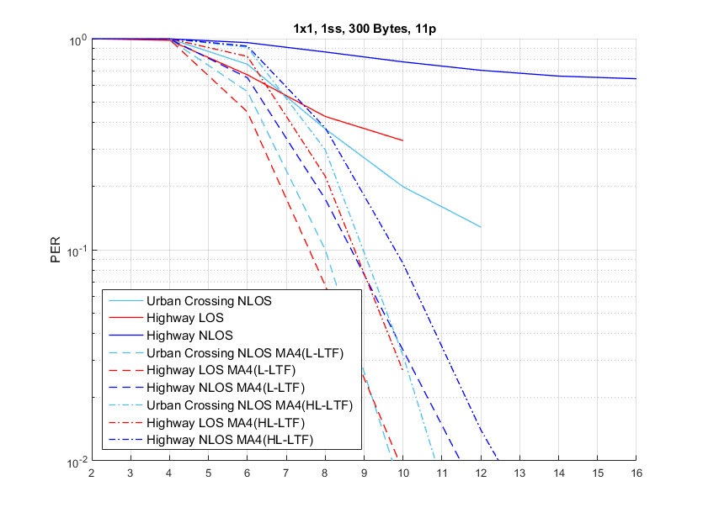
11p: Midamble for QPSK-1/2
, MCS2
, MCS2
Low-Doppler channels
High-Doppler channels
1.5 dB
1 dB
Only BCC applied
(11p)
(11p)
Only BCC applied
(11p)
(11p)
(11p)
To use L-LTF (2 OFDM symbols) as Midamble providing around 1-1.5 dB gain comparing to using modified L-LTF (1 OFDM symbol) at the cost of overhead.
In high-Doppler channels, simulation result shows the considerable advantage of Midamble even with HL-LTF.

Slide 10
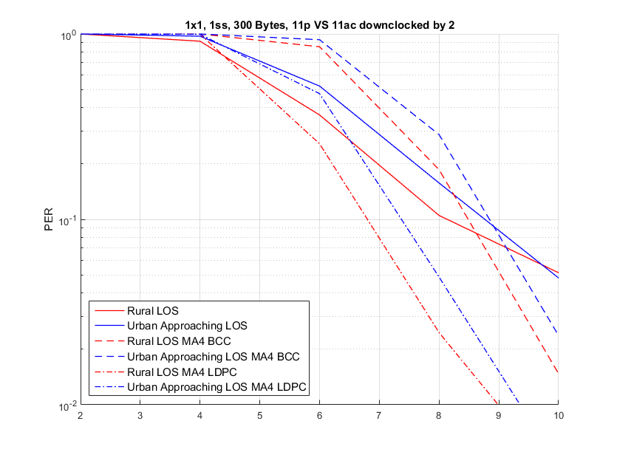
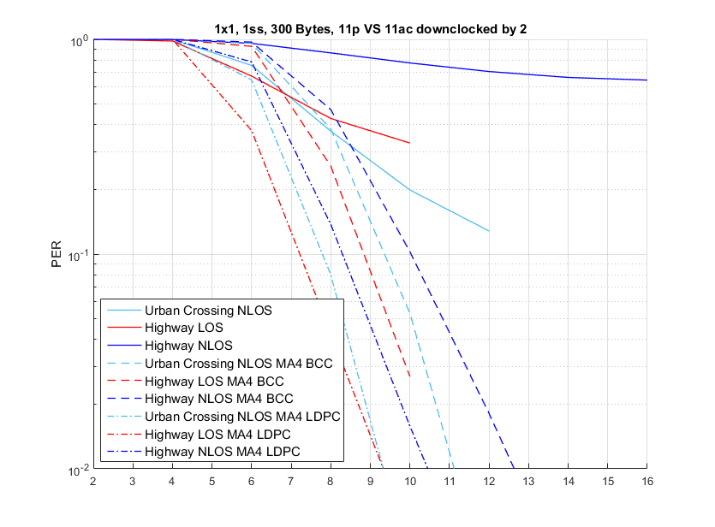
11ac 20MHz DC2:
Midamble for QPSK-1/2
, MCS2
, MCS2
Low-Doppler channels
High-Doppler channels
2 dB
2 dB
(11p)
(11p)
(11p)
(11p)
(11p)
In high-Doppler channels, simulation results show the considerable advantage of Midamble with BCC alone.
Given Midamble implemented, LDPC providing around 2 dB gain comparing BCC for all C2C channels

Slide 11
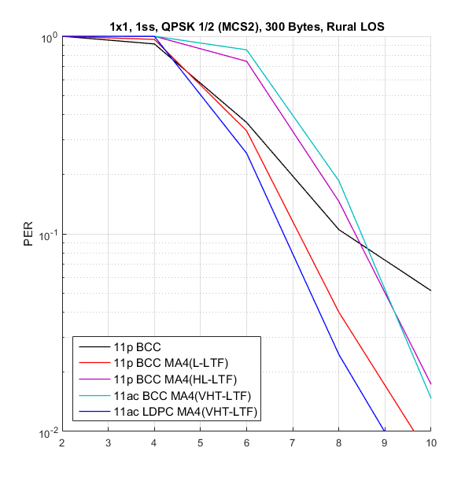
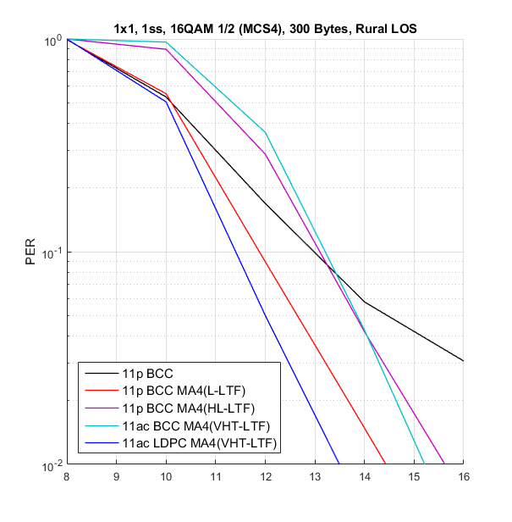
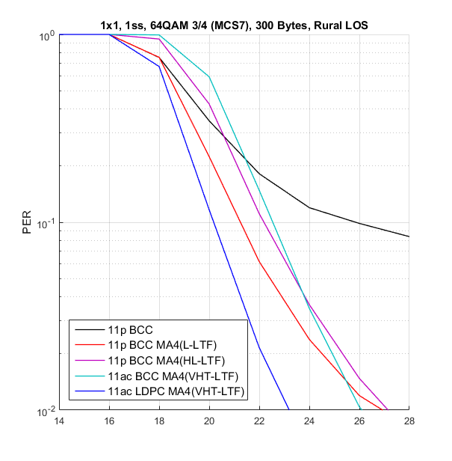
Rural LOS
3 dB
1.5 dB
In Rural LOS channel with MCS2 and MCS4, NGV with BCC and Midamble (HL-LTF and VHT-LTF) seems not to provide enough gain at 10% PER even at the cost of MA overhead.
Given Midamble implemented, NGV can achieve around 3 and 1.5 dB gain with LDPC and BCC respectively for MCS7.

Slide 12
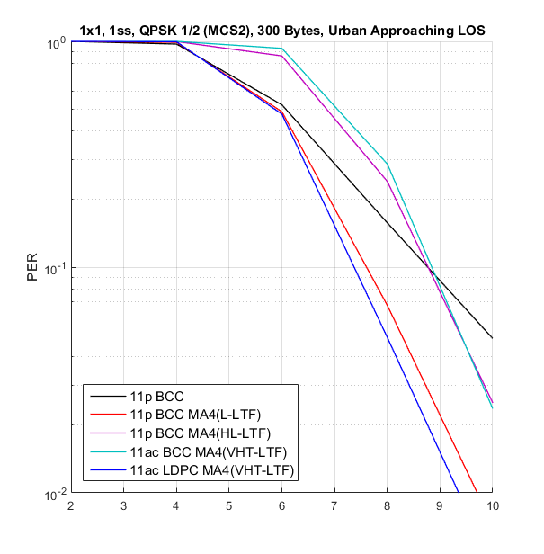
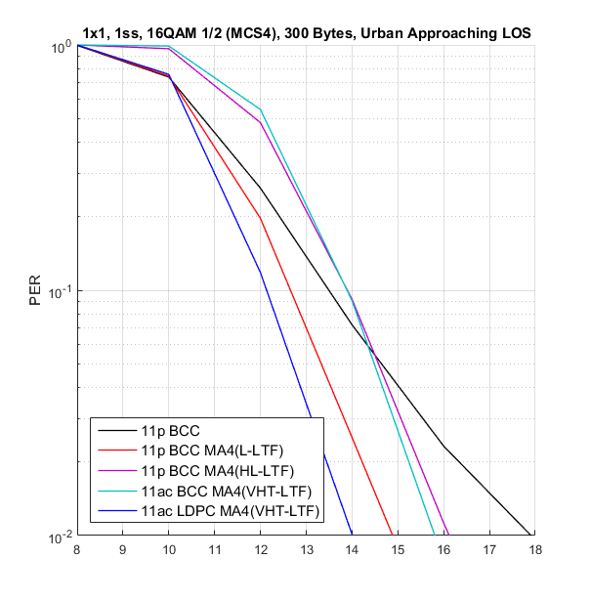
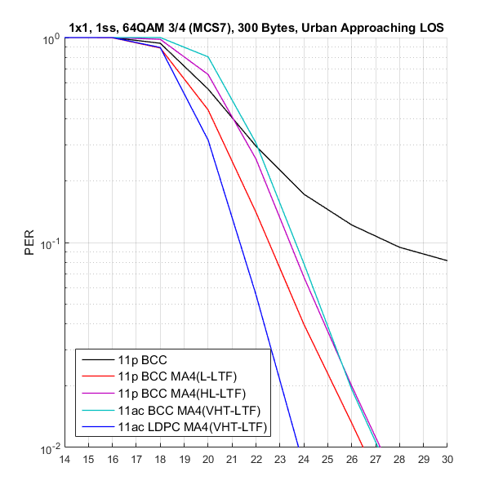
Urban Approaching LOS
6 dB
4 dB
In Urban Approaching LOS channel with MCS2 and MCS4, NGV with BCC and Midamble (HL-LTF and VHT-LTF) seems not to provide reasonable gain at 10% PER even at the cost of MA overhead.
Given Midamble implemented, NGV can achieve around 6 and 4 dB gain with LDPC and BCC respectively for MCS7.

Slide 13
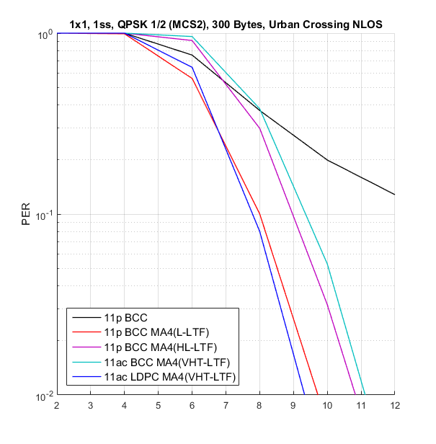
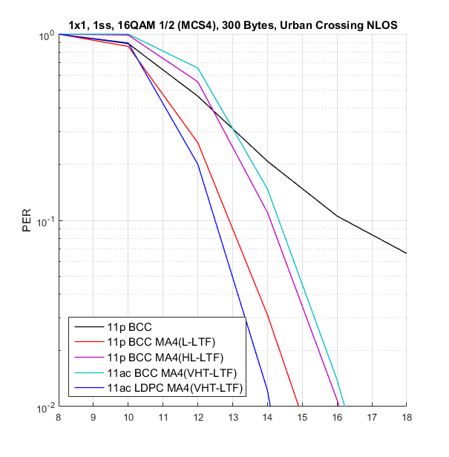
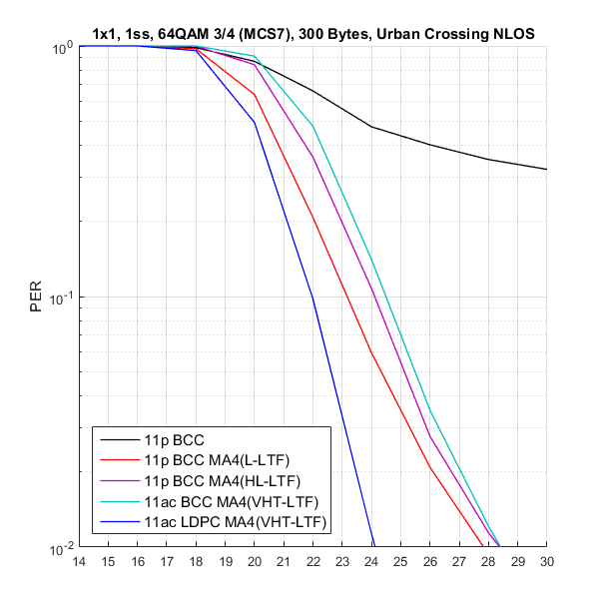
Urban Crossing NLOS
3 dB
2 dB
5 dB
4 dB
In Urban Crossing NLOS channel, NGV with BCC and Midamble (HL-LTF and VHT-LTF) providing acceptable gain for all MCS ranges.
Given Midamble implemented, NGV can achieve considerable gain for high MCS7.
LDPC generally providing around 2 dB gain comparing to BCC

Slide 14
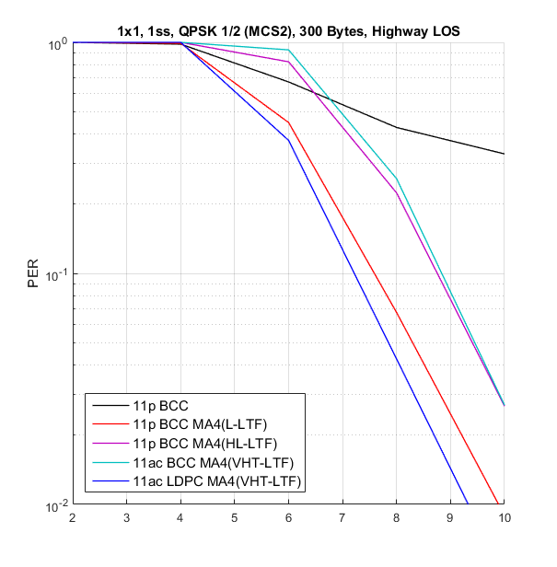
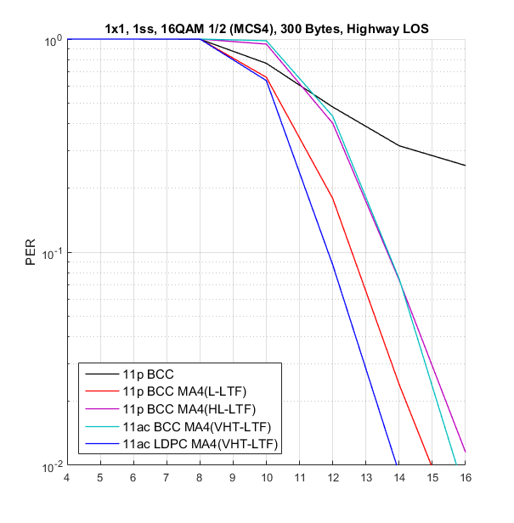
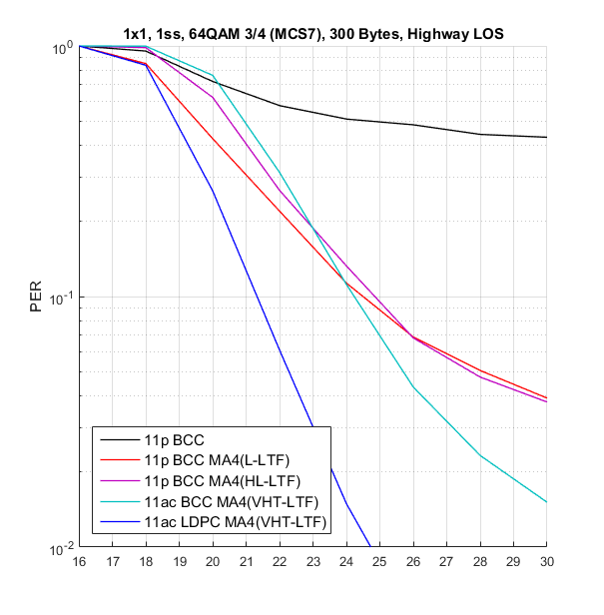
Highway LOS
In Highway LOS channel, NGV with BCC and Midamble (HL-LTF and VHT-LTF) providing considerable gain for all MCS ranges.
Given Midamble implemented, LDPC generally providing around 2 dB gain comparing to BCC

Slide 15
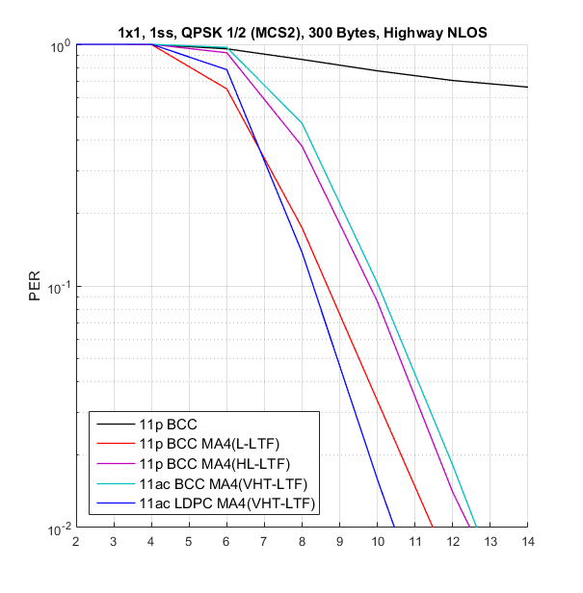
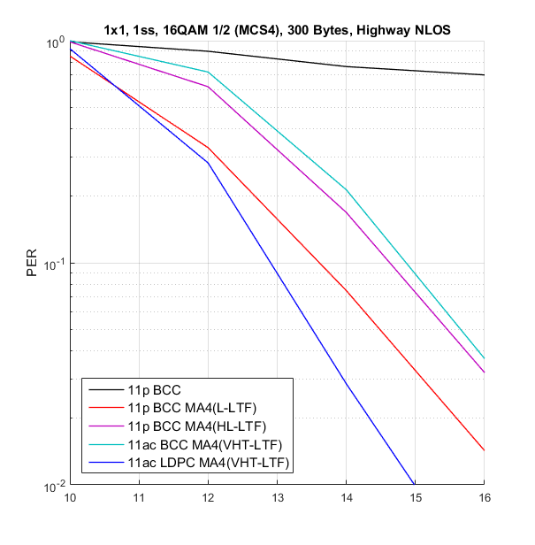
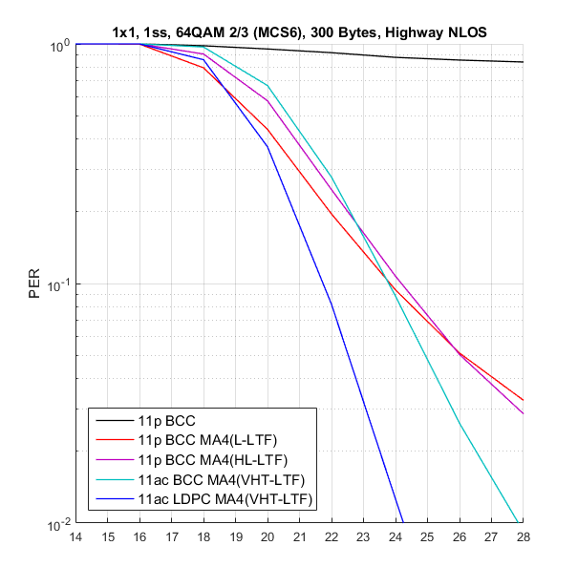
Highway NLOS
In Highway NLOS channel, NGV with BCC and Midamble (HL-LTF and VHT-LTF) providing prominent gain for all MCS ranges.
Given Midamble implemented, LDPC generally providing around 2 dB gain comparing to BCC

Slide 16
Summary
Midamble is a valuable candidate to mitigate Doppler effect
  Depending on the pilot tracking scheme implemented in simulators 11bd devices might show noticeable performance gap without Midamble.
  Given Midamble implemented, the simulation results show that 11bd can achieve prominent gains for most cases.
  Higher MCS (256 QAM if necessary) requires robustness to Doppler impact
For some cases (especially low MCSs) in low Doppler channels, 11bd PPDU with BCC and Midamble (HL-LTF and VHT-LTF) seems not to provide enough gain comparing to 11p with BCC.

Slide 17
Reference
[1] 11-19/0016r0 Potential PHY Designs for NGV
[2] 11-19/0009r0 Consideration on Features for 11bd
[3] 11-18/0858 NGV Doppler Channel Modeling
[4] 11-19/0017r4 Simulation of NGV Channel Models
[5] 11-18/1366r0 midamble design continued
[6] 11-18/1320r0 NSYM and TPE at RX side for Midamble design - Follow up

Slide 18
Appendix

Slide 19
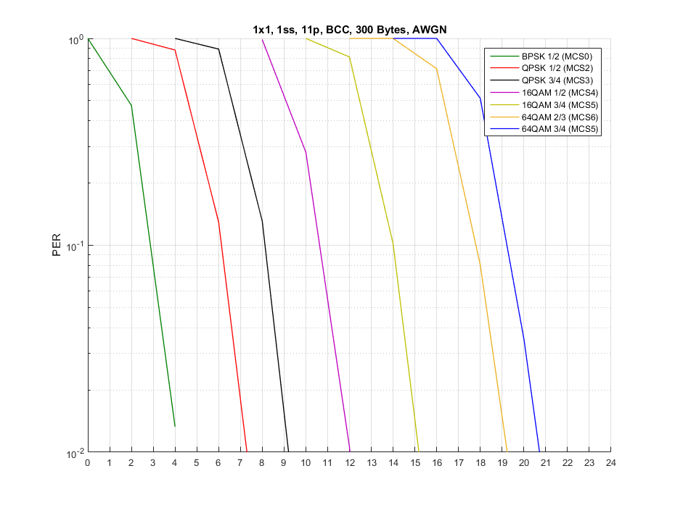
AWGN (1/2)

Slide 20
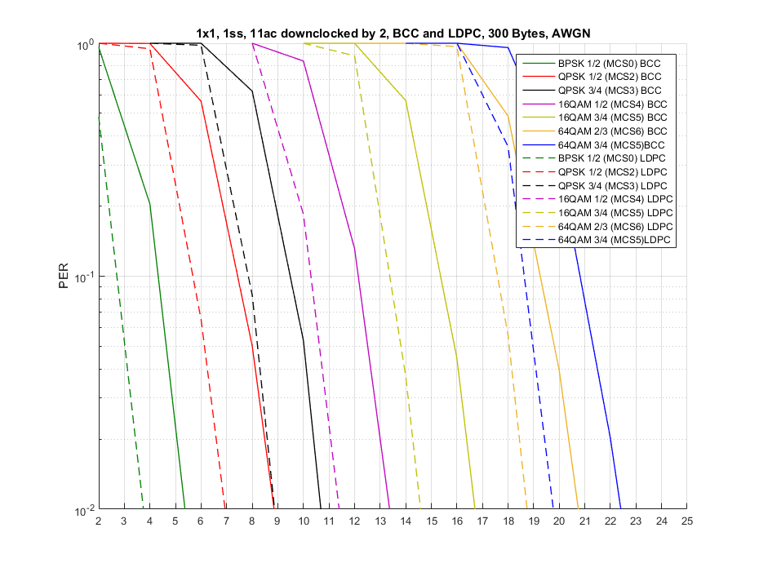
AWGN (2/2)

Slide 21
Channel Model Values in 11-14/0259r0
 | Tap1 | Tap2 | Tap3 |  | Units
Power | 0 | -14 | -17 |  | dB
Delay | 0 | 83 | 183 |  | ns
Doppler | 0 | 492 | -295 |  | Hz
Profile | Static | HalfBT | HalfBT
 | Tap1 | Tap2 | Tap3 | Tap4 | Units
Power | 0 | -10 | -15 | -20 | dB
Delay | 0 | 100 | 167 | 500 | ns
Doppler | 0 | 689 | -492 | 886 | Hz
Profile | Static | HalfBT | HalfBT | HalfBT
144km/hr max differential
252 km/hr max differential
Table 5: Rural LOS Parameters
Table 8: Highway LOS Parameters
 | Tap1 | Tap2 | Tap3 | Tap4 | Units
Power | 0 | -8 | -10 | -15 | dB
Delay | 0 | 117 | 183 | 333 | ns
Doppler | 0 | 236 | -157 | 492 | Hz
Profile | Static | HalfBT | HalfBT | HalfBT
 | Tap1 | Tap2 | Tap3 | Tap4 | Units
Power | 0 | -2 | -5 | -7 | dB
Delay | 0 | 200 | 433 | 700 | ns
Doppler | 0 | 689 | -492 | 886 | Hz
Profile | Static | HalfBT | HalfBT | HalfBT
Table 6: Urban Approaching LOS Parameters
252 km/hr max differential
119km/hr max differential
Table 9: Highway NLOS Parameters
 | Tap1 | Tap2 | Tap3 | Tap4 | Units
Power | 0 | -3 | -5 | -10 | dB
Delay | 0 | 267 | 400 | 533 | ns
Doppler | 0 | 295 | -98 | 591 | Hz
Profile | Static | HalfBT | HalfBT | HalfBT
Table 7: Crossing NLOS Parameters
126km/hr max differential

