Slide 1
MAC Service Updates for NGV
Date: 2019-05-14
Authors:

Slide 2
Abstract
The V2X protocol stacks perform several functions that are normally within the 802.11 MAC at higher layers. Furthermore, the rules that these functions must follow differ between the various, regional V2X standards (SAE, ETSI, etc.). NGV must provide a means by which these higher layers can provide the necessary control information downward and receive the necessary status information upward. This is most easily accomplished by modifying the MAC SAP to add V2X-specific parameters to the MAC data service primitives, as well as by some extensions to the MLME SAP. This cannot be accomplished solely by changes to the MLME SAP because there is no way to achieve fine-grained synchronization between primitives issued at the two SAPs.

Slide 3
Introduction
IEEE 802.11p is used as the access layer of several V2X regional standards such as ITS-G5 in Europe or SAE in the US. IEEE 802.11bd needs to be an enhancement to this access layer.
On top of the IEEE 802.11-based access layer, regional standards define a set of rules for decentralized congestion control (DCC), packet generation and dissemination.
  Many of the specific rules differ between the various regional standards
TGbd exists to standardize the PHY and MAC layers, collectively referred to by ITS standards as the “access layer”, as an enhancement to IEEE 802.11p.
  It is necessary for TGbd to have an appropriate interface to the higher ITS layers for both control requests and status reporting

Slide 4
Problems Using 802.11 MAC Below ITS Higher Layers
In order to operate using OCB mode, ITS higher layers require access to functions that currently reside solely within the 802.11 MAC and/or PHY
This necessitates overlap between the bottom ITS layer and the top of the MAC
An example of this overlap, for the IEEE 1609 protocol, appears below:
Diagram copied from 11-19/0752r0 by Justin McNew
The bottom of IEEE 1609.4 overlaps
with the top of the IEEE 802.11 MAC
Magic Happens Here!

Slide 5
What 802.11bd Needs to Provide to Upper Layers
802.11bd needs to be a standard that exposes a range of parameters and encoding options, providing a toolbox that can support a wide range of regional deployment configurations. For example:
  ITS-G5 requires IEEE 802.11p PPDUs to be encoded with QPSK ½ (6 Mb/s transmit rate), whereas SAE adjusts the data rate based on congestion level
  ITS-G5 the CAM message is triggered by vehicle dynamics (“enough” change in location, heading, or speed) while SAE transmissions often use periodic transmission (at 10 Hz)
Today, 802.11 does not provide a means by which higher layers can control things such as data rate/format (MCS) on an MPDU-by-MPDU basis.
802.11bd also needs to provide status to the ITS layers about the current state of the dynamic, rapidly-varying radio environment
ITS protocols need to be able to change the station MAC address, but today 802.11 does not provide a means to do this (other than by a full MAC reset)

Slide 6
Providing Access to the NGV Toolbox
The most appropriate means by which to provide higher layers with access to this “NGV Toolbox”, and to radio environment status, is by extending the MAC Data Service.
  The MLME SAP is not appropriate because it has no sense of time, and it is not possible to synchronize the effects of primitives at the MLME SAP with those at the MAC SAP.
  Creation of a new SAP would be possible, but is much more complex and does not appear to provide any advantages.
  Leaving this issue to solutions outside of the standard is almost certain to result in “no” votes at SA ballot (and, perhaps, letter ballot).
There are some NGV-related functions that are appropriate to invoke via extensions to the MLME SAP

Slide 7
Extending the MAC Data Service Primitives
The best way to extend MAC Data Service is to define a new, NGV-specific parameter to each of the MAC Data Service primitives:
  MA-UNITDATA.request (source address, destination address, routing information, data, priority, service class, radio environment request vector)
  MA-UNITDATA.indication (source address, destination address, routing information, data, reception status, priority, service class, radio environment status vector)
  MA-UNITDATA-STATUS.indication (source address, destination address, transmission status, provided priority, provided service class, radio environment status vector)
A radio environment {request/status} vector parameter shall be present at NGV stations and absent otherwise.
  By defining the new parameter as a vector, and describing the elements of these vectors in separate sub-clauses, the editorial impact on existing clause 5 text is minimized.

Slide 8
Radio Environment Request Vector Contents
The Radio Environment Request Vector allows the higher layers to control the format, encoding, and MPDU handling for the 802.11bd transmission
The elements of the Radio Environment Request Vector include:
  Transmission format (legacy/NGV, data rate/MCS, repetitions, etc.)
  Coding alternatives (BCC, LDPC, etc.)
  Spatial stream alternatives (MIMO, STBC, etc.)
  Aggregation alternatives
  PHY alternatives (band, channel, transmit power level, etc.)
  Expiry time (time after which this MSDU is discarded if not transmitted)
  … whatever else needs to be controlled within the NGV MAC and PHY functionality)
A value that permits selection within the MAC should exist for each element

Slide 9
Radio Environment Status Vector Contents
The Radio Environment Status Vector provides to the higher layers status about the current radio environment and the most recent 802.11bd reception
The elements of the Radio Environment Status Vector include:
  Transmission format used (legacy/NGV, data rate/MCS)
  Coding alternatives used (BCC, LDPC, etc.)
  Spatial stream alternatives used (MIMO, STBC, etc.)
  PHY alternatives used (band, channel, etc.)
  ChannelBusyPercentage (CBR/CBP) – from the most recent measurement period
  TechPercentage (see 11/19-0783) – from the most recent measurement period
  Number of stations detected during measurement of Channel Busy and Tech Percentages

Slide 10
MLME SAP Extension
IEEE 1609.4 includes a set of primitives extending the MLME_SAP. These appear as MLMEX-primitives in Clause 7 of IEEE 1609.4-2016
  As a minimum, the MLME_SAP in 802.11bd should include a request/confirm primitive pair that corresponds to MLMEX-AddressChange
  It is recommended strongly that the MLME_SAP in 802.11bd include a generic means for the MAC at an NGV station to accept additional, ITS-related management primitives
  It is unclear whether 802.11bd should include the full set of MLMEX primitives
    The exact set of extensions required vary with regional ITS standards
    The functions of the various regional MLME extensions should probably remain in the higher-layer standards documents, rather than having redundant definitions in documents that are maintained by different organizations, and are updated according to different schedules
    Defining the full set of MLMEX primitives will also necessitate adding quite a bit of normative text elsewhere in the MAC that may complicate and/or delay the work of TGbd

Slide 11
Additional Attributes in 802.11bd MIB
Some of the NGV-specific parameter values are static, and can be managed as MIB attributes rather than service primitive parameters at the MAC or MLME SAPs. These include:
  NGV activation (the NGV equivalent of dot11OCBactivated)
  NGV capabilities (to be indicated in transmissions from this station)
  NGV bands supported
  Measurement interval for ChannelBusyPercentage (default value 100ms)
  ChannelBusyPercentage smoothing parameters (to accommodate CBR/CBP differences)
  Measurement interval for TechPercentage (default value 1000ms)

Slide 12
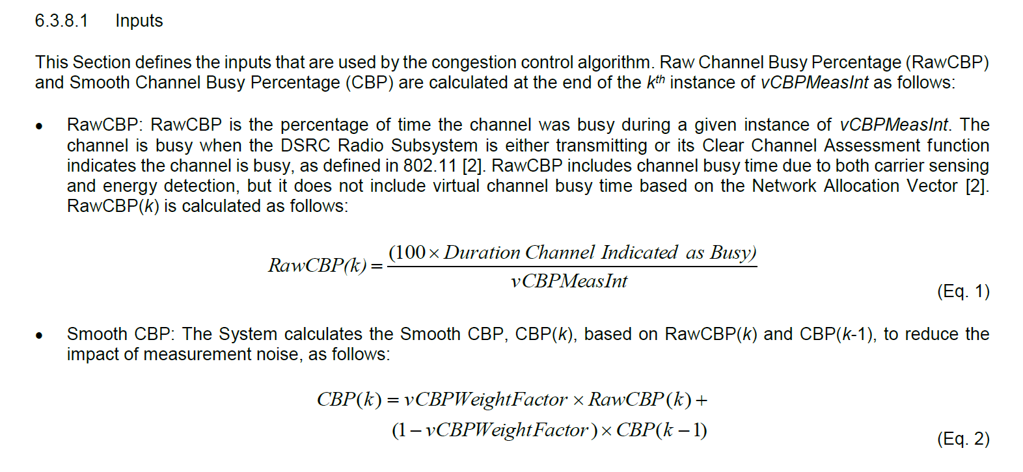
Channel Busy Percentage from SAE J2945-1

Slide 13
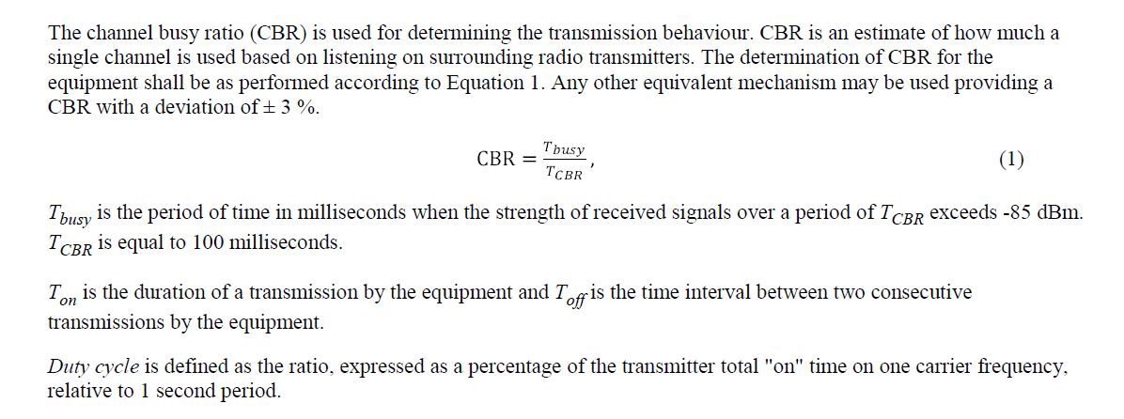
Channel Busy Ratio from ETSI EN 302 571 v2.1.1

Slide 14
Straw Poll #1
Do you agree to add the following text into Section 3.2 of SFD?
  New parameters shall be defined for the MAC service primitives, for use at NGV stations:
  MA-UNITDATA.request (source address, destination address, routing information, data, priority, service class, radio environment request vector)
  MA-UNITDATA.indication (source address, destination address, routing information, data, reception status, priority, service class, radio environment status vector)
  MA-UNITDATA-STATUS.indication (source address, destination address, transmission status, provided priority, provided service class, radio environment status vector)
Y:
N:
A:

Slide 15
Straw Poll #2
Do you agree to add the following text into Section 3.2 of SFD?
The elements of the Radio Environment Request Vector include:
  Transmission format (legacy/NGV, data rate/MCS, repetitions, etc.)
  Coding alternatives (BCC, LDPC, etc.)
  Spatial stream alternatives (MIMO, STBC, etc.)
  Aggregation alternatives
  PHY alternatives (band, channel, power level, etc.)
  Expiry time (time after which this MSDU is discarded if not transmitted)
Y:
N:
A:

Slide 16
Straw Poll #3
Do you agree to add the following text into Section 3.2 of SFD?
The elements of the Radio Environment Status Vector include:
  Transmission format used (legacy/NGV, data rate/MCS)
  Coding alternatives used (BCC, LDPC, etc.)
  Spatial stream alternatives used (MIMO, STBC, etc.)
  PHY alternatives used (band, channel, etc.)
  ChannelBusyPercentage (CBR/CBP) – from the most recent measurement period
  TechPercentage (see 11/19-0783) – from the most recent measurement period
  Number of stations detected during measurement of Channel Busy and Tech Percentages
Y:
N:
A:

Slide 17
Straw Poll #4
Do you agree to add the following text into Section 3.2 of SFD?
The MLME SAP shall be extended with primitives
  MLME-AddressChange.request (MAC address)
  MLME-AddressChange.confirm (accepted, rejected)
Y:
N:
A:

