Slide 1
802.11 Working Group Opening Report
March 2019
Authors:
Date: 2019-03-11

Slide 2
Introduction
This presentation, together with the reports cited on the next slide, forms the opening report of the IEEE 802.11 Working Group for March 2019.
Subgroup status is reported in the “Snapshots” submission (see documents slide for link). This is incorporated by reference into this opening report.
“Mx.y.z” terminology indicates that the item was on the tentative agenda for the Monday 802.11 plenary, and was agenda item x.y.z.

Slide 3
M1.3 Meeting Decorum
%
Please observe proper decorum in meetings
Photography or recording is not allowed
Press (i.e., anyone reporting publicly on this meeting) are to announce their presence (December 2015 IEEE-SA Standards Board Ops Manual 5.3.3.3)
Laptop speakers, cell phone / tablet ringers off
Wear your badges at all times in meeting areas
  Help the hotel security staff improve the general security of the meeting rooms
  Laptops HAVE BEEN STOLEN at previous meetings
  DO NOT assume that meeting areas are secure

Slide 4
M2.3.1 Summary of Liaisons - Incoming
New Liaison document received
  Response from Wi-Fi Alliance re: reserved value usage, see https://mentor.ieee.org/802.11/dcn/19/11-19-0277-00-0000-2019-02-liaison-response-from-wi-fi-alliance-re-reserved-value-usage.docx
Awaiting Response
  2018-09 Liaison from 3GPP RAN re: certain channel combinations for LAA, see https://mentor.ieee.org/802.11/dcn/18/11-18-1687-00-0000-2018-09-liaison-from-3gpp-ran-re-certain-channel-combinations-for-laa-in-5ghz.docx

Slide 5
M2.4 802 EC decisions
January - March EC decisions
Approve TGaz CSD update, see https://mentor.ieee.org/802.11/dcn/19/11-19-0215-01-00az-csd-update.docx

Slide 6
M2.4 IEEE-SA Standards Board (SASB) decisions
Approved 2019
Approved 2018
P802.11bc Broadcast Services
P802.11bd Next Generation V2X
P802.11ax PAR Extension approved 2018-09-27

Slide 7
M3.1 802.11 Working Group Session Documents
WG Session Reports
WG Agenda | https://mentor.ieee.org/802.11/dcn/11-19-0222
Opening report | https://mentor.ieee.org/802.11/dcn/11-19-0223
Snapshots | https://mentor.ieee.org/802.11/dcn/11-19-0255
1st vice chair | https://mentor.ieee.org/802.11/dcn/11-19-0250
2nd vice chair | https://mentor.ieee.org/802.11/dcn/11-19-0257
Treasurer | https://mentor.ieee.org/802-ec/dcn/19/ec-19-0035
Chair's Supplementary Material | https://mentor.ieee.org/802.11/dcn/11-19-0224
Motions | https://mentor.ieee.org/802.11/dcn/11-19-0256
Closing report | https://mentor.ieee.org/802.11/dcn/11-19-0258
Previous Session Minutes | https://mentor.ieee.org/802.11/dcn/11-19-0003

Slide 8
M3.2 Joint meetings and Reciprocal Credit
Reciprocal credit is provided to 802.11 voters for attendance at: 802.18, 802.19, 802.24, 802.1, NENDICA Industry Connections Activity**
  Reciprocal credit for 802.1 is for 801.1Qbz, 802.1CF, 802E
** When meeting

Slide 9
M3.2 802.18 details
Agenda: 18-19/0031, https://mentor.ieee.org/802.18/dcn/19/18-19-0031
Meeting times: Tuesday AM2, Thursday AM1
Discussion items this week of interest to 802.11 include
  Ofcom consultation on enabling opportunities for innovation (potential 2390-2400 auction); possible late comment submission
  ETSI BRAN, ERM TG-11 updates, CEPT SE45 and FM57 updates
  Review status: FCC NPRM on 6 GHz, USDoT next phases of DSRC analysis
  FCC Open meeting, 15 March, this Friday.
    R&O - Spectrum Horizons, > 95 GHz including 300GHz
    NPRM Expanding Broadband to the 896 / 935 MHz PLMR Band
  FCC NPRM 18-295 , 6 GHz status

Slide 10
M3.2 802.19 details
Agenda: 19-19/0012, https://mentor.ieee.org/802.19/dcn/19/19-19-0012
  Meeting times: Monday PM2 (Opening Plenary), Thurs PM2 (Closing Plenary)
802.19.3 (Sub-1GHz Coexistence PAR )
  Sub-1GHz Coexistence, see https://mentor.ieee.org/802.19/dcn/19/19-19-0014-00-0003-tg3-agenda-mar-2019.xlsx Monday PM1, Tuesday PM3, Thursday AM2
Discussion items this week of interest to 802.11 include
  802.19.3
  Coexistence Process – .19 Opening plenary Monday PM2

Slide 11
M4.1.1 Type of Groups
Type of Group | Description
WG | Working Group
SC | Standing Committee
TG | Task Group
SG | Study Group
TIG | Topic Interest Group
AHG | Ad Hoc Group

Slide 12
M4.1.1 IEEE 802.11 Groups
Type | Group | WG & Infrastructure
WG | WG11 | The IEEE 802.11 Working Group
SC | AANI | Advanced Access Networking Interface (AANI)
SC | ARC | Architecture
SC | COEX | Coexistence
SC | PAR | PAR review
802 SC | JTC1 | ISO/IEC JTC1/SC6
Type | Group | Amendments/Revision
TG | AX | High Efficiency Wireless LAN (HEW)
TG | AY | Next Generation 60 GHz (NG60)
TG | AZ | Next Generation Positioning (NGP)
TG | BA | Wake-up Radio
TG | BB | Light Communication (LC)
TG | BC | Enhanced Broadcast Service (BCS)
TG | BD | Enhancements for Next Gen V2X (NGV)
TG | MD | Revision (REVmd)
Type | Group | New Work
SG | EHT | Extremely High Throughput
SC | WNG | Wireless Next Generation
TIG | RTA | Real Time Applications

Slide 13
M4.1.2 PAR Expiration/Renewal Schedule
Project | PAR Expiration Date
AX | 31-DEC-2020
AY | 31-DEC-2019
AZ | 31-DEC-2019
BA | 31-DEC-2020
BB | 31-DEC 2022
BC | 31-DEC 2022
BD | 31-DEC 2022
802.11 (REVmd) | 31-DEC 2021
http://www.ieee802.org/11/PARs/index.html

Slide 14
M4.1.3 802.11 WG Appointed positions
WG Secretary – Stephen McCann
Treasurer – Jon Rosdahl
ANA Authority – Robert Stacey
WG Technical Editors – Robert Stacey, Peter Ecclesine

Slide 15
M4.1.3 Officers
Cat | Group | Chair | Vice Chair | Technical Editor | Secretary
WG |  | Dorothy STANLEY | Jon ROSDAHL, Robert STACEY | Robert STACEY Peter ECCLESINE | Stephen MCCANN
SC | AANI | Joseph LEVY
SC | ARC | Mark HAMILTON | Joseph LEVY |  | Joseph LEVY
SC | Coex | Andrew MYLES |  |  | Guido HIERTZ
SC | PAR | Jon ROSDAHL | Michael MONTEMURRO |  | Michael MONTEMURRO
SC | WNG | Jim LANSFORD | Lei WANG |  | Lei WANG
TG | MD | Dorothy STANLEY | Mark HAMILTON Michael MONTEMURRO | Emily QI Edward AU (subeditor) | Jon ROSDAHL
TG | AX | Osama ABOUL-MAGD | Alfred ASTERJADHI, Ron PORAT | Robert STACEY | Yasuhiko INOUE
TG | AY | Edward AU | Sang KIM | Carlos CORDEIRO | Jeorge HURTARTE
TG | AZ | Jonathan SEGEV | Assaf KASHER | CC WANG, Roy WANT | Roy WANT
TG | BA | Minyoung PARK | Yunsong YANG, Eunsung PARK | Po-Kai HUANG | Leif WILHELMSSON
TG | BB | Nikola SERAFIMOVSKI Volker JUNGNICKEL (pro-tem Mar19) | Tuncer BAYKAS | Volker JUNGNICKEL | Volker JUNGNICKEL
TG | BC | Marc EMMELMANN Stephen McCann (pro-tem Mar19) | Hitoshi MORIOKA, Stephen MCCANN |  | Xiaofei WANG
TG | BD | Bo SUN | Hongyuan ZHANG, Joseph LEVY | Bahar SADEGHI | James LEPP
SG | EHT | Michael MONTEMURRO |  |  | Denis SUNDMAN
TIG | RTA | Allan JONES |  |  | Kate MENG
New last meeting

Slide 16
M4.1.4 IEEE 802.11 Revisions
802.11
-2016
802.11
-2012
802.11
-2007
802.11
-2003
11aa
Video Transport
11k
RRM
11s
Mesh
11e
QoS
MAC
11u
WIEN
11v
Network
Management
11h
DFS & TPC
IEEE
Std
802.11
-1997
11ae
QoS Mgt Frames
11z
TDLS
11i
Security
11d
Intl roaming
11w
Management
Frame
Security
11r
Fast Roam
11f
Inter AP
11af
TV Whitespace
11n
High
Throughput
(>100 Mbps)
11j
JP bands
11a
54 Mbps
5GHz
PHY & MAC
11ac -VHT
>1 Gbps @ 5GHz
11p
WAVE
11y
Contention
Based
Protocol
11g
54 Mbps
2.4GHz
11b
11 Mbps
2.4GHz
11ad - VHT
>1 Gbps @ 60GHz
Notes:
doc.: IEEE 802.11-11/0483r0
May 2011
Bruce Kraemer (Marvell)
Page 16

Slide 17
M4.1.4 IEEE 802.11 Standards Pipeline
MAC
802.11aq
PAD
802.11
-2016
802.11bc
(BCS)
802.11
REVmd
802.11ak
GLK
802.11az
NGP
Real Time
Applications
(RTA) TIG
802.11ba
WUR
802.11ai
FILS
WNG
Ex. High
Throughput
SG
802.11bd
NGV
802.11ax
HEW
802.11ah
< 1Ghz
802.11bb
LC
802.11ay
NG60
802.11aj
CMMW
MAC & PHY
Discussion Topics
TIG/Study
groups
TG without
Approved draft
WG
Letter Ballot
Sponsor
Ballot
Published
Amendment
Published
Standard
17
Notes:
doc.: IEEE 802.11-11/0483r0
May 2011
Bruce Kraemer (Marvell)
Page 17

Slide 18
M4.1.5 Summary of ballots and comment collections
Type | Label | Group | Opened (mm-dd) | Dur (d) | # Comments | Ballot Group | Approve | Disapprove | Abstain | Return % | Approve % | Result
T | 237 | TGba | 01-30 | 32 | 827 | 329 | 202 | 43 | 26 | 86 | 82.45 | Pass
T | 238 | TGax | 02-01 | 24 | 1619 | 303 | 260 | 22 | 3 | 94 | 92.2 | Pass
T | 239 | TGay | 02-04 | 24 | 478 | 322 | 243 | 18 | 30 | 90 | 93.1 | Pass
T | 240 | TGaz | 02-05 | 32 | 1524 | 329 | 186 | 49 | 29 | 84 | 79.15 | Pass

Slide 19
M4.1.6 Current Membership Status
Data as of 2019-01-25
Status | Number
Aspirant | 106
Potential Voter | 37
Voter | 329
Ex Officio Voter | 11
Definitions:
  Aspirant: a member who has attended 1 qualifying meeting
  Potential Voter: a member who has attended 2 qualifying meetings and will become a voter at the start of the next plenary they attend
  Ex Officio Voter: a voter who has voting rights by virtue of their membership of the 802 EC and has requested to be recorded as an ex officio voter in 802.11

Slide 20
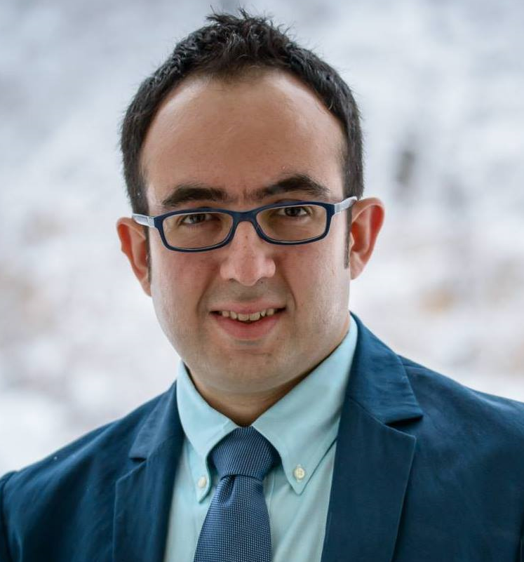
M5.1 Ad Memoriam: Amin Jafarian
Major contributor to IEEE802.11ah (2012-2014)
  Awarded for significant contributions to .11ah (2017)
    Relay operation, AP power save, NDP paging, etc.
Active contributor to IEEE802.11ax (2015)
  Studies on CCA performance, TXOP utilization
Amin will be remembered for his optimism, friendship, dedication, passion for photography, and joy of living an adventurous life
Amin Jafarian (1983-2019)
  Master in Finance from Princeton University in 2015
  Ph.D. in Electrical Engineering from University of Texas At Austin in 2011
  Awarded the Silver medal in the International Mathematical Olympiad in 2001 and the Gold medal in the National Mathematical Olympiad (Iran, 2000)
“Live your life to the fullest,
one major decision at a time”

Slide 21
M5.2 Comment Resolution Resources
Comment resolution resources
  See https://mentor.ieee.org/802.11/dcn/13/11-13-0230-03-0000-comment-resolution-tutorial.ppt
  See https://mentor.ieee.org/802.11/dcn/11/11-11-1625-02-0000-comment-resolution-guide.doc
There are many examples of good practice for documentation of comment analysis and resolution; ensures there is a record of comment consideration and agreed resolution
  https://mentor.ieee.org/802.11/dcn/18/11-18-0237-00-000m-cid-177.docx
  https://mentor.ieee.org/802.11/dcn/18/11-18-0930-00-000m-cid-1007.docx
  https://mentor.ieee.org/802.11/dcn/18/11-18-0669-04-000m-revmd-mac-comments-assigned-to-hamilton.docx
  https://mentor.ieee.org/802.11/dcn/18/11-18-1410-00-00ax-lb233-cr-spatial-reuse.docx

Slide 22
background data

Slide 23
Members by country and region
2019 Jan data

Slide 24
2019 Jan data

Slide 25
2019 Jan data

Slide 26
2019 Jan data

