Slide 1
Evaluation procedure for IMT-2020 eMBB Dense Urban
Date: 2010-01-17
Authors:

Slide 2
Abstract
This presentation details the requirements for benchmarking of 802.11ax vis-à-vis the IMT-2020 requirements for EMBB Dense Urban test environment ([6] and [7]).
In [2], [3], [4], and [5], we have documented the results of benchmarking of 802.11ax [1] capabilities in the EMBB Indoor Hotspot environment defined by IMT-2020 ([6], [7]).
This benchmarking confirmed that 802.11ax [1] meets the salient IMT-2020 requirements for the EMBB Indoor Hotspot environment, including mobility.
In [5], we had used an analytical approach using the IMT and 3GPP configurations to conclude that 802.11ax can meet the requirements of EMBB Dense Urban test environment .
However, the capabilities of 802.11ax in the EMBB Dense Urban environment need to be confirmed using simulations that adhere to the methodology specified by ITU-R for self-evaluating a RAT for IMT-2020 ([6] and [7]).

Slide 3
Outline
Background
Simulation setup
Simulation configuration and assumptions
Simulation methodology
Results
Conclusions
Next Steps
References

Slide 4
Background (1)
According to the IMT-2020 self-evaluation criteria, a candidate RAT needs to meet the minimum requirements for the following metrics for EMBB Dense Urban:
  Peak Spectral Efficiency
  Peak Data Rate
  5%ile User Spectral Efficiency
  User Experienced Data Rate
  Average Spectral Efficiency
  Mobility
The above metrics must be evaluated as follows:
  Peak Spectral Efficiency and Peak Data Rate must be evaluated analytically.
  5%ile User Spectral Efficiency, Average Spectral Efficiency and Mobility must be evaluated based on the simulation methodology specified by ITU-R.
  5%ile User Experienced Data Rate is derived from 5%ile User Spectral Efficiency

Slide 5
Simulation setup
The simulations must follow the self-evaluation methodology specified by ITU-R ([6] and [7]).
The simulator must be calibrated with respect to salient channel model parameters such as the geometry SINR, coupling loss, singular values, delay spread, spread of azimuth/elevation departure/arrival angles.
In our simulations ([2], [3] and [4]), for benchmarking of 802.11ax against EMBB Indoor Hotspot requirements:
  IMT-2020 simulation data presented by multiple companies in 3GPP ([8]) was used as the calibration benchmark .
  We used MATLAB to create the network topology and exercise the channel model using the parameters and configuration specified by ITU-R
  We also made the following assumptions:
    Antenna configuration: We used a configuration inferior to what is permitted by ITU
    MU-MIMO factor: We limited to a maximum factor of 2 to limit complexity
    Interference: We did not use schemes that can reduce interference such as Interference Coordination and Cancellation, Partial Frequency Reuse etc.
    Scheduling: We used a simple equal-time scheduler targeting a PER of 10%

Slide 6
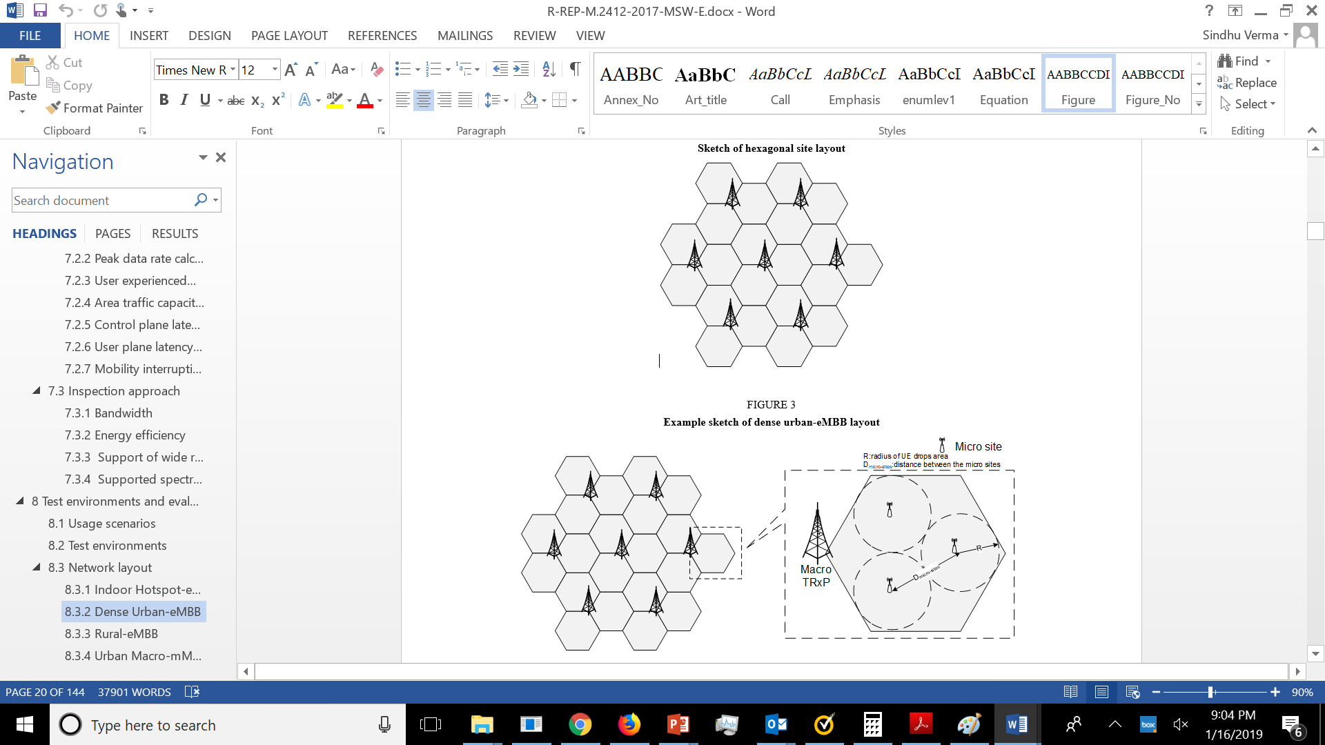
Network Topology
The network topology is specified by ITU-R ( [7]).
The eMBB Dense Urban network topology consists of two layers, a macro layer and a micro layer. The macro-layer base stations are placed in a regular grid, following hexagonal layout with 3 TRxPs each.
For the micro layer, there are 3 micro sites randomly dropped in each macro TRxP area. The micro-layer deployment (e.g. three micro sites per macro TRxP and there is either one or three TRxPs at each micro site) is not defined but should be reported by the proponent. The proponent should describe micro-layer base stations placement method.
The simulation is a wrap-around configuration of 19 sites, each of 3 TRxPs (per macro cell).
UEs are distributed uniformly over the whole area.
For configuration A (4 GHz), only macro layer is present. For our evaluations, we can ignore configuration B (30 GHz Macro) and configuration C (4GHz + 30 GHz, Macro and Micro)

Slide 7
Simulation configuration and parameters per Configuration A (1)
Carrier Frequency : 4 GHz (single layer Macro)
Simulation bandwidth : 20 MHz (TDD)
BS antenna height: 25m
UE antenna height: Outdoor UEs: 1.5 m, Indoor UTs: 3(nfl – 1) + 1.5; nfl ~ uniform(1,Nfl) where Nfl ~ uniform(4,8)
Total transmit power per TRxP: 44 dBm
UE power class: 23 dBm
Number of antenna elements per TRxP: Up to 256 Tx/Rx
Number of UE antenna elements: Up to 8 Tx/Rx
BS noise figure: 5 dB
UE noise figure: 7 dB
BS antenna element gain: 8 dBi
UE antenna element gain: 0 dBi
Thermal noise level: ‒174 dBm/Hz

Slide 8
Simulation configuration and parameters per Configuration A (2)
Percentage of high loss and low loss building type : 20% high loss, 80% low loss
Inter-site distance or ISD: 200m
Traffic model: Full buffer
Device deployment: 80% indoor, 20% outdoor (in‑car) randomly and uniformly distributed over the area under Macro layer
UE mobility model: Fixed and identical speed of all UEs of the same mobility class, randomly and uniformly distributed direction.
UE speeds of interest: Indoor users: 3 km/h, Outdoor users (in-car): 30 km/h
UE density: 10 UEs per TRxP randomly and uniformly distributed over the area under Macro layer
Channel model: UMa_A, UMa_B,
The complete configuration is specified in the ITU-R guidelines for self-evaluating a RAT ([6] and [7]).

Slide 9
Channel model
Building the entire channel model from scratch is a difficult and tedious exercise.
It is more effective to adopt an already available channel model generator which has been calibrated for channel Uma_A or Uma_B
Some important components of the channel model are:
  Pathloss function
  LOS/NLOS probability
  Penetration loss (building and car)
  Fast Fading

Slide 10
Metrics
  The following metrics for EMBB Dense Urban have to be evaluated via simulations:
    5%ile DL User Spectral Efficiency
    5%ile UL User Spectral Efficiency
    DL User experienced data rate
    UL User experienced data rate
    DL Average Spectral Efficiency
    UL Average Spectral Efficiency
    Mobility

Slide 11
Metrics : 5%ile DL and UL spectral efficiencies
Definition: 5th percentile user spectral efficiency is the 5th percentile point of the cumulative distribution function (CDF) of the normalized user throughput, estimated from all possible user locations.
The requirement for EMBB Dense Urban is as follows:
DL: 0.225 bits/s/Hz
UL: 0.15 bits/s/Hz

Slide 12
Metrics : DL and UL User Experience Data Rate
Definition: User experienced data rate is the 5% point of the cumulative distribution function (CDF) of the user throughput. User throughput (during active time) is defined as the number of correctly received bits, i.e. the number of bits contained in the service data units (SDUs) delivered to Layer 3, over a certain period of time.
In case of one frequency band and one layer of transmission reception points (TRxP), the user experienced data rate could be derived from the 5th percentile user spectral efficiency. Let W denote the channel bandwidth and SEuser denote the 5th percentile user spectral efficiency. Then the user experienced data rate, Ruser is given by: Ruser = W × SEuser. If the bandwidth is aggregated across multiple bands (one or more TRxP layers), the user experienced data rate is summed over the bands.
The requirement for EMBB Dense Urban is:
DL: 100 Mbit/s
UL: 50 Mbit/s

Slide 13



Metrics : Average DL and UL spectral efficiencies
Definition: Let Ri (T) denote the number of correctly received bits by user i (i = 1,…N) (downlink) or from user i (uplink) in a system comprising a user population of N users and M Transmission Reception Points (TRxPs). Let W denote the channel bandwidth and T the time over which the data bits are received. The average spectral efficiency may be estimated by running system-level simulations over number of drops Ndrops. Each drop gives a value of denoted as:
and the estimated average spectral efficiency resulting is given by:
For TDD, the channel bandwidth information should include the effective bandwidth, which is the operating bandwidth normalized appropriately considering the uplink/downlink ratio.
The requirement for EMBB Dense Urban is:
DL: 7.8 bits/s/Hz/TRxP
UL: 5.4 bits/s/Hz/TRxP

Slide 14
Metrics : Mobility
Mobility requirement for eMBB Dense Urban is met if at the 50%ile SINR CDF for Dense Urban at 30 kmph, the technology satisfies a UL spectral efficiency of 1.12 bits/s/Hz and also the residual decoded packet error ratio is less than 1%

Slide 15
Summary of analytical evaluations for EMBB Dense Urban ([5])
 | Metric | ITU-R Evaluation Method | Minimum Requirement | 802.11ax Performance
1 | Peak data rate | Analytical | DL/UL: 20/10 Gbps | DL/UL: 20.78 Gbps [Note 1]
2 | Peak spectral efficiency | Analytical | DL/UL: 30/15 bits/s/Hz | DL/UL: 58.01 bits/s/Hz [Note 2]
3 | User experienced data rate | Analytical for single band and single layer; Simulation for multi-layer | DL/UL: 100/50 Mbit/s | DL/UL: 195.2/73.6 Mbps [Note 3]
4 | 5th percentile user spectral efficiency | Simulation | DL/UL: 0.225/0.15 bits/s/Hz | DL/UL: 1.22/0.46 bits/s/Hz [Note 4]
5 | Average spectral efficiency | Simulation | DL/UL = 7.8/5.4 bits/s/Hz/TRxP | DL/UL: 11.34/5.37 bits/s/Hz/TRxP
6 | Mobility | Simulation | UL: 1.12 bits/s/Hz | Not evaluated
7 | Bandwidth | Inspection | 100 MHz, scalable | 20/40/80/80+80/160 MHz
Assumes a three carrier configuration: 8x8 HE160 + 8x8 HE160 + 8x8 HE40.
Assumes an 8x8 configuration.
Assumes 160MHz transmission bandwidth only. It is possible for 802.11ax to support a higher three carrier transmission bandwidth of (160+160+40) MHz.
This is an estimated value. It assumes the following antenna configuration: AP: 128Tx/Rx, Client: 4Tx/Rx.

Slide 16
References
[1] IEEE P802.11ax™/D3.0, “Draft Standard for Information technology Tele-communications and information exchange between systems Local and metropolitan area networks— Specific requirements Part 11: Wireless LAN Medium Access Control (MAC) and Physical Layer (PHY) Specifications; Amendment 6: Enhancements for High Efficiency WLAN” – June 2018
[2] IEEE 802.11-18/1573r7, Summary of 802.11ax Self Evaluation for IMT-2020 EMBB Indoor Hotspot, November, 2018
[3] IEEE 802.11-18/1240r4, Benchmarking of 802.11ax against eMBB Indoor Hotspot requirements using IMT-2020 simulation methodology, November, 2018
[4] IEEE 802.11-18/0915r3, Benchmarking of 802.11ax against eMBB Indoor Hotspot requirements using IMT-2020 simulation methodology, November, 2018
[5] IEEE 802.11-18/0517r2, 802.11ax for IMT-2020 EMBB Indoor Hotspot and Dense Urban, September, 2018
[6] Report ITU-R M.2410-0 (11/2017), Minimum requirements related to technical performance for IMT-2020 radio interface(s)
[7] Report ITU-R M.2412-0 (10/2017), Guidelines for evaluation of radio interface technologies for IMT-2020
[8] RT-170019, “Summary of email discussion “[ITU-R AH 01] Calibration for self-evaluation”, Huawei, December 2017

