Slide 1
Mutliband-60GHz-Location-Capability-Publishing
Date: 2019-01-09
Authors:

Slide 2
Usage
In a Mall or in other places where 60GHz location services are available, a mobile device, even though capable of using 60GHz for data or location, may not have the 60GHz part active. Even if it is active, it may not be aware of location services that are available, and their locations.
The assumption is that the mobile device has the <7GHz network device always operating.
The <7GHz APs may publish the existence of the 60HGz location services

Slide 3
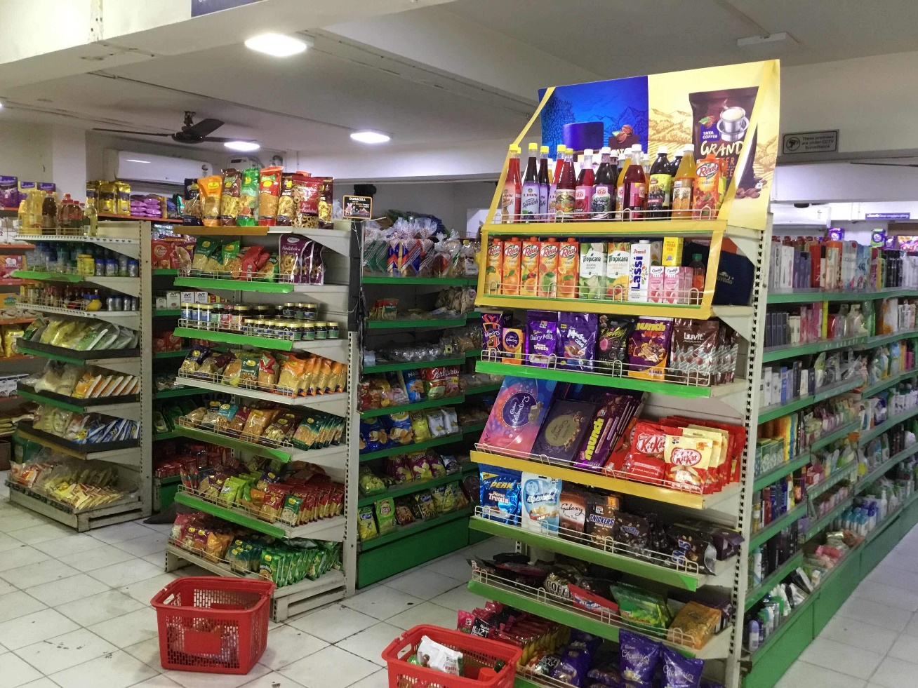
Example of Usage
Single <7GHz AP in a store
Several 60GHz Aps in the store – one in each isle.
<7GHz AP
60 GHz AP
60 GHz AP
60 GHz AP
60 GHz AP

Slide 4
Proposed Solution
Use a field in the beacon to indicate the existence of a 60GHz location service available in the “area” of the AP
Definition of area is implementation dependent
Another field may indicate that more information is available.
A STA the receives a beacon with this fields set to 1
It may query the AP for information on 60HGz location Aps.
The AP will respond with a list of:
60GHz APs operating channels.
60GHz APs locations
60GHz APs beacon interval and time of next beacon.
The STA may use this information and knowledge of its own location (based on <7GHz) measurements to turn on the 60GHz network, tune to the right frequency at the right time.

Slide 5
Changes required
2 Bit field in the beacon
Indication of 60GHz location services in the vicinity
Indication of availability of additional information on 60GHz location services.
A protocol to query the AP on 60GHz location services and get the response
Frames to carry 60GHz location services and elements with the specific information.

Slide 6
Possible protocol
Use the Neighbor Request frame and Neighbor Report frame to pass the information
Existing protocol
A new type of measurement in the measurement request element
Use the neighbor report element with 60GHz operating channel
Neighbor report will include Location Civic report subelement
Neighbor report will include a field about 60GHz location capability
New subelement to report beacon scheduling.
Add two capabilities field into the extended capabilities element
60GHz Location APs in the area
The AP can provide the information using the proposed protocol

Slide 7
References

