Slide 1
Drone Use Case Followup
Date: 2018-11-15
Authors:
Notes:
Hello everyone. I am Akira Kishida from NTT.
I’d like to introduce my presentation entitled as “Drone Use Case Followup”.
The document number is 0116r2.

Slide 2
Abstract
This presentation is follow up on our previous presentation concerning RTA use case of drone [1]. The details given in this presentation are described to the RTA Report draft [2].
Notes:
This presentation is follow up on our previous presentation concerning RTA use case of drone [1]. The details given in this presentation are described to the RTA Report draft [2].

Slide 3
Drone control
Drones are widely used in various businesses and entertainment.
  Gartner mentions that worldwide production of drones neared 3 million units in 2017 [3].
  Agriculture, inspection, aerial photography, survey, route guiding, logistics, inventory management, entertainment, e-Sports, digital signage, security for example [4].
Almost commercial drones employ Wi-Fi for their communication method.
  Wi-Fi is universal unlicensed wireless system and can be easily utilized and operated.
Notes:
As we introduced in last November meeting, drones are widely used in various businesses and entertainment.
Gartner mentions that worldwide production of drones neared 3 million units in 2017.
As an instance, there are a lot of use cases for drone as described here.
Almost commercial drones employ Wi-Fi for their communication method.
Because Wi-Fi is universal unlicensed wireless system and can be easily utilized and operated.

Slide 4
Examples of drone use cases and requirements
Use cases | Distance | Maximum delay
Inspection from the air | ~ 300 m | ~ 100 ms
Route guiding | ~ 1 km | ~ 100 ms
Logistics (outdoors) | ~ 5 km | ~ 100 ms
Logistics (indoor) | ~ 100 m | ~ 100 ms
Security patrol | ~ 1 km | ~ 100 ms
Gaming device | TBD | TBD
Digital signage | ~ 100 m | TBD
Real-time distribution of images | ~ 100 m | TBD
Given the Wi-Fi capabilities, only use cases with short communication ranges should be considered in the scope of 802.11 and the RTA TIG.
Notes:
This table shows the examples of drone use cases and requirements.
Given the Wi-Fi capabilities, only use cases with short communication ranges should be considered in the scope of 802.11 and the RTA TIG.

Slide 5
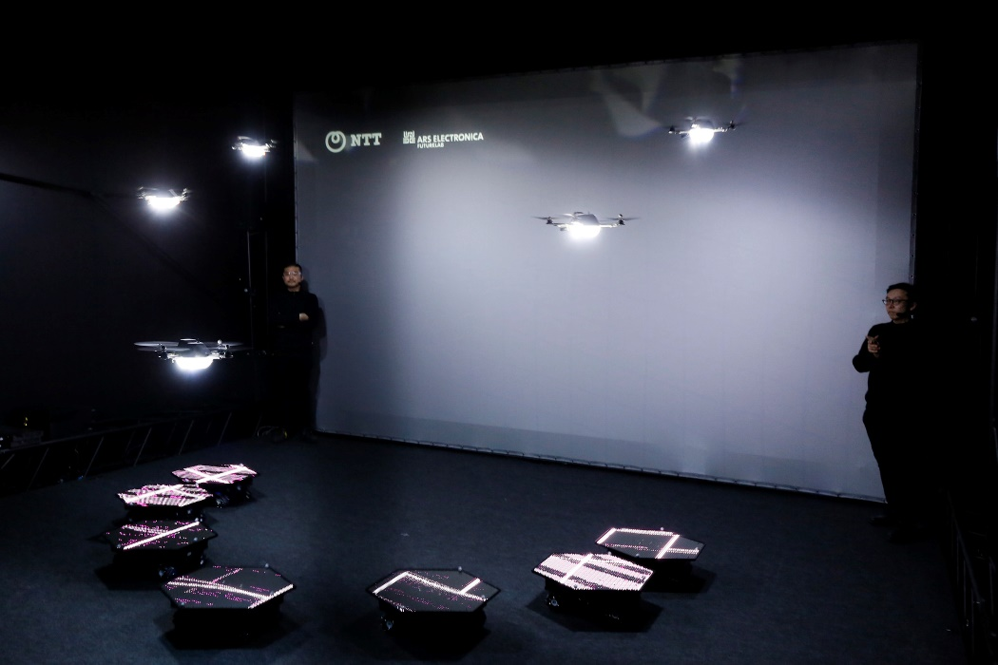
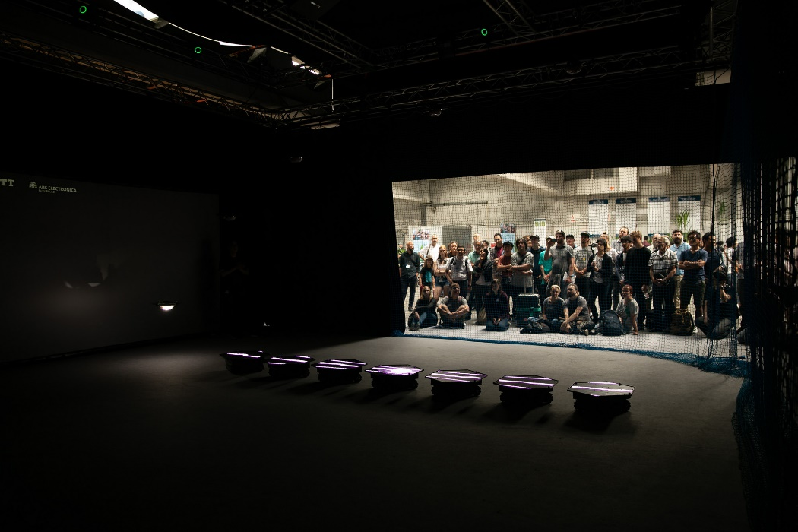
Drones for digital signage
Drones can be used for digital signage. These drones running on ground perform public viewing by making a concerted move [5].
  In this case, multiple drones must be controlled at the same time.
Photos by Swarm arena / Ars Electronica Futurelab, https://flic.kr/p/28tPf9k
Notes:
As one of the example, drones can be used for digital signage. These drones running on ground perform public viewing by making a concerted move.
In this case, multiple drones must be controlled at the same time.

Slide 6
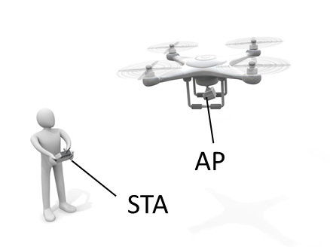
Architecture of drone use case (1)
There are several architectures for drone control.
  Standalone (single drone)
    Most of commercial drones adopt this architecture.
    A drone plays a roll of the AP and a controller (e.g. a smartphone or a console) becomes the STA.
    Only one drone can be managed per a single controller.
Notes:
We should consider the architecture for drone use cases.
There are several architectures for drone control as described.
One is, standalone for single drone. Most of commercial drones adopt this architecture.
In this architecture, a drone plays a roll of the AP and a controller becomes the STA.
Only one drone can be managed per a single controller.

Slide 7
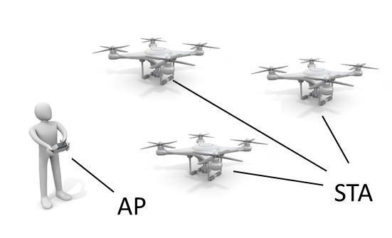
Architecture of drone use case (2)
  Standalone (multiple drones)
    The drones are desirable to be the STAs and a controller should be the AP.
    Due to sharing a same channel with the multiple drones and the AP, functions that ensure reliability will be needed in this architecture.
Notes:
Second, standalone for multiple drones.
The drones are desirable to be the STAs and a controller should be the AP.
In this case, due to sharing a same channel with the multiple drones and the AP, functions that ensure reliability will be needed.

Slide 8
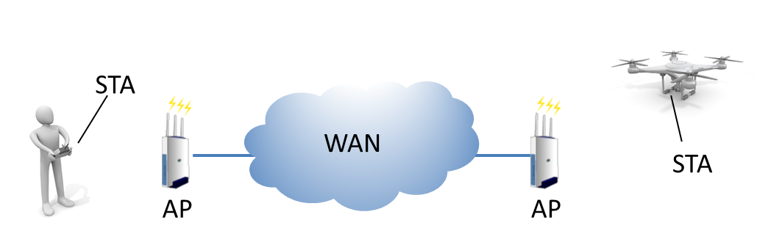
Architecture of drone use case (3)
  Network control
    The drone has a possibility to become the AP or the STA. However, it is desirable that the drone plays a roll of the AP.
    To control drones over the network remotely, network delay should be considered.
Notes:
Last, network control for drones.
In this case, the drone has a possibility to become the AP or the STA. However, it is desirable that the drone plays a roll of the AP.
To control drones over the network remotely, network delay should be considered.

Slide 9
Communication functions for drone control
Following functions provided by Wi-Fi should be considered for target use cases of drone.
  Tele control
    Controlling motions and functions of the drone. A few Kbps of data rate is required.
  Data transmission
    Monitoring information from sensors in a drone or information of the status of the drone itself. A few Kbps~Mbps of data rate is required.
  Picture / video transfer
    Transferring recorded pictures or videos by the drone. More than tens of Mbps of data rate is required.
Notes:
For every architecture as I explained, following functions should be important for target use cases of drone.
First, tele control that enables to control motions and functions of the drone. A few Kbps of data rate is required.
Second, Data transmission such as monitoring information from sensors in a drone or information of the status of the drone itself.
Range from A few Kbps to Mbps of data rate is required.
Last, Picture or video transfer that transfer recorded pictures or videos by the drone. More than tens of Mbps of data rate is required.

Slide 10
Challenges for drone control
Stable operation of drone control
  Tele control is important for stable operation for drone control.
  Although tele control does not require high data rate and strict latency requirements compared to past IEEE 802.11 standards' CSD, loss of tele control might cause unintended motion of drones.
  We have to consider the fact that drone is a moving STA.
Simultaneous transmissions of tele control and video/data transfer
  Coexistence of tele control and high data rate transmission such as video transfer should be considered.
Notes:
These challenges are very important for drone use cases for RTA.
One is, stable operation of drone control
As I mentioned, tele control is important for stable operation for drone control.
Although tele control does not require high data rate and strict latency requirements compared to past IEEE 802.11 standards' CSD, loss of tele control might cause unintended motion of drones.
Moreover, we have to consider the fact that drone is a moving STA.
The other is, simultaneous transmissions of tele control and video/data transfer
Coexistence of tele control and high data rate transmission such as video transfer should be considered.

Slide 11
Conclusions
We investigated drone use cases and proposes that only use cases with short communication ranges should be target for 802.11 and the RTA.
Several architectures for drone should be considered for each use case.
Increase of reliability for tele control is required for drone control
  To solve these issues, further investigations of potential technical features should be required.
    For example, priority control, separation of control messages and data messages or protection mechanism for control messages.
Notes:
Then, we summarize this presentation.
We investigated drone use cases and proposes that only use cases with short communication ranges should be target for 802.11 and the RTA.
In addition to that, several architectures for drone should be considered for each use case.
For challenges of drone RTA use case, increase of reliability for tele control is required.
To solve these issues, further investigations of potential technical features should be required.

Slide 12
References
[1] Akira Kishida, et al., “Discussion on Target Use Cases of RTA,” IEEE 802.11-18-1978r4
[2] Kate Meng , et al., “RTA report draft,” IEEE 802.11-18-2009r3
[3] Gartner, “Almost 3 Million Personal and Commercial Drones Will Be Shipped in 2017,” Feburuary 2017.
[4] Impress Corporation, “World Drone Market Report 2017,” December 2016.
[5] SWARM ARENA, https://ars.electronica.art/futurelab/project/swarm-arena/.

