Slide 1
Preliminary test results of 11ad-based 60GHz mmW for V2I use cases
Authors:
Date: 2019-1-15
Acknowledgement: This work was partly supported by “Study and investigation on technical conditions for new ITS wireless systems utilizing mmWave toward realizing Connected Car society” of The Ministry of Internal Affairs and Communications, Japan.

Slide 2
Background
Several use cases using mmWave V2X were proposed to NGV [1], though consensus has not reached, and the use cases included V2I and V2V scenarios.
This informative submission demonstrates a test result of V2I mmWave communication using 11ad-based devices. The result shows that the 11ad PHY as well as beamforming mechanism works for mid-level vehicle speed – assuming 60 km/h – scenarios.
[1] 11-18/1977r5 Use Cases for NGV using High Data Rate

Slide 3
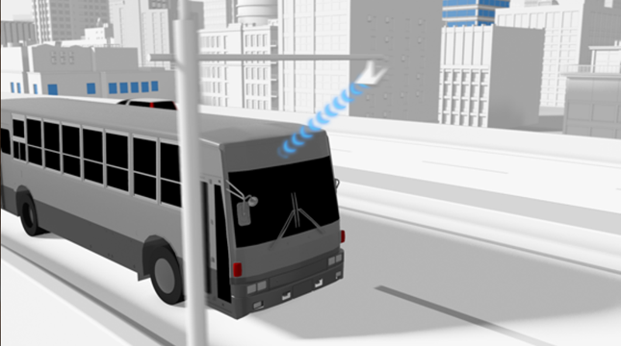
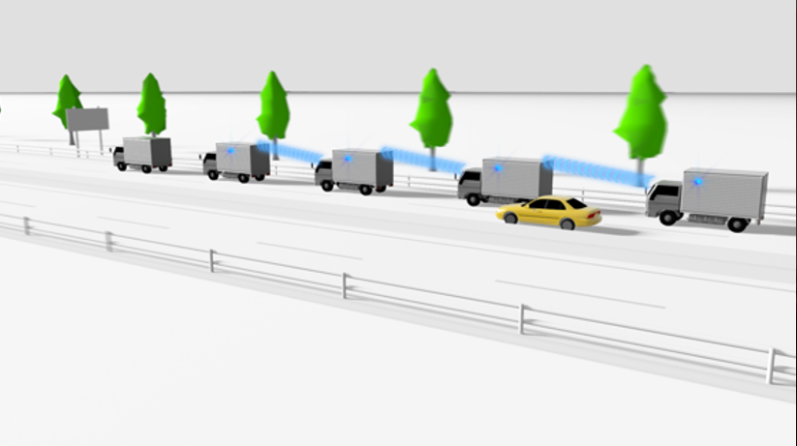
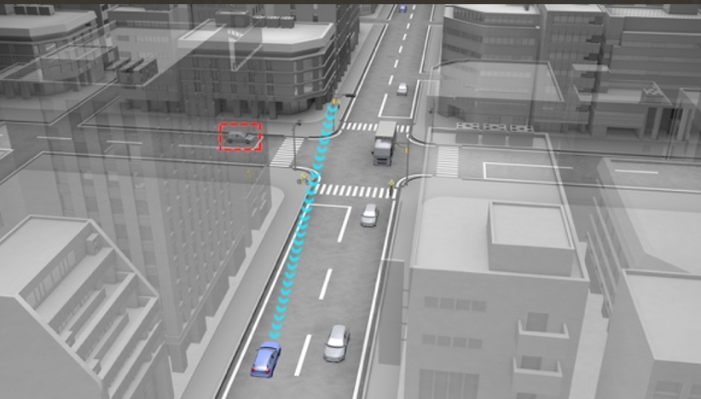
Proposed use cases[1] recap
Traffic Offloading to 60 GHz band
Rich Sensor Sharing
Proposed target performance:
- >1 Gbps max data rate
- Vehicle mobility in a city (~60km/h)
for both use cases;
Additionally
- <10 ms latency for data packets
for Rich Sensor Sharing use case
Downloading 3D maps
Bird’s-Eye View for Platoon (V2V)
Uploading sensor data
Bird’s-Eye View for Intersection (V2I/V2X)

Slide 4
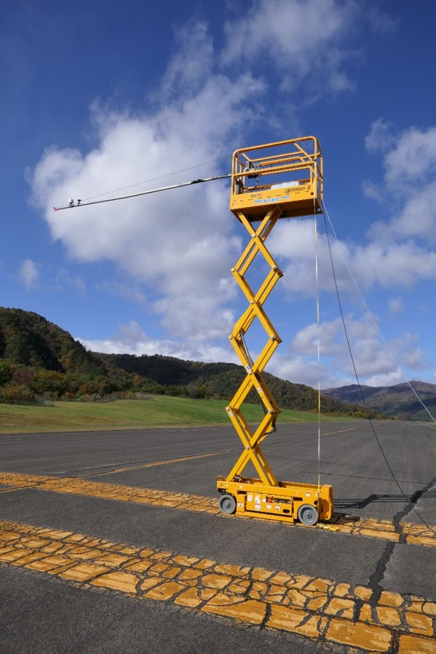
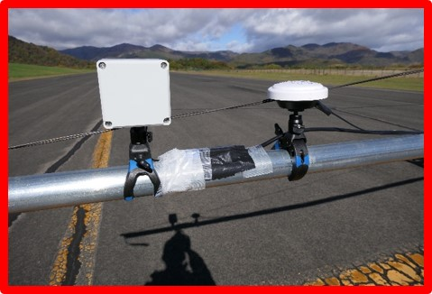
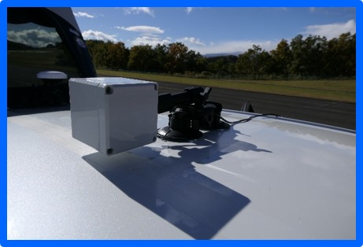
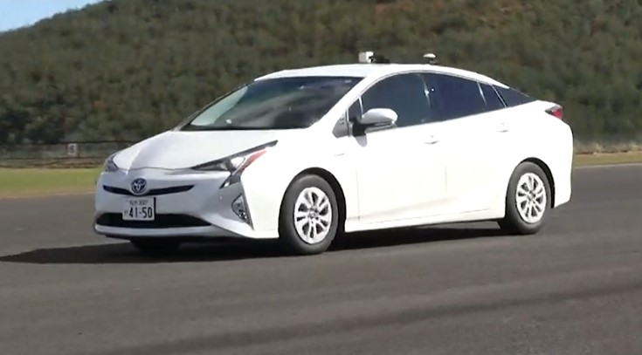
Test setup
Road Side Unit
On Board Unit
11ad
non-AP
STA
11ad AP
ch2: 60.48 GHz
6m

Slide 5
An example test result
An example
Vehicle speed: 60 km/h
Application: iperf over TCP (Direction: OBU to RSU)
The following slides show pictures every 3 seconds

Slide 6
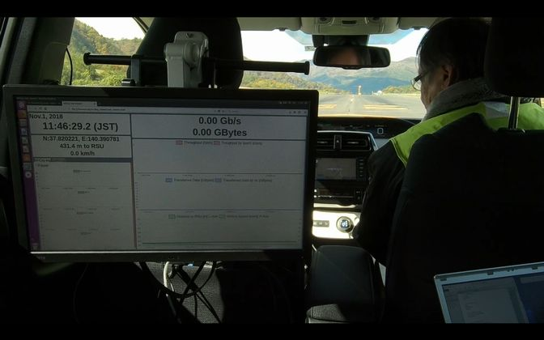
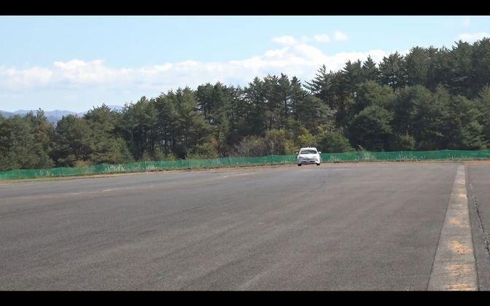
0’00’’

Slide 7
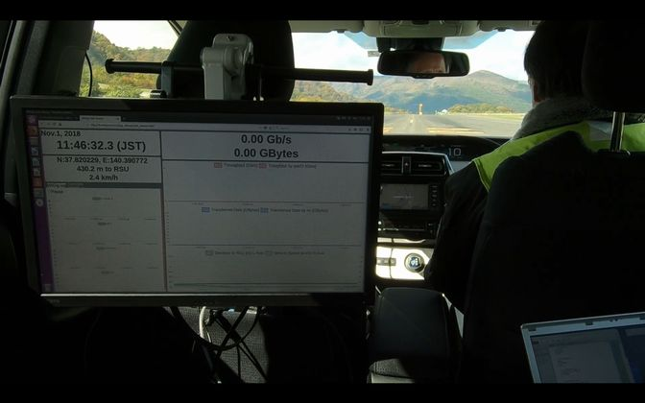
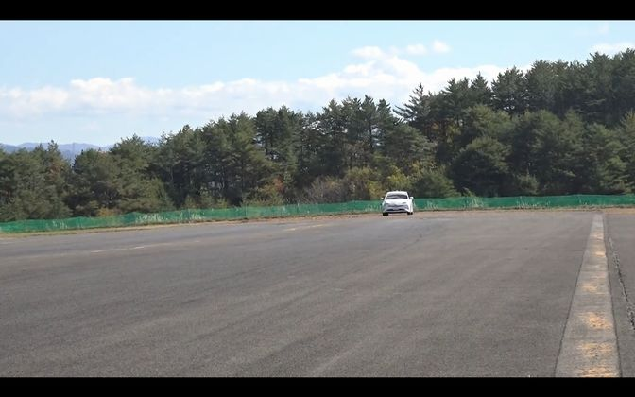
0’03’’

Slide 8
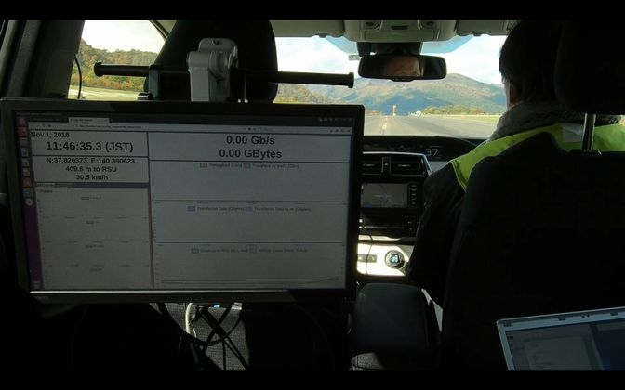
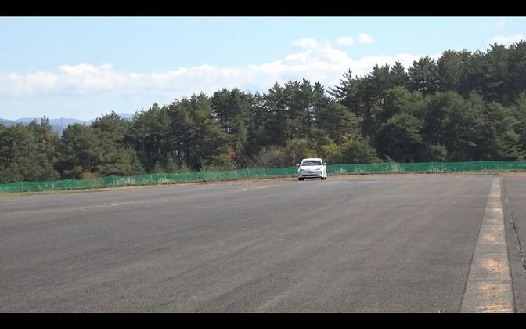
0’06’’

Slide 9
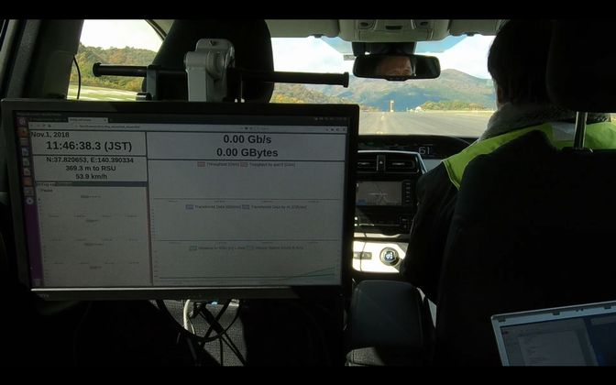
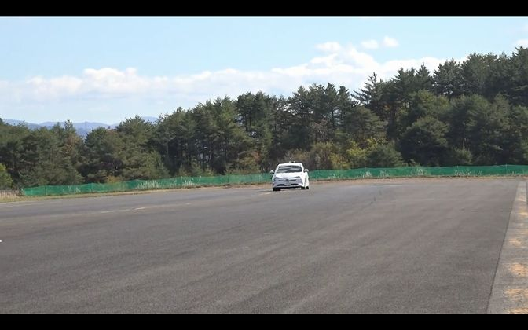
0’09’’

Slide 10
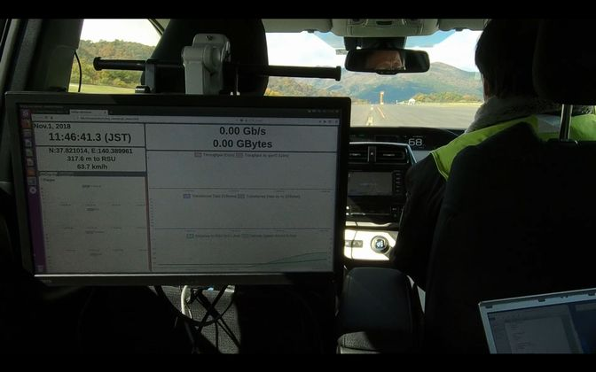
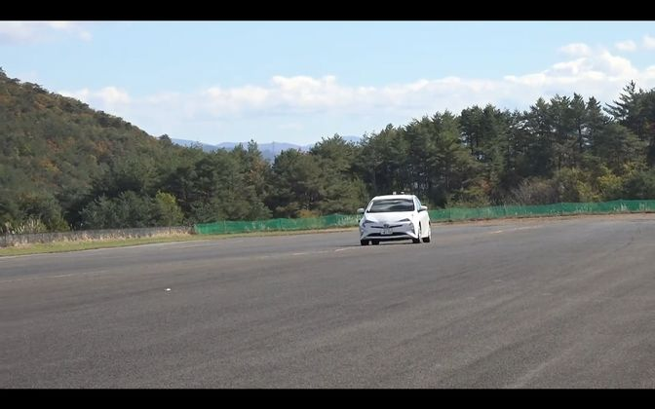
0’12’’

Slide 11
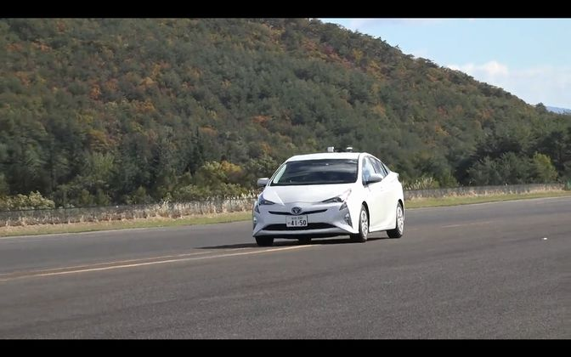
0’15’’

Slide 12
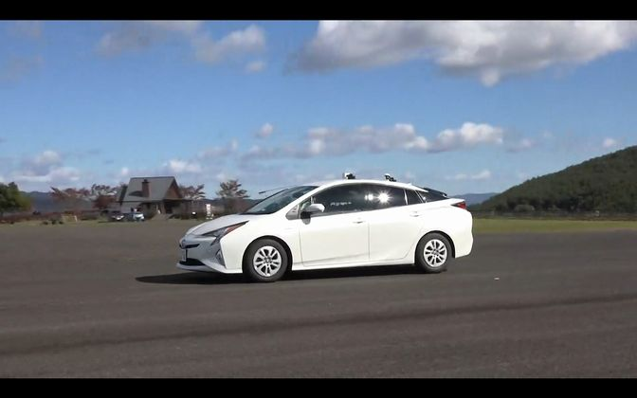
0’18’’

Slide 13
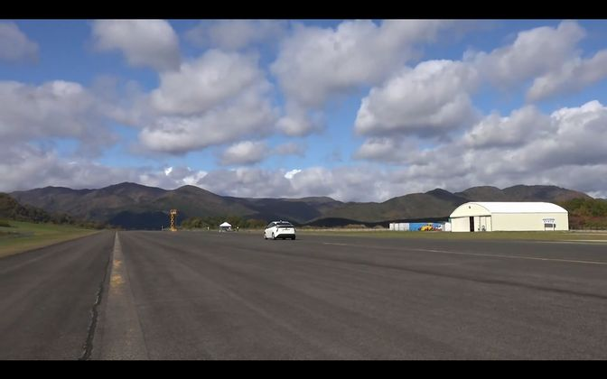
0’21’’

Slide 14
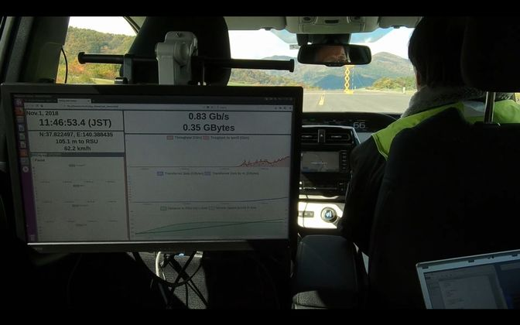
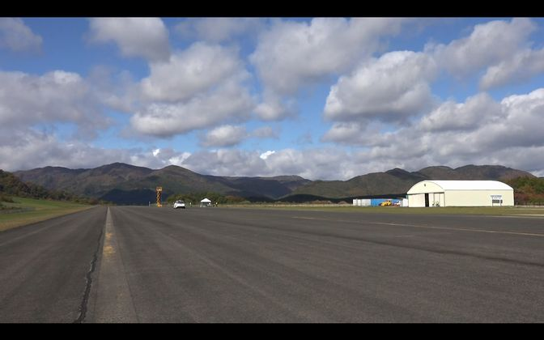
0’24’’

Slide 15
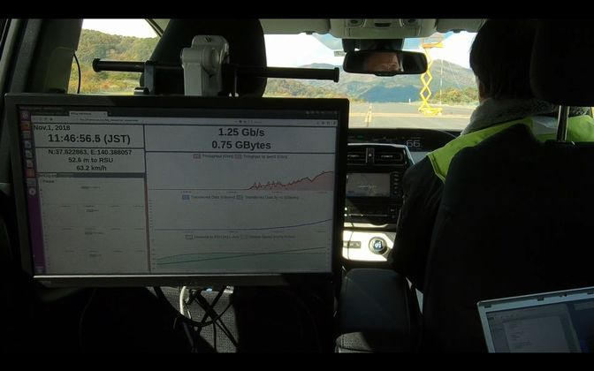
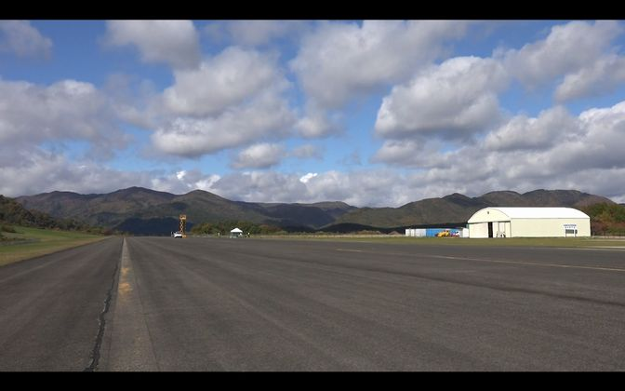
0’27’’

Slide 16
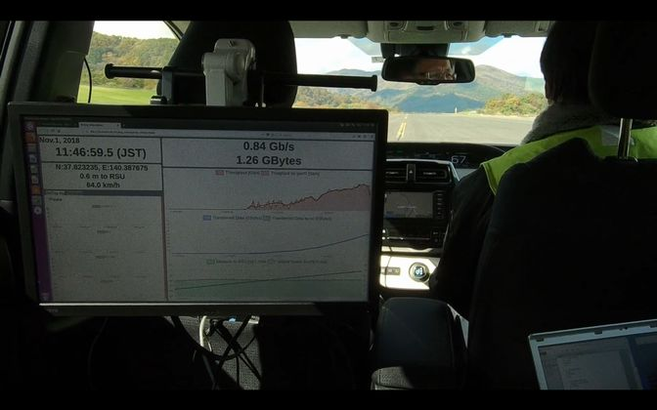
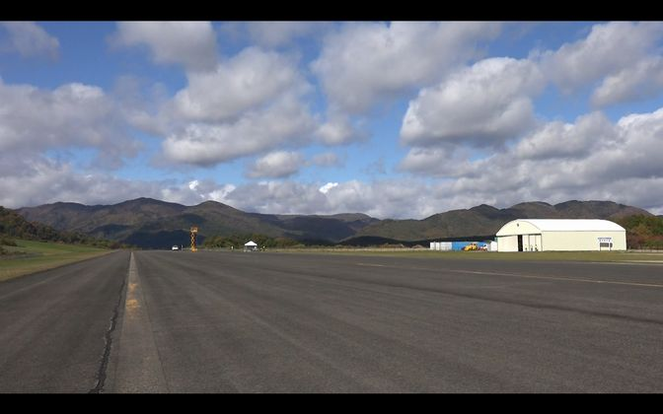
0’30’’

Slide 17
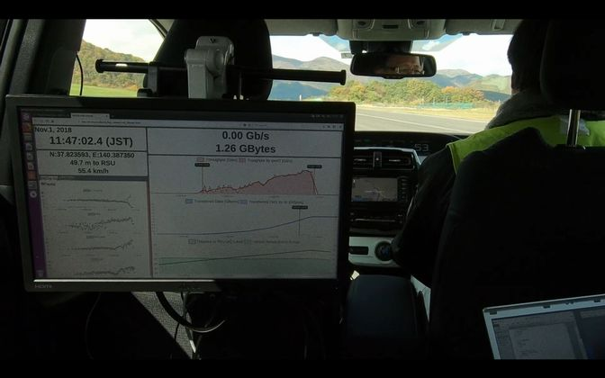
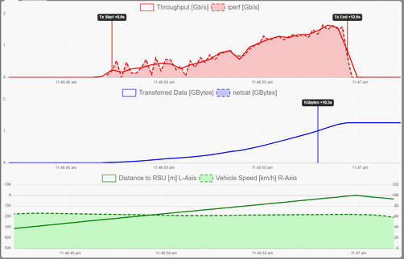
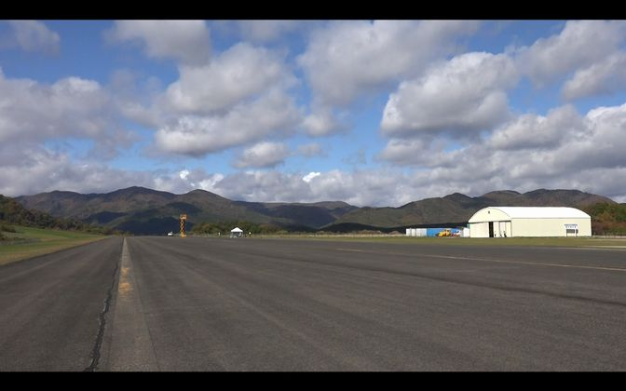
0’33’’
achieved >1Gbps
transferred 1.26Gbytes
maintained
>60km/h

Slide 18
Test results summary
1 RSU on a straight road; the vehicle go through under the RSU
An 11ad AP for RSU and non-AP STA for OBU were used
Data transfer from vehicle to infrastructure was tested
using iperf (TCP) or file transfer over netcat (TCP) for each of test iterations
>1 GBytes data transfer at 60km/h vehicle speed was demonstrated
>1 Gbps was achieved (and maintained for several seconds) at 60km/h
11ad beamforming kept the link without beam lost

Slide 19
For Further Study
Revisit use case discussion of V2V and V2I
Channel measurement/modelling as well as testing with more complicated scenarios
To study and test on initial link performance

Slide 20
Conclusion
V2I communication with 11ad-based OBU to RSU at 60 km/h vehicle speed are demonstrated.

Slide 21
References
[1] 11-18/1977r5 Use Cases for NGV using High Data Rate

