Slide 1
Joint Processing MU-MIMO
Date: 2019-01-14
Authors:
Name | Affiliations | Address | Phone | email
Ron Porat | Broadcom |  |  | ron.porat@broadcom.com
Srinath Puducheri | Broadcom

Slide 2
Abstract
In the September meeting contribution number 1439 we introduced a framework for joint processing (previously called distributed) MU-MIMO operation using wireless synchronization techniques, building on mechanisms that exist in 11ax.
In this contribution we provide simulation results for the proposed framework
    Problems reminder –
      Problem A - from the time of NDP (when channel feedback is collected) to the time of joint data transmission, each AP drifts based on its own (e.g. 20ppm) clock. In addition, AP acquisition timings vary each packet.
      Problem B – during joint data transmission, APs start drifting again due to residual CFO error
    Proposed solutions reminder –
      Problem A - slave triggers are sent before the NDP and before joint data transmissions to enable drift estimation. The slave trigger enables capturing the exact phase drift which will include the impact of CFO and phase noise.
      Problem B – we propose accurate CFO estimation

Slide 3
Problem A - Phase alignment before the joint data transmission

Slide 4
Estimation
    Each slave AP uses the channel estimates from the slave triggers, denoted here by the vectors h_ndp (from the trigger before the NDP) and h_data (from the trigger before the joint data transmission) to calculate two parameters related to the phase drift:
      Timing errors (acquisition error) – these are manifested as a linear phase drift across frequency.
      Common phase drift due to different RF clocks and phase noise between the Master and each slave AP
    We assume here for tone i where all other impairments are lumped into the noise component (incl. channel aging)
    And then form, as an example, the following metric:
      With MIMO configuration, this metric is summed up across the receive antennas
    It is straightforward to form metrics to estimate theta and phi from h_diff.

Slide 5
Simulation Methodology
    We employ two sets of simulations – the first simulation is used to estimate phase and timing error. The second simulation performs joint MU-MIMO transmission whereby each slave AP has an offset in the amount of the residual estimation error relative to the master AP.
    Both sets of simulations use the 11nD channel model with -30dBc aging and BW=80MHz.
    Residual common and linear phase errors are simulated across 1000 channel realizations using one beamformed 4x LTF
    In the joint MU-MIMO simulation each slave AP is assumed to have as input the same 10% worst residual phase error for all channel instantiations.
    We calculate average MU SINR per STA per spatial stream with and without impairments and plot them.

Slide 6
Simulation Configurations
    We believe the vast majority of cases for mesh deployments will involve 4-antenna AP. Hence we focus on two configurations:
      Two 4-antenna AP (one master one slave)
      Four 4-antenna AP (one master three slaves)
    Each configuration is 75% loaded - 2 streams to three or six 2-antenna STA for a total of 6 or 12 streams
    In terms of SNR we have a 2D problem – AP-AP SNR and STA-AP SNR. For simplicity we ran simulations assuming 2 fixed AP-AP SNR values – 10 and 20 dB and varied the STA-AP SNR. We assume all STA have the same SNR to all AP.

Slide 7
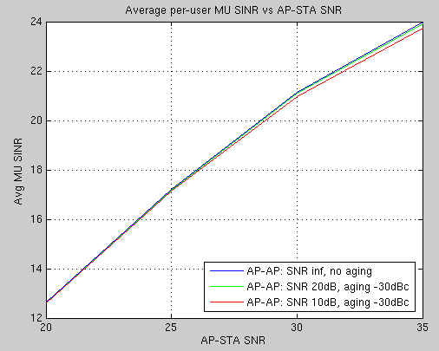
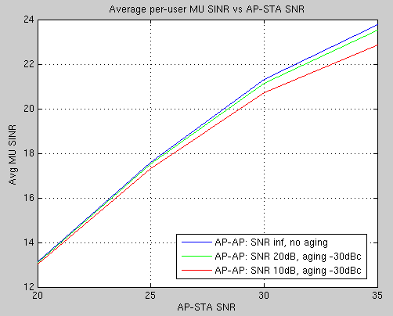
Results
    Two AP
    Four AP
No significant impact on the average per-STA MU-SINR is seen as the residual timing/phase estimation error are small

Slide 8
Problem B - Controlling the drift during joint data transmission

Slide 9
High Level Description
At the beginning of the joint data transmission, all the APs are phase/time-synchronized with very small residual error based on the description of problem A.
However, during the joint transmission the APs will start drifting again which will cause the phase offset between them to increase with time.
In the following slides we estimate the performance degradation with various fixed phase offsets between the APs and provide a result for CFO estimation.
Simulation scenarios – same configuration as problem A.
Simulation methodology - we compare the joint processing MU-MIMO performance of multiple APs relative to a baseline comprising of TDMA between single APs:
  The baseline also assumes 75% loading MU-MIMO
  We assume equal sum power for joint processing as for the baseline single AP (in the following slide the X-axis means total power across all AP)
  This is similar to assumptions made for MU-MIMO but in this case alternatively per-AP fixed power can be assumed, yielding higher gains.

Slide 10
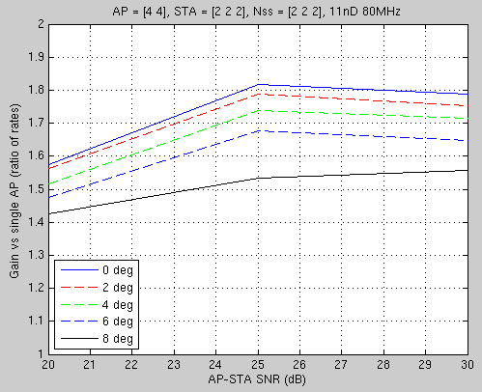
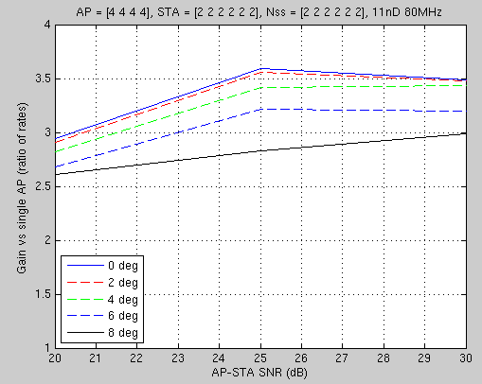
Results
    Two AP
    Four AP
8 degrees of phase offset still provide substantial gains

Slide 11
CFO Estimation
Accurate CFO estimation at the slave AP is important to minimizing the phase drift between slave and master AP during the joint data transmission.
For an example here, we have leveraged the 4x LTF in 11ax to improve CFO estimation beyond the performance available from the L-LTF by assuming in exactly the same manner that we have two identical and adjacent 4x LTF (in the HE-LTF part) and estimated the phase drift between them.
For the AP configuration assumed throughout (4-ant AP for master and slave) we got 30Hz residual CFO error in moderate SNR

Slide 12
Summary
Our investigation demonstrates the feasibility of this scheme by proving that estimation techniques can compensate for the drift between slave and master APs. This is achieved using the following two components:
  First, estimating and compensating the total phase drift between the NDP and the joint data transmission
  Second, estimating CFO accurately to minimize phase drift during the joint data transmission

