Slide 1
Joint Beamforming protocol simulation
Date: 1/11/2019
Authors:

Slide 2
Introduction
EHT has been discussing various levels of multi-AP coordination
  Coordinated vs. joint operation
  See [1], [2], [3] for proposed scenarios and terminology
Constrained Distributed MIMO ([4], [5]) was proposed to allow synchronization and CFO correction to be addressed through wireless protocol

Slide 3
Constrained MU-MIMO
One AP acts as “Master AP” and can be heard by all other APs (“Slave APs”)
Each joint transmission is preceded by a “Slave Trigger” from the Master AP
  This allows slave APs to correct for phase and timing drift and CFO
  Similar in function to Trigger frame in UL MU transmission in 11ax
  Simulations on required and achievable synchronization in have been presented in [6], [7]

Slide 4
Constrained MU-MIMO (2)
Multi-AP operation requires all APs (Master + Slaves) to share data to the final recipient prior to the joint transmission
Submissions so far have not explicitly addresses this Backhaul mechanism
  [8] suggest a Wi-Fi/repeater like approach (Wi-Fi backhaul)
  [5] mentions both mesh and wired solutions

Slide 5
Analysis
Purpose of this submission:
  Provide network simulation results on the expected performance of various backhaul mechanisms
    mesh vs. wired solutions
Results account for the protocol overhead inherent in the various proposals
Initial results are shown for joint Beamforming

Slide 6
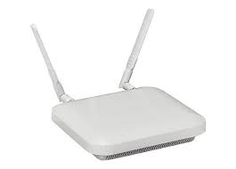

Joint Beamforming scenario
The following scenario was discussed in [8]
AP1 is the master AP
Transmission at time T1 constitutes the backhaul
  Data is communicated between AP1 and AP2
Transmission at time T2 is the joint transmission
  Both AP1 and AP2 send data to the STA
Data frame at T1
AP2
Data frame
AP1
at T2
Data frame at T2
STA

Slide 7
Joint Beamforming protocol
AP1
AP2
STA
Adapted from [8]
JTA frame + Data frame are the backhaul transmission
  Combined into single frame for the simulations presented here
JT Trigger frame “announces” the joint transmission
  allows AP2 to synchronize
JTA frame
Wired or wireless
Data frame
JT Trigger frame
Data frame using joint transmission

Slide 8
Simulation setup
AP1 and AP2 are in fixed locations, 40 ft apart
APs are 4x4, STA is 2x2
STA position is changed to see performance in each position
  Covering an area of roughly 200 x 200 ft
  Calculate throughput for each position
For joint BF, MCS for each link is based on combined RSSI with additional BF gain
  See [9] for details on BF gain
PHY layer is abstracted using RSSI vs. Throughput measurements between a 4x4 AP and a 2x2 STA
MAC overhead is fully accounted for
  CSMA, ACK, joint transmission protocol, …

Slide 9
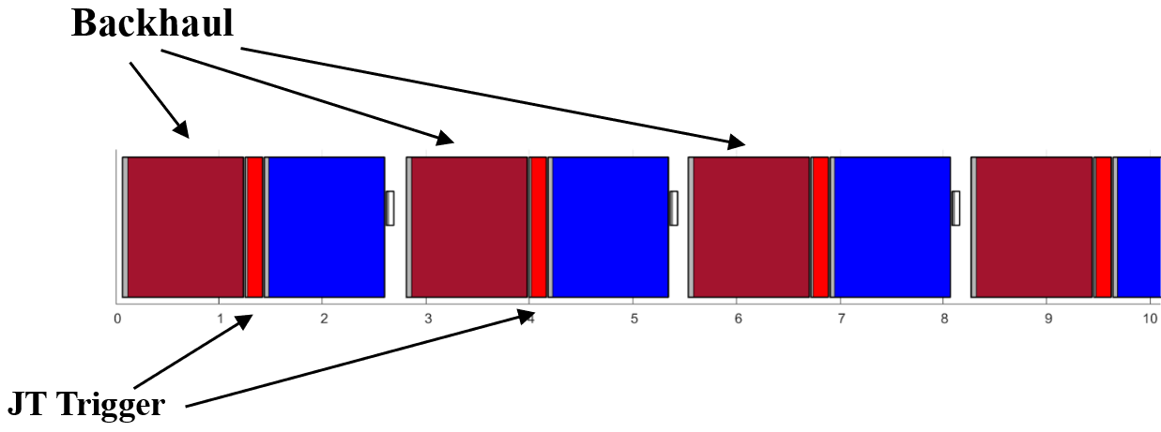
Case 1: Wi-Fi backhaul
Data for STA is communicated between AP1 and AP2 using Wi-Fi
  Using MCS appropriate for the AP1-AP2 link
Compare throughput of joint BF with throughput of direct AP1->STA transmission
Airtime usage illustration:

Slide 10
Results for Case 1
Wireless Backhaul adds significant protocol overhead
Throughput to STA much lower than direct transmission in most of the space

Slide 11
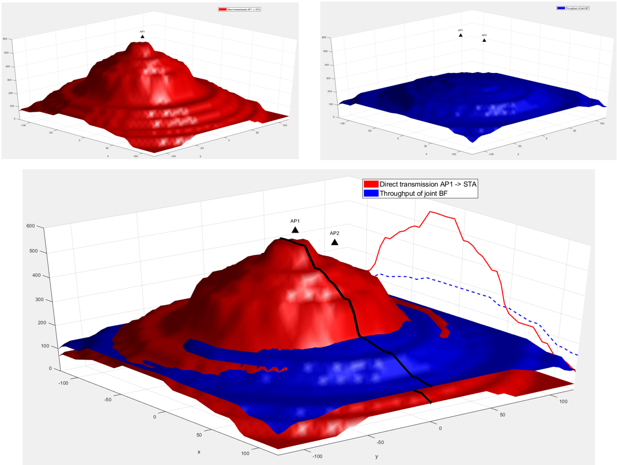
Full results for Case 1

Slide 12
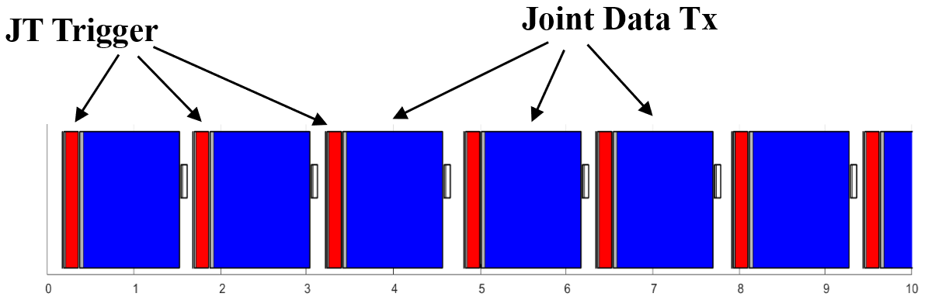
Case 2: Wired backhaul
Data for STA is communicated between AP1 and AP2 using a different cabled network
We compare the performance of joint BF with coordinated transmission (either AP1 or AP2, depending on STA position)
  Wired backbone is available
Airtime usage illustration:

Slide 13
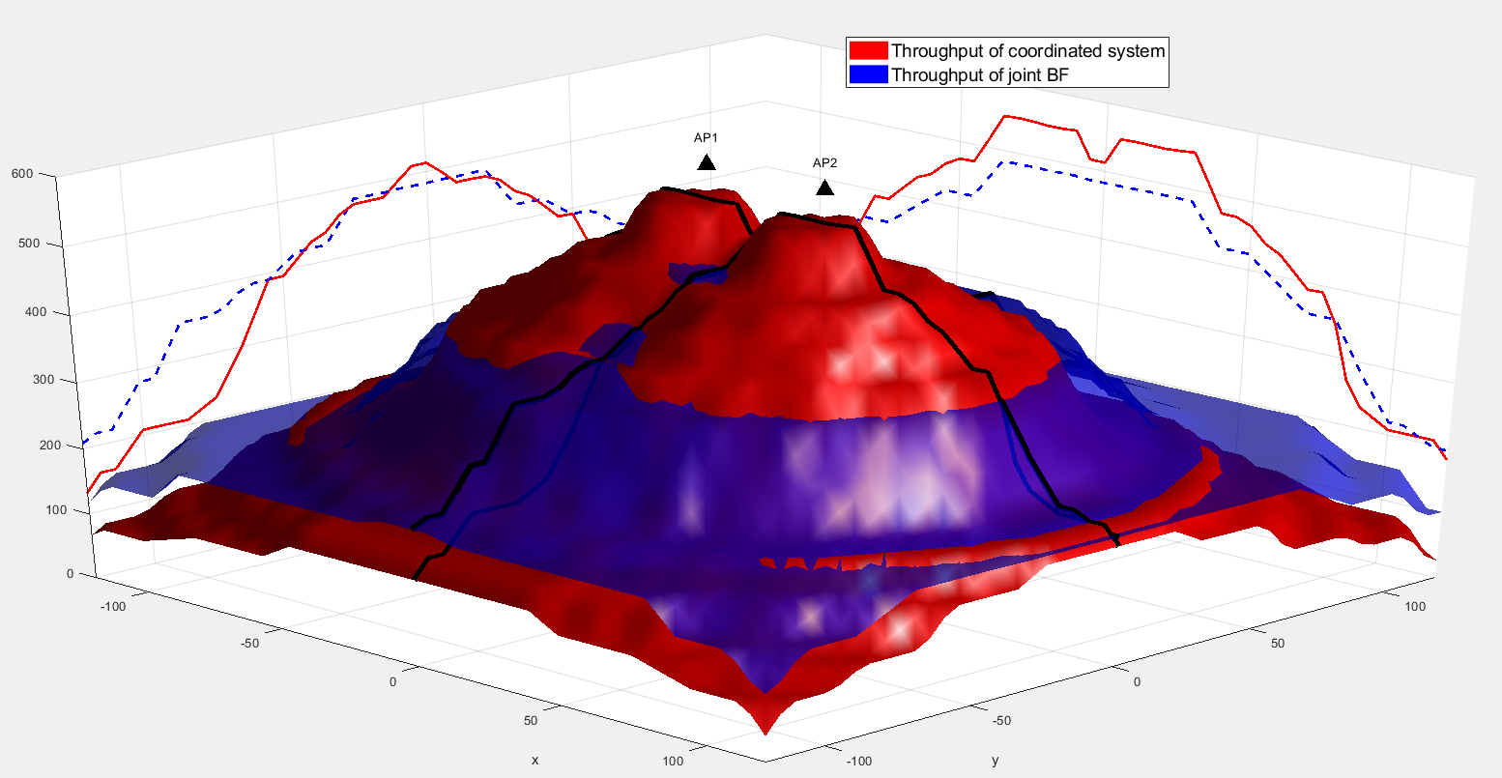
Results for Case 2
No improvement inside BSS
Impact of residual protocol overhead
Improved performance at “cell edge” (see [9])

Slide 14
Conclusions
Wireless backhaul communication between APs (Case 1) drastically reduces performance
  Performance similar to repeater mode
  Speed could be increased by higher MIMO orders (eg 8x8)
For good performance, Joint BF requires APs to be connected by a backhaul other than Wi-Fi
Overhead from JT Trigger frame still has non-negligible impact on performance
When a wired backhaul is present, coordinated operation may outperform joint operation

Slide 15
Other Questions
What is the impact of sounding overhead?
  Not considered in the overhead calculation
What is the impact on MU-MIMO performance?
How does interference of joint AP transmission impact OBSS?
BF gains in distributed antenna cases need to be better understood

Slide 16
References
[1] Discussions on Multi-AP Coordination, 802.11-18/1509
[2] Terminology for AP Coordination, IEEE 802.11-18/1926r2
[3] Considerations on AP Coordination, IEEE 802.11-18/1576r1
[4] Distributed MU-MIMO and HARQ Support for EHT, IEEE 802.11-18/1116r0
[5] Constrained Distributed MU-MIMO, IEEE 802.11-18/1439r0
[6] Initial Distributed MU-MIMO Simulations, IEEE 802.11-18/1962r0
[7] AP Coordinated Beamforming for EHT, IEEE 802.11-18/1510r1
[8] Consideration on multi-AP coordination for EHT, IEEE 802.11-18/1982r0
[9] Beamforming Gain for Distributed MIMO, IEEE 802.11-19/xxxx

