Slide 1
TGbc Selection Procedure Discussion
Date: 2019-01-13
Authors:

Slide 2
Abstract
The presentations aims at assisting TGbc in a discussion on a “Selection Procedure” to adapt for the task group.
The presentation summarizes one possible, full-scale selection procedure encompassing the creation of a ”Functional Requirement Document”, a “Specification Framework Document”, and “Full Draft Amending Text Proposals.
The discussion of the exhaustive selection procedure shoul allow TGbc to make an educated decision on which part(s) of the process to adopt.
The presented selection procedure corresponds to selection procedures discussed by, e.g., TGax, TGay, etc.

Slide 3
Nomenclature -- Overview
Functional Requirement
Specification Framework
Detailed Specification
Xxx “Text" vs. “Document”

Slide 4
Nomenclature: Functional Requirement
High-level / abstract description of a goal or aspect, which is to be addressed.
Not a detailed text on how to realize the goal (this is a technical feature that would go in the SFD).
Examples [1]:
The amendment shall provide at least one mode of operation capable of achieving at least four times improvement in the average throughput per station in a dense deployment scenario, while maintaining or improving the power efficiency per station
The amendment shall bring latency to a desirable level to meet QoS requirements in high dense deployment scenario.
The amendment shall provide a mechanism to facilitate efficient use of spectrum resources and to manage interference between neighboring overlapping BSS (OBSS) in a dense deployment scenario.
The amendment shall enable backward compatibility with legacy IEEE 802.11 devices operating in the same band.
The amendment shall enable coexistence with legacy IEEE 802.11 devices operating in the same band.
Legacy performance shall not be significantly degraded by operation in or in proximity of 11ax network.

Slide 5
Nomenclature: Specification Framework
Text that technically describe in the context of 802.11 how to implement / realize one or several functional requirements.
Includes all technical features, such as descriptions of frame formats or technical concpets
Detailed enough to include in the standard
BUT: does not yet contain the editorial instructions on how to modify the 802.11 standard in order to incorporate the text.
Already structured according to the clauses of the 802.11 standard

Slide 6
Nomenclature: Specification Framework (cont.)
Examples [2]:
6 MAC
6.1 General
This section describes general MAC functional blocks.
The amendment shall define a mechanism to allow the AP to configure the use of RTS/CTS initiated by non-AP STA.
[MAC Motion #1, January 2015, see [140]]
In 2.4 GHz HE STAs should send beacon and probe (request & response) frames at rates ≥ 5.5 Mb/s. [MAC Motion 24, 2015, see [141]]
HE STAs shall support the Multiple BSSID Set.
[MAC Motion 28, September 17, 2015, see [142]]

Slide 7
Nomenclature: Detailed Specification
Detailed specification text (= actual amendment text) including instructions to the editor on how to modify the 802.11 standard (and amendments preceding TGbc)
Details one or all aspects of the Specification Framework
All aspects = full proposal
Not all aspects = partial proposal
Examples:
… you know that part of the game ;-)

Slide 8
Nomenclature: TG Documents
Xxx := Functional Requirement || Specification Framework || Detailed Specification
Xxx Text
Individual contribution of xxxText
Subject to discussion and approval by the TG
Owned by the “authors”
Xxx Document
Document owned by the TG, handled by the TG-Editor
Collection of all approved xxx Text submission
Detailed Specification Document == TGbc Draft

Slide 9
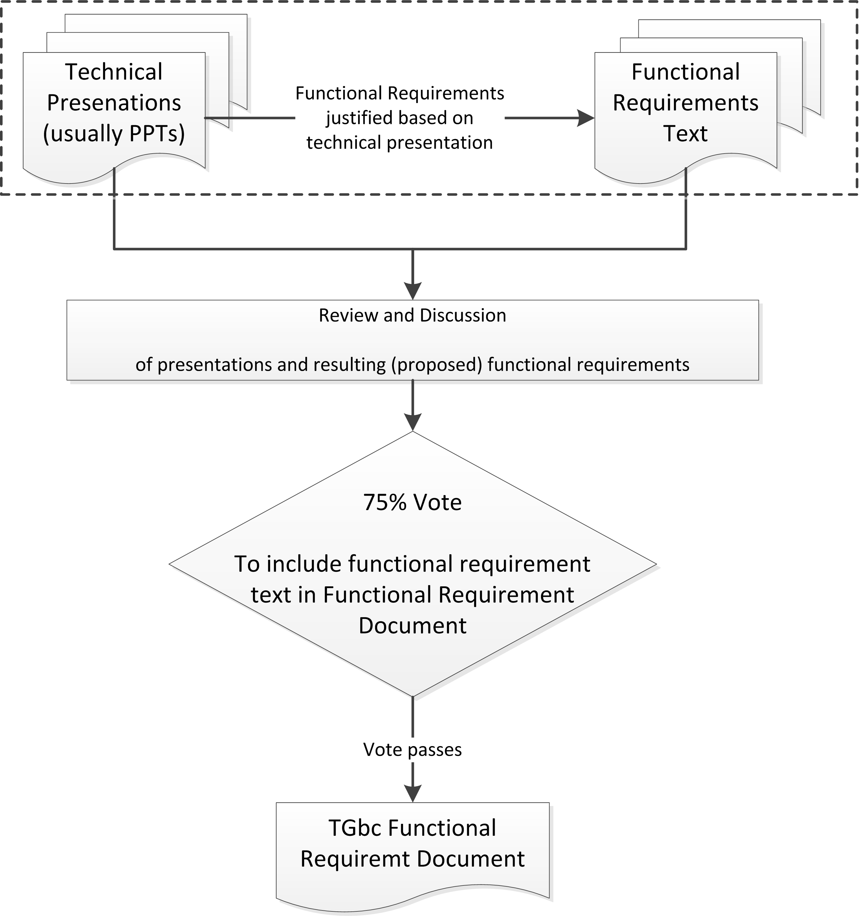
Selection Procedure: Creation of Functional Requirements Document

Slide 10
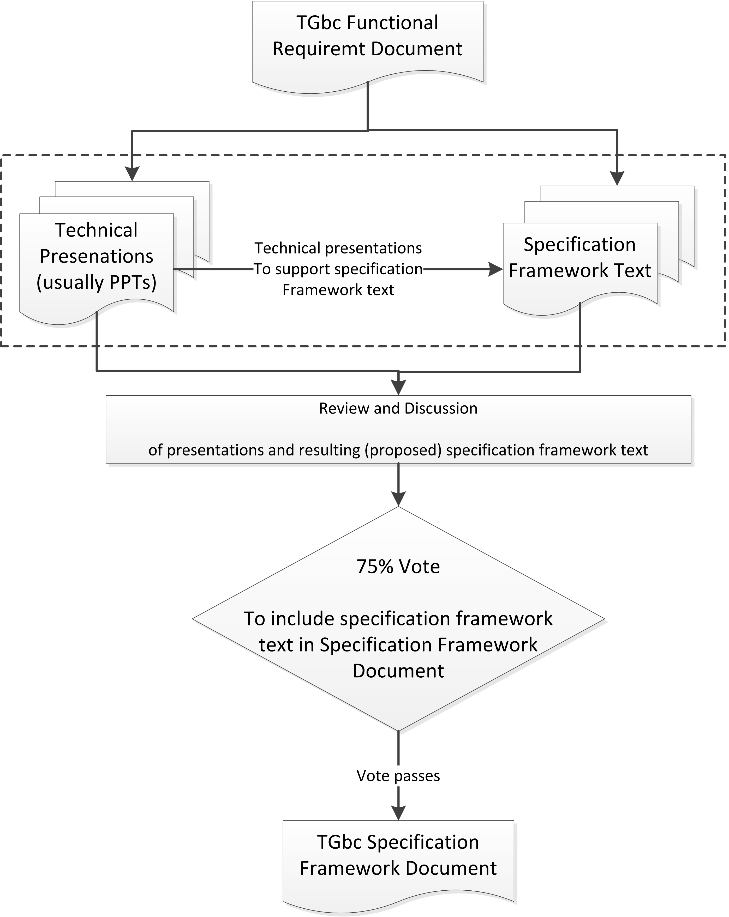
Selection Procedure: Creation of Specification Framework Document

Slide 11
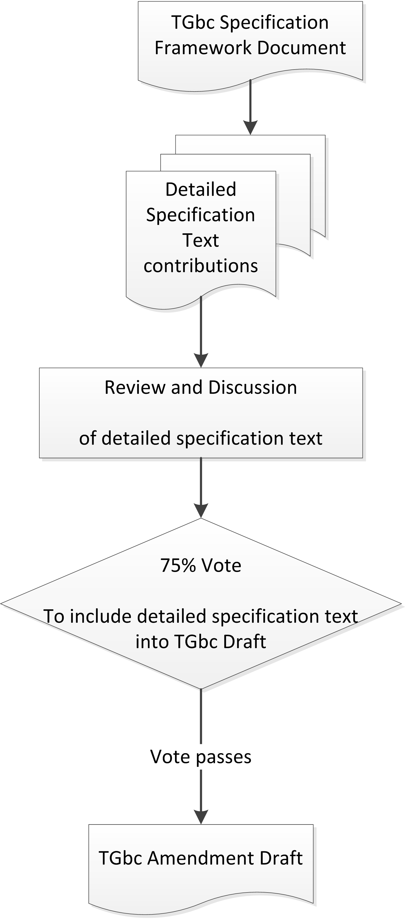
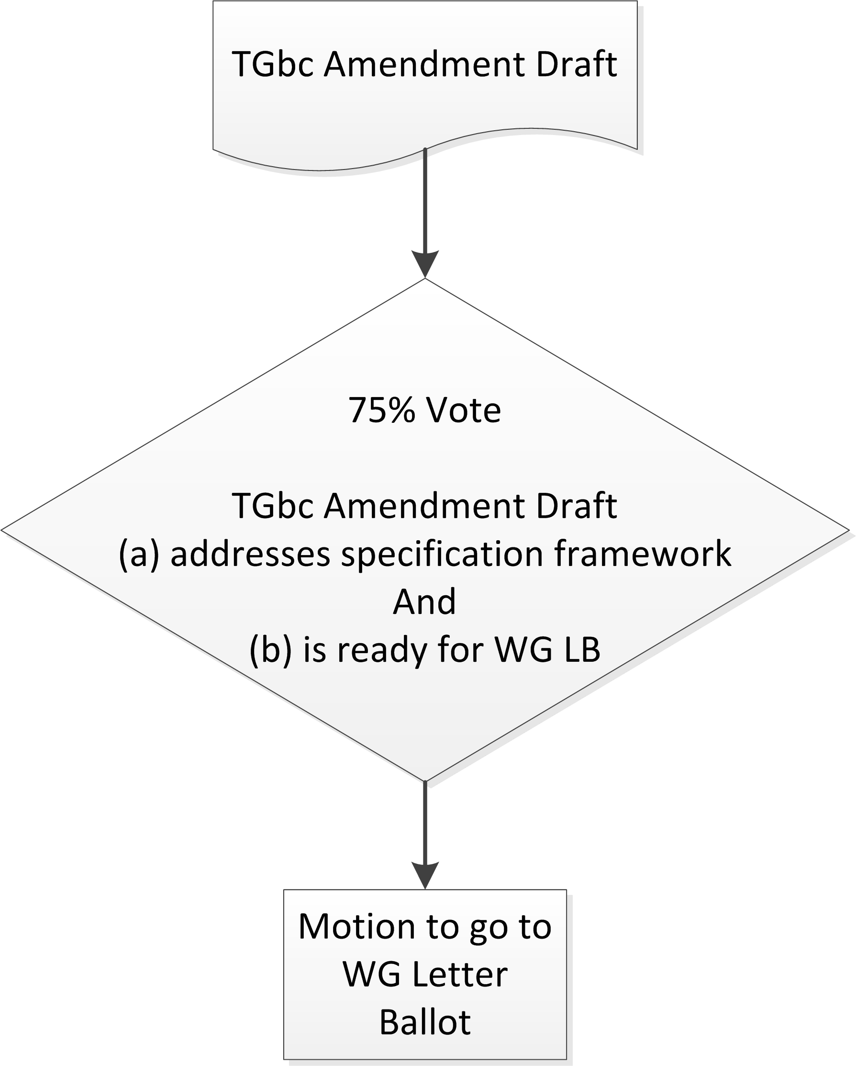
Selection Procedure: Creation of Detailed Specification Text (TGbc Draft)

Slide 12
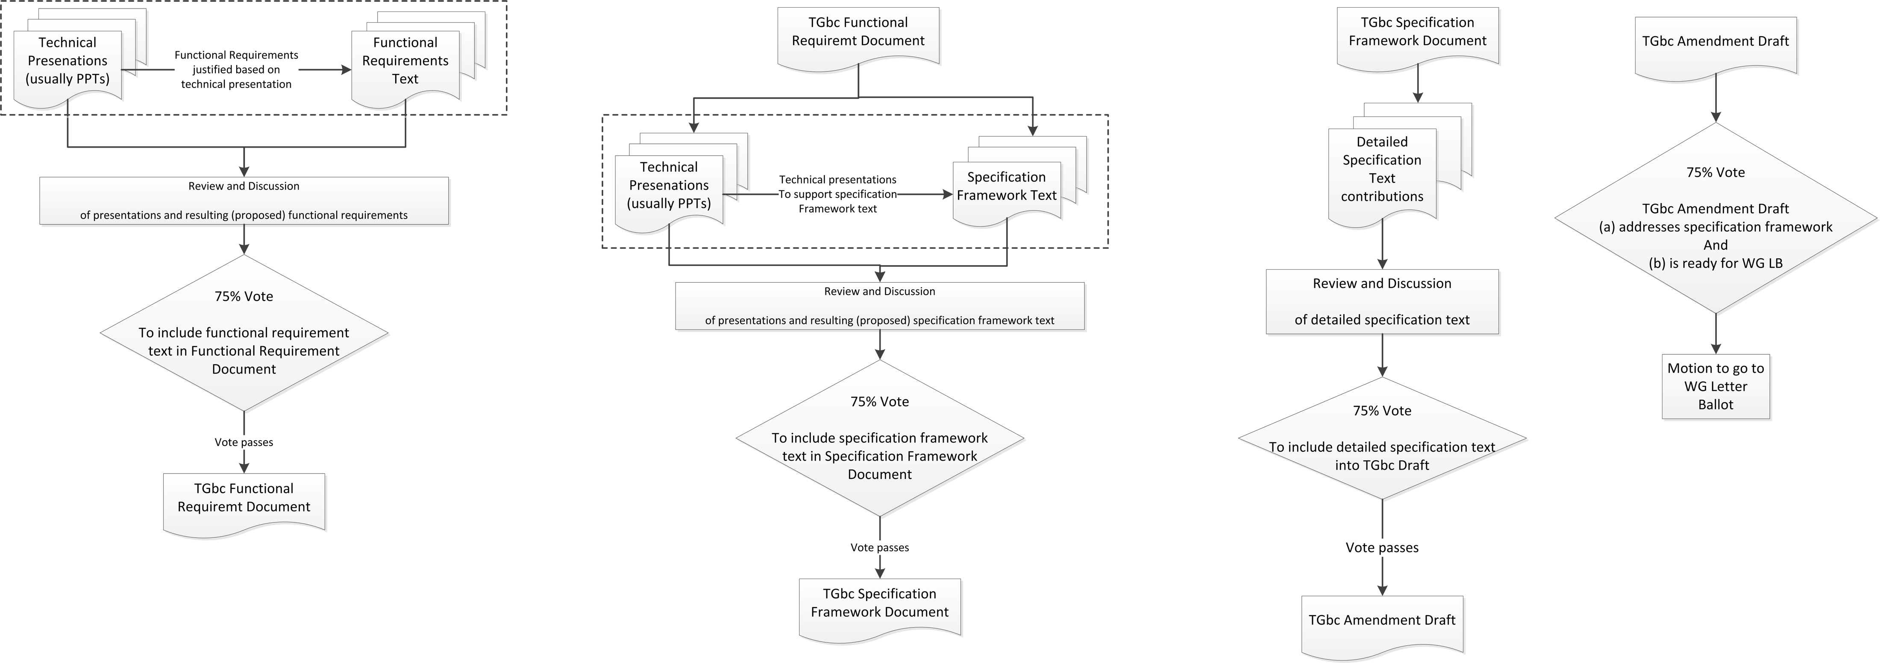

Slide 13
Discussion on TGbc Selection Procedure
Aspects to consider
Overhead in creating the documents vs. clarity of what to achieve / do in the next step
Impact on timeline
Adapt
Some or all of the presented selection procedure
An entirely different approach
Vote to move from one “step” to the next one, i.e.: “believing the xxx Document is complete”?

Slide 14
References
[1] Proposed 801.11ax Functional Requirements, 11-14/1009r2.
[2] Specification Framework for Tgax, 11-15/0132.
[3] 802.11ax Selection Procedure, 11-14/0938.

