Slide 1
Distributed MU-MIMO Architecture Design Considerations
January 2018
Date: 2018-12-21
Authors:
Name | Affiliation | Address | Phone | Email
David Lopez-Perez | Nokia
Mika Kasslin
Henkka Rantala
Eric Torkildson
Lorenzo Galati
Adrian Garcia

Slide 2
Introduction
January 2018
Distributed MIMO – a.k.a. D-MIMO – is a wireless technology, through which a network can realize joint transmissions/receptions from multiple non-collocated time- & phase-synchronized transmitters to multiple non-collocated time- & phase-synchronized receivers
D-MIMO presents a number of benefits
  Enhances multiplexing capabilities
  Mitigates inter-cell interference
  Leads to better spatial reuse
It also has challenges
  Channel sounding
  Synchronization
  Architecture
D-MIMO

Slide 3
D-MU-MIMO-related proposals in EHT
January 2018
In previous EHT TIG/SG meetings, D-MIMO has attracted considerable attention, touching on a number of topics
  Motivation for EHT
  Usage of the right terminology and nomenclature in EHT
  MIMO channel sounding issues and enhancements
11-18-1461: Discussions on the PHY features for EHT | Xiaogang Chen, Intel
11-18-1533: View on EHT Candidate Features | Yusuke Tanaka, Sony
11-18-1547: Technology Features for 802.11 EHT | Kome Oteri, InterDigital
11-18-1926: Terminology for AP Coordination | Sameer Vermani, Qualcomm
11-18-1509: Discussions on Multi-AP Coordination | Jianhan Liu, MediaTek
11-18-1576: Considerations on AP Coordination | Bo (Boyce) Yang, Huawei
11-18-1191: MU sounding improvements | Sigurd Schelstraete, Quantenna
11-18-1982: Consideration on multi-AP coordination for EHT | Kiseon Ryu, LG electronics

Slide 4
D-MU-MIMO-related proposals in EHT
January 2018
  D-MIMO synchronisation issues and enhancements
  None of the above contributions relate to the system architecture and/or propose a reference model for D-MIMO
  Concepts such as mater AP, ethernet backhaul, etc. are mentioned, but not addressed specifically [11-18-1439][11-18-1962] [11-18-1982] [11-18-1982]
  In this contribution, we highlight the need for a new reference model to realize an efficient D-MIMO oriented architecture
11-18-1439: Constrained Distributed MU-MIMO | Ron Porat, Broadcom
11-18-1962: Initial Distributed MU-MIMO Simulations | Ron Porat, Broadcom
11-18-1510: AP Coordinated Beamforming for EHT | Sudhir Srinivasa, Marvell

Slide 5
D-MIMO Arch. for DL/UL processing
January 2018
Internet
Control plane + data plane fronthaul
D-MIMO AP1
Router
D-MIMO PU
D-MIMO AP2
D-MIMO AP3
A logical D-MIMO processing unit (PU) is added to the architecture, which
  buffers all the downlink source data
  selects the transmission direction, the nodes to be used in such transmission, the amount of data to transmit, the precoder, etc.
  precodes and forwards precoded I/Q samples to the TX nodes over the fronthaul for transmission [downlink]
  receives I/Q samples from the RX nodes over the fronthaul and jointly processes them for reception [uplink]
The D-MIMO PU can be co-located with an D-MIMO AP, the Master AP, or sit on its own
D-MIMO PU to deal with distributed UL joint processing

Slide 6
High-Capacity Out-band Fronthaul
January 2018
Bandwidth | 20 MHz | 40 MHz | 80 MHz | 160 MHz | 320 MHz
Sym. duration (us) | 12.8 | 12.8 | 12.8 | 12.8 | 12.8
Samples/symbol | 256 | 512 | 1024 | 2048 | 4096
Bits/complex sample | 24 | 24 | 24 | 24 | 24
Req’d Gbps/antenna | 0.48 | 0.96 | 1.92 | 3.84 | 7.68
For joint reception, a high-capacity, low-latency fronthaul is needed between the D-MIMO APs and the D-MIMO PU to distribute I/Q samples in near real time, see the above table
For example, when looking at D-MIMO APs with 4 antennas and handling 80 MHz, each D-MIMO AP requires a 7.68 Gbps fronthaul
Such requirements are hard to meet in sub-6GHz bands, thus advocating for wired or mmWave fronthaul solutions
Wired or mmWave fronthaul to distribute I/Q samples in near real time

Slide 7

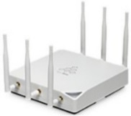
Distributed Channel Access Function
January 2018
In 802.11, stations share the channel using carrier sense multiple access with collision avoidance (CSMA/CA) [1]
The channel must be idle prior to channel access
With conventional APs, its co-located antennas are likely to share a common view of the channel state (idle/busy)
With D-MIMO, the physical separation between D-MIMO APs leads to different views of the channel state, making such channel state decisions (idle/busy) ambiguous
idle channel
D-MIMO PU/AP1
dAP2
dAP3
dAP4
busy
idle
idle
ambiguous channel
view
Centralised carrier sensing to deal with ambiguous channel state assessments

Slide 8
Example of Centralized CSMA/CA
January 2018
CCA statuses sent to D-MIMO PU/AP1 over fronthaul network
D-MIMO PU/AP1
CSMA/CA
Control plane + data plane fronthaul
dAP2
dAP3
dAP4
Distribute precoded data over the fronthual
AP1/PU
DMIMO Trigger
Joint TX
AP2
BUSY CHANNEL
AP3
Joint TX
AP4
Joint TX
The D-MIMO PU (collocated with the Master AP in the figure)
runs the CSMA/CA function of the D-MIMO group, formed by the D-MIMO APs in the figure [2]
sends a D-MIMO trigger, when such centralized CSMA/CA function deems the channel idle, indicating which D-MIMO APs are part of the D-MIMO transmission, and providing a reference for synchronization [11-18-1962]
D-MIMO PU handles CSMA/CA info from multiple non-collocated MAC layers

Slide 9
Existing arch. reference models:
Multiple MAC sublayer management entity
January 2018
Traditionally, a Wi-Fi device may contain one or more STAs – thus having multiple MAC sublayers – that share the same PHY layer [1]
  A multiple MAC station management entity (MM-SME) coordinates these multiple MAC sublayers sharing the same PHY layer, and controls parameters such as power management mode, DMG antenna configuration, and other parameters, as well as the statuses of the coordinated STAs (see 4.9.3 of [1])
Each STA may also have multiple channel access functions (DCF/ EDCAFs/…)
In both cases, the different CSMA/CA functions of the multiple co-located MAC sublayers are uncoordinated, and do not share related information, such as
  NAV state
  Physical carrier sense (CS) status
Current reference models do not accommodate for centralised CSMA/CA

Slide 10
Existing arch. reference models:
Multiband management entity
January 2018
The station management entity (SME) of a multi-band capable device also contains a multi-band management entity that manages multiple MAC sublayers [1],
  This multi-band management entity facilitates a pair of multi-band capable devices to discover, sync, (de)authenticate, (dis)associate, manage resources and transfer sessions from a band/channel to another band/channel (see 4.9.4 of [1])
  For transparent FST, a shared multi-band management entity has access to the local information within each SME; and in this case, the state information includes block ack agreements, TSs, association state, RSNA, security keys, sequence counter, and PN counter (See figure)

Slide 11
Existing arch. reference models:
Multiband management entity
January 2018
Similarly as in the multiple MAC sublayer management entity, the different CSMA/CA functions across the multiple co-located MAC sublayers of a multi-band capable device are uncoordinated, and do not share related information, such as
  NAV state
  Physical carrier sense (CS) status
Current reference models do not accommodate for centralised CSMA/CA

Slide 12
Proposed multiple MAC sublayers enhancements for D-MIMO
January 2018
To realize efficient D-MIMO transmissions, we propose that the EHT group specifies a reference model and interfaces for D-MIMO operation, building on the existing ones, where a new multiple MAC D-MIMO management entity (MM-DME)
  shall coordinate the D-MIMO related actions of the multiple non-collocated D-MIMO APs that do not share the same antennas and form a D-MIMO group, e.g.
    shall manage the CSMA/CA function of all coordinated D-MIMO APs
    shall have access to information on NAV and physical carrier sense statuses in addition to the transmission status of all coordinated D-MIMO APs
  may use a high-capacity wired or wireless fronthaul to exchange information required for coordination and data samples
  may sit on the D-MIMO PU
Other architecture related topics also need attention (e.g. MAC/PHY splitting)
Propose to study in detail a new reference arch. for D-MIMO

Slide 13
References
January 2018
[1] IEEE Std 802.11-2016. IEEE Standard for Information Technology—Local and Metropolitan Area Networks—Specific Requirements. Part 11: Wireless LAN MAC and PHY Specifications.
[2] Neelakantan Nurani Krishnan, Eric Torkildson, Enrico Rantala, Ivan Seskar, Narayan Mandayam, and Klaus Doppler, “D-MIMOO – Distributed MIMO for Office Wi-Fi Networks,” at IEEE DySpan, 2018.

Slide 14
Ref. Model for Multiple MAC Sublayers
January 2018
  Note: See 4.9.3 of [1]
Reference models need to be enhanced to cater to D-MIMO requirements

Slide 15
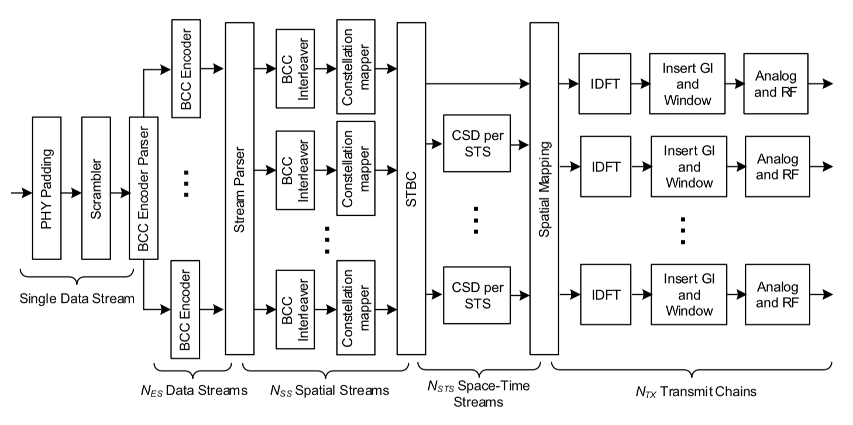
Example D-MIMO DL PHY sublayer split
January 2018
Sublayer split is here or
after any block that follows
Common PHY at PU
AP-1 PHY
AP-N PHY
Samples transferred between common PHY and D-MIMO AP PHYs over fronthaul
Tx block diagram shown for SU-MIMO Data Field, but it also applies similarly to other SU-MIMO and MU-MIMO fields

