Slide 1
Indicating NGV Capabilities in MAC Header
Date: 2019-01-10
Authors:

Slide 2
Abstract
NGV stations must have a means to detect each other
It is highly desirable for this indication of NGV capability be included in legacy 802.11p frames sent by NGV stations so that NGV stations can detect each other while sending frames that are already required for legacy communication
Any such indication must be encoded in a manner that does not affect interoperability, coexistence, backward compatibility, or fairness with legacy 802.11p stations
It is highly desirable that this means be extensible to multiple capabilities
If NGV is successful, there will eventually be other generations of V2X enhancements
The Duration/ID field of the MAC header can be used for this purpose
If this indication is included in 802.11p broadcast PPDUs sent in a 10MHz channel, up to five capability bits are available

Slide 3
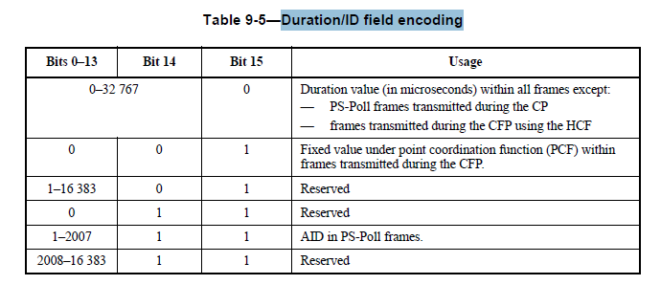
Background – format of the Duration/ID field
Duration/ID field is 16 bits long and directly follows the Frame Control field in the MAC header
In Data type frames the Duration/ID field contains a duration (in units of microseconds) in bits 14 through 0, and bit 15 equal to zero

Slide 4
Using the duration value to indicate NGV capabilities
In group-addressed data frames the duration value is specified to be zero
So OCB broadcast data frames sent by legacy 802.11p stations will always have duration=0
Therefore, NGV-capable stations can use a (limited range) of non-zero duration values in OCB broadcast data frames to indicate capabilities, while retaining full interoperability and backward compatibility with 802.11p
Duration values less than the SIFS time cannot affect channel access, because, even if such a value were used to update the NAV, that NAV setting will expire before the earliest time that channel state (NAV or CCA) is used
For legacy 802.11p operating in a 10MHz channel, duration values in the range [0:31] are always “safe” (because SIFS is 32 microseconds)
Accordingly, duration bits 4:0 can be used to indicate NGV capabilities

Slide 5
Proposed encoding of NGV capabilities (1)
In OCB broadcast data frames:
Duration = 0 indicates legacy 802.11p capabilities only
Duration = 1 indicates 802.11p and 802.11bd capabilities
Duration > 1 reserved for future extensions
And can also be used for NGV options that are not part of basic NGV capability (if any)
Bit 0 | Bit 1 | Bit 2 | Bit 3 | Bit 4
IEEE 802.11bd (NGV) support | reserved for future standard support | reserved for future standard support | reserved for future standard support | reserved for future standard support
Exact usage open for discussion

Slide 6
Proposed encoding of NGV capabilities (2)
The proposed encoding is shown in the following table.
Rows below “IEEE 802.11bd” are speculative and shown for example only
 | Bit 0 IEEE 802.11bd (NGV) support | Bit 1 IEEE 802.11bd+ support | Bit 2 IEEE 802.11bd++ support | Bit 3 reserved | Bit 4 reserved
IEEE 802.11p | 0 | 0 | 0 | 0 | 0
IEEE 802.11bd | 1 | 0 | 0 | 0 | 0
IEEE 802.11bd+ | 1 | 1 | 0 | 0 | 0
Etc… | … | … | … | … | …
Possible selective legacy support | 1 | 1 | 0 | 1 | 1
IEEE 802.11bd++++ | 1 | 1 | 1 | 1 | 1

Slide 7
Update to Duration/ID field encoding table
If this proposal is adopted, the Duration/ID field encoding table changes as shown:
Bit 0-4 | Bit 5-13 | Bit 14 | Bit 15 | Usage
0-31 | 0 | 0 | 0 | Standards capability indication for group-addressed NGV frames
0–32 767 |  |  | 0 | Duration value (in microseconds) within all frames except: — PS-Poll frames transmitted during the CP — frames transmitted during the CFP using the HCF
0 |  | 0 | 1 | Fixed value under point coordination function (PCF) within frames transmitted during the CFP.
1–16 383 |  | 0 | 1 | Reserved
0 |  | 1 | 1 | Reserved
1–2007 |  | 1 | 1 | AID in PS-Poll frames.
2008–16 383 |  | 1 | 1 | Reserved

Slide 8
Is this proposed use of the Duration/ID field safe?
YES!
The duration value is never used for filtering, so reception is unaffected
NAV should not be updated using duration from a group-addressed data frame
This was normative from 802.11-1997 until 802.11-2007, but no longer appears (because other parts of the relevant annex were out of date, not due to any changes about the NAV)
Even if the NAV is updated using this capability-indicating pseudo-duration, any value shorter than aSIFSTime will expire before the first sensing of the medium after PHY-RXEND.indication, so medium access is unaffected
By limiting capability indication to group-addressed OCB data frames, this technique will never interfere with cases where unicast data frames, or other frame types, do contain durations that are needed for NAV update

Slide 9
Summary
We propose to encode capabilities to support NGV, and subsequent vehicular amendments, using non-zero duration values in legacy 802.11p group-addressed data frames sent by NGV-capable stations
At least five capability bits can be represented in a fully interoperable and backward-compatible manner, which leaves space to indicate additional, future capablities
Placing this capability indication in the MAC header rather than in a PHY field is more efficient, because no symbols are added, and more reliable, because the MAC header is CRC-protected

