Slide 1
Impact of Installation Costs on EHT PAR and CSD
January 11, 2019
Authors:
Name | Company | Phone | email
Brian Hart | Cisco (US) |  | brianh@cisco.com
David Kloper |  |  | dakloper@cisco.com
Peter Jones |  |  | petejone@cisco.com
Andrew Myles | Cisco (Australia) | +61 418 656587 | amyles@cisco.com

Slide 2
EHT CSD should properly account for installation costs of a 20 Gbps AP
Situation
The draft PAR (1231r1) & CSD (1233r1) reports “supporting a maximum throughput of at least 18/30 Gbps” and “The proposed amendment has no known impact on installation costs.”
For many years, industry has recommended that venues pull dual cat6a cables, supporting 20 Gbps full duplex max
Complication
Requiring different cabling structures (e.g., >2 cables, fiber, unfamiliar cable types, etc) complicates installation, and creates barriers to adoption of EHT
Solution
For traditional AP use cases, the EHT PAR and CSD should explicitly limit backhaul requirements for a triband AP to 2x10Gbps (2xCat6a) Ethernet max

Slide 3
Cabling Variability

Slide 4
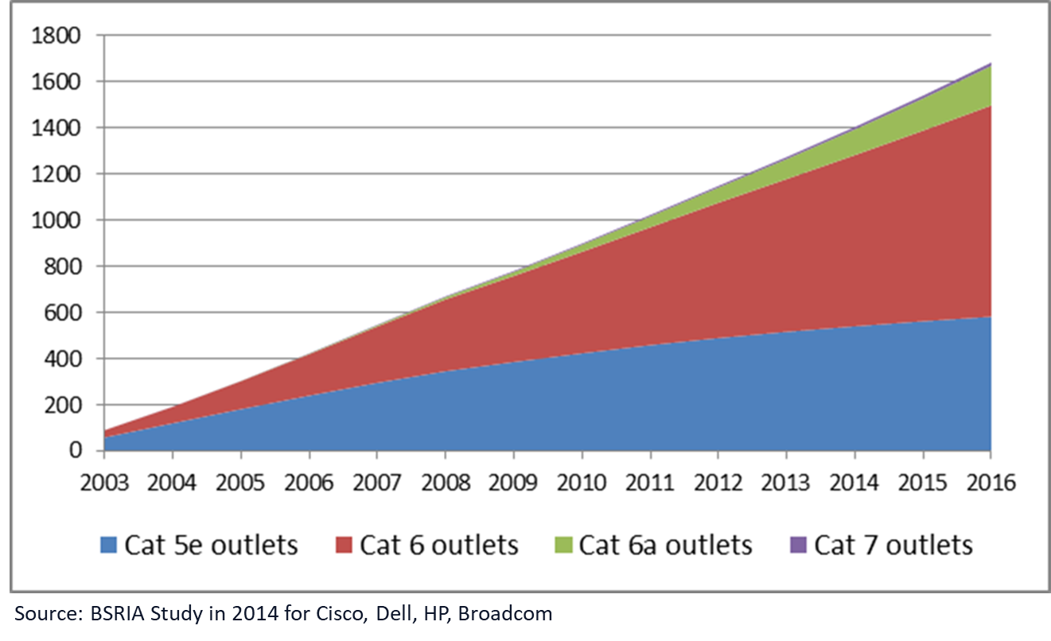
Updated
A lot of installs use cat5e or cat6, and will continue to do so …
2014 installed base
90+% Cat 5e/6
2018 update
130 – 135 million outlets per year
An est. 60% are new installations
1.4 billion installed base in 2014
1.6 billion in 2017.
Source: BSRIA NBASE-T webinar – https://www.nbaset.org/wp-content/uploads/2018/10/WebinarBSRIA_Oct2018_Final.pdf

Slide 5
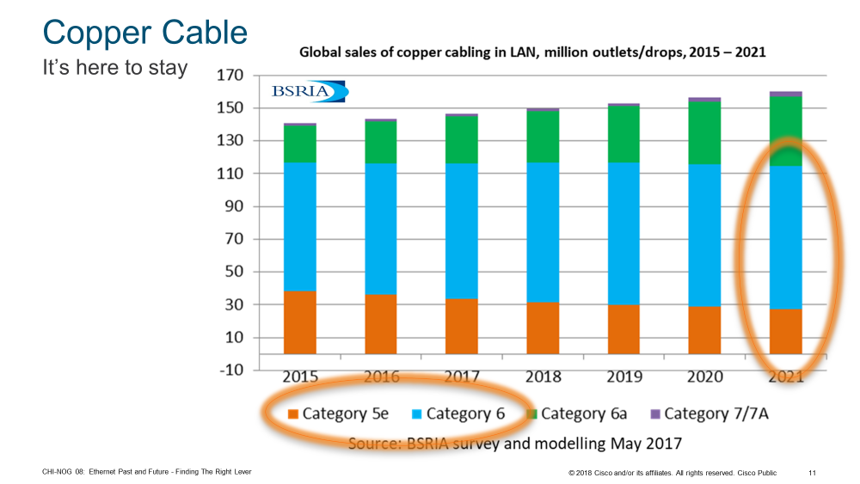
A lot of installs use cat5e or cat6, and will continue to do so …

Slide 6
Different cable installs lead to different data rates.
Huge variation by install date, policy, and geography.

Slide 7
Cabling Best Practice

Slide 8
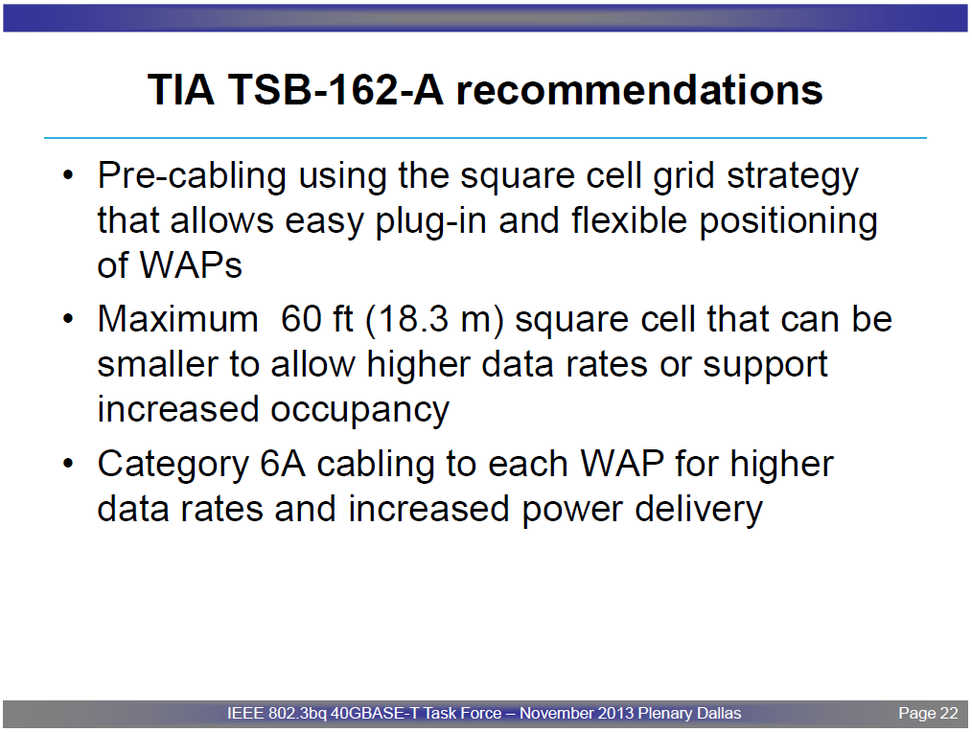
Updated
TIA-162-A Telecommunications Cabling Guidelines for Wireless Access Points
www.ieee802.org/3/bq/public/nov13/larsen_3bq_01_1113.pdf

Slide 9
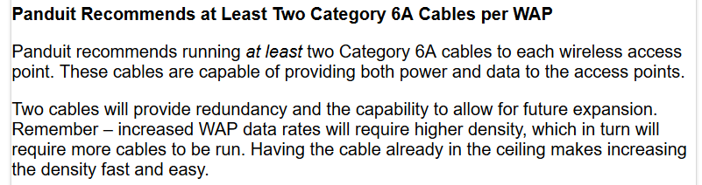
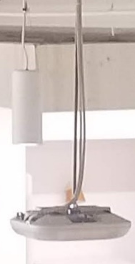
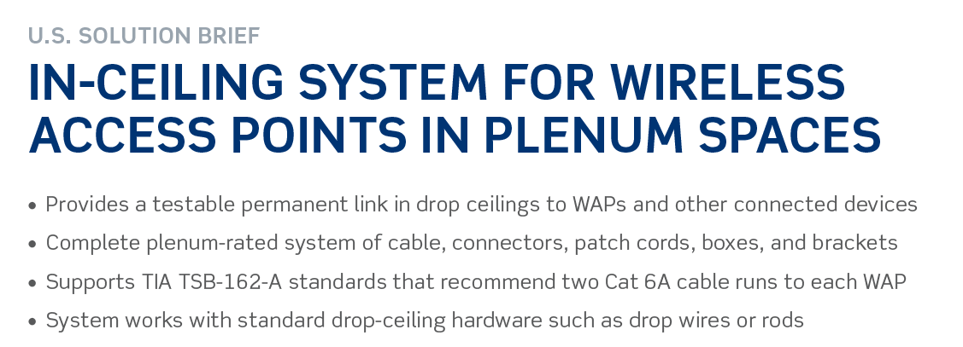
Updated
Industry recommendation examples (Panduit, Leviton)
http://panduitblog.com/2015/06/16/enterprise/cabling-infrastructure-wireless-access-points/
Cisco San Jose example
https://www.leviton.com/en/docs/Leviton_3KeyRecsForCablingTo802.11acWirelessAccessPoints.pdf

Slide 10
Impact of EHT requiring new cabling practices
Updated
EHT will not succeed if it expects the industry to change basic installation practices.
  Buildings are designed so wiring closets are within a 100m Manhattan distance of everywhere on the floor
    25GBASE-T is defined for 30m of Cat 8 (data center use case)
  Cat7/7a/8 require new design and installation practices.
    Bigger cables, lower bend radius, etc., increase the cost of the cabling system.
  TIA-162-A does allow for MMF OM3 fiber, but this is not common.
    25GBASE-SR OM3 reach is 70M (10GBASE-SR OM3 is 300m), and power must be separately delivered.
    Copper/fiber composite cable (powered fiber cable) is not commonly deployed in this environment or best practice.
  Major Barrier to Adoption

Slide 11
Proposed PAR and CSD Changes

Slide 12
Proposed PAR edits: make it explicit that backhaul requirements are benign
30 Gbps is a source of concern, especially since a typical triband AP could increase this by 56%
5.2b Scope of the project:
  This amendment defines standardized modifications to both the 802.11 physical layers (PHY) and the 802.11 Medium Access Control Layer (MAC) that enable modes of operation capable of supporting a maximum throughput of at least 18/30 Gbps, as measured at the MAC data service access point (SAP), with carrier frequency operation between 1 and 7.125 GHz while ensuring backward compatibility and coexistence with legacy IEEE802.11 devices in the 2.4 and 5 GHz unlicensed bands, and with IEEE802.11ax devices in the 6 GHz band.
  8.1 Scope of the project:
  Item 5.2b:
  The focus of this amendment is on:
  WLAN indoor and outdoor operation in the 2.4 GHz, 5 GHz and 6GHz frequency bands. Outdoor operation is limited to stationary and pedestrian speeds
  WLAN operation that does not require AP products, which might include 2.4, 5 and 6 GHz APs, to need more than dual 10 Gbps full duplex for wired backhaul.

Slide 13
Proposed CSD edits: acknowledge cabling impact
Consideration of installation costs.
  Industry has recommended dual Cat6a cabling for APs for many years. For venues following this advice, tThe proposed amendment has no known impact on installation costs even for high end EHT APs.
  In many other cases, such as lower end APs compliant with EHT or networks designed such that the bulk of the traffic originates or terminates at end-points cohosted with STAs, the proposed amendment is not expected to impact installation costs either.
  In some cases, new cabling infrastructure is required for optimum EHT AP performance. The cabling cost is balanced and comparable to the cost of an initial 802.11 AP installation.

Slide 14
Strawpoll
  Do you support making a change to the PAR and CSD as per Slides 13 and 14?
Y/ N /A?

Slide 15
Backup

Slide 16
No change to operational costs, since AP Power Envelope evolves slowly, but AP Power Envelope will limit feature-set
  There is a trade-off between AP size (aesthetics), environmental sealing, passive/active cooling, and features.
  Assuming historical patterns continue, then aesthetics, sealing and passive cooling are primary considerations, and they define a maximum size and power envelope for high-end APs without options:
    May’10, AP3500, 11n 2x3:2x40M, 2300cm³, 12.95W
    Nov’11, AP3600, 11n 4x4:3x40M, 2640cm³, 15.4W
    May’14, AP3700, 11acR1 4x4:3x80M, 2640cm³, 16.8W
    Jun’16, AP3800, 11acR2 4x4:3x160M, 3020cm³, 25.8W
  The maximum size and power envelope has evolved slowly and is presently around 25W.
  Inclusion of additional features (number of bands, number of transceivers per band, and bandwidth per band) relies principally upon improvements to component efficiency.

Slide 17
CSD Operation costs: no edits needed
  Consideration of operational costs (e.g., energy consumption).
  There are billions of WLAN systems in operation around the world. WLAN systems are recognized to provide a total cost of ownership (TCO) that provides a significant operation cost benefits. This amendment is not expected to change today’s operation costs.
Agreed. Based on historical patterns, power consumption will not markedly change

