Slide 1
HARQ in Collision-Free and Collision-Dominated Environments
Date: 2019-01-13
Authors:

Slide 2
Abstract
In this contribution, we evaluate the performance of HARQ in collision-free (AWGN-impaired) and collision-dominated (interference-impaired) environments.
We show that using the AWGN-impaired HARQ schemes in interference-limited environments results in a loss in performance and discuss some solutions to the problem.

Slide 3
Introduction
Hybrid ARQ is one of the candidate features under discussion for 802.11 EHT [1]
  HARQ combines retransmissions at the bit or symbol level before decoding to improve performance (e.g. reliability, goodput) compared with simple ARQ (used in existing 802.11) that decodes the latest retransmission (ReTx).
Its performance in 802.11 (using 802.11ax as baseline) has shown to provide some gains over simple ARQ in [2],[3],[4],[5],[6], and [7]
In this contribution, we study the performance of HARQ in the following environments:
  Collision-free (AWGN-impaired): An environment where the primary impairment is AWGN
  Collison-dominated (interference-impaired): An environment where the primary impairment is interference from collisions.
We show that using the AWGN-impaired HARQ schemes in the interference-limited environments results in a loss in performance and discuss some solutions to the problem.

Slide 4
HARQ Overview
HARQ may be Chase Combining (CC) HARQ or Incremental Redundancy (IR) HARQ
In CC HARQ, each ReTx contains the same data and parity bits
  This can be symbol-level CC (SL CC) or bit-level CC (BLCC).
  SL CC has better performance [8] and may have lower memory requirements
  CC does not require any changes to the current FEC in the 802.11 standard
In IR HARQ, each ReTx uses a different set of coded bits with different redundancy versions generated by puncturing the encoder output.
  ReTx are punctured to contain both parity and systematic bits (self decodable packets) or parity bits only (non self-decodable packets)
  Self-decodable IR-HARQ allows for decoding individual packets in case of entire packet loss due to collisions.
  May require changes to the current FEC in the 802.11 standard
SL CC and self decodable IR HARQ are recommended for study during the EHT TG

Slide 5
HARQ Overview (ctd)
HARQ may be adaptive or non-adaptive
  In adaptive HARQ, the ReTx may change the MCS and channel resources used.
  In non-adaptive HARQ, the ReTx uses the same MCS and channel resources
  For indoor channels with low Doppler, allowing a change in resources may be beneficial
  HARQ may be synchronous or non-asynchronous
  In synchronous HARQ, the ReTx for each process occur at predefined times relative to the initial transmission
  For asynchronous HARQ, the ReTx can occur at any time relative to the initial transmission
  802.11 is inherently asynchronous due to the use of an unlicensed channel
Adaptive, asynchronous HARQ is recommended for the EHT TG

Slide 6
Evaluation Metrics
Packet Error Rate (PER):
  PER = Number of successful packets / total number of unique information packets
  Does not take into account the number of retransmissions, e.g. may have HARQ with lower PER but multiple retransmissions.
Number of Transmissions (ReTx):
  Average Number of transmissions till successful packet decoding
Goodput: Successful Throughput incorporating retransmissions
  Goodput = (1-PER) x no. of bits per packet / packet duration / ReTx
  1-PER : number of successful transmissions
  No. of bits per packet / packet duration : Raw throughput

Slide 7
Simulations I: HARQ in AWGN
This is the collision-free environment
Simulation Assumptions
  802.11ax, 242 tone RU, 20 MHz, Regular GI, 4x HE-LTF, AWGN channel
  1x1, BCC, MCS 4 (BCC: 16 QAM rate ¾)
  Packet length = 1000 bits, Single MSDU/MPDU
  No impairments, ideal Channel Estimation, ideal feedback
Schemes
  ARQ with 2 transmissions
  Bit level Chase Combining HARQ with 2 transmissions
  Symbol level Chase Combining HARQ with 2 transmissions
  IR HARQ with 2 transmissions

Slide 8
Simulation I: Goodput and PER
Gain in HARQ seen at lower SNRs with the best performance from IR-HARQ.

Slide 9
Simulation II: HARQ with Link Adaptation in Fading Channel
Combine HARQ with link by selecting best performance for all MCS at any SNR
Assumptions:
  802.11ax, 242 tone RU, 20 MHz, Regular GI, 4x HE-LTF, DNLOS channel
  Nt = Nr = Nss = 2, BCC IR HARQ
  MSDU/MPDU
    Payload size:
      MCS 0~3:1500B, MCS4:2500B, MCS5:3000B
      1 MPDU per PPDU
  No impairments and ideal Channel Estimation

Slide 10
Simulation II: Goodput
Assumes ideal link adaptation for both HARQ and non HARQ
Up to 4 dB gain at lower SNRs

Slide 11
HARQ and Interference
Unlicensed noise model is collision-dominated, with uncontrolled and highly variable interference power per PPDU [9]
  Combining transmissions that have been corrupted by collisions may impact the performance [9][7][10].
Solutions that have been discussed include
  Limit to positively identified PPDUs [9]
  Limit to non-collision environments e.g. trigger based transmission or multi-AP deployment [5]
  Use a collision aware receiver : first decode without combining and do not contaminate buffer [7]
  Account for impairment type, i.e. loss due to collision or AWGN [10]
We will show the performance of HARQ in 802.11 with collisions and demonstrate how accounting for collisions may resolve the problem.

Slide 12
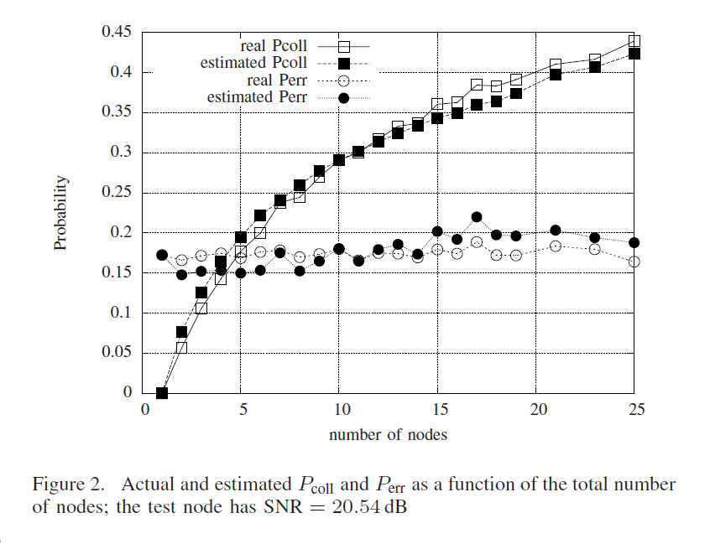
Simplified Collision Modeling
From [11]

Slide 13
Simultion III: HARQ and collisions in AWGN
Assumptions
  PPDU Format: 802.11ax, 242 tone RU, 20 MHz, Regular GI, AWGN channel
  1x1, BCC, MCS 4 (BCC: 16 QAM rate ¾)
  Packet length = 1000 bits, Single MSDU/MPDU
  Ideal Channel Estimation
  Interference at 0 dB, e.g. BSS edge STA within 2 APs that form a hidden node set.
    Ideal collision estimation with collision probability = 0.2.
Schemes
  ARQ with 4 transmissions
  HARQ IR with 4 transmissions
  Collision aware HARQ IR with 4 transmissions
    Attempt decoding without combining
    Add packet to buffer if there is no collision, i.e. ideal collision estimator

Slide 14
Simulation III: Goodput and PER
At higher SNRS, AWGN-impaired HARQ (IR) performs very poorly

Slide 15
Summary of Results
PER floor seen due to collisions in system.
  Floor based on collision model, i.e. overlap, relative strength and collision probability, e.g. Pc ~ 40% at 25 nodes [11]
At high SNRs (for the MCS), simple ARQ is adequate
  The performance of AWGN-impaired HARQ is poor due to combining corrupted transmissions.
  Collision aware HARQ is equal to simple ARQ
At low SNRs (for the MCS), HARQ shows some gains
  However, collision aware HARQ shows larger gains over arq and IR HARQ
Conclusion:
  Need method to enable receiver estimate if collision or not, or to turn on classic HARQ only at lower SNRs

Slide 16
Conclusion
HARQ shows improvements in performance over simple ARQ
  Symbol Level Chase Combining and self decodable IR HARQ are recommended for study during the EHT TG.
  Adaptive, asynchronous HARQ is recommended for the EHT TG.
In collision dominated environments, direct implementation of HARQ may result in worse performance than simple ARQ
  Collision Aware HARQ methods result in the best performance in these environments

Slide 17
References
[1] IEEE 802.11-18/1231r1, EHT draft proposed PAR, Laurent Cariou (Intel), Nov 2018
[2] IEEE 802.11-18/1979r0, HARQ performance analysis, Tianyu Wu (Samsung), Nov 2018
[3] IEEE 802.11-18/1992, HARQ Feasibility, Hongyuan Zhang (Marvell), Nov 2018
[4] IEEE 802.11-18/2031r0 BRCM, HARQ gain studies, Sindhu Verma (Broadcom), Nov. 2018
[5] IEEE 802.11-18/1963r1, Discussion on HARQ for EHT, Bo Sun (ZTE), Nov 2018
[6] IEEE 802.11-18/2029r0, HARQ in EHT, Imran Latif (Quantenna), Nov 2018
[7] IEEE 802.11-18/1955r0, HARQ for EHT - Further Information, Shimi Shilo (Huawei), Nov 2018
[8] T. Ait-Idir, S. Saoudi, "Turbo packet combining strategies for the MIMO-ISI ARQ channel", Trans. Commun., vol. 57, no. 12, pp. 3782-3793, 2009
[9] IEEE 802.11-18/1549r0, Candidate Technology Review, Brian Hart (Cisco Systems), Sept 2018
[10] IEEE 802.11-18/1547r0, Technology Features for 802.11 EHT, Kome Oteri (InterDigital), Sept 2018
[11] N. Baldo, F. Maguolo, S. Merlin, A. Zanella, M. Zorzi, D. Melpignano, D. Siorpaes, "GORA: Goodput Optimal Rate Adaptation for 802.11 using Medium Status Estimation", Proceedings of IEEE ICC, May 2008.

Slide 18
Appendix

Slide 19
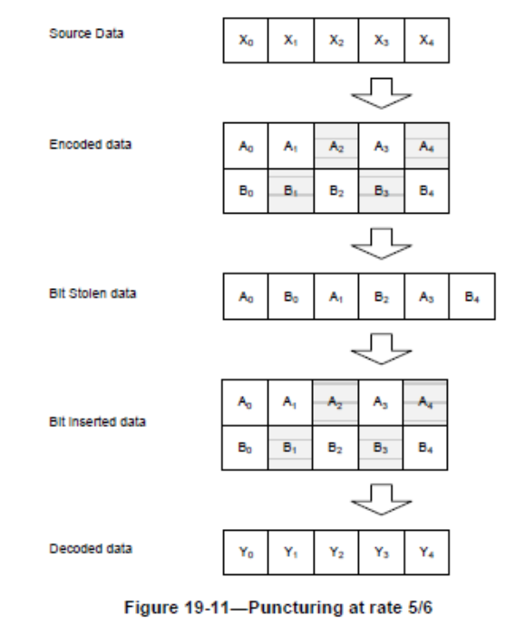
IR for BCC
BCC: change puncturing pattern (implemented)
  ½: [1 1 1 0], [1 1 0 1], [1 0 1 1], [0 1 1 1]
  ¾ : [1, 1, 1, 0, 0, 1],[1, 1, 0, 1, 1, 0],[1, 1, 1, 0, 1, 0],[1, 1, 0, 1, 0, 1]
  5/6: [1, 1, 1, 0, 0, 1, 1, 0, 0, 1],[1, 1, 1, 1, 1, 0, 0, 1, 0, 0], …

Slide 20
Simulation I: Number of Transmissions

Slide 21
Simulation III: Number of Transmissions
Transmissions

