Slide 1
Multi-channel interference mitigation
Date: 2019-01-14
Authors:
Ron Toledano, Autotalks

Slide 2
Abstract
Interferences resulted from multi-channel operation reduce the effective communication range
Shown in IEEE802.11-18/1928r0
In multi-channel environment, each channel is used independently carrying traffic with arbitrary profile
Synchronizing channels, using carrier-aggregation like scheme, isn’t applicable
In this presentation we suggest multi-channel interference mitigation scheme
Ron Toledano, Autotalks

Slide 3
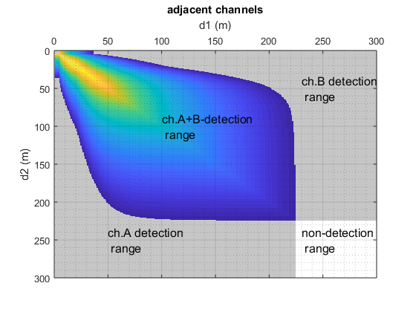
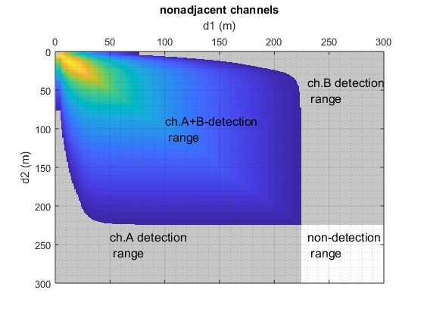
Multiple Channels Interferences - Recap
Interference free multi-channel operation can’t be assured
Ron Toledano, Autotalks

Slide 4



Unconstrained Operation → Chaos
TX Ch. 1
TX Ch. 2
Transmission ignores activity in other channels
As a result, two close vehicles can transmit concurrently
  All vehicles in proximity of one channel transmission will not receive the other channel transmission, despite its relevancy and relative short distance
Ron Toledano, Autotalks

Slide 5
Constrained Operation → Spatial Coordination
TX Ch. 1
TX Ch. 2
Transmission considers activity in other channels
Concurrent transmission from close vehicles is prevented
  Important messages aren’t harmed
Ron Toledano, Autotalks

Slide 6

Concept of Operation
Within Ch1. interference range → Delay Ch. 2 transmission
Outside Ch1. interference range → Ch. 2 can transmit
TX Ch. 1
TX Ch. 2
Ron Toledano, Autotalks

Slide 7
Transmission Flow
No
Multi-channel interfere?
Yes
Transmit
Delay transmission
Interference is quantified by RSSI level, reflecting target communication range
  Target range is determined by use-case, commonly 300 meters for safety
Real-time transmission deferral decision is needed
  V2X upper layer can configure decision parameters, but can’t perform real-time RSSI comparisons
  MAC can perform real-time RSSI comparisons based on information from PHY
Ron Toledano, Autotalks

Slide 8
Multi-Channel Interference Mitigation Layer
Adding MAC layer is suggested
  Required by any system: single radio or multi-radio
V2X upper layer
MAC
Multi-channel interference mitigation
PHY
Ron Toledano, Autotalks

Slide 9
RSSI Based Decision
RSSI is indicative to distance
Upon transmit request, adjacent packet RSSI is compared with threshold
  If above threshold → Interference too strong. Vehicle is likely too close → Delay transmission
  If below threshold → Interference not harmful. Vehicle is likely far enough → Transmit
RSSI varies based on environment
  For example, truck on road, curve, building, etc…
  V2X upper layer can adjust the threshold based on expected RSSI in target range
Ron Toledano, Autotalks

Slide 10
Adjacent Channel RSSI Measurement
Low complexity adjacent channel RSSI measurement is feasible
  Deducting energy based on main channel
  Measuring energy on a wider span
  Measurement performance targets can be set, such as detection of interferences stronger than -65dBm
Adjacent Ch.
Main Ch.
Adjacent Ch.
Estimation based on main channel
Wide-span energy measurement
Ron Toledano, Autotalks

Slide 11
Zoom on Interface
V2X upper layer
Config (Adjacent channel RSSI threshold(s))
Additional channels
Multi-channel interference mitigation
Adjacent channel RSSI(s)
Delay TX
PHY
Ron Toledano, Autotalks

Slide 12
Summary
Multi-channel interference mitigation would enable reliable multi-channel operation
Achieving efficient spatial utilization
Suggested mitigation scheme delays transmission based on adjacent channels RSSI
PHY estimates RSSI of adjacent channels
RSSI value(s) compared with threshold(s)
Threshold(s) is configured by V2X upper layer
Ron Toledano, Autotalks

